Slide 1
Lecture 4
Multi-s/c methods : timing
Lecture notes and examples:
https://github.com/irfu/Nordita_Magnetic_Reconnection_School_2015

Slide 2
Software setup
Reference:
Analysis analysis methods for multi-spacecraft data, Chapter 11: http://www.issibern.ch/PDF-Files/analysis_methods_1_1a.pdf
G.Paschmann et all, Characteristics of the near-tail dawn magnetopause and boundary layer, Annales Geophysicae (2005) 23: 1481–1497

Slide 3
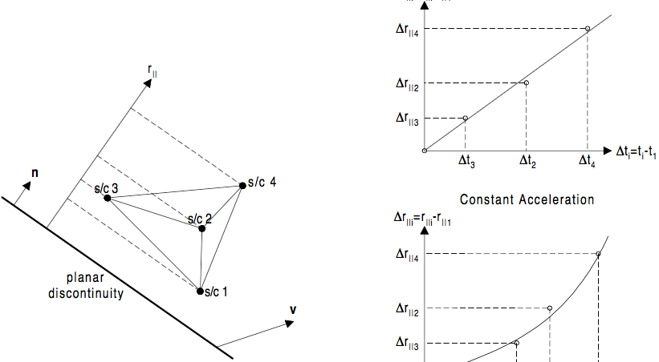
4-s/c timing

Slide 4
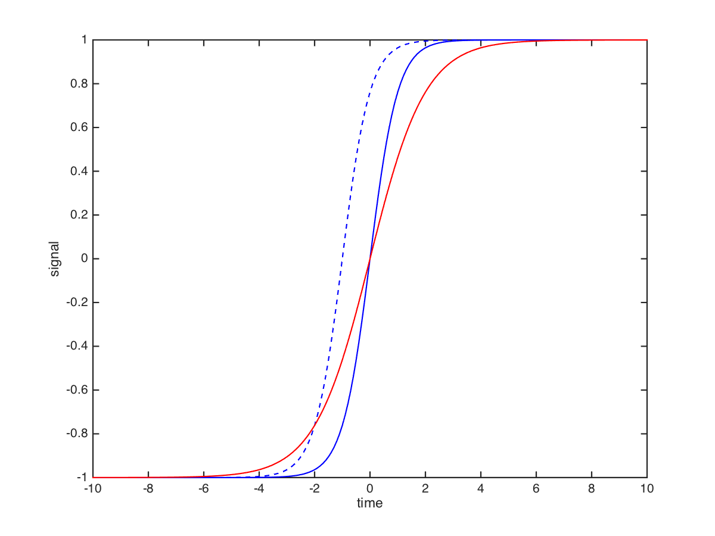
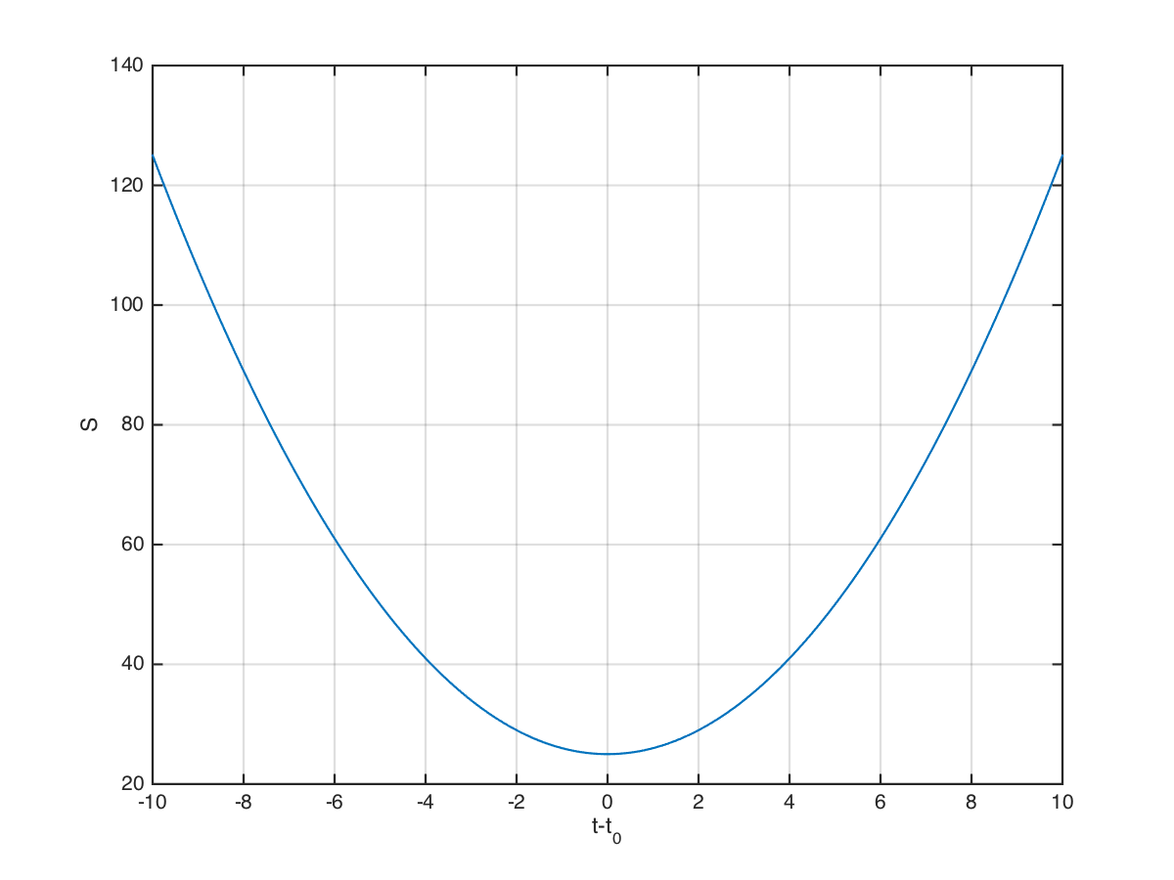
Definition of timing error
area S
2*Δt
S=2S₀
S=S₀

Slide 5
2-s/c timing
When to use?
SC constellation is not in a tetrahedron formation
Observed structure is very dynamic: 4 SC observe different signatures
How to do?
Perform MVAB on a pair of s/c, find normal direction
Use timing to get the velocity along this normal

Slide 6
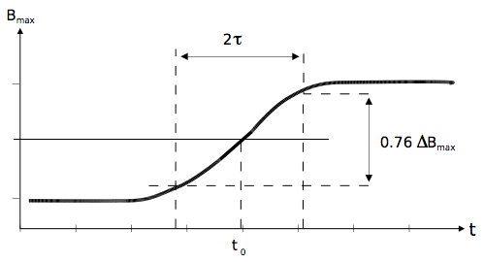
Definition of thickness

Slide 7
Assignment
Use interval from Paschmann et al, 2005 (downloaded earlier) to:
Identify boundary crossings
determine orientation and thickness of the boundaries
Estimate errors
Definition of thickness

