Slide 1


Netflix Strategy Analysis
Cross-Platform Content Analysis, SWOT & Strategic Recommendation
Naqiao Gu
July 2026

Slide 2
Project Overview
Business Problem Streaming platforms compete on content volume, genre variety, and content quality.
Project Objective Identify strategic opportunities for Netflix based on its content portfolio and competitive position.
Data & Scope The dataset covers movies and TV shows available on Netflix, Hulu, Prime Video, and Disney+.
Analysis Focus Content volume, release-year patterns, genre mix, IMDb ratings, Rotten Tomatoes scores, and strategic recommendation.
Netflix was selected for the final platform-level strategy analysis.

Slide 3
Industry Landscape: Five Forces
Force | Risk Level
Competitive Rivalry | Very High
Threat of New Entrants | Moderate
Bargaining Power of Suppliers | High
Bargaining Power of Customers | Very High
Threat of Substitutes | Very High
Overall Industry Assessment
Competitive Rivalry: Netflix is competing with Prime Video, Hulu, and Disney+ not only on content size, but also on original titles and content quality.
Threat of New Entrants: Starting a streaming platform is possible, but matching Netflix’s scale, brand recognition, and global reach would be difficult and expensive.
Supplier Power: Netflix depends on studios, creators, and IP owners for popular content, which can increase licensing and production costs.
Customer Power: Subscribers can easily leave Netflix when they do not see enough new or valuable content, since switching to another platform is simple.
Threat of Substitutes: Netflix also competes with YouTube, TikTok, gaming, and social media for the same limited entertainment time.

Slide 4
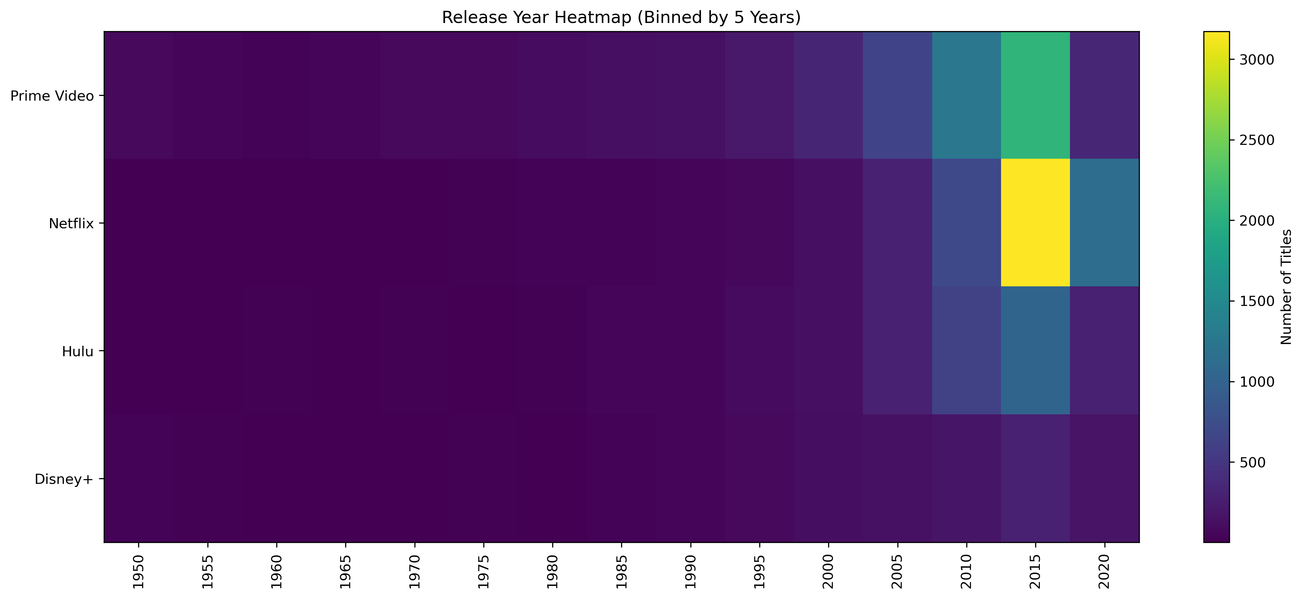
Platform Strategy Analysis
Release-Year Pattern
Across all four platforms, title counts are concentrated in more recent release years.
Netflix Position
Netflix shows a strong catalog concentration in the mid-to-late 2010s.
Competitive Context
Similar patterns across competitors suggest that catalog freshness is an industry standard rather than a unique Netflix advantage.
Strategic Limitation
Release-year distribution measures catalog recency and volume, but does not directly measure content quality.
Strategic Implication
Netflix should maintain catalog freshness while competing more selectively on content quality.

Slide 5
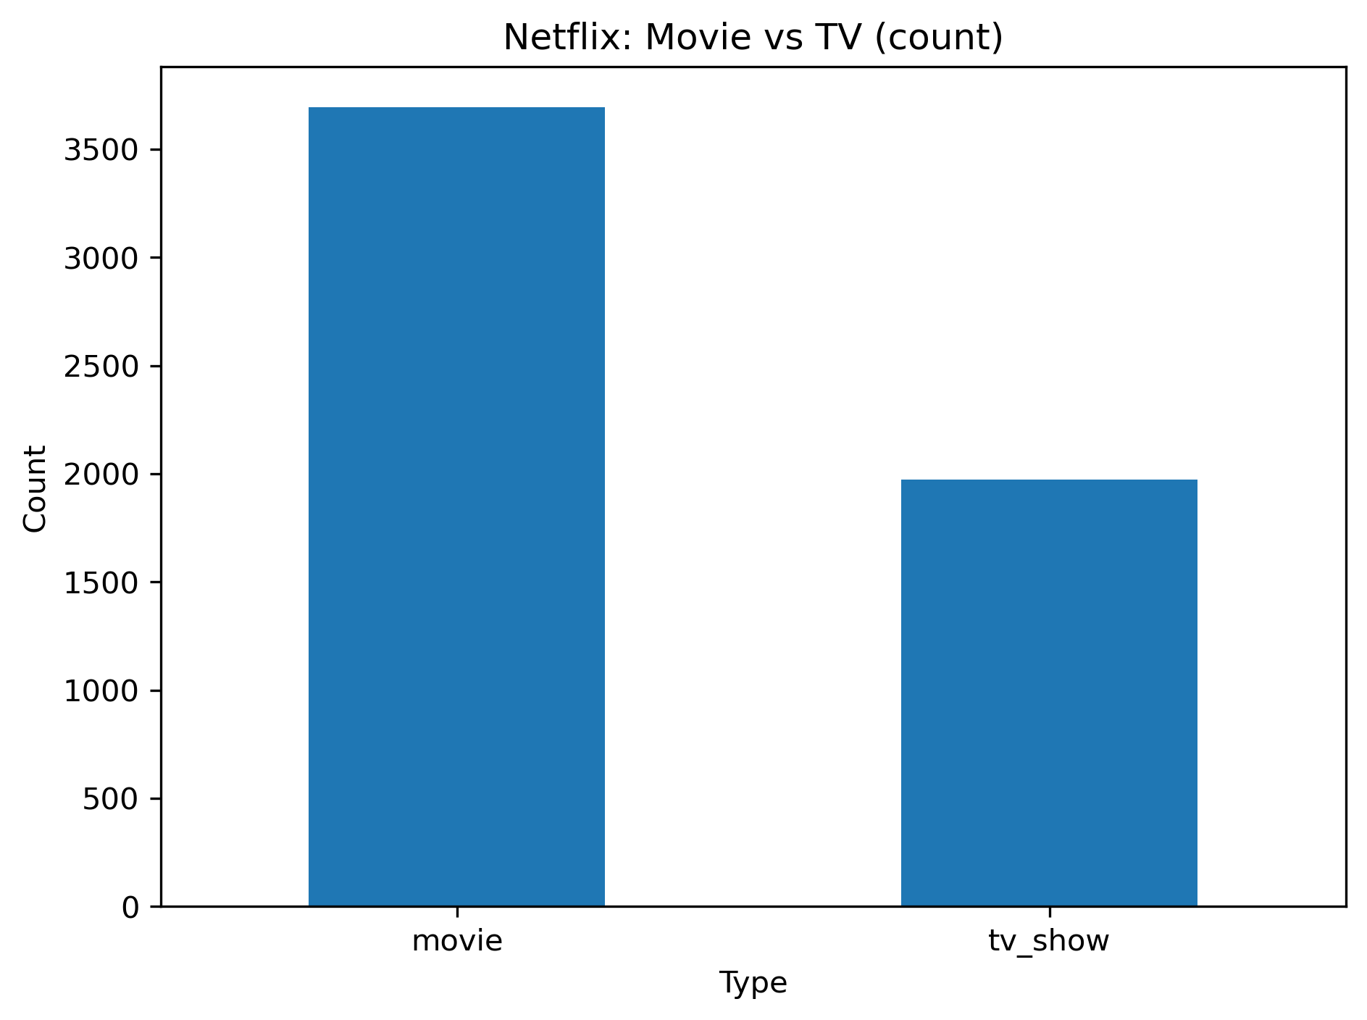
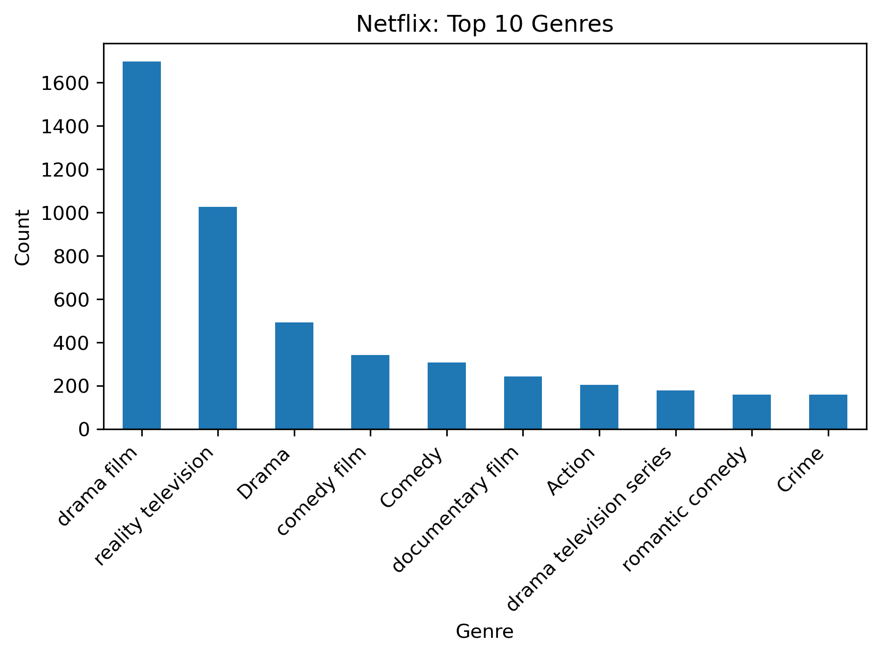
Netflix Content Mix
Movies make up about two-thirds of Netflix’s catalog. Drama film and reality television are the two largest genre categories. Since movies represent the largest share of the catalog, improving future movie quality would strengthen a major part of Netflix’s content strategy.

Slide 6
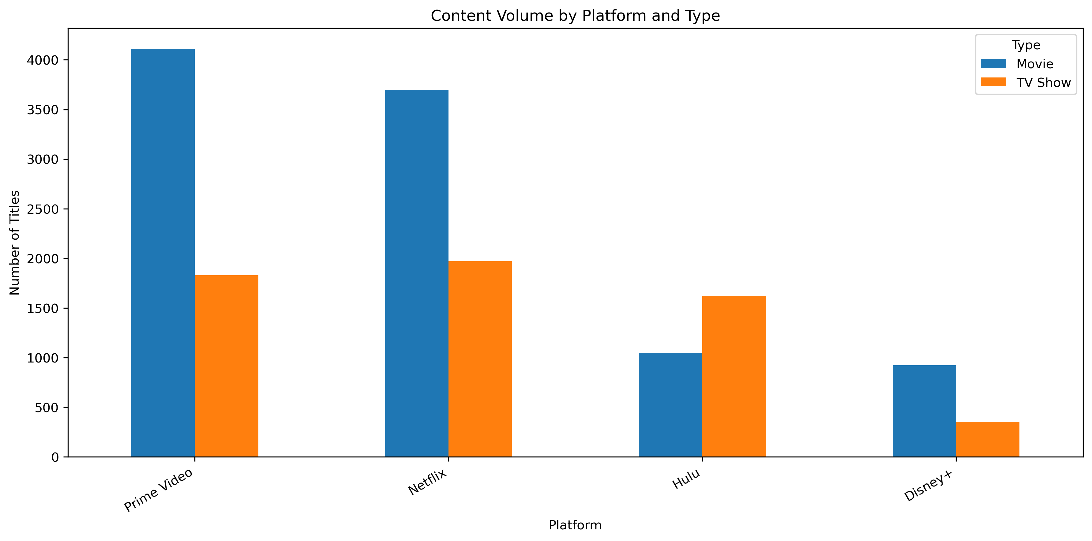
Netflix SWOT Analysis: Strength & Opportunity
Strength
Observation: Netflix has one of the largest content libraries in the comparison, with about 3.7K movies and 2.0K TV shows.
Evidence: Content Volume Comparison (Fig. 6.2)
Strategic implication: Its large catalog gives viewers more choices across movies and TV shows.
Opportunity
Market gap observed: Netflix already has a large movie catalog, so adding more movies alone may not create a strong competitive advantage.
Strategic opportunity: Netflix should place more emphasis on the quality of future movie investments rather than continuing to expand movie volume.

Slide 7
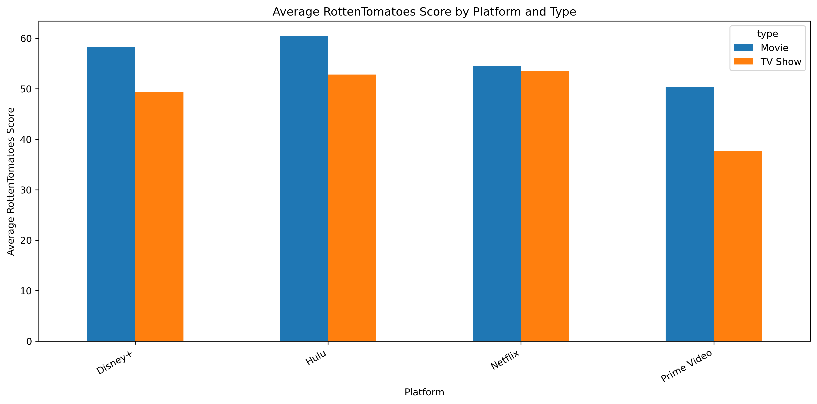
Netflix SWOT Analysis: Weakness & Threat
Weakness
Observation: Netflix’s average movie Rotten Tomatoes score is 54.4, below Hulu at 60.4 and Disney+ at 58.3.
Evidence: Average Rotten Tomatoes Comparison (Fig. 6.5)
Risk implication: The weakness is concentrated in movie quality, since Netflix remains competitive in average TV-show ratings.
Threat
Competitive signal observed: Prime Video has more movies, while Hulu has the highest average movie rating in the comparison.
Evidence from comparison: Content Volume Comparison (Fig. 6.2) and Average Rotten Tomatoes Comparison (Fig. 6.5)
Strategic risk: Netflix may lose movie-focused viewers to competitors offering either a larger movie catalog or stronger-rated movies.

Slide 8
Strategic Recommendation
Platform | Movie Titles | TV Show Titles | Avg. Movie RT Score | Avg. TV Show RT Score
Netflix | 3,695 | 1,971 | 54.4 | 53.6
Prime Video | 4,113 | 1,831 | 50.4 | 37.8
Hulu | 1,047 | 1,621 | 60.4 | 52.8
Disney+ | 922 | 351 | 58.3 | 49.4
Source: Content Volume Comparison (Fig. 6.2) and Average Rotten Tomatoes Comparison (Fig. 6.5).
Based on the SWOT analysis, Netflix should invest less in expanding its movie catalog and focus more on the quality of future movie releases.
This recommendation is supported by Netflix’s large movie catalog and its lower average movie scores compared with Hulu and Disney+.
The expected outcome would be higher-quality future movies and a stronger competitive position in the streaming market.

Slide 9
Expected Impact of Strategic Recommendation
Estimated Revenue Protected = Average Paying Memberships × Retention Scenario × Avg. Monthly Revenue per Paying Membership × 12
Calculation Input | Value
Average paying memberships | 210.8M
Illustrative retention scenario | 1%
Additional paying memberships retained | ≈2.1M
Avg. monthly revenue per paying membership | $11.67
Annual revenue per paying membership | $140.04
Estimated Annual Streaming Revenue Protected ≈$295M
Retaining an additional 1% of paying memberships through higher-quality future movies could protect approximately $295M in annual streaming revenue.
Source: Netflix 2021 Annual Report; estimate based on an illustrative 1% retained-membership scenario.

