Slide 1
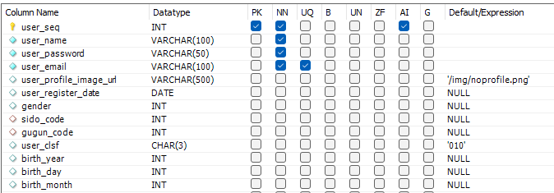
users

Slide 2

gender
group_code
sido_code
gugun_code

Slide 3


Attraction_description
attraction_detail

Slide 4
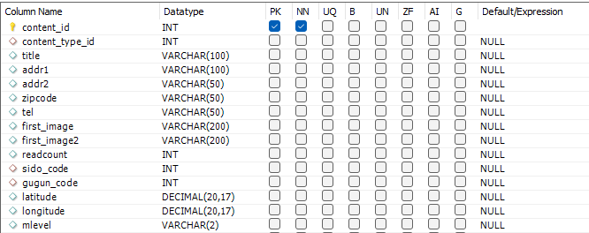
attraction_info

Slide 5


favorite_attraction
board

