Slide 1
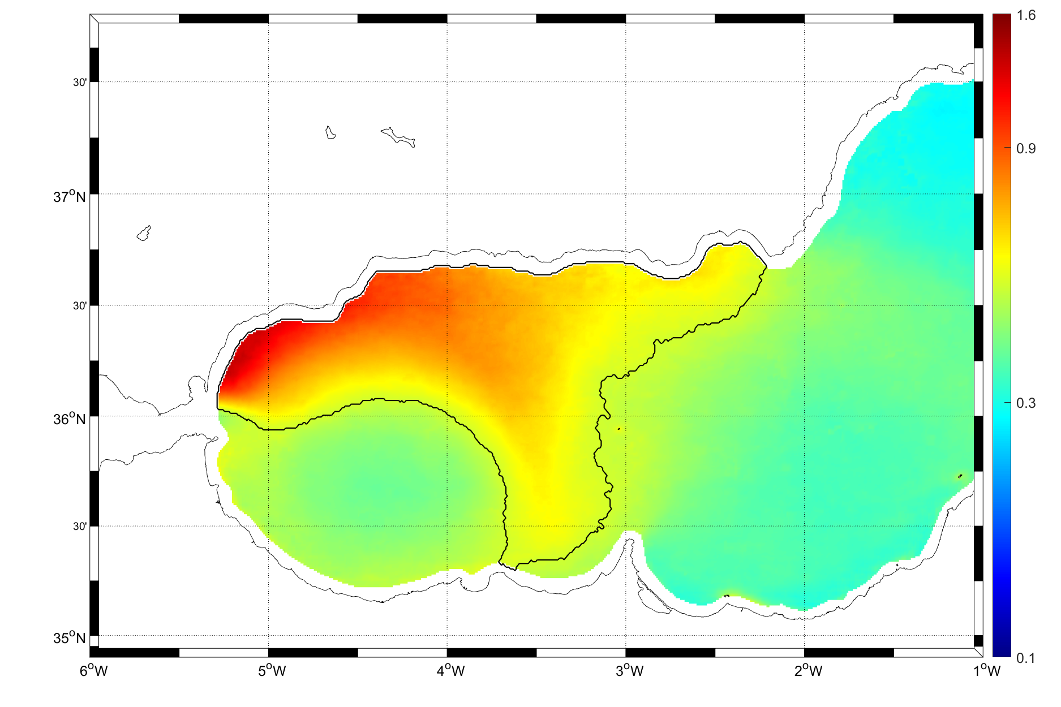
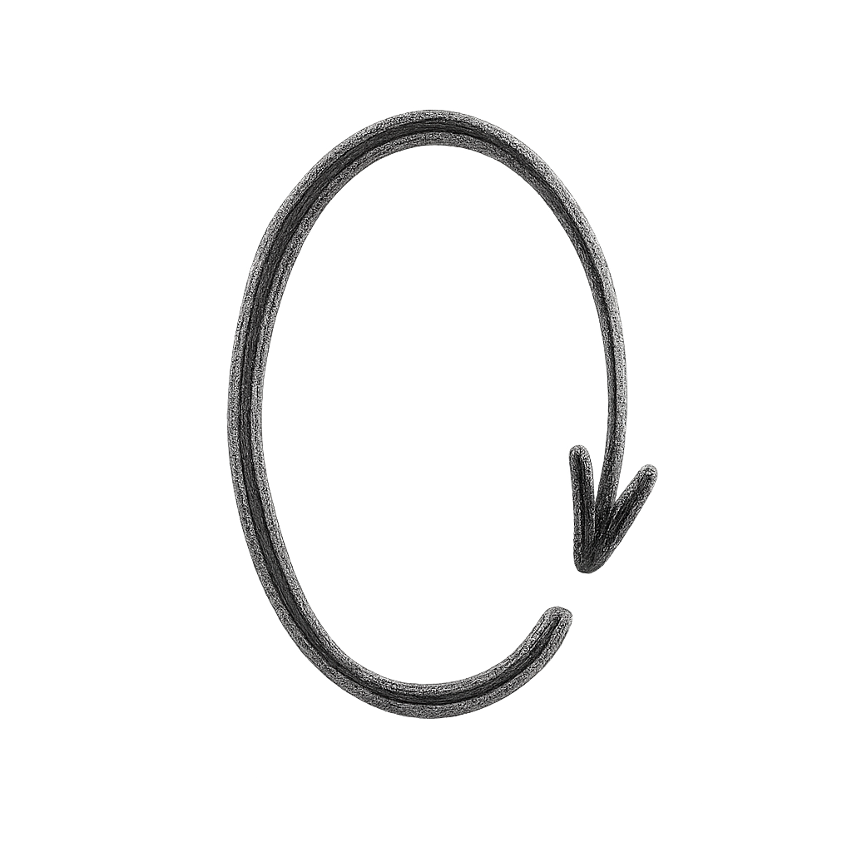

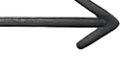
SPAIN
Estepona
Zone 1
Zone 2
CsCG
AJ
Strait of Gibraltar
WAG
EAG
MOROCCO

Slide 2
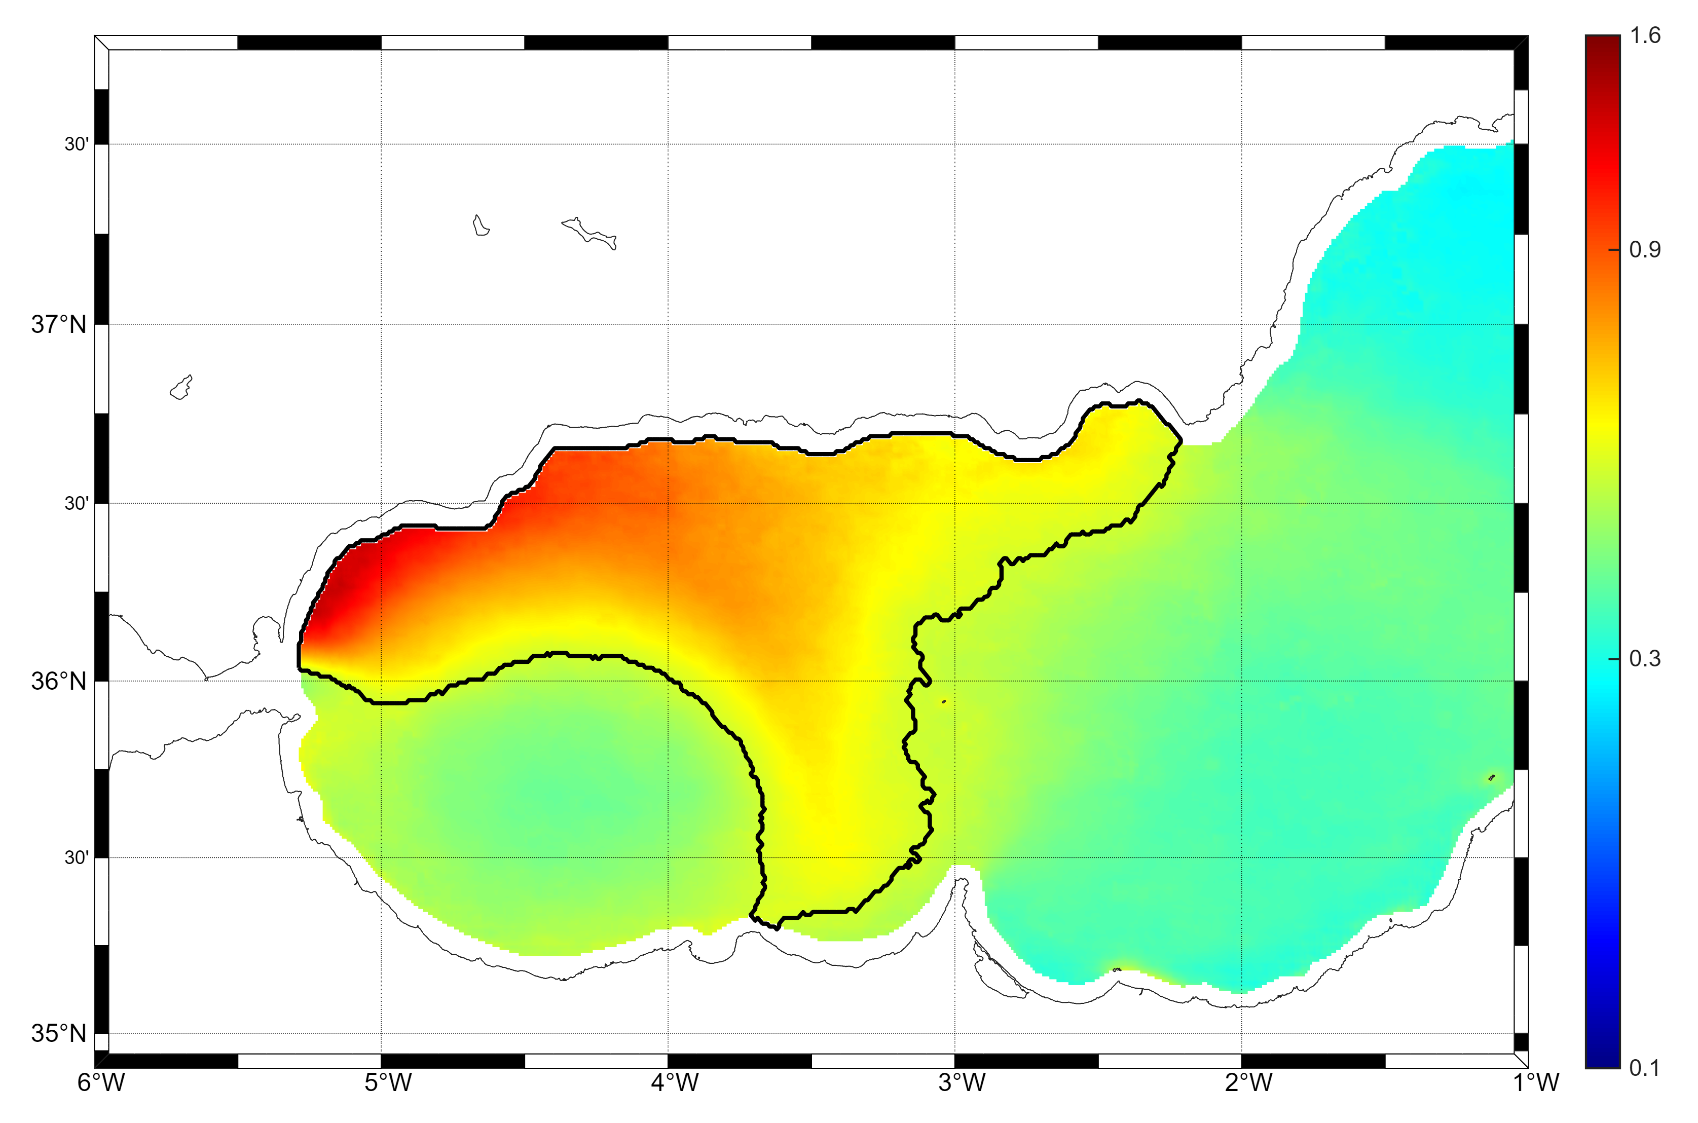

SPAIN
Estepona
Zone 1
Zone 2
CsCG
AJ
WAG
CCG
EAG
Strait of Gibraltar
MOROCCO

Slide 3
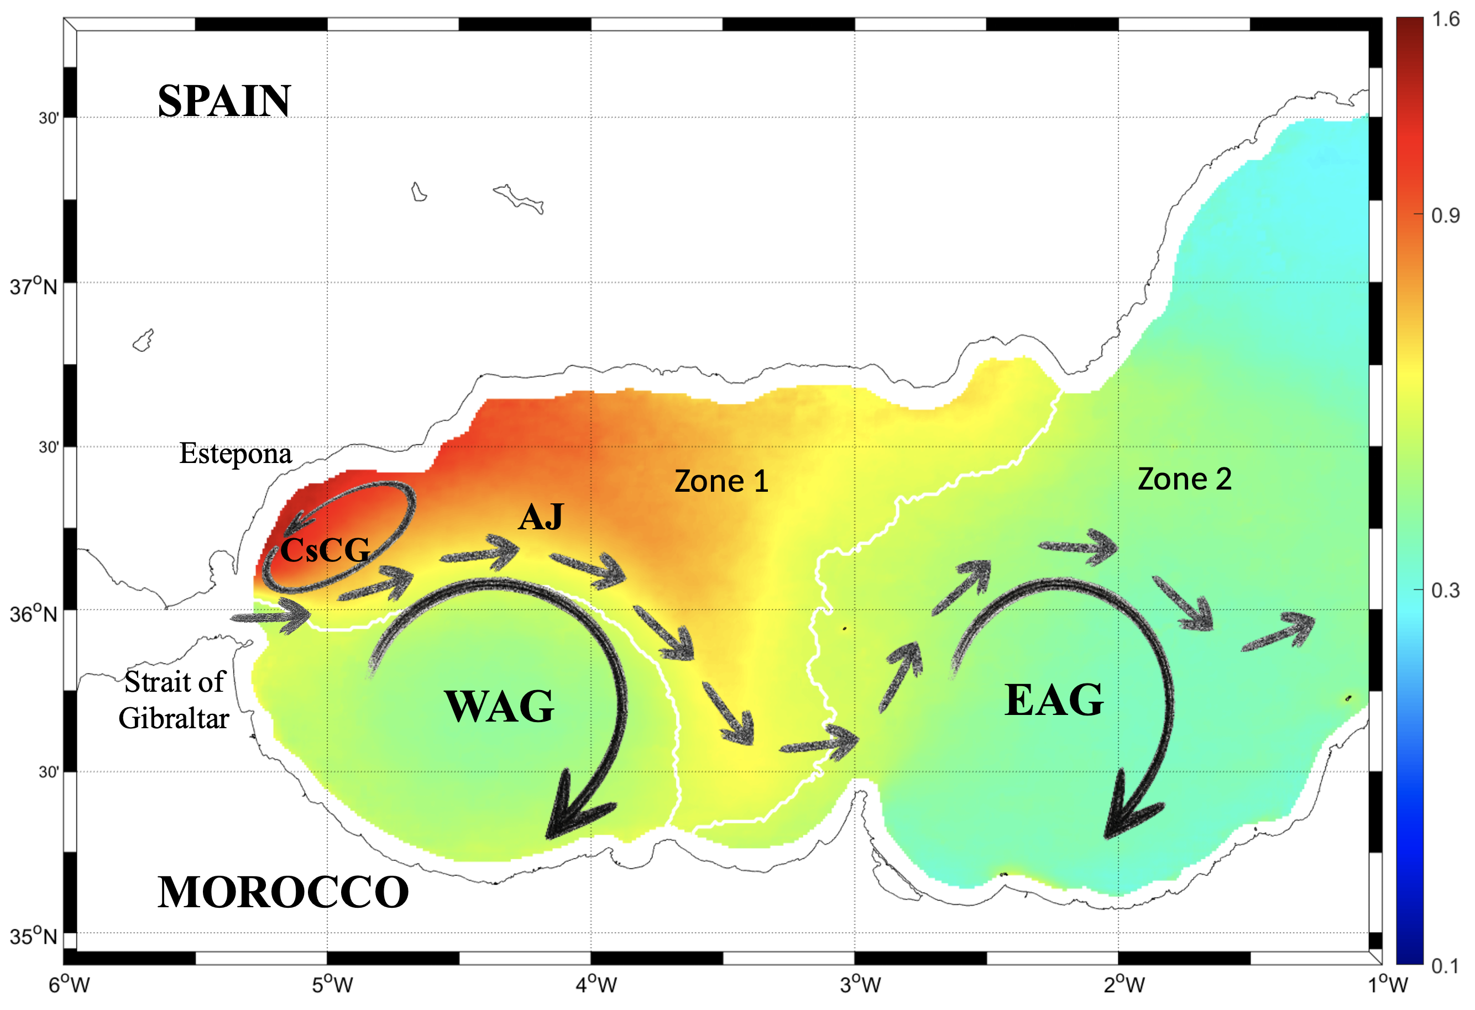
CCG

