Slide 1
Research on NVM (I)
Cloud native relational database: PolitDB
Zhen Liu
Ruan, Chaoyi, et al. "Persistent Memory Disaggregation for Cloud-Native Relational Databases." Proceedings of the 28th ACM International Conference on Architectural Support for Programming Languages and Operating Systems, Volume 3. 2023.

Slide 2
Disaggregated cloud-native database and PM
Backgroud

Slide 3
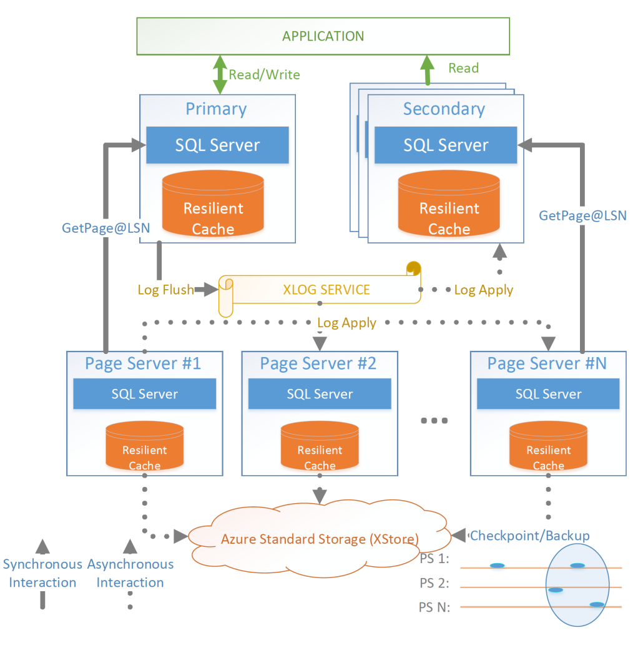
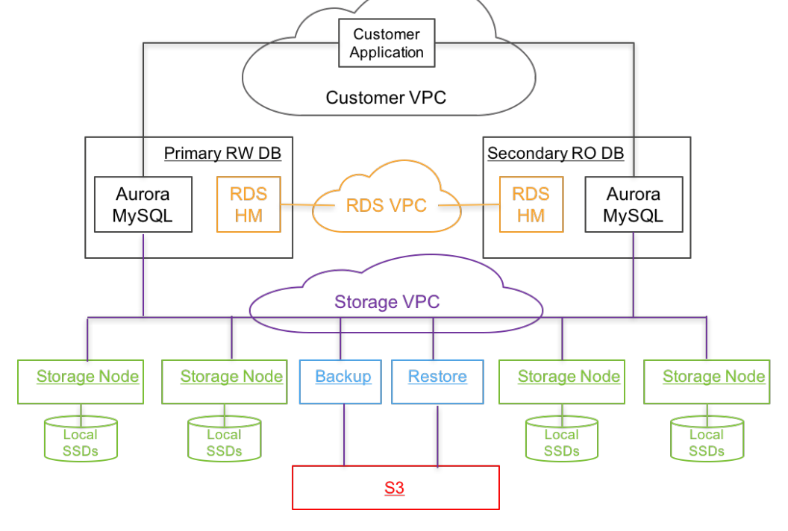
Disaggregated cloud-native database
Two-tier architecture (storage disaggregation)
compute and storage separation
Amazon Aurora[SIGMOD’17]
Microsoft Socrates[SIGMOD’19]
Alibaba PolarDB[FAST’20]
Aurora Architecture
Socrates Architecture

Slide 4
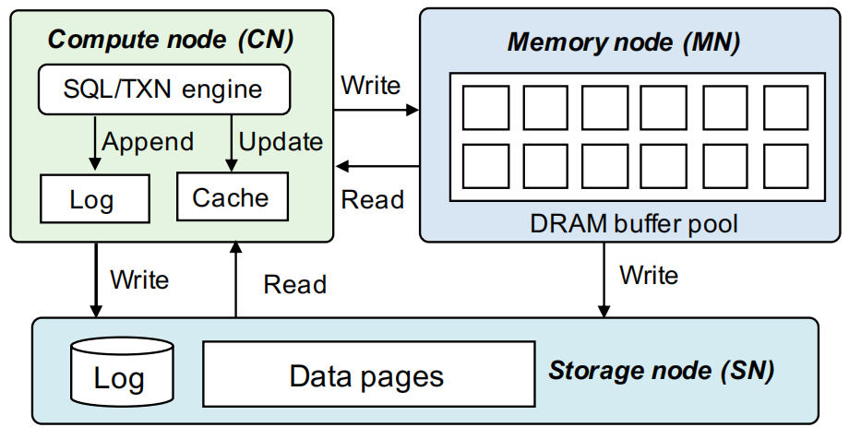
Disaggregated cloud-native database
Three-tier architecture (memory disaggregation)
separate compute node (CN) and memory node (MN)
PolarDB-serverless[SIGMOD’21]
LegoBase[VLDB’21]
Compute node: CPU+DRAM
SQL server
Local cache
Committed log
Memory node: DRAM
Remote cache
Storage node: SSD/HDD
WAL Log
Data Pages
Sample three-tier disaggregated cloud-native DB architecture

Slide 5
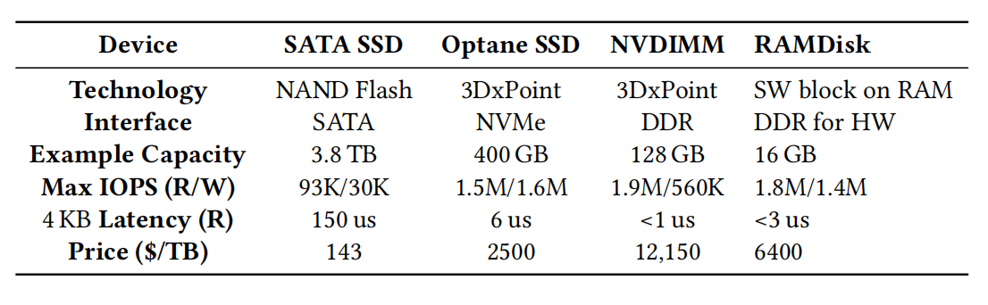
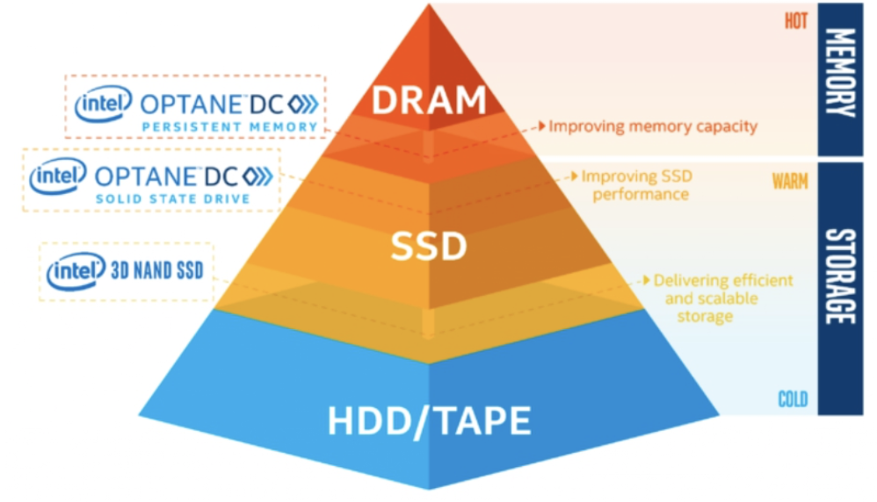
PM
Multi-fold benefits to database systems
large capacity
low latency
byte addressability
persistence
Alter the landscape of the storage hierarchy
DRAM
PM
SSD
HDD
Performance-price of fast and ultra-fast storage devices(ASPLOS’23)

Slide 6
Constraints in DRAM disaggregation and Existing PM disaggregation work shortage
Analysis

Slide 7
Constraints in DRAM disaggregation
DRAM limited per-machine density
one DIMM slot can hold 512GB Optane PM, but only 128GB DDR4 DRAM
DRAM volatility
need WAL log to guarantee persistence
Write remain slow with transactions
need to persist changes in time to the storage layer

Slide 8
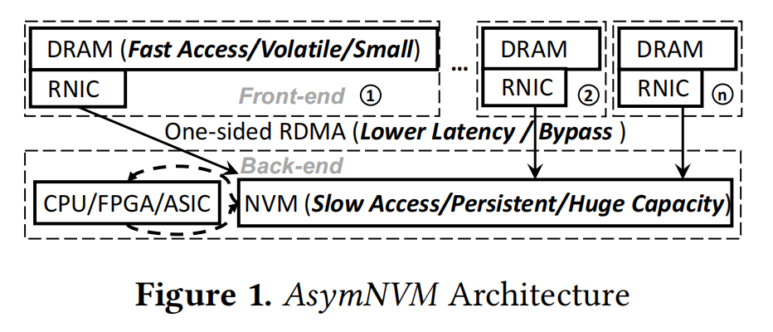
PM disaggregation: AsymNVM
AsymNVM: An Efficient Framework for Implementing Persistent DataStructures on Asymmetric NVM Architecture [ASPLOS'20]
Advantage
share NVM resources
base on one-side RDMA
front-end nodes close to 100% CPU usage
back-end nodes generate very small CPU usage (<10%)
Shortage
focus on supporting native data structures, not universal
heavy remote CPU usage

Slide 9
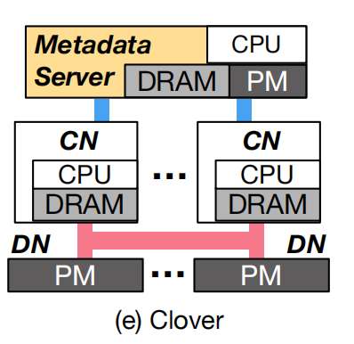
PM disaggregation: Clover
Disaggregating Persistent Memory and Controlling Them Remotely: An Exploration of Passive Disaggregated Key-Value Stores [ATC’20]
Advantage
scaleable PM resources
RDMA
low lantency
low CPU usage
Separate data and metadata and manage them in different forms
Shortage
focus on simple applications (KV stores), not universal
make the PM/network bandwidth more bottleneck-prone

Slide 10
PilotDB Architecture and Workflow
Architecture

Slide 11
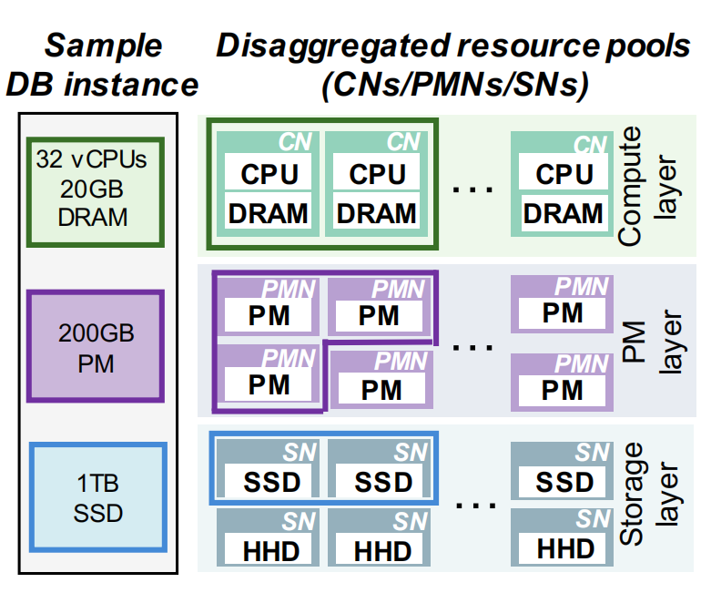
Architecture
3-level architecture for cloud-native relational DBs
Compute node (CN)
SQL/TXN server
LBP(local buffer pool)
Persistent memory node (PMN)
CDLog store(committed log)
RBP(remote buffer pool)
Storage node (SN)
Data pages
PilotDB architecture

Slide 12
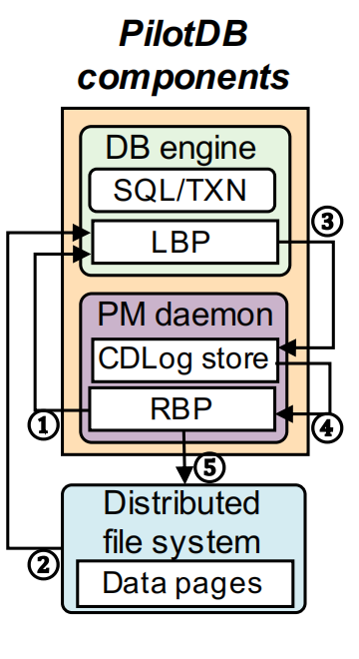
Workflow
Transaction execution workflow
access the LBP
LBP: cach the most recently used data pages
at a latency of∼0.91μs
LBP miss, contact PMN to fetch the target page
RBP: cach much more data pages than LBP
at a latency of∼8μs
RBP miss, fetch the page from SN, send another copy to RBP
at a latency of∼277μs
CN collect log and flush them to PMN CDLog
PMNs evict colder pages to SN
PilotDB transaction execution workflow

Slide 13
PilotDB major challenges
Design

Slide 14
Challenge 1: PM bandwidth contention
PM have lower bandwidth than DRAM
Max IOPS (R/W)
Intel Persistent Memory 200 series (NVDIMM): 1.9M/560K
16GB DDR-4 DIMM (2133 MT/s) (RAMDisk): 1.8M/1.4M
High PM bandwidth demands to remote PM, especially for writes
load pages
log WAL entries
flush dirty pages
PilotDB design
sends only logs to PMNs
manage and control logs at the CN side
ship to and apply logs at the PMN side
update PM-buffered pages by logs

Slide 15
Challenge 2: PM side CPU consumption
PM’s large capacity and high-density installation allow a PMN to support many tenants
PMN CPU resources could quickly become a scalability bottleneck
PilotDB design:
make PM-side compute-light
while still process log applications and coordinate concurrent CN access

Slide 16
From design to implementation
Implementation

Slide 17
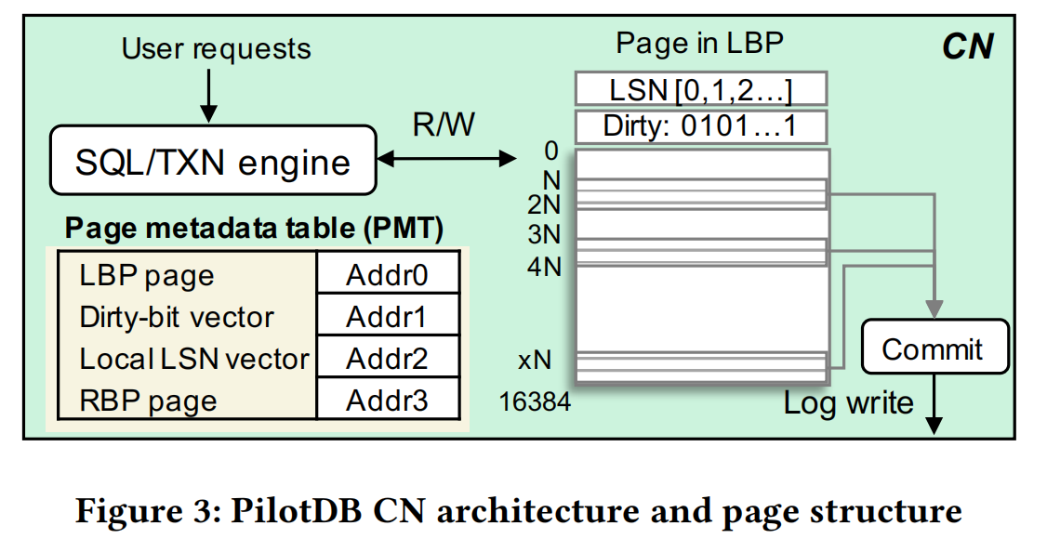
CN-Driven Log
split each 16KB page into configurable, equal-sized mini-pages
avoids read/write amplification between CNs and PMNs
PM-knowledgeable CN
fast, RDMA-based remote PM access
page metadata table(PMT)
CDLog
consists of two parts:
metadata
data

Slide 18
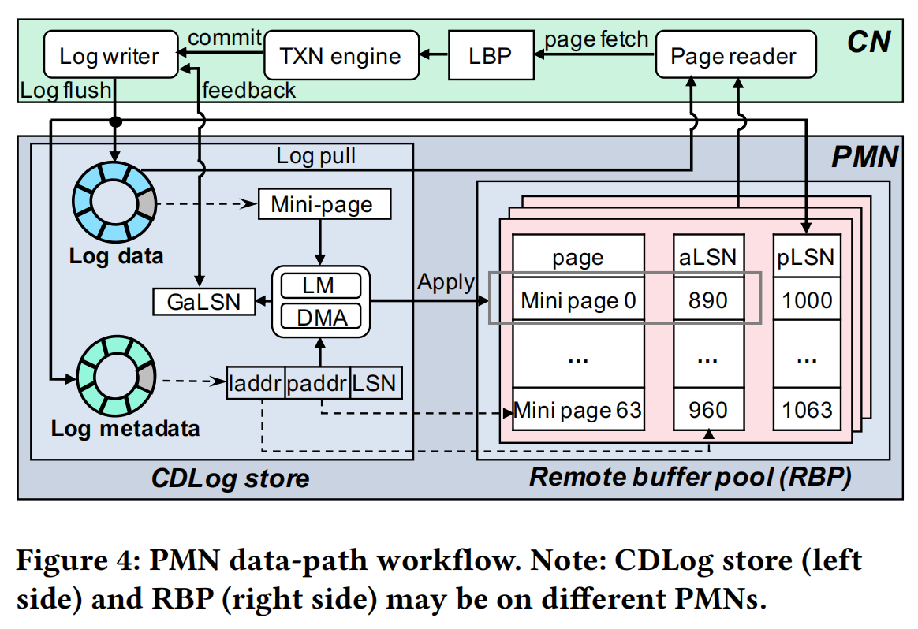
Light-Weight, RDMA-Friendly PMN Processing
Light-weight log application
scan the WAL entries
use DMA for memory copy
Optimistic remote read
LBP miss, CN read the target RBP page using one-sided RDMA
check page freshness locally

Slide 19
Sysbench Results
Evaluation

Slide 20
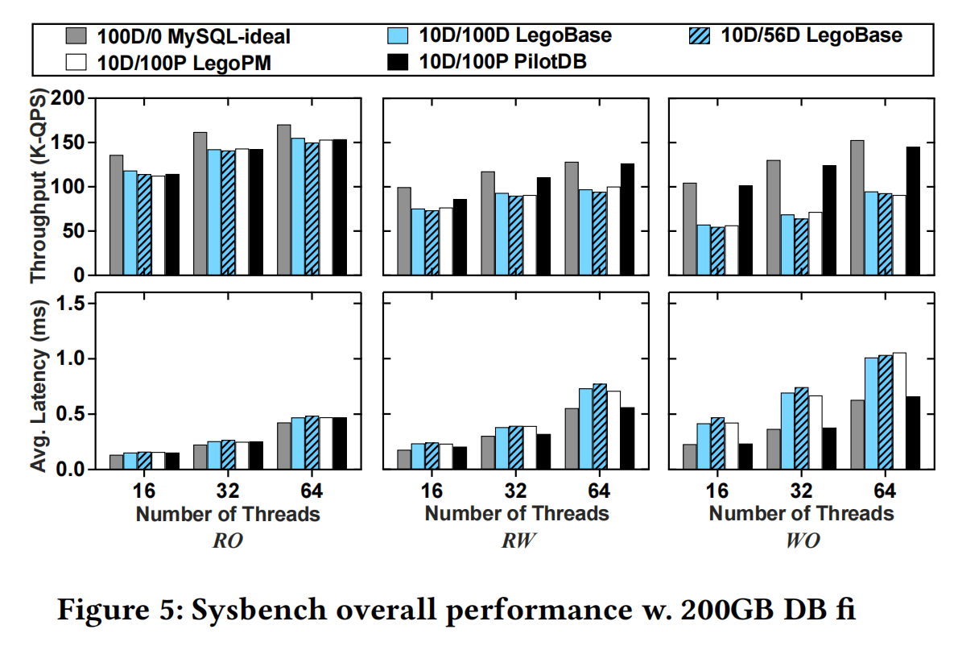
Sysbench overall performance
RO
achieves 90.2% of the MySQL-ideal throughput
RW
more evident advantage
WO
throughput reach 97.0% of MySQL-ideal
at least a 1.53× improvement over the other three baselines

Slide 21
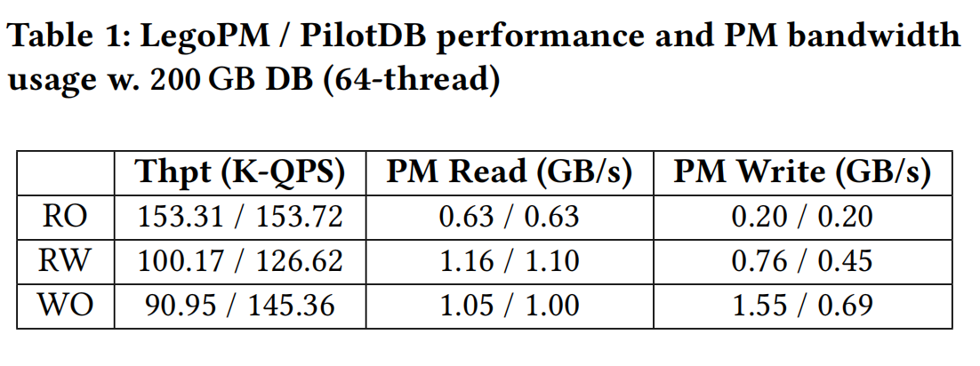
PM bandwidth consumption reduction
Deliver 26.4% and 59.8% higher throughput over LegoPM
Reduce remote PM write bandwidth by 40.8% and 55.5%

Slide 22
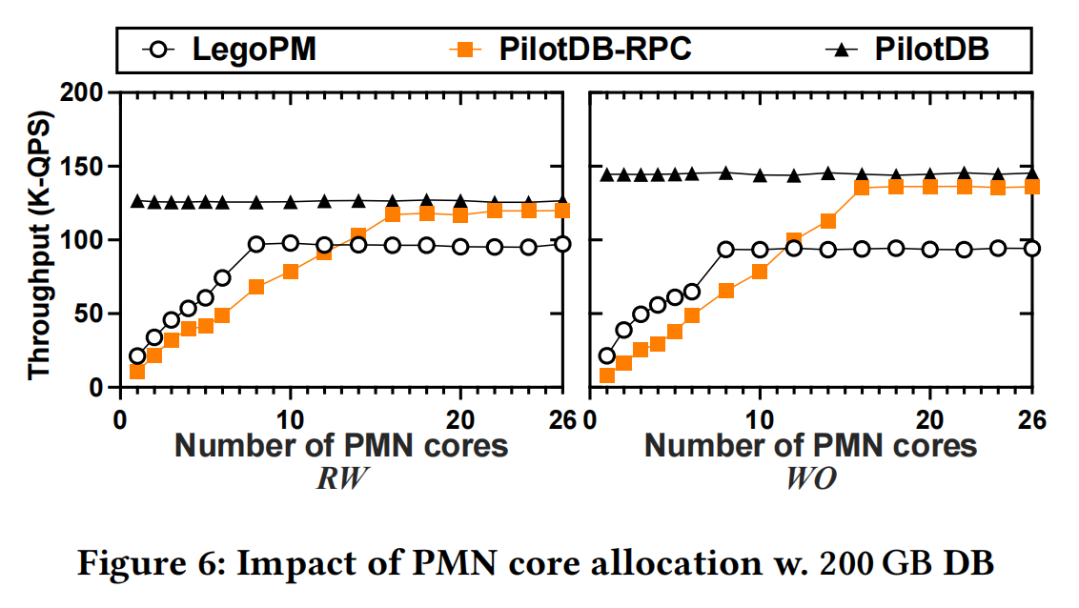
Remote CPU involvement reduction
PilotDB
lower number of PMN cores
higher thoughput

Slide 23

Thanks
May 18th, 2023

