Slide 1
Research on Cloud-native Database Latency I:
Calcspar
Zhen Liu
Zhou, Yuanhui, et al. "Calcspar: A Contract-Aware LSM Store for Cloud Storage with Low Latency Spikes" WNLO, Huazhong University of Science and Technology, Wuhan, Hubei, China

Slide 2
AWS EBS, SILK, CruiseDB, Mixgraph and RocksDB performance on Cloud Storage
Backgroud

Slide 3

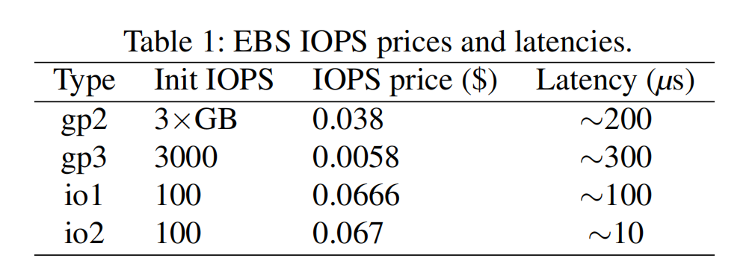
AWS EBS
An easy-to-use, scalable, high-performance block-storage service designed for Amazon EC2
Price and performance relationship of the corresponding volume type
the higher IOPS price the lower Latency
Notes:
EBS是一种易于使用且可扩展的高性能数据块存储服务，适合用于 Amazon Elastic Compute Cloud (Amazon EC2)
EBS服务存在的问题：
付费 IOPS 只保证返回的 I/O 数，而不是最优延迟
EBS性能伸缩只支持增加付费IOPS，需要数小时到数天才能生效
没有协议说明负载超过 IOPS 时如何响应请求

Slide 4
SILK
Balmau, Oana, et al. "SILK: Preventing Latency Spikes in Log-Structured Merge Key-Value Stores." USENIX ATC. 2019.
Goal: Optimize LSM-tree write long tail latency
Latency Spikes
99th percentile latencies
From lessons to design: I/O Scheduler
Make sure L0 is never full -> Prioritize internal operations at lower level
Ensure enough I/O for flush/compaction on low levels -> Preempt compactions
Make sure other compactions don’t fall far behind -> Opportunistic compactions
First priority: Flushing
Second priority: L0->L1 compactions
Third priority: Higher level compactions

Slide 5
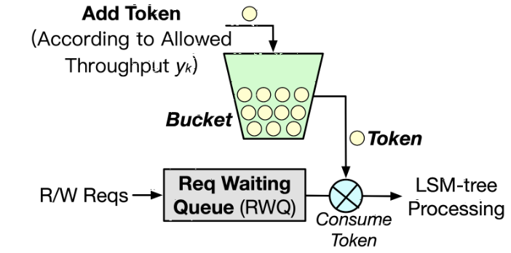
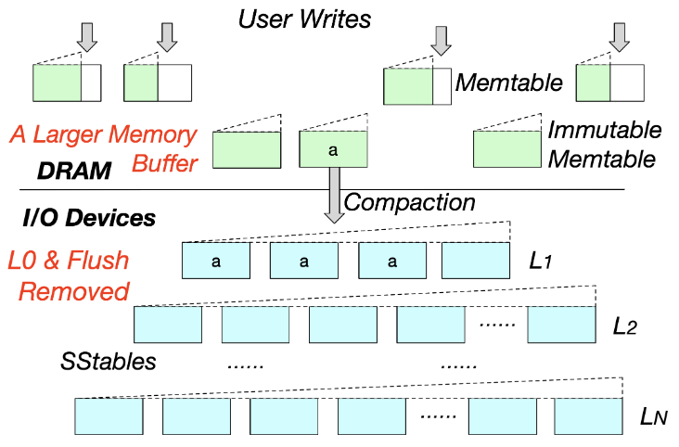
CruiseDB
Liang, Junkai, and Yunpeng Chai. "CruiseDB: An LSM-Tree Key-Value Store with Both Better Tail Throughput and Tail Latency." IEEE ICDE. 2021.
Goal:
make throughput more stable
achieve lower tail latency
From lessons to design:
Avoid full memory buffer -> Token-Bucket-based Admission Control
L0’s lacking order causes slow read requests -> Eliminate L0 in SP-LSM-tree
Diagram of the token-bucket-based admission control
The structure of the simplified practical LSM-tree

Slide 6
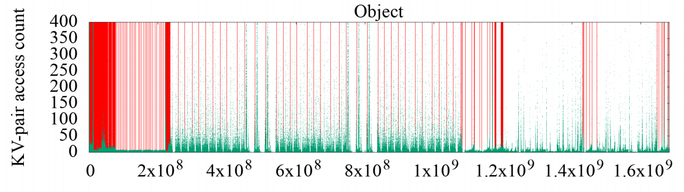
Mixgraph
Cao, Zhichao, and Siying Dong. "Characterizing, modeling, and benchmarking RocksDB key-value workloads at Facebook." USENIX FAST. 2020.
Conclusion
Real loads have the key space loaclity feature
YCSB simulation is coarse-grained (key), not fine-grained (key space)
uniform and zipfian
Contribution
Mixgraph benchmark
mimic social graph OLTP
key-ID of keys in the whole key-space
Heat-map of Get in Object during a 24-hour period

Slide 7
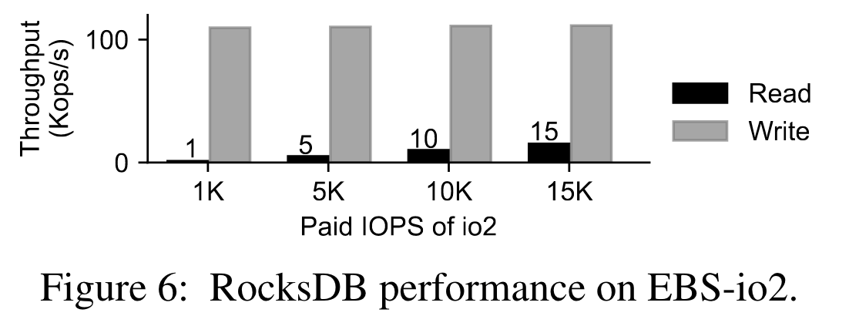
RocksDB on Cloud Storage
RocksDB does not work well on cloud storage
LSM-tree is a write-optimized structure instead of reducing read I/Os
write operations can be cached and aggregated into large chunks
read requests may need to access multiple levels
Experiment
Read and write stress tests on io2 storage volumes with different paid IOPS
Findings
As IOPS increases, read throughput increases, write throughput remains the same
Maybe batch write, but it is not mentioned in the paper
Read I/Os easily and repeatedly hit the IOPS limitations
which cause elevated tail latency

Slide 8
From EBS Experiments to EBS Latency Model
Analysis
I

Slide 9
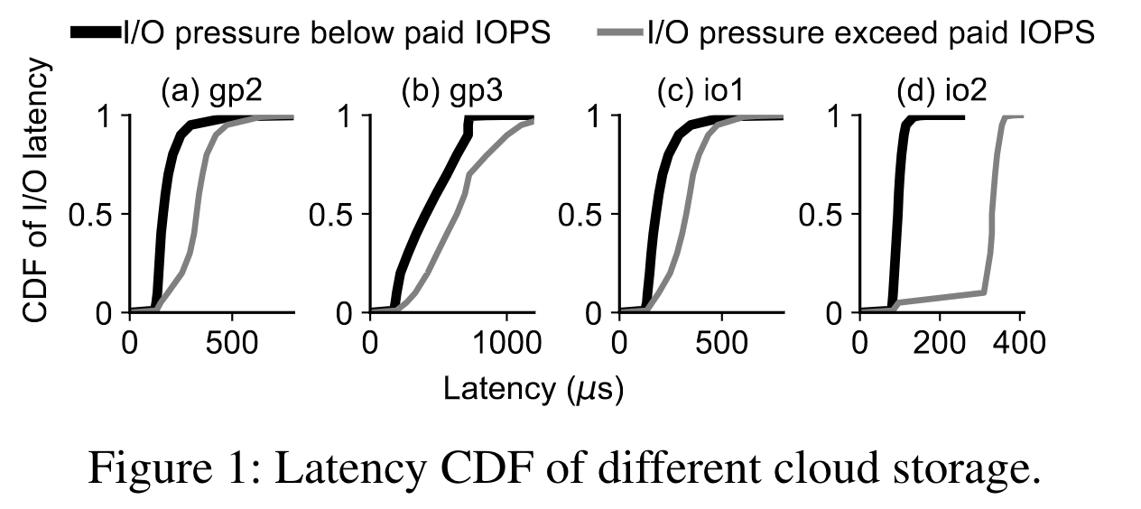
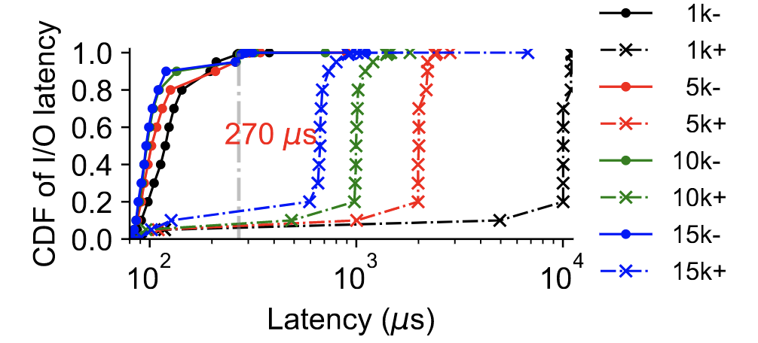
Exp. I Exceed or not the paid IOPS
Experiment
Same paid 3K IOPS with different cloud storages
Different paid IOPS with io2
Finding
When the I/O pressure exceeds the paid IOPS, the latency increases deterministically and significantly
Figure 2: Latency CDF under different paid IOPS.

Slide 10
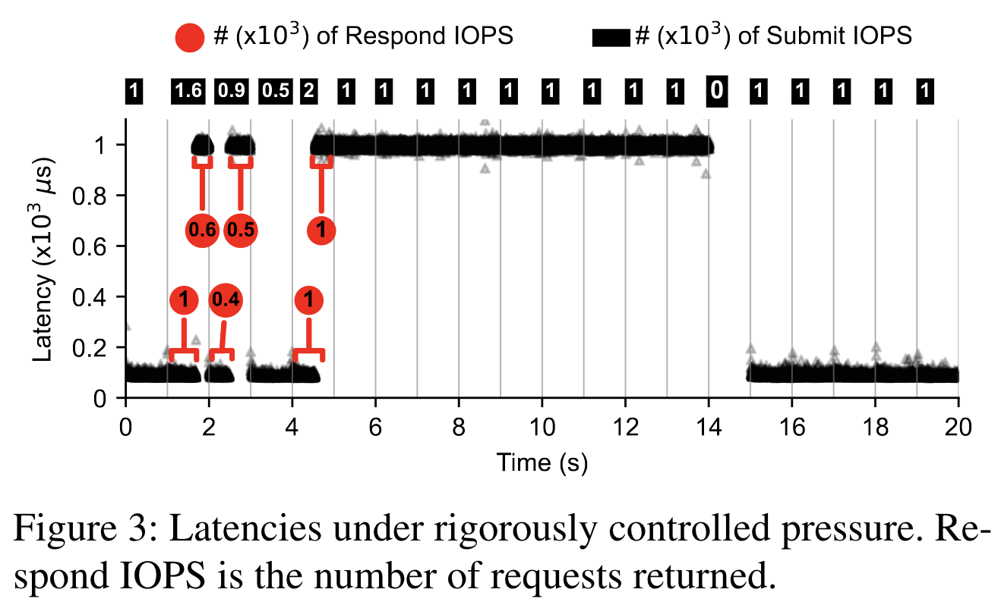
Exp. II Controlled pressure
Experiment
Control the I/O send rate in a single thread for an 1000-IOPS io2 volumes
Finding
When submit IOPS < paid IOPS, the latency is lower than 200μs
When submit IOPS > paid IOPS, the latency is about 1000μs
Speculative Reason
speed-limiting mechanism inside EBS

Slide 11
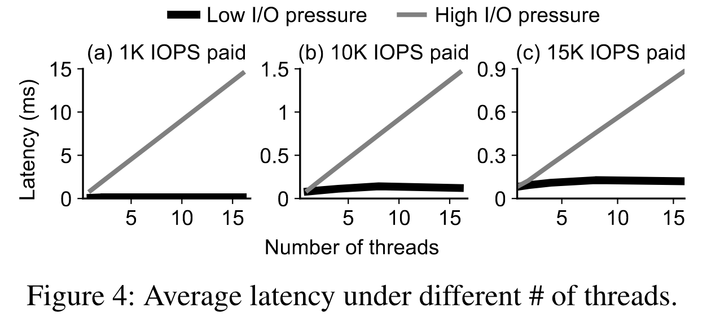
Exp. III Different number of threads
Experiment
Two different I/O pressures are sent to io2 with different number of threads
Finding
When submit IOPS < paid IOPS, average latency holds around 120μs and does not increase with more threads
When submit IOPS > paid IOPS, the access latency first grows to the level of 1/IOPS seconds while growing linearly with the number of threads

Slide 12
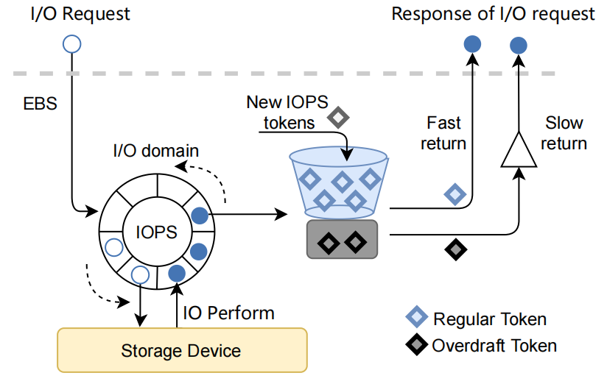
EBS Latency Model
Basic components
buffer queue (called I/O domain): maintain requests (length = paid IOPS)
token bucket: maintain regular token (number of tokens = paid IOPS)
borrowing pool: maintain overdraft token (number of tokens = paid IOPS)
Overdraft rule
EBS controls request responding speed
by managing the rotation of I/O domain
Request gets token:
first gets the regular token from the token bucket
if no token in the bucket, obtians the overdraft token from the borrowing pool
Tokens replenish:
IOPS tokens per second, prioritized in the borrowing pool
token bucket
borrowing pool
Estimated EBS IOPS throttling mechanism

Slide 13
From RocksDB Experiments to Challenges in Avoiding Latency Spikes
Analysis II
Notes:
一方面去验证提出的EBS latency model和overdraft rule
一方面找出RocksDB的在云上长尾延迟过大的主要问题/挑战

Slide 14
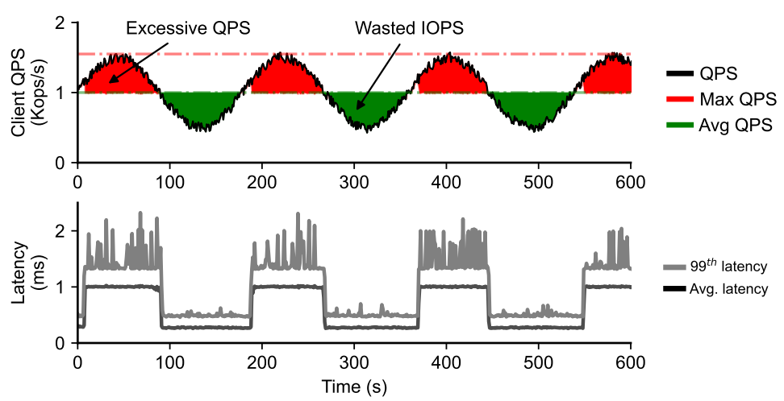
Exp. I Client fluctuating read requests
Experiment
Send fluctuating read requests to an io2 volume in a single thread
Finding
At first, QPS can exceed the paid IOPS in a brief period, due to the overdraft rule
Then QPS fall to the paid IOPS and latency is significantly higher than during low load
Challenge
The read latency fluctuates significantly because cloud storage isn’t flexible enough to meet the changing demand
Client random read QPS and request latency with single thread

Slide 15
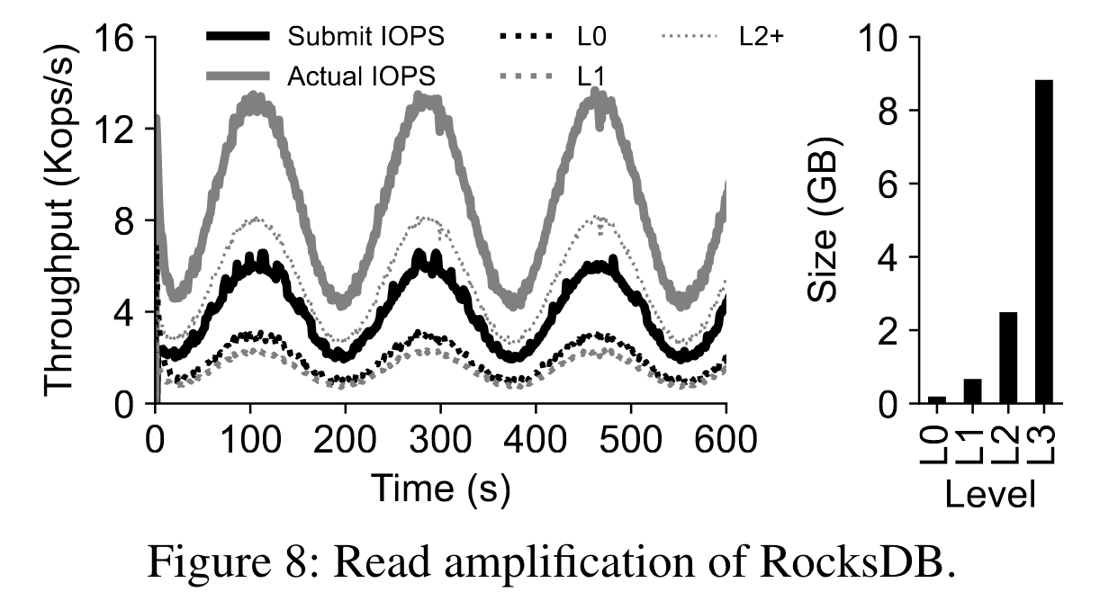
Exp. II Submit IOPS v.s. Actual IOPS
Experiment
Send fluctuating read requests to an io2 volume in a single thread
Finding
Actual IOPS is about 3× of the submit IOPS
L0 and L1 level takes up close to 1/3 of the I/O accesses
Challenge
The read amplification in LSM-Tree further strengthens the workloads fluctuation

Slide 16
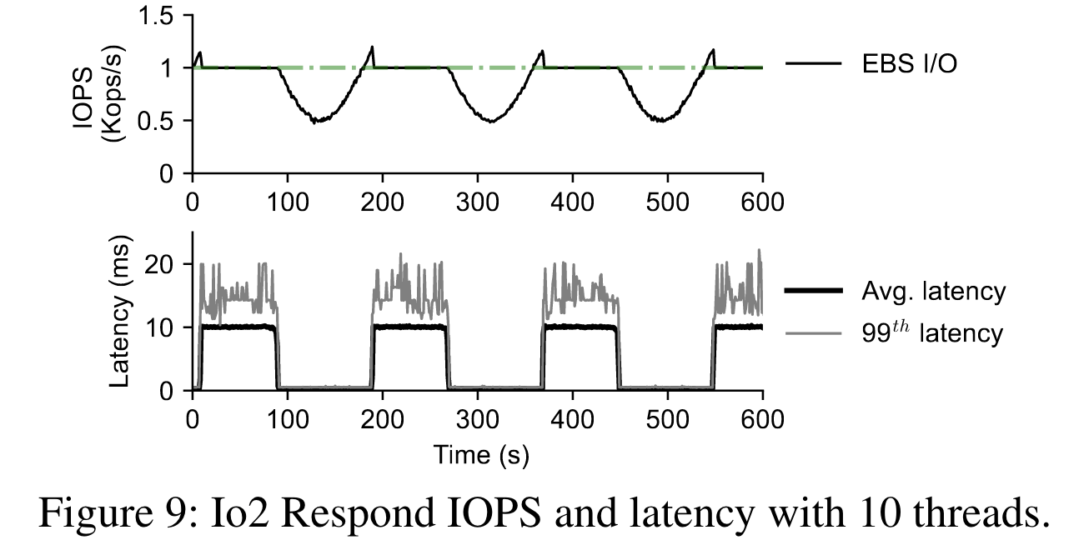
Exp. III Single thread v.s. ten threads
Experiment
Send fluctuating read requests to an io2 volume with ten threads
Finding
The latency increases 10× at high loads compared to single threads
When the I/O domain is full, requests are queued on each thread
Challenge
Thread I/O competition
requests among multiple threads are congested in the I/O domain resulting in a multiplication of tail latency

Slide 17
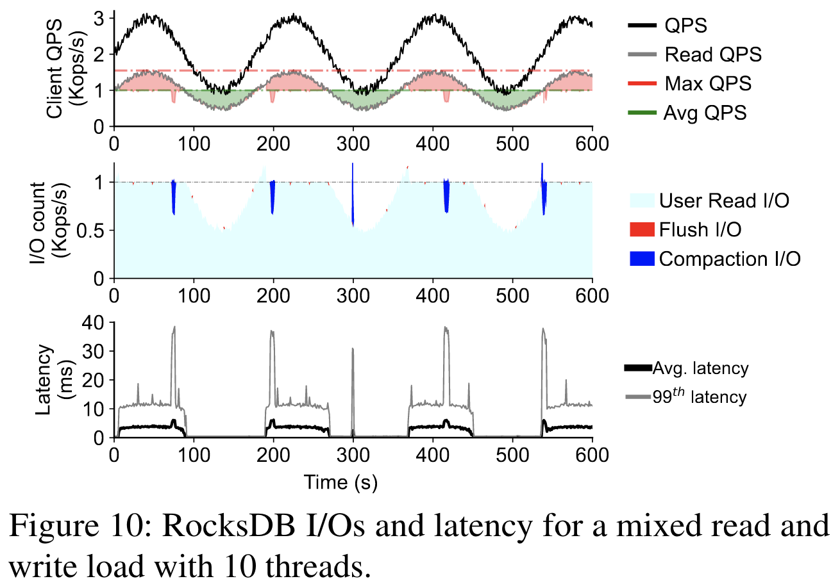
Exp. IV Write requests impact
Experiment
Send some write requests while keeping the read QPS constant
Finding
70ths: RocksDB launched compaction operations, which took up more IOPS
300ths: even in low workload period, RocksDB internally initiates some compactions, blocking user requests
Challenge
Bulk write blocking

Slide 18
From Analysis to Design
Design

Slide 19
Calcspar Design
Analysis
When submit IOPS > paid IOPS, access latency grows to 1/IOPSs
Muti-threads inevitably congest due to limited tokens
Read amplification problem cause significant latency spikes
LSM-tree internal compactions compete with user I/O requests
Design
Proactively control the number of I/Os during high-load periods
Use different priority to ensure critical requests are not blocked
Devise a latency-aware cache for hotspot
Differentiate I/Os for compactions on different levels

Slide 20
From Design to Implementation
Implementation

Slide 21
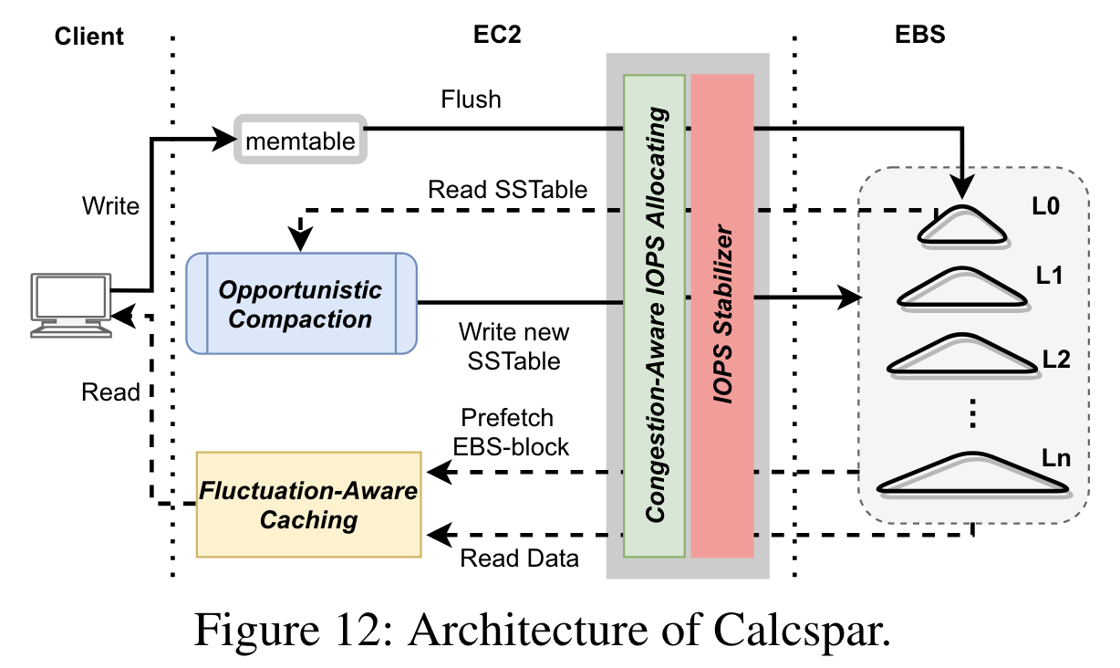
Architecture of Calcspar
Four significant components
IOPS Stabilizer for EBS
Congestion-Aware IOPS Allocating
Fluctuation-Aware Caching
Opportunistic Compaction

Slide 22
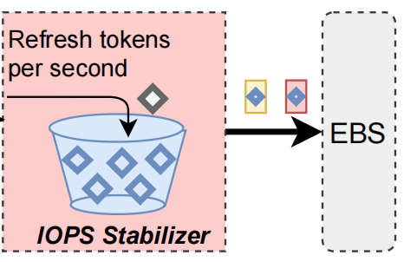
IOPS Stabilizer for EBS
Design:
Proactively control the number of I/Os during high-load periods
Essence:
mimic the EBS token speed limit mechanism
Details:
each request must obtain a token before accessing the EBS
the number of tokens is refreshed every second decided by the paid IOPS
requests sent to EBS do not exceed the paid IOPS

Slide 23
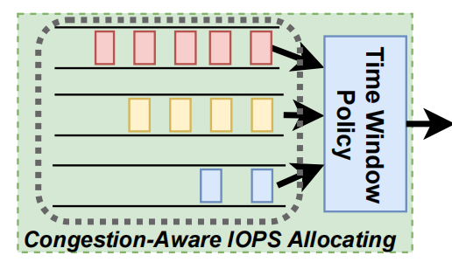
Congestion-Aware IOPS Allocating
Design:
Use different priority to ensure critical requests are not occasionally blocked
Details:
Multi-priority Queues
user-requests > flush > L0-L1 compaction > higher level compactions > prefetching
Dynamic Time Window Policy
time window represents a period within 1s which Calcspar grants requests to acquire tokens on a best-effort basis
window size matches the priority of the queue

Slide 24
Fluctuation-Aware Caching
Design:
Devise a latency-aware cache for hotspot
Details:
Hotspot-Aware Proactive Prefetching
workload is light, maintains a global table to track the hotness of EBS-blocks
Shift-Aware Passive Caching
workload is heavy, manages the cache space passively using LRU
Cache Integration
using two cache policies manage the same cache space

Slide 25
Opportunistic Compaction
Design:
Differentiate I/Os for compactions on different levels
Details:
For L0 SSTables, which significantly affects read I/O amplifications, Calcspar prioritizes compaction on them
For L1 and L2 SSTables, Calcspar puts their compaction I/Os into the medium priority queue, where they are opportunistically processed
As for SSTables in levels below L2, Calcspar assigns these compaction I/Os to the lowest priority queue, since short-term deferral has no noticeably affect on performance

Slide 26
Overall Performance
Evaluation

Slide 27
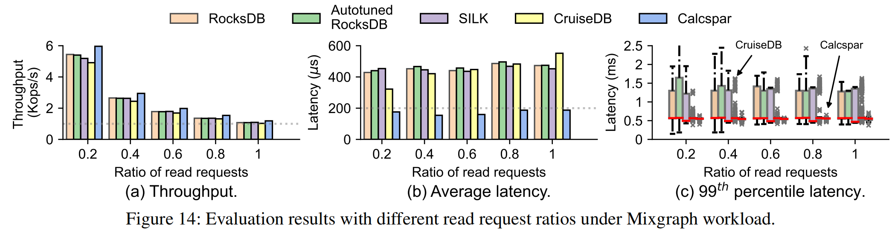
Mixgraph benchmark
Performance for different read/write ratio configurations under Mixgraph
Conclusion
The throughput of Calcspar is better than other systems under all read ratios
Calcspar significantly reduces the average latency
Calcspar achieves a lower and more stable tail latency

Slide 28
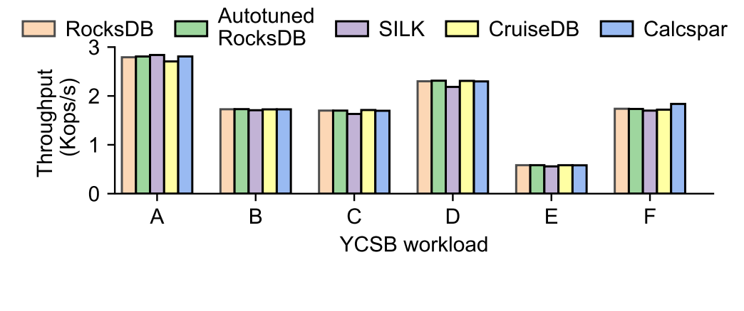
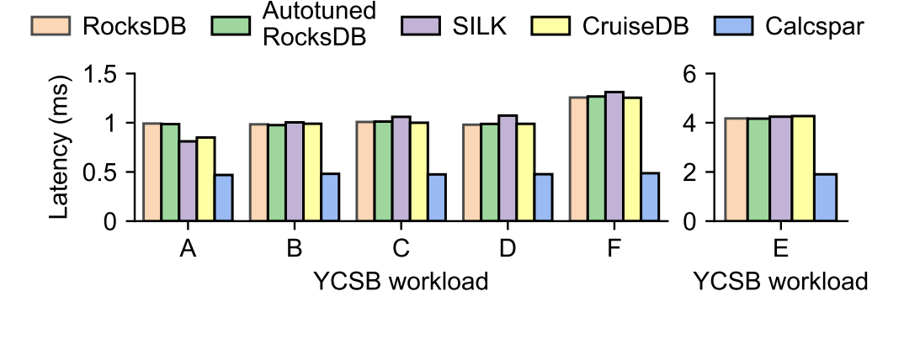
YCSB benchmark
Throughput for each key-value stores system under six workloads of YCSB
99th percentile latency for each key-value stores system under six workloads of YCSB

Slide 29
Thought of by Calcspar
Thoughts

Slide 30
Thought of by Calcspar
Crash consistency
Why doesn't Calcspar have a WAL log? How is its crash consistency guaranteed?
Read performance
Does Calcspar directly read Fluctuation-Aware Caching or read memtable and immutable memtable first?
Write performance
Calcspar does not perform as well as RocksDB in the write performance experiment
Whether making flush and other LSM-tree internal operations have a lower priority than user requests will cause write stalls?

Slide 31
Thought of by Calcspar
How to ensure low latency and improve throughput under certain paid IOPS?
Improve cache hit rate (Calcspar does not propose a new cache algorithm, only prefetches hot data during the low-load)
Add new Cache structures (except RocksDB block cache and SSTable cache)
Fine-grained memtable makes L0 layer hot and cold separated (in write-intensive load, the L0 layer is not all hot data or different scenarios have different definitions of hot data)
Dynamically adjust priority based on load characteristics or hotness-aware

Slide 32

Thanks
June 1st, 2023

