Slide 1
Transaction Model of Disaggregated Persistent Memory
Zhen Liu
Zhen Liu
2022/4/14

Slide 2


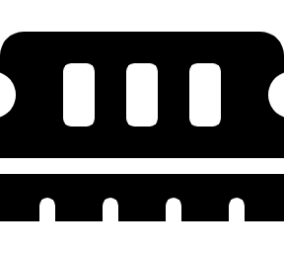

Background
Disaggregated architecture has not been fully discussed
Big gap between conventional distributed system
Monolithic Server
…
…
…
…
…
…
…
…
RDMA Network
Big gap!
…
…
…
One-sided Primitive
…
…
…
One/two sided Primitive
RDMA Network
Disaggregated Architecture
Distributed Architecture

Slide 3


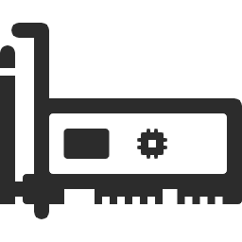
Background
Disaggregated architecture has not been fully discussed
Big gap between conventional distributed system
…
L1
L1
L2
L2
Write 100Gpbs
NVRAM
L3 cache
Read 320Gpbs
NIC
PCIe3.0/4.0
128~256Gpbs
IB/100~200Gpbs
PCIe
Memory controller
Read 900Gpbs
DRAM
One/two sided primitives
Write 600Gpbs

Slide 4

Background
Previous distributed transactions works
Based on monolithic servers
Work on how to excavate hardware potential (e.g. RDMA,HTM)
Monolithic Server
…
…
…
Previous works:
SOSP'15 FaRM SOSP'15 DrTM
EuroSys'16 DrTM+R OSDI'16 FaSST OSDI'18 DrTM+H
Two-sided Primitive
Two-sided Primitive
…
One-sided Primitive
One-sided Primitive
Local
memory
Shared memory

Slide 5


Background
Distributed transactions works on disaggregated architecture
Only support one-sided primitive between CP and MP.^{[1]}
Compute Pool
…
…
…
…
Problems:
Previous works with two sided primitives fail to work in the memory pool.
When cluster size becomes large, one sided primitives have pool scalability.
Two-sided Primitive
RDMA Network
One-sided Primitive
Memory Pool
…
…
…
1. FORD: Fast One-sided RDMA-based Distributed Transactions for Disaggregated Persistent Memory

Slide 6
Background
Differences between different works
RDMA primitives
Pure two-sided: FaSST
Hybrid: FaRM, DrTM, DrTM+H
Pure one-sided: FORD
System architecture
Disaggregated: FORD
Distributed: All others
Targets
Generality: FaRM
Flexibility, scalability: FaSST
High performance: DrTM, DrTM+R,DrTM+H, FORD

Slide 7
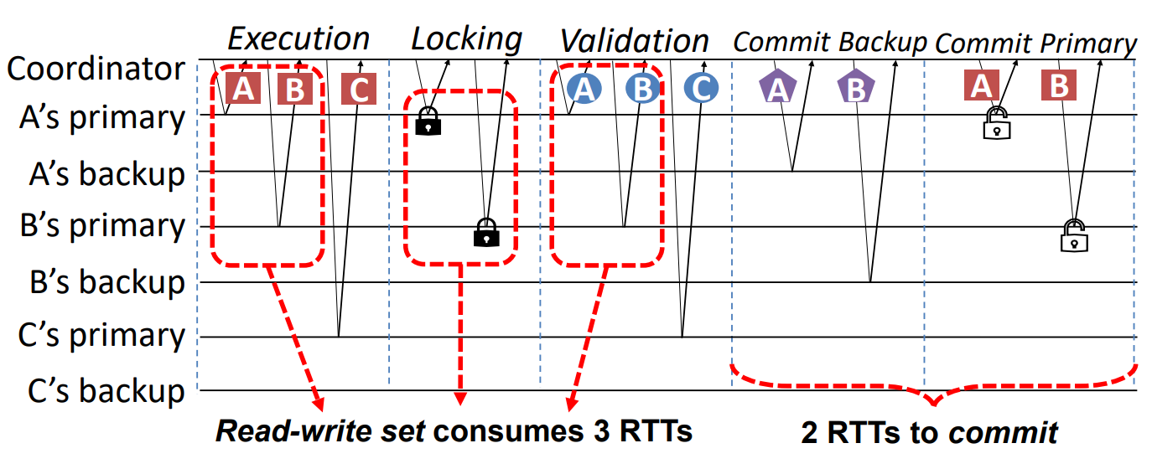
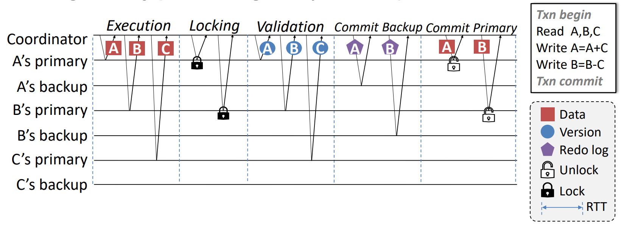
Background
Problems of pure one sided RDMA transaction
Too many RTTS during a transaction
PM bandwidth become bottleneck
Example: Txn with 3 nodes (A,B,C), each node has 1 backup
1. FORD: Fast One-sided RDMA-based Distributed Transactions for Disaggregated Persistent Memory

Slide 8
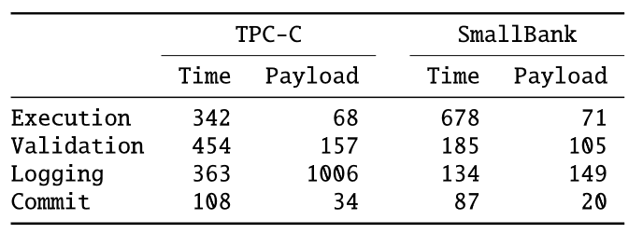
Problems
Problems of disaggregated architecture
One-sided RDMA primitives consumes much bigger NIC buffer
Small write incurs write amplification
Compute Pool
…
Payload size (bytes) in different phases for TPC-C and SmallBank.
SQ
CQ
One sided primitives need highest transport type, which consumes more NIC buffer.
State
State
State
Data from OSDI’18 DrTM+H
…
e.g. Connect-IB support 400QPs

Slide 9
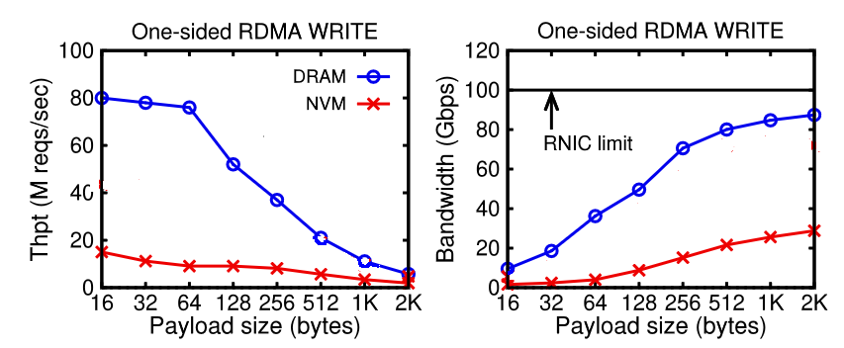
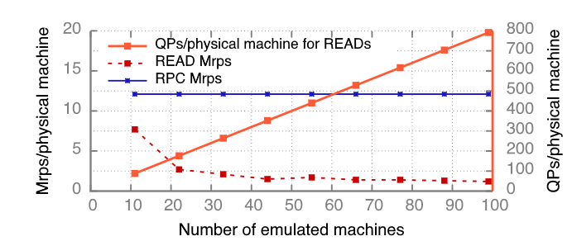
Problems
Problems of disaggregated architecture
One-sided RDMA primitives consumes much bigger NIC buffer
Small write incurs write amplification
Comparison of FaSST RPC and READ throughput with increasing QPs on physical machines.
Performance of one-sided RDMA WRITE on DRAM and NVM, (a) throughput and (b) aggregated bandwidth
1. OSDI’16 FaSST: Fast, Scalable and Simple Distributed Transactions with Two-Sided (RDMA) Datagram RPCs
2. ATC’21 Characterizing and Optimizing Remote Persistent Memory with RDMA and NVM

Slide 10
Idea
In previous work, we waste the bandwidth between CN
Can we mitigate some workload of memory node to compute nodes (e.g. lock)?
We just do data R/W after reaching an agreement on CN
Two-sided Primitive for metadata
Compute Pool
…
SQ
CQ
The overhead of memory nodes can be mitigated by CN!
One-sided Primitive for data
State
State
State
Also avoid small writes on persistent memory.
…

Slide 11
Challenge
Decouple the data r/w from consistency coordination
C1: Efficient bidirectional mapping memory
Support fast and consistent search
Dynamical changed with the workload
C2: Effective metadata synchronization mechanism
Multi-level synchronization (from inside nodes to distributed nodes)
Apply hardware features (e.g. HTM)
C3: Cost-effective data transferring
Compute node can aggregate data r/w requests and send them by batch

