Slide 1
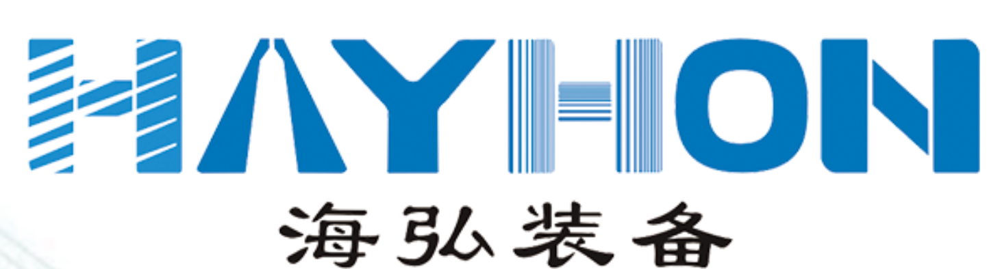




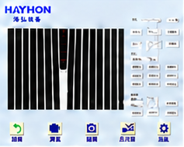
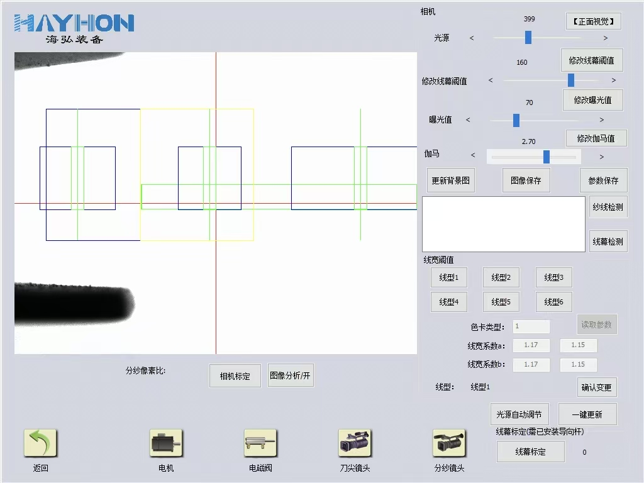
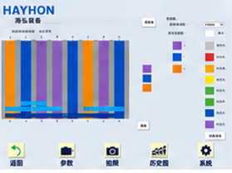


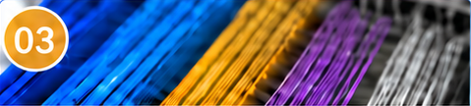




VISION SYSTEM
Image
Capture
→
Feature
Extraction
→
Data
Comparison
Decision &
Action
AI Vision for Smarter Inspection
→
Self-Learning. Continuously Improving.
Intelligent cameras capture images in real time. The AI computing system converts the width, shape, shadow and color features of reed dents and yarns into comparable data. With each warp yarn processed, the system learns and evolves, making each recognition and decision more accurate and better supported by data.
Reed Dent Recognition Interface
Single-Yarn Analysis Interface
Color Pattern Editor
01
02
03
AI Reed Positioning
AI Single-Yarn Verification
AI Color Pattern Recognition
Automatic Reed Count Recognition
for High-Density Reeds
One Yarn. Every Pick.
Simplify Color Matching. Automate Drawing-in.
Analyzes yarn width, shape and shadow patterns against a single-yarn model to verify that each pick contains exactly one yarn.
Before operation, the DVI Dynamic Vision System captures yarn colors and establishes reference standards. During operation, it compares color similarity in real time to identify and accurately pick yarns by color across multiple layers.
Precisely locates reed dents to ensure efficient, reliable drawing-in through the reed.
Performance
Performance
Performance
Prevents insertion into incorrect dents or missed dents and readily accommodates high-density reeds.
Ensures single-yarn picking and detects and blocks double-yarn, multiple-yarn and missed picks.
Supports coordinated operation across yarn layers A, B and C, with built-in support for multicolor pattern programming.
Key Capability
Key Capabilities
Key Capabilities
Supports High-Density Reeds
with Counts of 42 and Above
Single-Yarn Recognition | Double-Yarn Detection |
Missed-Pick Detection
Up to 3 Yarn Layers | Multicolor Compatibility |
Automated Drawing-in
Built Around Your Production · Tailored Solutions & Lifetime Service
→
→
→
Online Technical Analysis. Real-Time Response.
Production
Requirements
Online
Analysis
Software
Upgrades
Ongoing
Adaptation
Built on Windows with standard interfaces, the system supports customized updates based on actual production needs. Free software upgrades and ongoing algorithm improvements help the system adapt to new requirements and stay aligned with your production.
Windows Platform | On-Site Customization | Free Upgrades | Expandable Architecture | Lifetime Evolution
DVI
Comprehensive Solutions for Intelligent Textile Manufacturing

