Slide 1
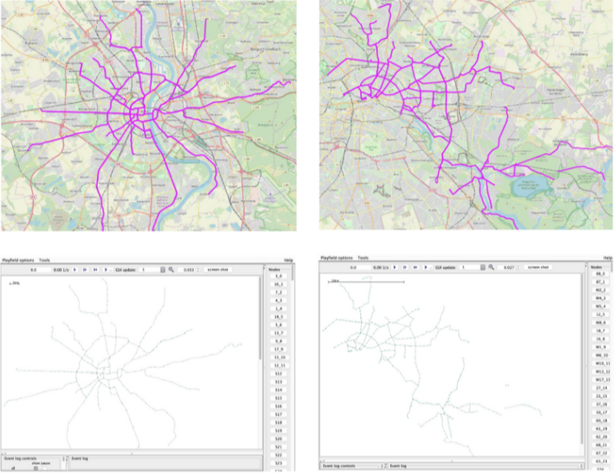
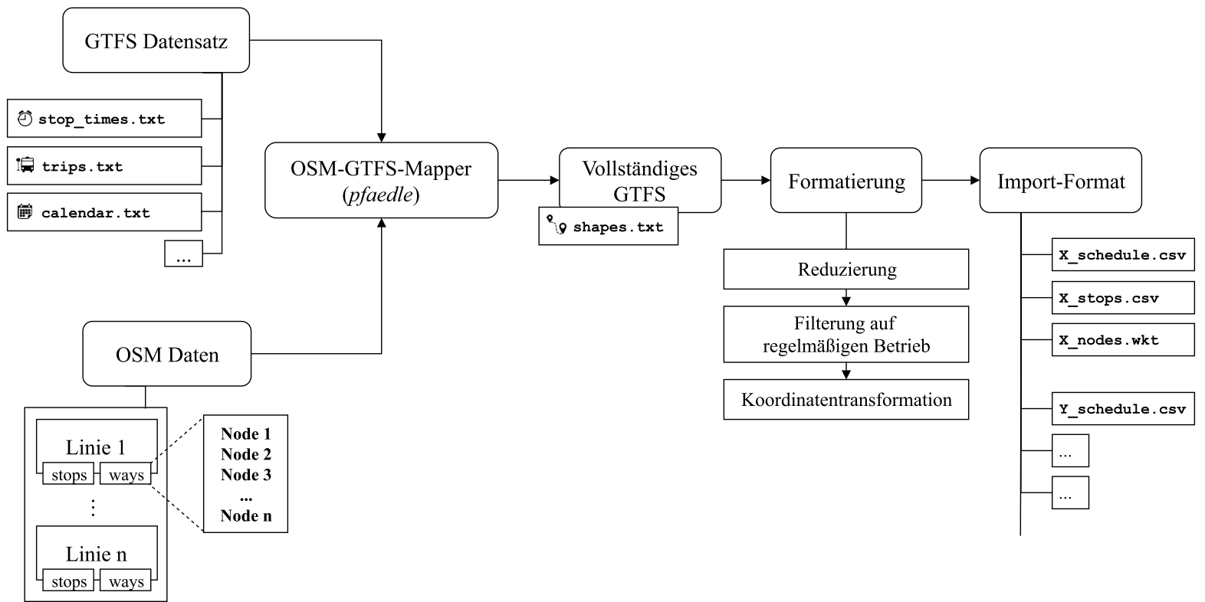
Adaptive Simulation for public transportation
Allow scenario adaptation at runtime
  How to define alternative schedules?
  How to integrate to the simulator?

Slide 2
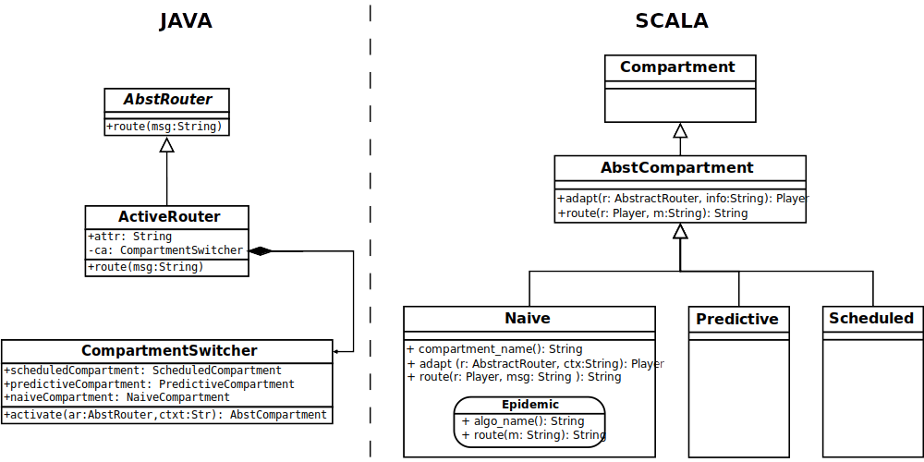
Performance assessment of DTN routing algorithms as Roles
Design routing algorithm as roles to be exchanged at run-time
  Some already provided by The-One
Compare the role-based approach to non-role based variant

Slide 3
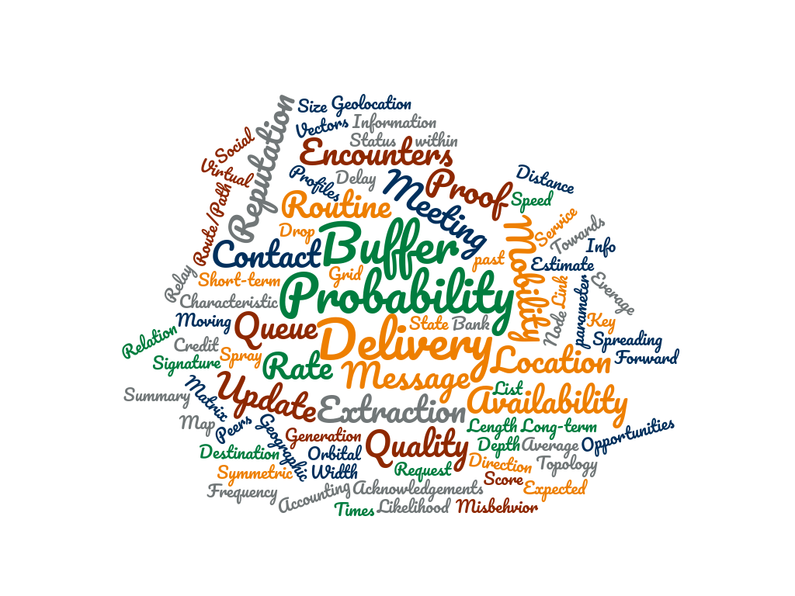


Metadata Exchange Trade-offs and Limits
Up to what granularity can metadata be exchanged at runtime?
How much is the overhead (network/storage) given different scenarios characteristics:
  Size
  Number of devices
  Density
  Speed

