Slide 1
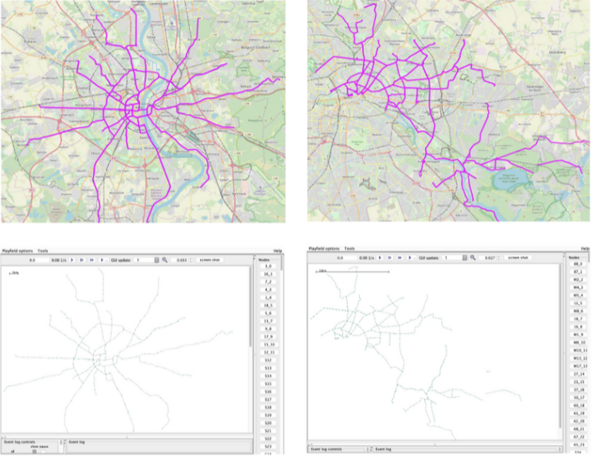
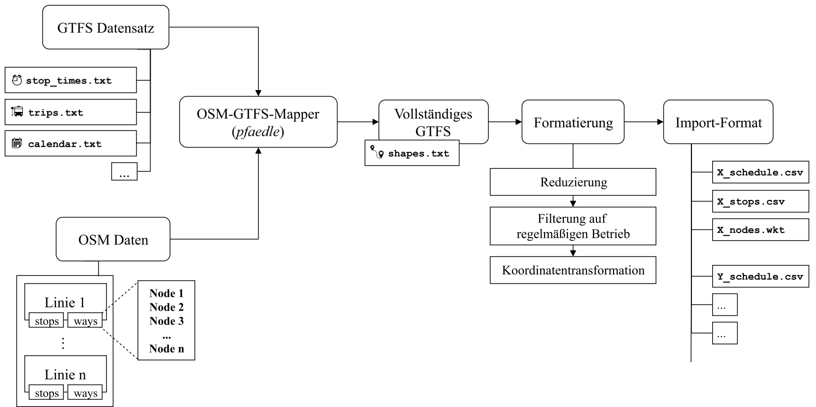
Adaptive Simulation for public transportation
Allow scenario adaptation at runtime
  How to define alternative schedules?
  How to integrate to the simulator?

Slide 2
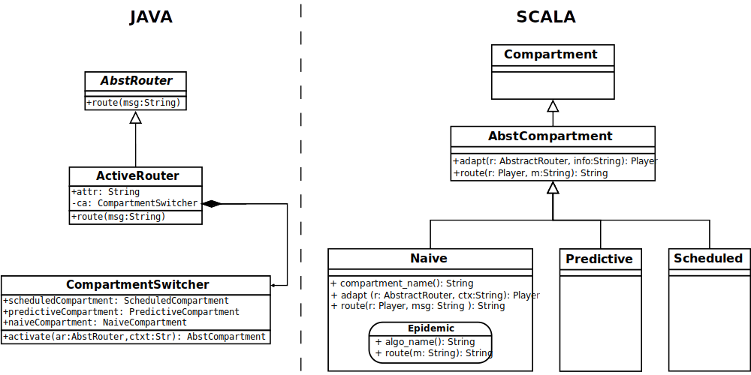
Performance assessment of DTN routing algorithms as Roles
Design routing algorithm as roles to be exchanged at run-time
  Possibly the same provided by The-One
Compare the role-based approach to non-role based variant

Slide 3
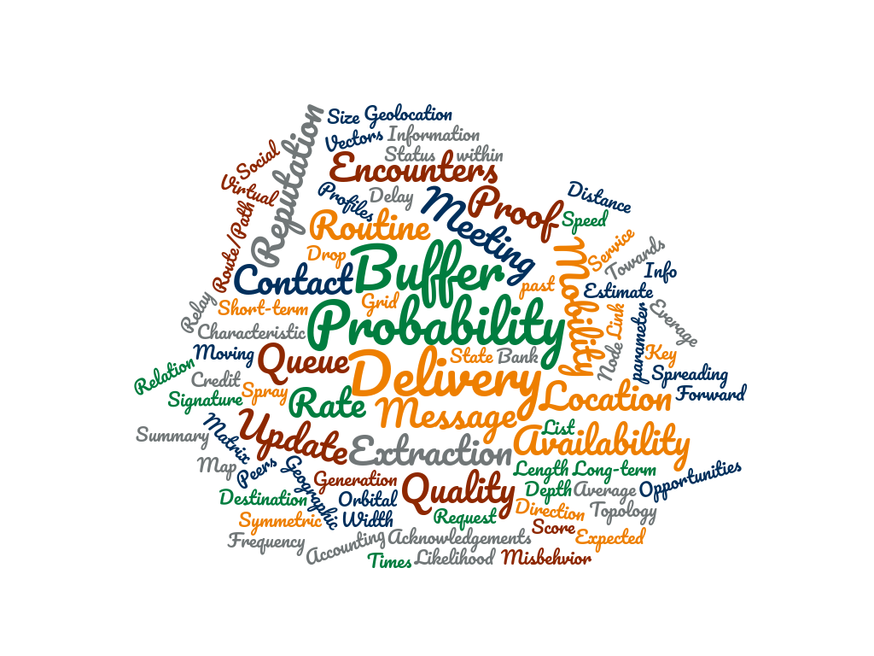


Metadata Exchange Trade-offs and Limits
Up to what granularity can metadata be exchanged at runtime?
How much is the overhead (network/storage) given different scenarios characteristics:
  Size
  Number of devices
  Density
  Speed

Slide 4
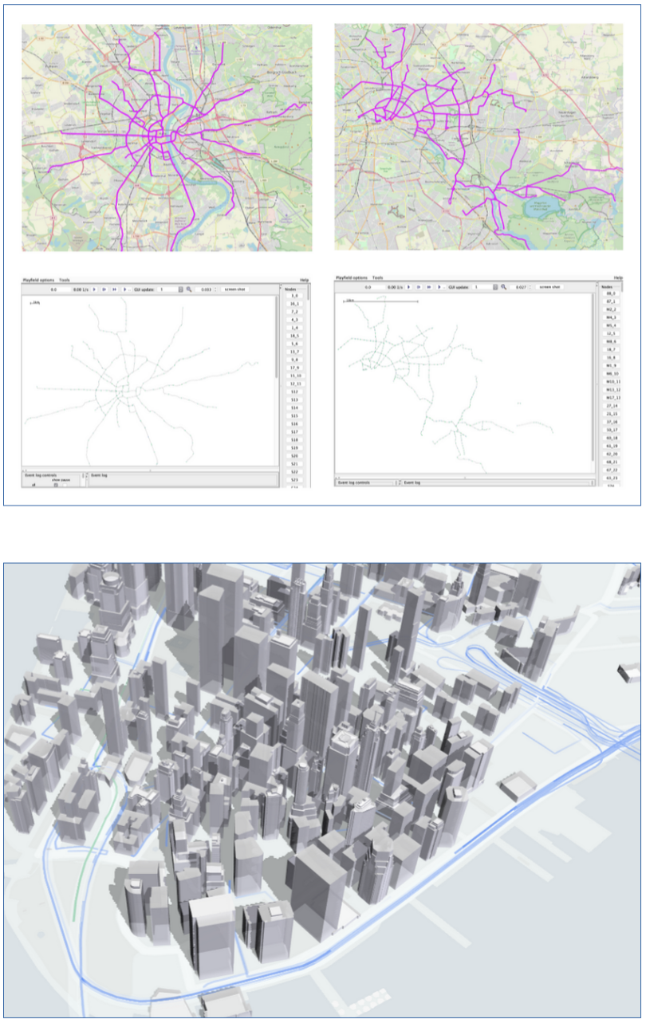
Simulation visualization
What are the best/possible ways to visualize and extract information from simulated runs
  Currently one get amount of message drops or delivery probability (general information)
  Interesting would be:
    heatmaps
    addicional information about what regions are affected by what issue
    Runtime visualization
      deck.gl / mapbox

Slide 5
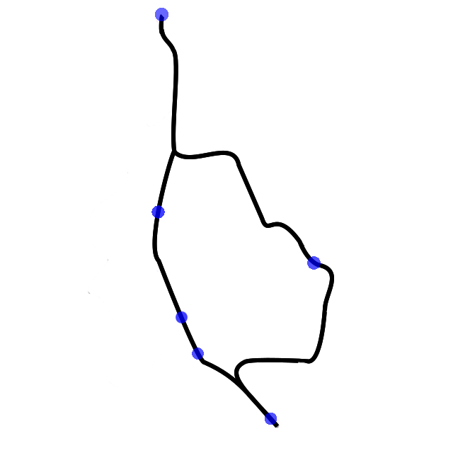

Auto parameterization for DTN protocols
Parameterization in ProPHET
DaSilva [2012] shows that an increase of 20% could be achieved defining the paramters of ProPHET depending on density for stochastic movement (movement in dartmouth campus)
Given a scheduled environment (bus traffic), automatic find out the best possible parameters for a given use-case
  Brute force / Machine learning
  Compare Performance to the default parameters
Device | Likelihood
90
95
100
Station 1 (s1)
Station 2 (s2)
Station 3 (s3)

