Slide 1


5th International Conference on Robotics and Machine Vision
Seoul, Korea
March 5-7, 2021
Transfer Learning Adaptive
Facial Attractiveness Assessment
Irina Lebedeva, Prof. Yi Guo, Dr. Fangli Ying
School of Information Science and Engineering
East China University of Science and Technology

Slide 2

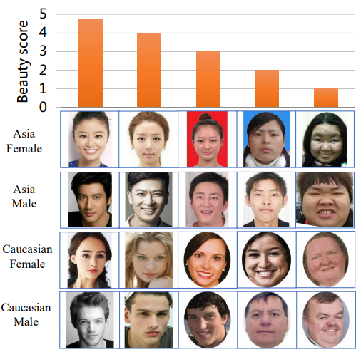
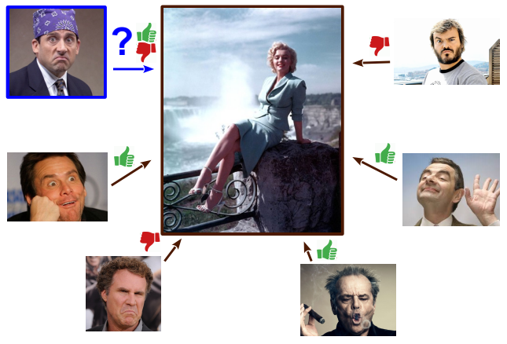
Introduction

Slide 3
Contributions
Transfer Learning combined with Support Vector Regression
was applied to Facial Beauty Prediction.
CNN specially designed and pre-trained for face recognition,
namely FaceNet, was exploited as a feature extractor.
The method was evaluated on face images captured in both
constrained and unconstrained environment.
Data preprocessing methods in various combinations
were demonstrated in order to find the most effective approaches
for both type of face images.





Slide 4
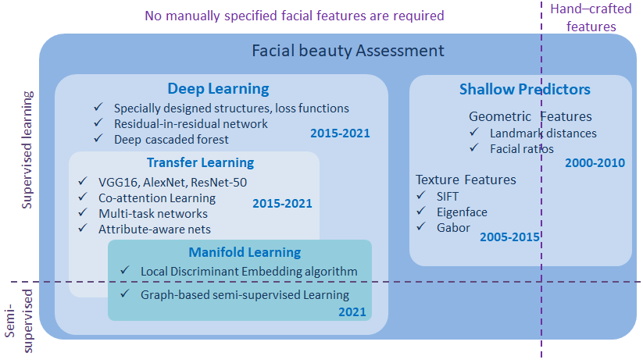
Background

Slide 5

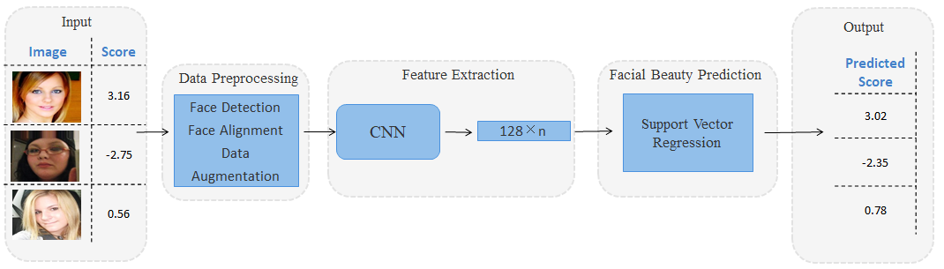
Method
Pipeline

Slide 6
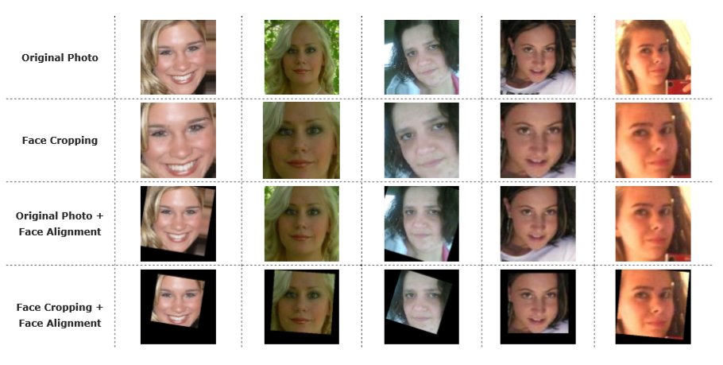
Preprocessing

Slide 7
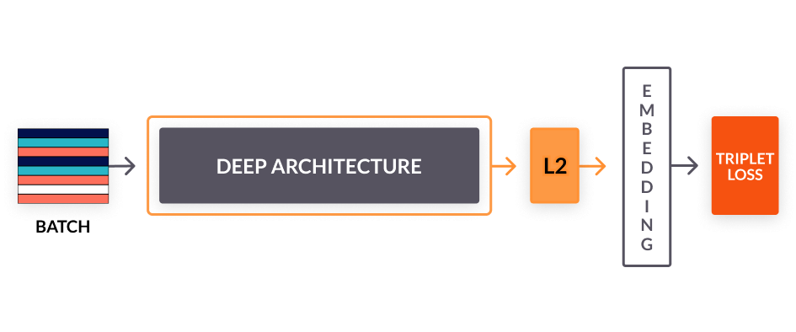
Feature Extractor
FaceNet

Slide 8
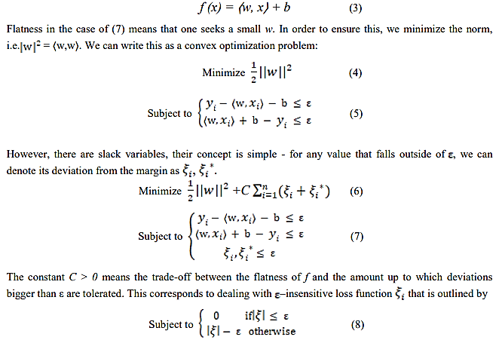
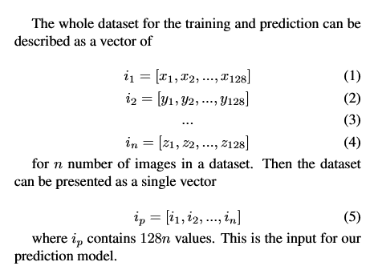
Prediction Model
Input
Support Vector Regression

Slide 9
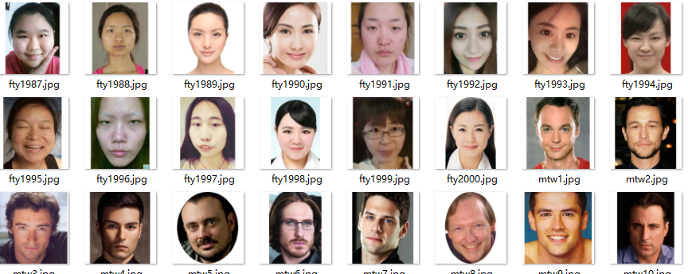
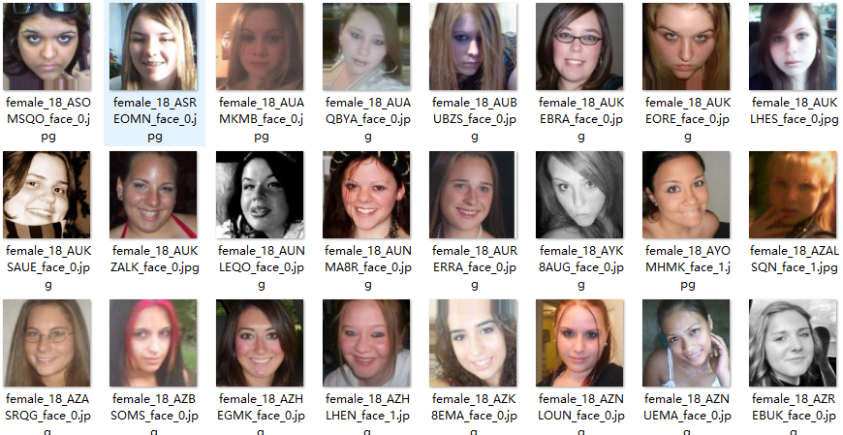
Datasets
SCUT-FBP 5500
HotOrNot
(Gray Dataset)

Slide 10
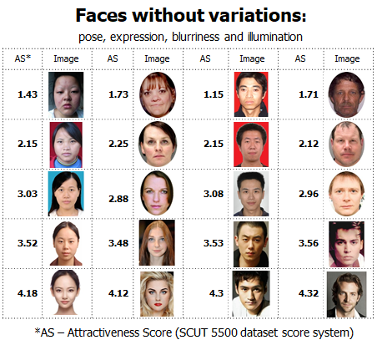
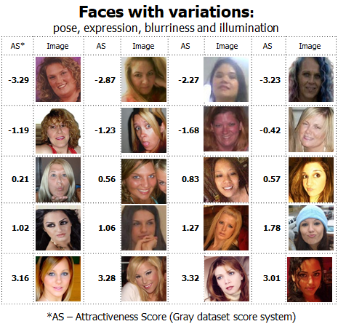
Images

Slide 11
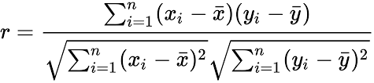
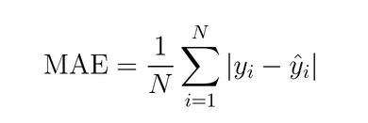
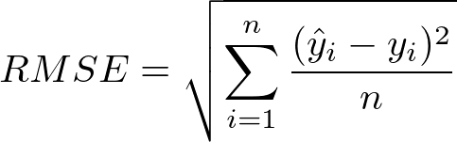
Metrics

Pearson Correlation
Mean Absolute Error
Root Mean Square Error



Slide 12
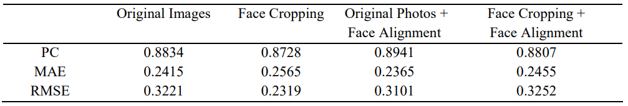
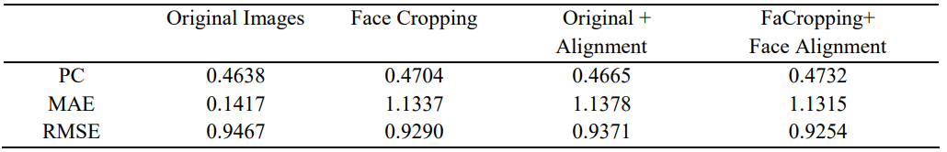
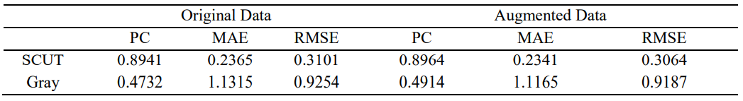
Results
The Method Results on SCUT-FBP 5500 Dataset
The Method Results on Gray Dataset
The Proposed Method with and without Data Augmentation

Slide 13
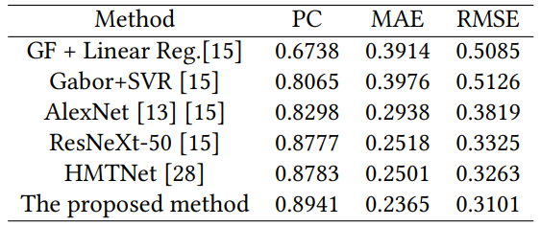
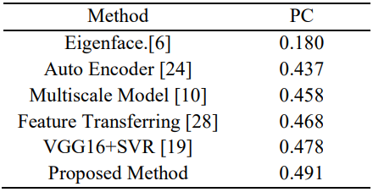
Comparison with the State-of-the-Art
Comparison with other
state-of-the-art approaches on
SCUT-FBP 5500 dataset
Performance comparison with
the related state-of-the-art works on
Gray dataset

Slide 14
Conclusion
Transfer learning, especially CNN pre-trained for Face Recognition
is an effective approach for Beauty Assessment.
The proposed method improves the facial beauty prediction state-of-the art on both face images in-the-wild and in constrained environment.
Image preprocessing in less critical for images in constrained environment.




Slide 15
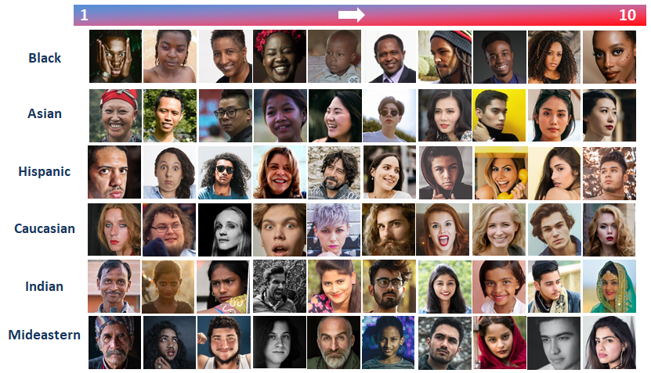
Future Works
Multi-ethnic dataset with face images in-the wild
FBP method effective on all ages, gender, ethnicities
in full pose and expression range
Personal beauty preferences
prediction, Visual
Recommender System
Personalized Facial Beauty
Enhancement





Slide 16

华东理工大学
East China University of Science and Technology
Thank you for you attention!
Q&A
Irina Lebedeva
irina.val.lebedeva@gmail.com
2021.03.06

