Slide 1
Recommendation Systems
Capstone project by irina amari
November 2021

Slide 2
Irina Amari - MS in Applied Mathematics - Experience in Sales, Marketing

Slide 3
Executive Summary
GOAL: to create Recommendation System of songs for users of a music platform.
PROBLEM STATEMENT: use available data about songs and song/user interaction to automate decision making process of recommending songs to:
* Increase customer satisfaction and engagement within the platform
* Achieve Company’s Goals: Increasing Revenue, Margin, Number of Loyal Customers, ROI, etc.
DATA: is very sparse. For 76k unique users, 10k unique songs -> only 2mln interactions (only 0.26% from all possible interactions).
POTENTIAL APPROACHES: 5 Potential Techniques were explored and estimated (Popularity-Based, Cosine Similarity CF, Matrix Factorization CF, Clustering, Content-Based). Non of them is ideal -> has limitations.
BEST APPROACH: Hybrid Method, combines Content Based (reduce sparsity, handles cold start problem, new items problem) and Matrix Factorization Collaborative Filtering (increases discoverability) . For new users – Popularity-Based approach.
APPROACH IMPLEMENTATION: Content-Based Filtering is used as an input for Matrix Factorization Algorithm.

Slide 4
Details of Problem Statement
BUSINESS PROBLEM: customers are overloaded with information -> help them filter relevant personalized information according to the strategy of the company.
DATA SCIENCE PROBLEM: to predict for any Target User, which Songs he will be ready to listen. Show N best recommendations for Target User. Test, which recommendation approach works best.
PROPOSED METHOD
IS INCREASING:
*engagement and
*discoverability
DATA COLLECTION: explicitly (ratings, feedback from the user, typing KWs) or implicitly (through order history, clicks, add to cart/list, number of times listened, etc,). I our case – only implicitly – number of times listened.
Users' info
Recommendation system
Recommendation for target user
User/items interactions
Items info
Notes:
Business Strategies: Strategies: 1. revenue, margin, ROI; 2. loyalty/engagement of customers; 3. average sales units, average sum of purchase, click through rate, conversion; 4. get rid of overstock/ discontinued items, launch new items, paid advertisement, etc…)

Slide 5
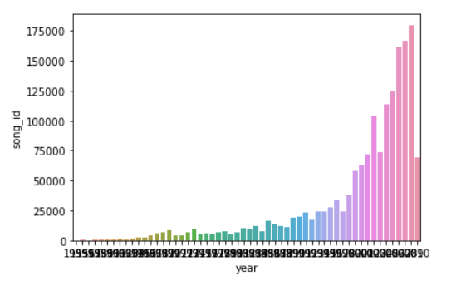
Data Insights
unique
“song_id”
AVAILABLE DATA:
SUMMARY STATISTICS:
76k unique songs, 10k unique users,
3.3k unique artists names, 5.4k unique releases.
75% of records belong to years from 1999 to 2010,
~11% belongs to 2009 – limited catalog coverage
~18% of data has missing year
( => 1. use external sources. 2. omit year)
Song Catalog
(title, artist, release, year)
Song/User Interactions
Merged
Database

Slide 6
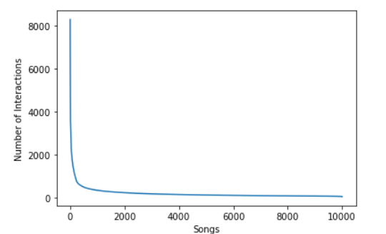
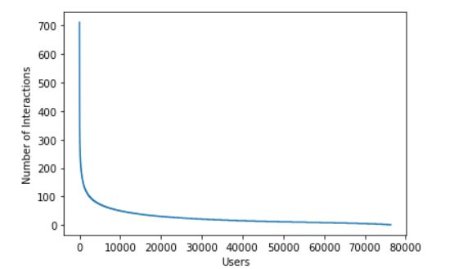
Data Insights
SPARSITY OF THE DATA: while exploring most popular songs and most active users: LONG TAIL PLOTS FOR SONGS AND USERS.
SONGS
Only a small number of songs have high interactions:
Only 24 songs have 3000 interactions or more.
Only 57 songs have 2000 interactions or more.
Most of the songs have very small interactions.
80% Of songs (from 2k to 10k) have 233 interactions in total or less.
USERS
The most active user interacted with only 711 songs (7% of all songs).
~1% (754 Unique users) interacted with only 158 to 711 songs (1.6%-7%)
~65% of unique users have interacted with 23 or less songs
(out of 10k unique songs – 0.2% out of all potential songs).
~10% of unique users have interacted with 5 or less songs
(out of 10 000 unique songs).

Slide 7
Potential Approaches: Qualitative Comparison
 | Requires | Requires items info (content observed features) | Requires users' info (demographic observed features) | Cold Start Problem |  | Sparsity-ok | Cost of Computation-ok | Scalability/ Time to Provide Recommendation | Quality of Recommendation | Novelty/ Diversity of Recommendation
 | User/Item Interaction Data | Items Info (Content Observed Features | Users’ Info (Demographic Observed Features) | New Items (Zero or not enough historical interactions) | New Users (Zero or not enough historical interactions) |  |  |  | Personalized | Novelty/ Diversity/ Discoverability
Popularity-Based | some data | - | - | - | + | + | + | + | - | -
Collaborative Filtering (User-User Cosine Similarity) | + | - | - | - | - | -/+ | - | +, only for small db | + | +
Collaborative Filtering (Matrix Factorization) | + | - | - | - | - | - | + | + | + | +
Clustering (by user/item interaction) | + | No (in our case) | No (in our case) | - | - | - | + | + | No (in our case) | No (in our case)
Content Based (by items) | some | + | - | + | - | + | + | + | + | lack of diversity
HYBRID (Content-Based-items + Matrix Factorization + Popularity-Based(for new users) | + | + | - | + | + | + | + | + | + | +

Slide 8
Potential Approaches: Quantitative Comparison
 | Precision |  |  |  | Recall
Number of Recommendations= | 10 | 20 | 30 | 40 | 10 | 20 | 30 | 40
Popularity-Based | 0.000 | 0.000 | 0.000 | 0.000 | 0.000 | 0.000 | 0.000 | 0.000
Collaborative User-User Cosine Similarity | 0.007 | 0.005 | 0.004 | 0.003 | 0.004 | 0.006 | 0.007 | 0.007
Matrix Factorization CF | 0.229 | 0.190 | 0.173 | 0.162 | 0.025 | 0.041 | 0.056 | 0.069
Content-Based | 0.050 | 0.046 | 0.044 | 0.041 | 0.031 | 0.057 | 0.080 | 0.102
HYBRID | 0.055 | 0.055 | 0.053 | 0.051 | 0.033 | 0.065 | 0.094 | 0.120

Slide 9
Best Approach - HYBRID
COMBINATION OF 3 APPROACHES
CONTENT-BASED FILTERING: We are using observed feature of Songs - TEXT. Applying TF-IDF keywords extraction technique. Calculating Cosine Similarity between all songs, based on extracted keywords. For Target User -> recommend K songs, most similar to what he was listened before.
* Doesn’t need user info, only some history of Target user interactions
* Solves Cold Start Problem for New Items; Reduces Sparsity
* Can create “information bubble”
MATRIX FACTORIZATION (SINGULAR VALUE DECOMPOSITION) COLLABORATIVE FILTERING:
* Uses interaction data between Songs and Users
* Creates personalized recommendations with possibility of discovery/exploration
* Solve “Information Bubble” Problem, offers discovery, exploration
POPULARITY-BASED METHOD:
* New users with Zero or not enough interaction history

Slide 10



Implementation of HYBRID Approach
L(${user}_{i};$ ${song}_{j}$) = $f_{observed features}({user}_{i};$ ${song}_{j}$) + $f_{latent features}(u_{i};$ $v_{j}$)
1 STEP: Content-Based Algorithm to our data -> to find function of observed features (KeyWords from song Metadata).
2 STEP: Matrix Factorization Algorithm to estimate the Difference.
3 STEP: Combine Estimations of $L_{ij}^{obs}$(observed features) and ${ L}_{ij}^{diff}$ (latent features).
$L_{ij}^{obs}$= $f_{observed features}({user}_{i};$ ${song}_{j}$)
$L_{ij}^{diff}= L_{ij}^{obs}$ - $L_{ij}^{obs}$
$L_{ij}^{PREDICTED}= L_{ij}^{obs}$ + $L_{ij}^{diff(ESTIMATION)}$

Slide 11
Implementation of HYBRID Approach
STEP 1
STEP 2
STEP 3
Song Catalog
Content-Based
(Song Text Features)
Estimate Part with Observed Features
Matrix Factorization
To estimate Latent Features of Data
COMBINE both Estimations in one PREDICTION
Merged Data
Song/ User Interactions
Estimation of the Algorithm
(Precision, Recall)
TESTING
Testing Set
80%
Training Set
20%

Slide 12
Testing of Recommendation Systems
DATASET
Training Set (80%)
Testing Set (20%)
Instead of 80/20 can be K-fold Cross-Validation
Same users, Same items
Interactions 80/20
Recommendation System MODEL Training
FINAL PREDICTIVE MODEL
(PREDICTIONS)
User1: S11-p, S12-p, S13-p, …
User2: S21-p, S22-p, S23-p, …
…
K RECOMMENDATIONS
Actual Songs from Testing Set Listened to the Users
User1: S11, S12, S13, …
User2: S21, S22, S23, …
…
Estimation of the Algorithm
Precision, Recall measured by user
Average Precision @K
Average Recall @K

Slide 13


Precision/Recall @K: Example
FOR TARGET USER
K=5 Recommendations
True Positive | True Positive | True Positive | False Positive | False Positive
Predicted Recommendation of K Songs
K=5
True Positive | True Positive | True Positive
Actual
Songs
N=10
PRECISION @K =$\frac{Number of TRUE POSITIVES}{K −Number of Recommended Items}$
$$\frac{3}{5}$$
RECALL @K =$\frac{Number of TRUE POSITIVES}{N −Number of all Relevant Items }$
$$\frac{3}{10}$$

Slide 14
Recommendations
SUGGESTION FROM THE BUSINESS POINT OF VIEW:
Determine Ecommerce Goals of the Company => Adjust Recommender System to the Goals.
A/B testing. Also determine which types of users do we use it for.
Optimization of algorithm for different strategies/different users.
Collect Any Available Data -> Input for RS for more Relevant/ Personalized recommendations.
Define budget, architecture and legal aspects of storage and collecting the data.
EXPECTED BENEFITS:
Increase customer satisfaction -> more traffic/ more time on the platform -> more interaction.
Increase average order value, number of items per purchase -> overall sales volume.
Personalization.
Transform browsers to loyal customers.
Possibility to target different groups of customers, one-to-one marketing .

Slide 15
Recommendations
COSTS, POTENTIAL CHALLENGES:
Cost of storing potential information and processing the data.
Updating algorithm depending on the data available.
System update frequency (near real time, once a day/week/month).
Legal issues.
Privacy concerns.
Ethical problems of influencing customers through recommendations.
FUTHER RESEACH and IMPROVEMENT
1. A/B testing.
2. The problem presented had no user data. Collect user data -> can do Content-Based filtering or Clustering by user.
3. For testing Data: random split into 80/20 training and testing sets -> can do k-fold Cross-Validation.
4. This database had data only about number of interaction times. If we have other measurements (ratings, clicks,r eviews, etc.) we can make solution more complex -> use multi-dimensional matrices (tensors).
5. The data is static in this problem. If we can measure data through time intervals -> can do Matrix estimation on Time Series

Slide 16
Conclusion
MODEL CAN BE IMPLEMENTED IN Any Area of ECOMMERCE
THE BEST POSSIBLE APPROACH - Hybrid: combination of different techniques.
THE MORE DATA – THE BETTER:
* About users
* About items
* Different types of interactions (ratings, clicks, number of times, etc.)
* System can be fine tuned.

