Slide 1
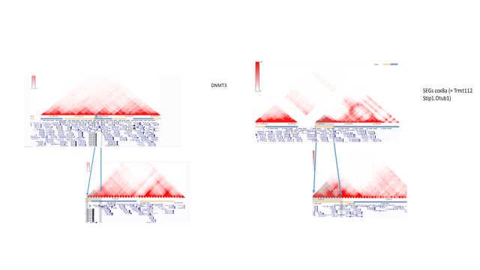
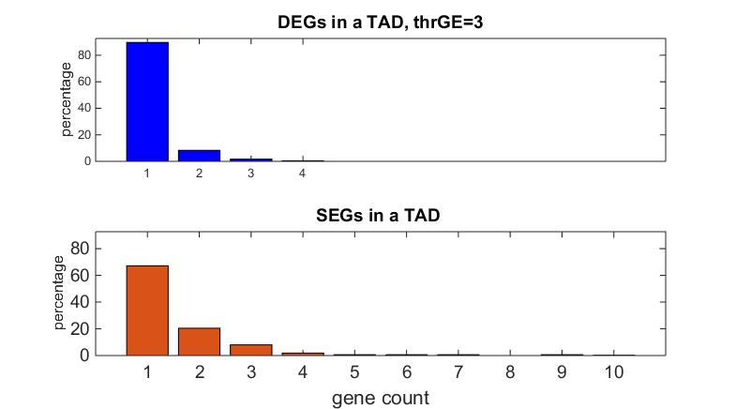
SEGs share same TAD more often than DEGs
A
Distribution of gene counts in a TAD: DEG vs SEG
B

Slide 3
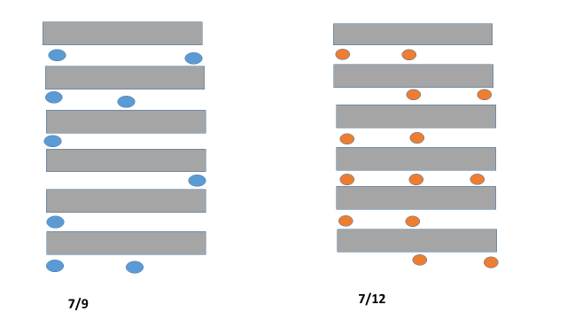
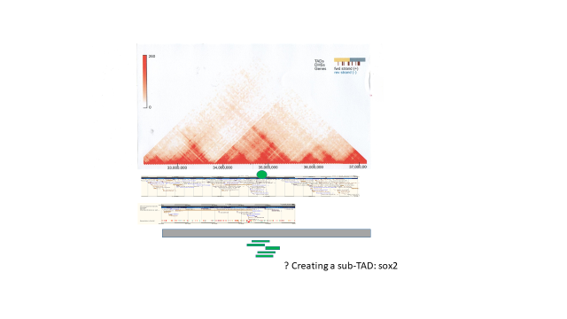
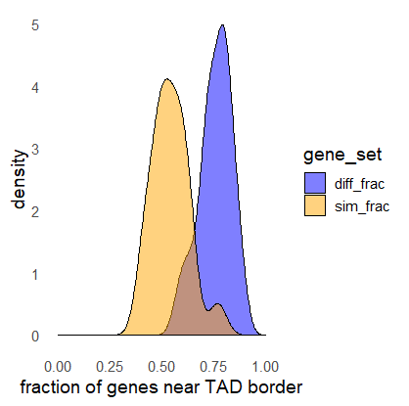
C
DEGs and SEGs relative TADs borders
D

Slide 4
SEGs share same TAD more often than DEGs
A
B
Given set of TAD, DEGs and SEGs, compute
Number/fraction of DEG SEG genes for each TAD:

Slide 6
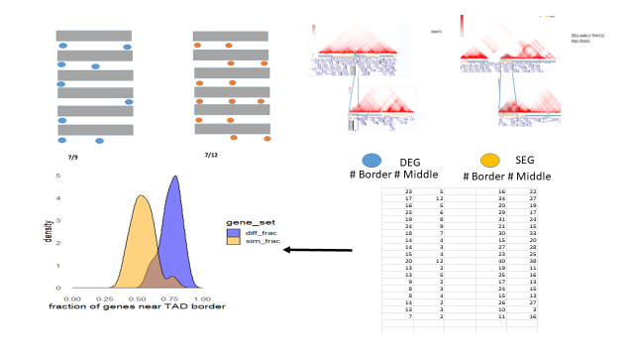
A
B
D
C

