Slide 1
SORTARI
Enescu Irina Stefania
Grupa 133

Slide 2
Tipuri de sortari implementate
Python Sort – sortare predefinita (Tim Sort)
Counting Sort
Radix sort (cu baza 10, cu baza 2, baza 2⁸ si cu baza 2¹⁶)
Shell Sort (cu secvente impartite in 2 si 10)
Quick Sort (cu pivotul ultimul element si mediana din trei)
Merge Sort
Observatie! Datele din tabel sunt calculate pe baza numarului de elemente care trebuie sortate (mov), numerele fiind generate automat, random si celui mai mare numar care poate fi generat (alb). Acestea reprezinta timpii de rulare.

Slide 3
PYTHON – SORTARE PREDEFINITA
 | 10 | 10² | 10³ | 10⁴ | 10⁵ | 10⁶ | 10⁷ | 10⁸
10 | 0.0 s | 0.0 s | 0.0 s | 0.000999 s | 0.008002 s | 0.084987 s | 0.823636 s | 8.845091 s
10² | 0.0 s | 0.0 s | 0.0 s | 0.001998 s | 0.012003 s | 0.110018 s | 1.17298 s | 12.33223 s
10³ | 0.0 s | 0.0 s | 0.001003 s | 0.001998 s | 0.015004 s | 0.164003 s | 1.823999 s | 35.89435 s
10⁴ | 0.0 s | 0.0 s | 0.001001 s | 0.001000 s | 0.029011 s | 0.246004 s | 2.727001 s | 32.71949 s
10⁵ | 0.0 s | 0.0 s | 0.000999 s | 0.002000 s | 0.019001 s | 0.298003 s | 3.815035 s | 53.51286 s
10⁶ | 0.0 s | 0.0 s | 0.001000 s | 0.002000 s | 0.019001 s | 0.301988 s | 4.412701 s | 74.21095 s
10⁷ | 0.0 s | 0.0 s | 0.000999 s | 0.000999 s | 0.019020 s | 0.299999 s | 4.507581 s | 83.89178 s
10⁸ | 0.0 s | 0.0 s | 0.001000 s | 0.002002 s | 0.019997 s | 0.303013 s | 4.487124 s | 77.30881 s

Slide 4
PYTHON – SORTARE PREDEFINITA
Observam ca odata cu cresterea numarului de elemente si cu cresterea maximului, cresc si timpii de rulare.
Diferentele dintre timpii de rulare pentru acelasi numar de elemente, dar cu maxim diferit sunt relativ mici pentru valori mici.

Slide 5
COUNTING SORT
 | 10 | 10² | 10³ | 10⁴ | 10⁵ | 10⁶ | 10⁷ | 10⁸
10 | 0.0 s | 0.0 s | 0.0 s | 0.004992 s | 0.056999 s | 0.436025 s | 3.88184 s | 38.66556 s
10² | 0.0 s | 0.001001 s | 0.001999 s | 0.021004 s | 0.158022 s | 1.626016 s | 15.67614 s
10³ | 0.0 s | 0.000995 s | 0.014001 s | 0.137001 s | 1.389008 s | 14.13526 s | 140.5477 s
10⁴ | 0.002994 s | 0.014992 s | 0.137023 s | 1.344999 s | 14.16201 s | 136.1437 s
10⁵ | 0.051995 s | 0.152024 s | 1.392983 s | 13.89495 s | 134.9139 s
10⁶ | 0.429025 s | 1.603982 s | 13.74300 s | 130.4229 s
10⁷ | 3.266975 s | 15.78301 s | 131.9456 s
10⁸ | 30.429 s | 152.4660 s

Slide 6
COUNTING SORT
Observam ca odata cu cresterea numarului de elemente si cu cresterea maximului, cresc si timpii de rulare foarte mult.
Diferentele dintre timpii de rulare pentru acelasi numar de elemente, dar cu maxim diferit sunt foarte mari chiar si pentru valori relativ mici, dar pentru valori si mai mari.

Slide 7
Radix sort (baza 10)
 | 10 | 10² | 10³ | 10⁴ | 10⁵ | 10⁶ | 10⁷ | 10⁸
10 | 0.0 s | 0.0 s | 0.000995 s | 0.005001 s | 0.050022 s | 0.477982 s | 4.527994 s
10² | 0.0 s | 0.0 s | 0.002 s | 0.009 s | 0.09 s | 0.941478 s | 8.811442 s
10³ | 0.0 s | 0.0 s | 0.000998 s | 0.015999 s | 0.152998 s | 1.558776 s | 14.98846 s
10⁴ | 0.0 s | 0.0 s | 0.001996 s | 0.020001 s | 0.219022 s | 2.738017 s | 19.39943 s
10⁵ | 0.0 s | 0.000997 s | 0.001998 s | 0.020975 s | 0.236022 s | 2.922266 s | 25.99021 s
10⁶ | 0.0 s | 0.0 s | 0.001999 s | 0.048003 s | 0.292019 s | 3.281409 s | 29.94621 s
10⁷ | 0.0 s | 0.0 s | 0.005996 s | 0.044974 s | 0.33303 s | 3.62398 s | 34.64791 s
10⁸ | 0.001 s | 0.001001 s | 0.003 s | 0.038001 s | 0.367008 s | 6.176559 s | 42.02037 s

Slide 8
Radix sort (baza 2)
 | 10 | 10² | 10³ | 10⁴ | 10⁵ | 10⁶ | 10⁷ | 10⁸
10 | 0.0 s | 0.0 s | 0.001996 s | 0.019001 s | 0.171997 s | 1.857077 s | 20.28343 s | 183.6373 s
10² | 0.0 s | 0.0 s | 0.004 s | 0.03 s | 0.357999 s | 3.299995 s | 33.02238 s
10³ | 0.0 s | 0.000997 s | 0.004998 s | 0.042976 s | 0.495008 s | 5.119043 s | 49.64400 s
10⁴ | 0.0 s | 0.142 s | 0.005999 s | 0.066006 s | 0.816009 s | 7.306526 s | 77.23461 s
10⁵ | 0.0 s | 0.025005 s | 0.006997 s | 0.085014 s | 0.818018 s | 8.390724 s | 84.33582 s
10⁶ | 0.0 s | 0.001004 s | 0.010995 s | 0.084976 s | 1.011977 s | 10.11050 s
10⁷ | 0.000995 s | 0.002002 s | 0.010997 s | 0.117983 s | 1.189977 s | 12.15266 s
10⁸ | 0.0 s | 0.001998 s | 0.009999 s | 0.135997 s | 1.318022 s | 13.46509 s

Slide 9
Radix sort (baza 2⁸)
 | 10 | 10² | 10³ | 10⁴ | 10⁵ | 10⁶ | 10⁷ | 10⁸
10 | 0.0 s | 0.0 s | 0.001 s | 0.004 s | 0.049 s | 0.440999 s | 4.588997 s | 49.25334 s
10² | 0.0 s | 0.0 s | 0.001 s | 0.008002 s | 0.091009 s | 0.91348 s | 9.237066 s
10³ | 0.0 s | 0.0 s | 0.001999 s | 0.012001 s | 0.130989 s | 1.608972 s | 16.61500 s
10⁴ | 0.0 s | 0.0 s | 0.002002 s | 0.017002 s | 0.190428 s | 2.030998 s | 20.62658 s
10⁵ | 0.0 s | 0.0 s | 0.001999 s | 0.02 s | 0.24435 s | 2.54498 s | 25.98809 s
10⁶ | 0.0 s | 0.0 s | 0.001999 s | 0.025003 s | 0.291002 s | 3.005236 s | 31.03997 s
10⁷ | 0.0 s | 0.0 s | 0.004 s | 0.03 s | 0.35302 s | 3.569419 s | 38.28324 s
10⁸ | 0.0 s | 0.0 s | 0.002999 s | 0.06 s | 0.385982 s | 4.073175 s | 40.65020 s

Slide 10
Radix sort (baza 2¹⁶)
 | 10 | 10² | 10³ | 10⁴ | 10⁵ | 10⁶ | 10⁷ | 10⁸
10 | 0.0 s | 0.0 s | 0.0 s | 0.005001 s | 0.048022 s | 0.510005 s | 4.586060 s
10² | 0.0 s | 0.0 s | 0.001998 s | 0.007999 s | 0.087023 s | 0.923023 s | 9.459978 s
10³ | 0.0 s | 0.0 s | 0.000998 s | 0.015002 s | 0.142982 s | 1.658016 s | 15.43158 s
10⁴ | 0.0 s | 0.0 s | 0.002002 s | 0.027997 s | 0.200969 s | 2.084011 s | 20.69903 s
10⁵ | 0.0 s | 0.0 s | 0.001998 s | 0.018998 s | 0.193025 s | 2.041024 s | 19.53907 s
10⁶ | 0.0 s | 0.0 s | 0.002999 s | 0.020998 s | 0.228001 s | 2.503585 s | 23.92461 s
10⁷ | 0.0 s | 0.0 s | 0.002999 s | 0.026025 s | 0.28599 s | 3.025994 s | 29.18582 s
10⁸ | 0.0 s | 0.0 s | 0.005001 s | 0.03198 s | 0.335917 s | 3.553986 s | 36.40142 s

Slide 11
RADIX SORT – ANALiza baze
Observam ca Radix Sort cu baza 10, cu baza 2⁸ si cu baza 2¹⁶ au timpi de rulare apropiati. Cu toate acestea, Radix Sort cu baza 2¹⁶ pare cel mai rapid. Acest algoritm se poate implementa si cu operatii de shiftare pe biti.
Odata cu cresterea numarului de elemente si cu cresterea maximului, cresc si timpii de rulare pentru toti algoritmii Radix Sort.

Slide 12
SHELL SORT (Secvente impartite la 2)
 | 10 | 10² | 10³ | 10⁴ | 10⁵ | 10⁶ | 10⁷ | 10⁸
10 | 0.0 s | 0.0 s | 0.000996 s | 0.020004 s | 0.133023 s | 1.617989 s | 19.97416 s | 242.9119 s
10² | 0.0 s | 0.0 s | 0.001004 s | 0.011996 s | 0.142998 s | 1.643005 s | 19.53543 s | 251.1182 s
10³ | 0.0 s | 0.0 s | 0.001001 s | 0.017999 s | 0.153977 s | 1.76302 s | 20.43416 s | 257.5039 s
10⁴ | 0.0 s | 0.0 s | 0.0 s | 0.015007 s | 0.140021 s | 1.790421 s | 21.47777 s | 266.4759 s
10⁵ | 0.0 s | 0.0 s | 0.000997 s | 0.018013 s | 0.145991 s | 1.950495 s | 21.43550 s | 409.3443 s
10⁶ | 0.0 s | 0.0 s | 0.000997 s | 0.014025 s | 0.151994 s | 1.878165 s | 21.62024 s
10⁷ | 0.0 s | 0.0 s | 0.0 s | 0.013997 s | 0.14102 s | 1.684001 s | 21.48826 s
10⁸ | 0.0 s | 0.0 s | 0.002002 s | 0.011002 s | 0.144974 s | 1.732022 s | 21.62731 s

Slide 13
SHELL SORT (Secvente impartite la 10)
 | 10 | 10² | 10³ | 10⁴ | 10⁵ | 10⁶ | 10⁷ | 10⁸
10 | 0.0 s | 0.0 s | 0.000997 s | 0.005 s | 0.049 s | 0.579997 s | 7.196911 s | 75.23582 s
10² | 0.0 s | 0.0 s | 0.0 s | 0.003995 s | 0.058002 s | 0.631017 s | 6.696003 s | 79.86523 s
10³ | 0.0 s | 0.0 s | 0.0 s | 0.004999 s | 0.050004 s | 0.650999 s | 7.573008 s | 83.07631 s
10⁴ | 0.0 s | 0.0 s | 0.0 s | 0.004996 s | 0.05 s | 0.664999 s | 7.315013 s | 88.69369 s
10⁵ | 0.0 s | 0.0 s | 0.001003 s | 0.004999 s | 0.049015 s | 0.596996 s | 7.158249 s | 91.83438 s
10⁶ | 0.0 s | 0.0 s | 0.000999 s | 0.004001 s | 0.046 s | 0.773017 s | 6.669014 s | 80.95689 s
10⁷ | 0.0 s | 0.0 s | 0.0 s | 0.004002 s | 0.049002 s | 0.592994 s | 6.915203 s | 80.33124 s
10⁸ | 0.0 s | 0.0 s | 0.0 s | 0.003996 s | 0.062003 s | 0.662978 s | 6.776005 s | 81.80358 s

Slide 14
SHELL SORT – ANALiza IMPARTIRI
Observam ca daca impartirea se realizeaza la un numar mai mare, algoritmul este mai eficient si timpul de rulare este mai mic. Acest lucru se observa foarte bine in cazul in care avem 10⁸ elemente cu maximul 10: pentru Shell Sort (2) timpul de rulare este 242.9119 s, in timp ce Shell Sort (10) sorteaza in 75.23582 s.

Slide 15
Shell sort – observatie
Observam (mai ales in cazul N = 100000000) ca timpul de rulare este in crestere pana la maxim = 100000, iar apoi acesta incepe sa scada.

Slide 16
MERGE SORT
 | 10 | 10² | 10³ | 10⁴ | 10⁵ | 10⁶ | 10⁷ | 10⁸
10 | 0.0 s | 0.0 s | 0.003997 s | 0.036996 s | 0.460021 s | 6.459963 s | 65.16255 s
10² | 0.0 s | 0.0 s | 0.004002 s | 0.034998 s | 0.477 s | 6.66069 s | 67.05497 s
10³ | 0.0 s | 0.0 s | 0.003996 s | 0.035 s | 0.502024 s | 6.656906 s | 77.99634 s
10⁴ | 0.0 s | 0.0 s | 0.002999 s | 0.039025 s | 0.485023 s | 6.262549 s | 74.90290 s
10⁵ | 0.0 s | 0.0 s | 0.003006 s | 0.044999 s | 0.497022 s | 6.625016 s | 74.57346 s
10⁶ | 0.0 s | 0.0 s | 0.002999 s | 0.036977 s | 0.517973 s | 6.473806 s | 75.46189 s
10⁷ | 0.0 s | 0.0 s | 0.003992 s | 0.037024 s | 0.475975 s | 6.685985 s | 78.24316 s
10⁸ | 0.0 s | 0.001 s | 0.004002 s | 0.03998 s | 0.514018 s | 6.515384 s | 83.6076 s

Slide 17
QUICK SORT (PIVot – ultimul element)
 | 10 | 10² | 10³ | 10⁴ | 10⁵ | 10⁶ | 10⁷ | 10⁸
10 | 0.0 s | 0.0 s | 0.002001 s | - | - | - | - | -
10² | 0.0 s | 0.0 s | 0.002 s | - | - | - | - | -
10³ | 0.0 s | 0.0 s | 0.002002 s | - | - | - | - | -
10⁴ | 0.0 s | 0.0 s | 0.001998 s | - | - | - | - | -
10⁵ | 0.0 s | 0.0 s | 0.001003 s | - | - | - | - | -
10⁶ | 0.0 s | 0.0 s | 0.000999 s | - | - | - | - | -
10⁷ | 0.0 s | 0.0 s | 0.002002 s | - | - | - | - | -
10⁸ | 0.0 s | 0.0 s | 0.001 s | - | - | - | - | -

Slide 18
QUICK SORT (PIVot – mediana din 3)
 | 10 | 10² | 10³ | 10⁴ | 10⁵ | 10⁶ | 10⁷ | 10⁸
10 | 0.0 s | 0.0 s | 0.002 s | - | - | - | - | -
10² | 0.0 s | 0.0 s | 0.001001 s | - | - | - | - | -
10³ | 0.0 s | 0.0 s | 0.002 s | - | - | - | - | -
10⁴ | 0.0 s | 0.0 s | 0.000999 s | - | - | - | - | -
10⁵ | 0.0 s | 0.0 s | 0.001 s | - | - | - | - | -
10⁶ | 0.0 s | 0.0 s | 0.002 s | - | - | - | - | -
10⁷ | 0.0 s | 0.0 s | 0.001004 s | - | - | - | - | -
10⁸ | 0.0 s | 0.0 s | 0.001997 s | - | - | - | - | -

Slide 19
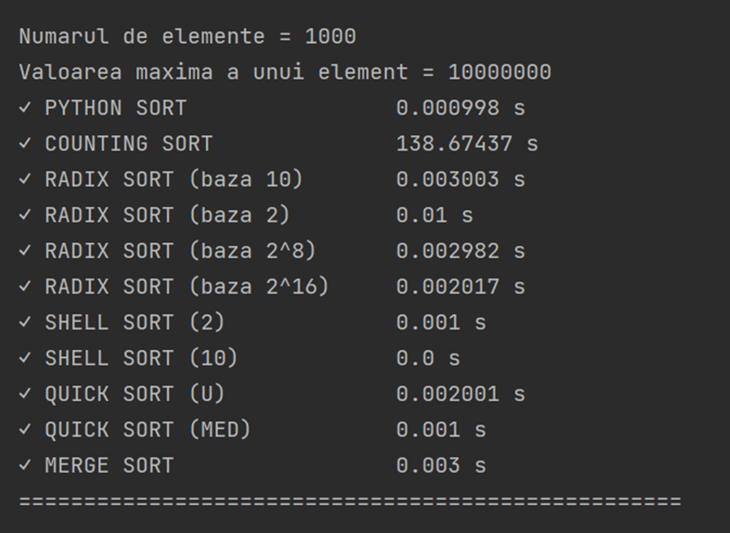
TESt 1
Pe acest test pot rula toti algoritmii.
Observam ca programul care ruleaza cel mai greu este Counting Sort.
Pentru a face o comparatie corecta intre ceilalti algoritmi, rulam un test fara Counting Sort si Quick Sort.

Slide 20
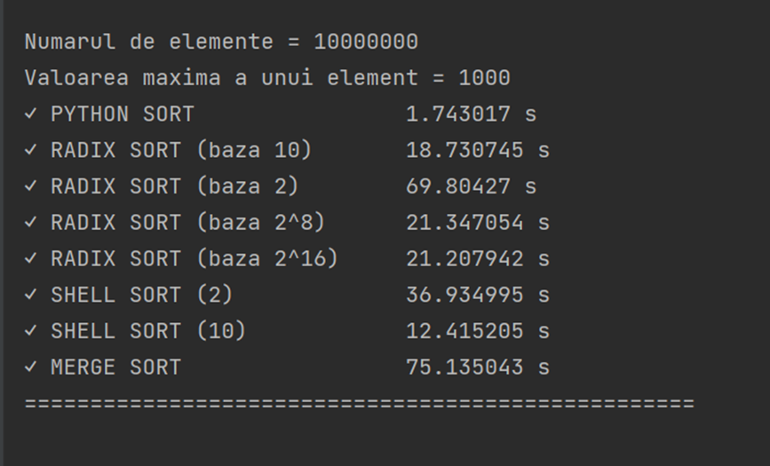
TEST 2

Slide 21
Clasament (cei mai rapizi … cei mai lenti)
PYTHON SORT
SHELL SORT (10)
RADIX SORT (10)
RADIX SORT (2^16)
RADIX SORT (2^8)
SHELL SORT (2)
RADIX SORT (2)
MERGE SORT
COUNTING SORT

