Slide 1





Data Platform Architecture
Full-snapshot ingestion • Historical tracking in Silver • Business-ready Gold KPIs
Bronze
Silver
Gold
Ingestion
CSV Snapshots
Full snapshot of active listings (can run multiple times/day)
snapshot_ts derived from filename (YYYY_MM_DD_HHMMSS)
Loaded via Stage + COPY INTO
Reporting
BI Dashboards (region, property type, channel)
Ad-hoc SQL by analysts
Stable inputs
Raw tables
Immutable raw tables (no updates, no deletes)
Snapshot + ingestion metadata for lineage
Enables deterministic reprocessing
Curated & historical
Listings modeled as SCD Type 2 dimension (is_current, is_active, effective from / to)
Leads modeled as fact events (one row per contact)
Data quality enforced (invalid leads quarantined)
Business Ready
Active only listings and leads
Clean joins, no invalid references
Precomputed KPIs / Marts
Design Principles
Full snapshots, not partial updates
Raw data is never changed
History is kept, nothing is overwritten
Only validated data reaches reporting

Slide 2
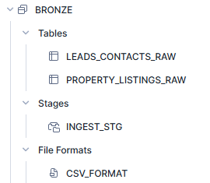
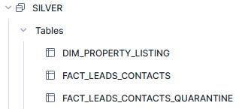
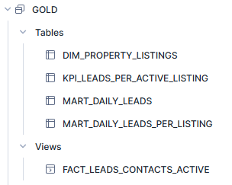
Data Model & Key Tables - COMPUTATION
SCD2 historical dimension for listings; tracks attribute changes over time and flags current vs inactive listings (is_current, is_active, effective dates)
Raw lead/contact events as received (append-only), stored with snapshot + ingestion metadata for traceability.
Raw snapshot ingestion of listings (append-only) including snapshot_ts, file_name, ingested_at for lineage
Cleaned lead events fact table (1 row per lead), deduped by contact_id, standardized sources and timestamp
Stage for CSV files
File format for CSV
Rejected leads that fail validation (e.g., listing_id not found); used for monitoring, audit, and upstream fixes.
Current active listings only (safe dimension for analytics and joins).
Business KPI mart: leads per active listing, aggregated by region and property_type for performance comparisons.
Daily aggregated leads by date, region, property type, and contact source; optimized for BI dashboards and trend analysis.
Daily KPI mart calculating leads per active listing, used to track performance trends over time by region and property type.
Valid leads linked to active listings only (prevents KPI pollution).

Slide 3
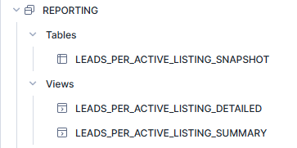
Data Model & Key Tables - CONSUMPTION
Point-in-time snapshot of the “Leads per Active Listing” KPI, stored as a table for stable reporting and historical comparisons.
Why it exists
Ensures consistent numbers for reports
Protects dashboards from upstream changes
Useful for exports and month-end reporting
aviv.gold.kpi_leads_per_active_listing
Detailed view of the KPI with additional breakdowns (e.g. date, source), used for deeper analysis and drill-downs.
Typical use
Analysts exploring trends
Root-cause analysis
aviv.gold.mart_daily_leads_per_listing
Aggregated view of leads per active listing by region and property type, used for high-level dashboards.
Typical use
Executive or product-level reporting
Compare regions and property types
aviv.gold.kpi_leads_per_active_listing

Slide 4
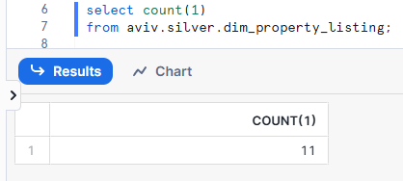
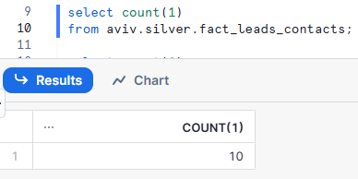

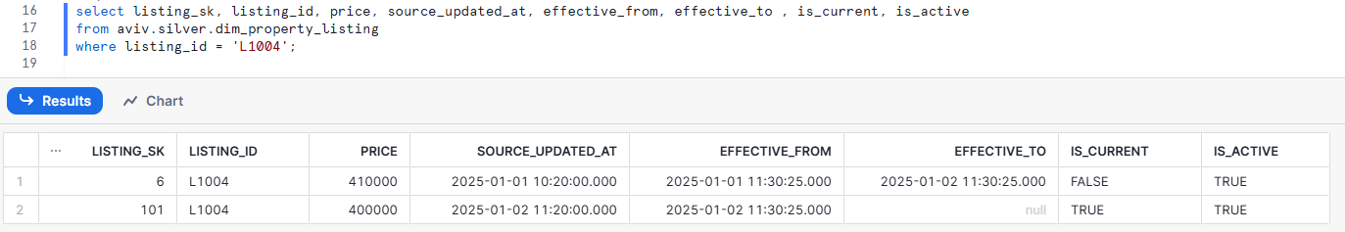
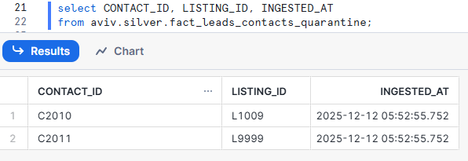
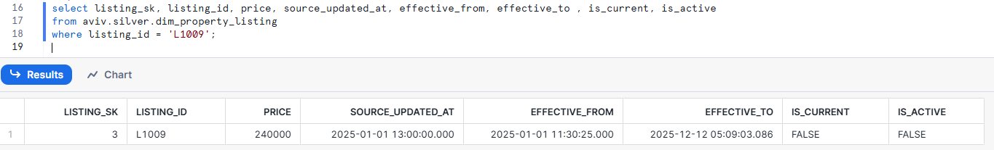
Data Model & Key Tables – SCD Type 2
Property listings
(DIM)
Leads
(FACT)
SCD2 Type – data updated
Data Quality
SCD2 Type – data removed from bronze

