Slide 1
iOS Development Webinar
April 25, 2022

Slide 2
Contents
1. Introduction
Swift, Objective-C History.
2. Swift Foundation
Swift language core concepts and features
3. Demo
Demo project using both UIKit and SwiftUI
* Reference info

Slide 3
Swift & Objective-C history
Objective-C
Brad Cox and Tom Love designed the Objective-C language in the early 80s at a company called StepStone.
Layered on top of C
NeXT Software licenced Objective-C in 1988.
* Reference info

Slide 4
Swift & Objective-C history
Swift
Development began at apple in 2010 by Chris Lattner.
Swift 2.2 becomes open-source December 2015.
The language is intended to be safer and more concise than Objective-C
* Reference info

Slide 5
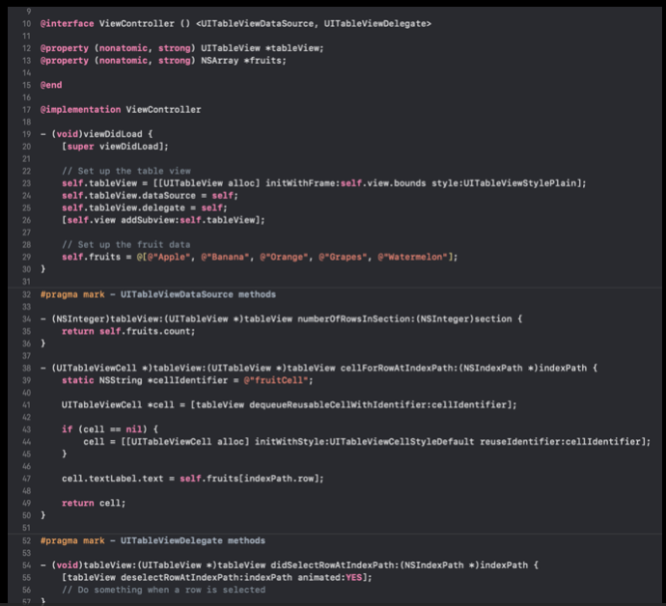
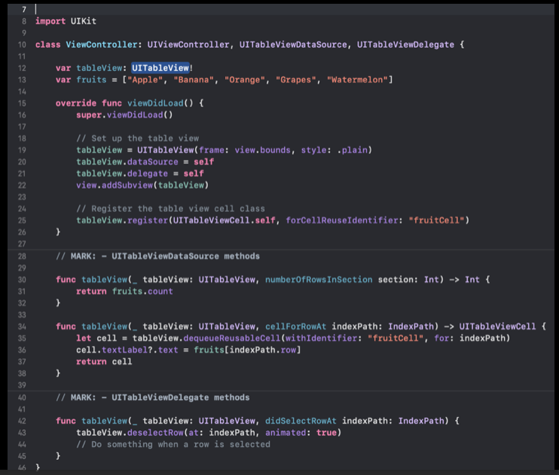
Benefits of Swift
Easy to learn
* Reference info

Slide 6
Benefits of Swift
Swift
Xcode Palygrounds
Safer than Objective-C
Apple is committed to Swift
* Reference info

Slide 7
Swift Pitfalls
Swift version updates
Cannot support iOS prior to iOS 7
Some low level APIs work smoother using Objective-C (AVFoundation, CoreAnimation)
* Reference info

Slide 8
Swift foundation
Core features

Slide 9
Resources
https://www.hackingwithswift.com/
https://developer.apple.com/videos/all-videos/

Slide 10
Demo Project
Champions League Top Scorers

