Slide 1

Continuous Improvement Process (CIP) Tool with semantic Text Similarity Analysis
Student:
Teodora Irina MĂRGINEAN
Scientific Coordinator: As. Eng. Zoltán CZAKO

Slide 2
Introduction & Objectives
Motivation
All companies value their employees’ ideas and consider them a source of continual improvement which represents the ongoing effort to improve products, services and processes.
The majority of those companies are currently providing time consuming and labourious means to their employees for this process, such as Google Forms, Microsoft Forms or even e-mail, due to their cost-effectiveness.
The goal of this project is to replace the existing pipeline that the companies use with an application that will centralize all the data and perform similarity checks on that data.
The similarity checks will replace the knowledge base of the leader who reviews the ideas and of the process responsible.
Objectives
design and develop a Web application which offers employees the ability to submit ideas and leaders and administrators to review and reward them with a bonus, if the case.
research and implement a method used to compute the semantic similarity between the ideas.

Slide 3
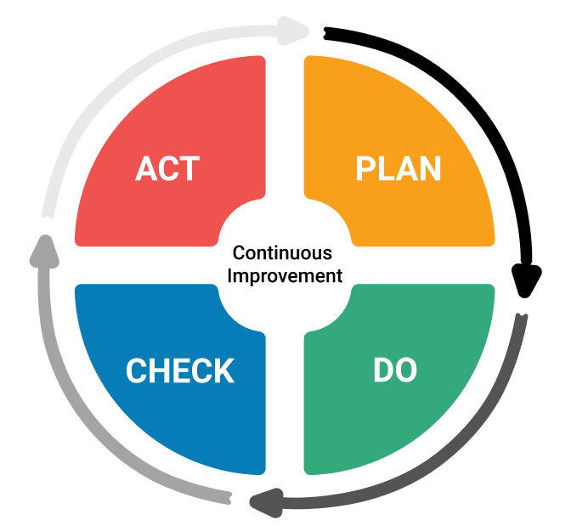
Analysis and theoretical foundation
Continuous Improvement Process (CIP) is an international standard employed by companies worldwide to gather input from employees in the form of improvement ideas.
The PDCA cycle is used in CIP, consisting of four phases:
Plan – plan and analyze
Do – implement changes
Check – verify changes
Act – adopt changes
A complete cycle represents a step of improvement, which is equivalent to an idea being implemented.

Slide 4
Analysis and theoretical foundation
The similarity verifications are executed using Machine Learning algorithms from the branch of Natural Language Processing.
Three approaches have been implemented to compute the semantic similarity between two pieces of text. These three approaches are:
GloVe Embeddings & Cosine similarity – uses word embeddings pre-trained on Wikipedia & Gigaword text dumps and computes the cosine between the embeddings
Gensim, NLTK & Cosine similarity – creates bags of words using doc2bow from the tokenized input sentences, applies TF-IDF and then computes the cosine function between the indices in the index matrix generated using the Gensim similarity object
SBERT & Cosine similarity – uses SBERT word embeddings which are built on top of BERT word embeddings and fine-tuned; they are pre-trained on Wikipedia and Brown Corpus and the cosine is applied between them and the result is converted to percentages.

Slide 5
Analysis and theoretical foundation
Approach | MSE | Max Error
GloVe | 555.19 | 60.87
Gensim | 0.38 | 0.99
SBERT | 0.02 | 0.39
The approaches have been compared using the Mean Squared Error and the Maximum Error evaluation metrics against a dataset [6] composed of records of type:
Sentence 1
Sentence 2
Similarity (a value between 0 and 5)
The method which generated the best results using these metrics is SBERT & Cosine similarity, which was integrated inside CIP Tool.

Slide 6
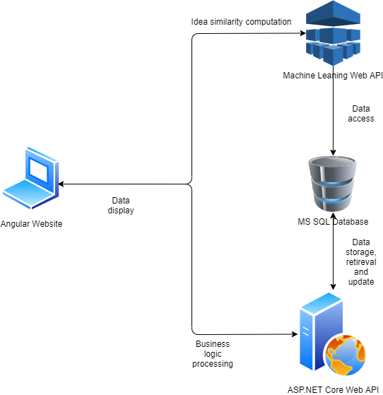










Design &Implementation
The system is composed of four modules:
Backend application – manages the data
Frontend (Web) application – displays the data
Machine Learning API – computes the similarity percentage between the ideas
MS SQL Database – stores the data

Slide 7
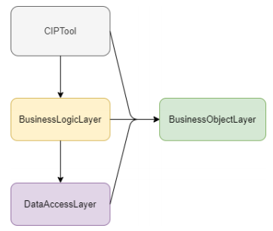
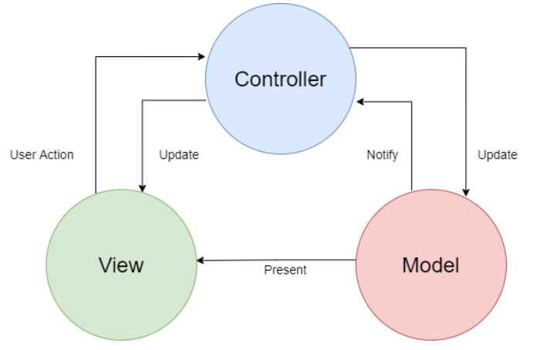
Design &Implementation
The Three-Tier architectural pattern was used in the backend application, with the solution being split into four different projects.
The backend was developed using ASP.NET Core 3.1.
The frontend was developed using Angular 9.
The MVC architectural pattern was used in both backend and frontend applications.
The communication between the backend API, ML API and frontend is done via HTTP requests using the REST architectural style.
The data is transferred between the applications using the JSON format.

Slide 8
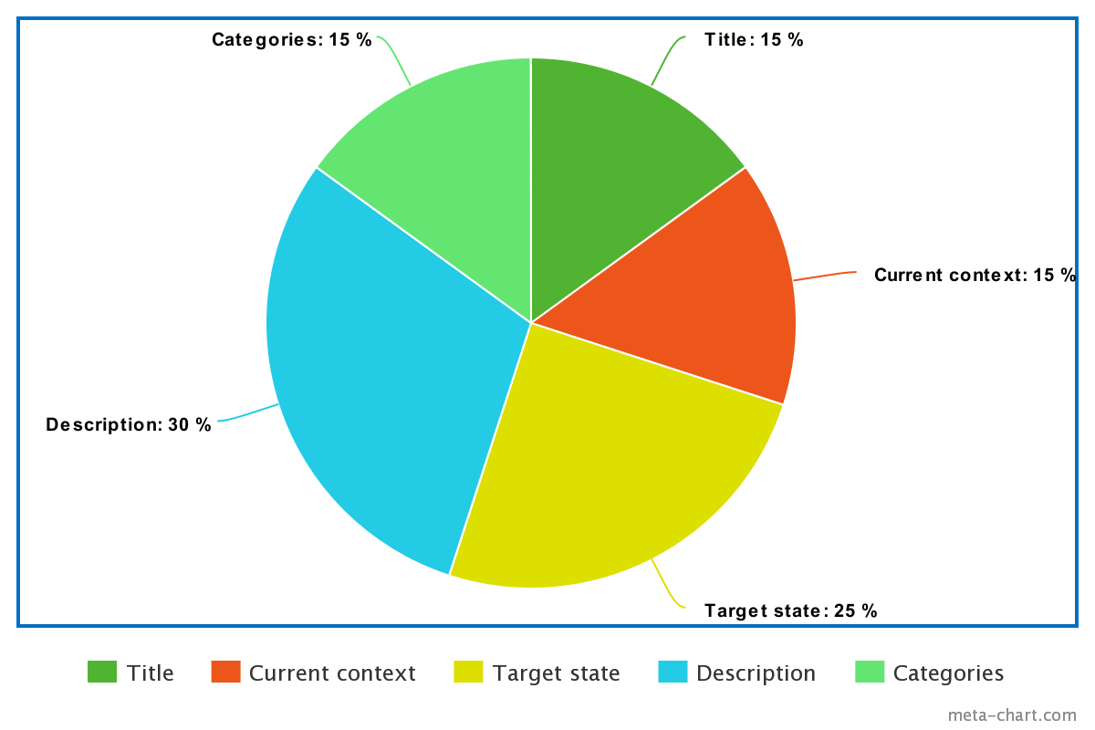
Design &Implementation
The Machine Learning API was developed using Python, PyTorch, SentenceTransformers and Flask.
The computation of similarity between two ideas was done by computing the similarity between relevant idea fields:
Title
Current context
Target state
Description
Categories
The similarity was computed by assigning each field a weight in the final result.
Only ideas which have the similarity percentage > 40% are considered similar.

Slide 9
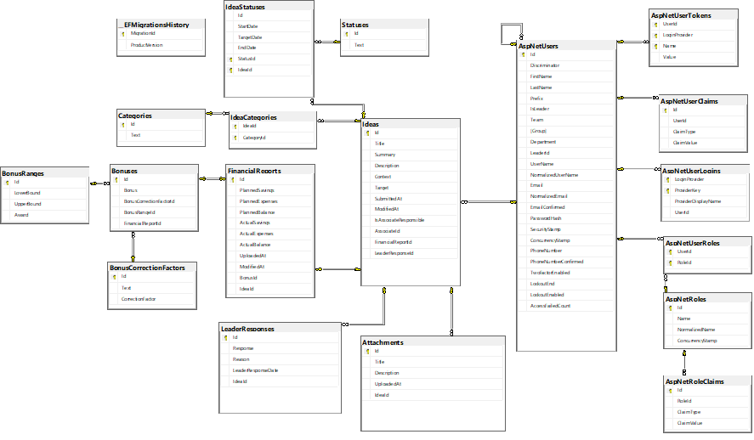
Design &Implementation
A Microsoft SQL Server database was created.
The database was normalized to the BCNF.
It was generated using Entity Framework Core as the ORM and Identity Framework Core in the backend application.

Slide 10

Testing & evaluation
The tool was tested and evaluated in two ways:
Functional testing
Text similarity algorithm evaluation
The functional testing was performed against the main use cases, their main flow and their alternative scenarios:
Submit Idea
View idea details
Edit Idea
Review idea
Confirm implementation
Export Statistics to PDF
The testing was successful in the considered use cases and the application works as expected.

Slide 11
Testing & evaluation
The text similarity algorithm was validated using standard regression evaluation metrics:
The results proved that the algorithm is performing well enough to be integrated into CIP Tool.
Evaluation Metric | Value
Max Error | 0.3975
Mean Absolute Error | 0.1237
Mean Squared Error | 0.0226
Mean Squared Log Error | 0.0081
R2 Score | 0.2895

Slide 12
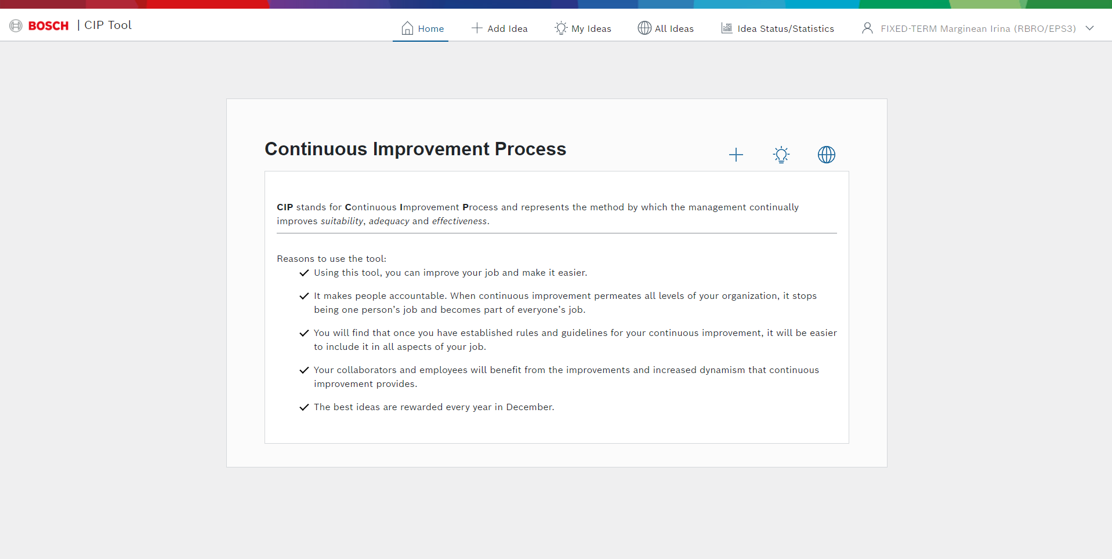
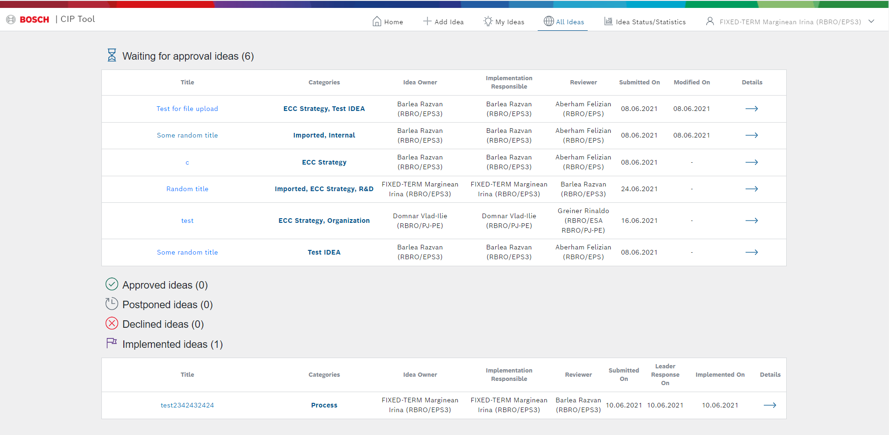
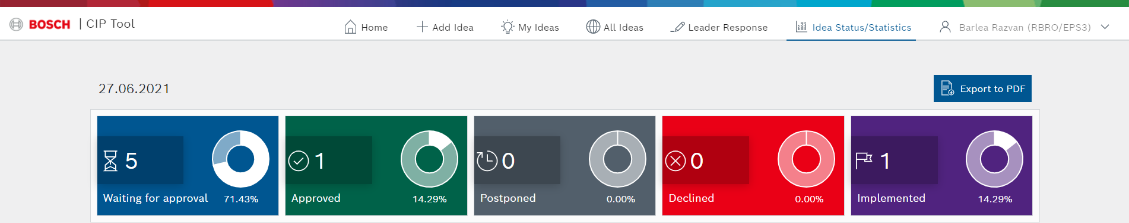
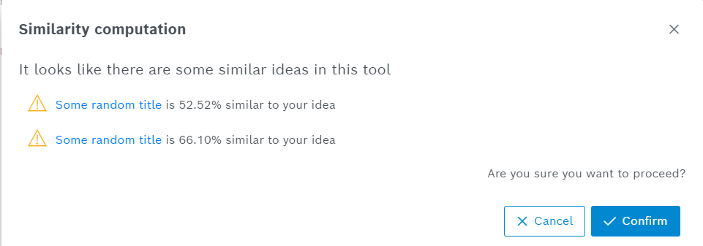
results
The following results have been obtained in this project:
The generation of a normalized SQL Server database.
The implementation of an API which performs the secure business logic on the data in the database.
The implementation of a Machine Learning API which is responsible for performing the computation of the semantic similarity between ideas.
The creation of a Web Graphical User Interface which allows the effortless and user-friendly utilization of the tool, according to the designed mock-ups.

Slide 13
Future improvements
The future improvements include:
researching and integrating/developing a text similarity algorithm which yields better results
personalizing the confirmation e-mails and adding more information inside them
implementing the domain-based Windows authentication
gathering user information from the Active Directory inside companies
implementing a feature which allows leaders to change the reviewers of an idea
improving the security on the Machine Learning API
implementing a feature which allows viewing the edit history of an idea
adding a survey inside the tool

Slide 14
Selective bibliography
[1] E. Lodgaard, I. Gamme, and K. Aasland, “Success factors for pdca as continuous improvement method in product development,” IFIP Advances in Information and Communication Technology, vol. 397, pp. 645–652, 01 2013.
[2] J. Pennington, R. Socher, and C. Manning, “GloVe: Global vectors for word representation,” in Proceedings of the 2014 Conference on Empirical Methods in Natural Language Processing (EMNLP). Doha, Qatar: Association for Computational Linguistics, Oct. 2014, pp. 1532–1543. [Online]. Available: https://www.aclweb.org/anthology/D14-1162
[3] Wael H. Gomaa, Aly A. Fahmy, A Survey of Text Similarity Approaches, International Journal of Computer Applications (0975 – 8887) Volume 68– No.13, April 2013.
[4] J. Pennington, R. Socher, and C. D. Manning. Gensim: Core concepts. [Online]. Available: https://radimrehurek.com/gensim/auto examples/core/run core concepts.html#sphx-glr-auto-examples-core-run-core-concepts-py
[5] N. Reimers and I. Gurevych, “Sentence-bert: Sentence embeddings using siamese bert-networks,” 01 2019, pp. 3973–3983.
[6] Semeval sts task. [Online]. Available: https://github.com/brmson/datasetsts/tree/master/data/sts/semeval-sts

Slide 15

THANK You for youR attention! Questions?

