Slide 1
Construal of identity in complaints
Irina Wagner PhD Student University of Colorado Boulder Department of Linguistics

Slide 2
Acknowledgements
Dr. Cowell
Dr. Fox
The Department of Linguistics
Center of Studying Indigenous Languages of the West
University of Colorado’s United Government of Graduate Students.

Slide 3
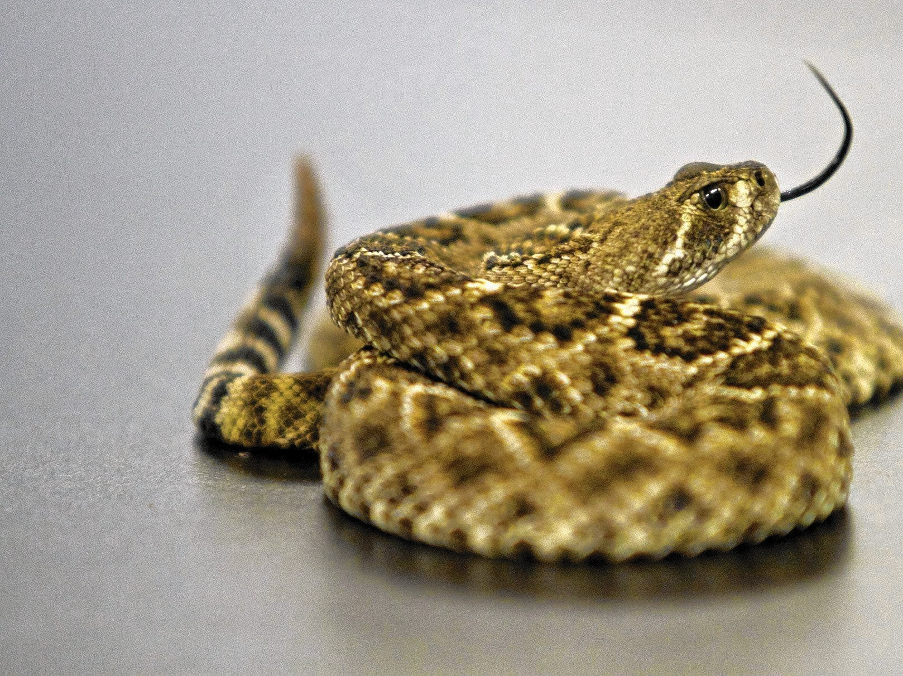
Complaining in Arapaho culture

Slide 4
The background of the study

Slide 5
Main question

Slide 6
Data

Slide 7
Methodology

Slide 8
Findings

Slide 9
Conclusion

