Slide 1
Survey Comparison Project Figures

Slide 2
SVC vs. Roving Surveys

Slide 3
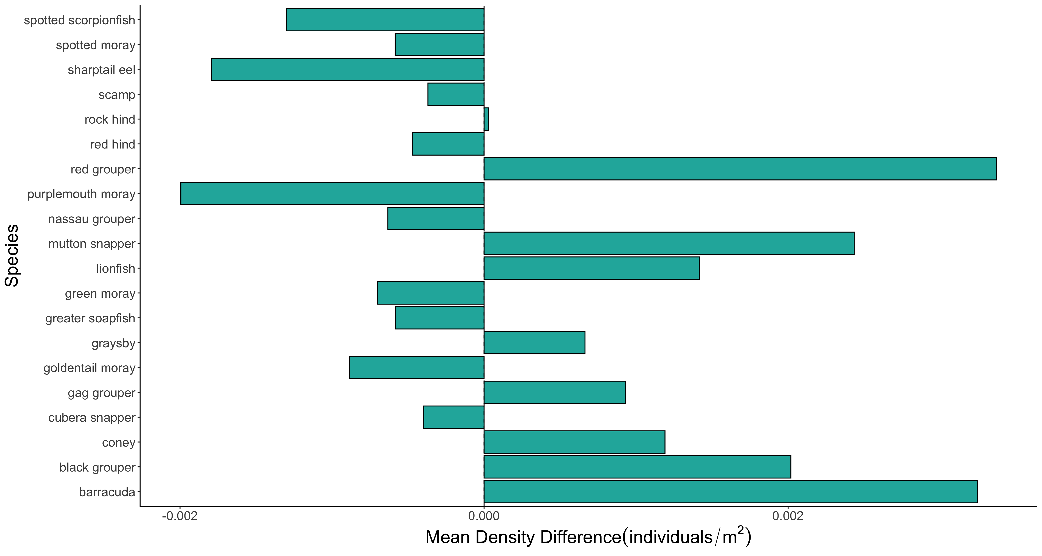

Slide 4
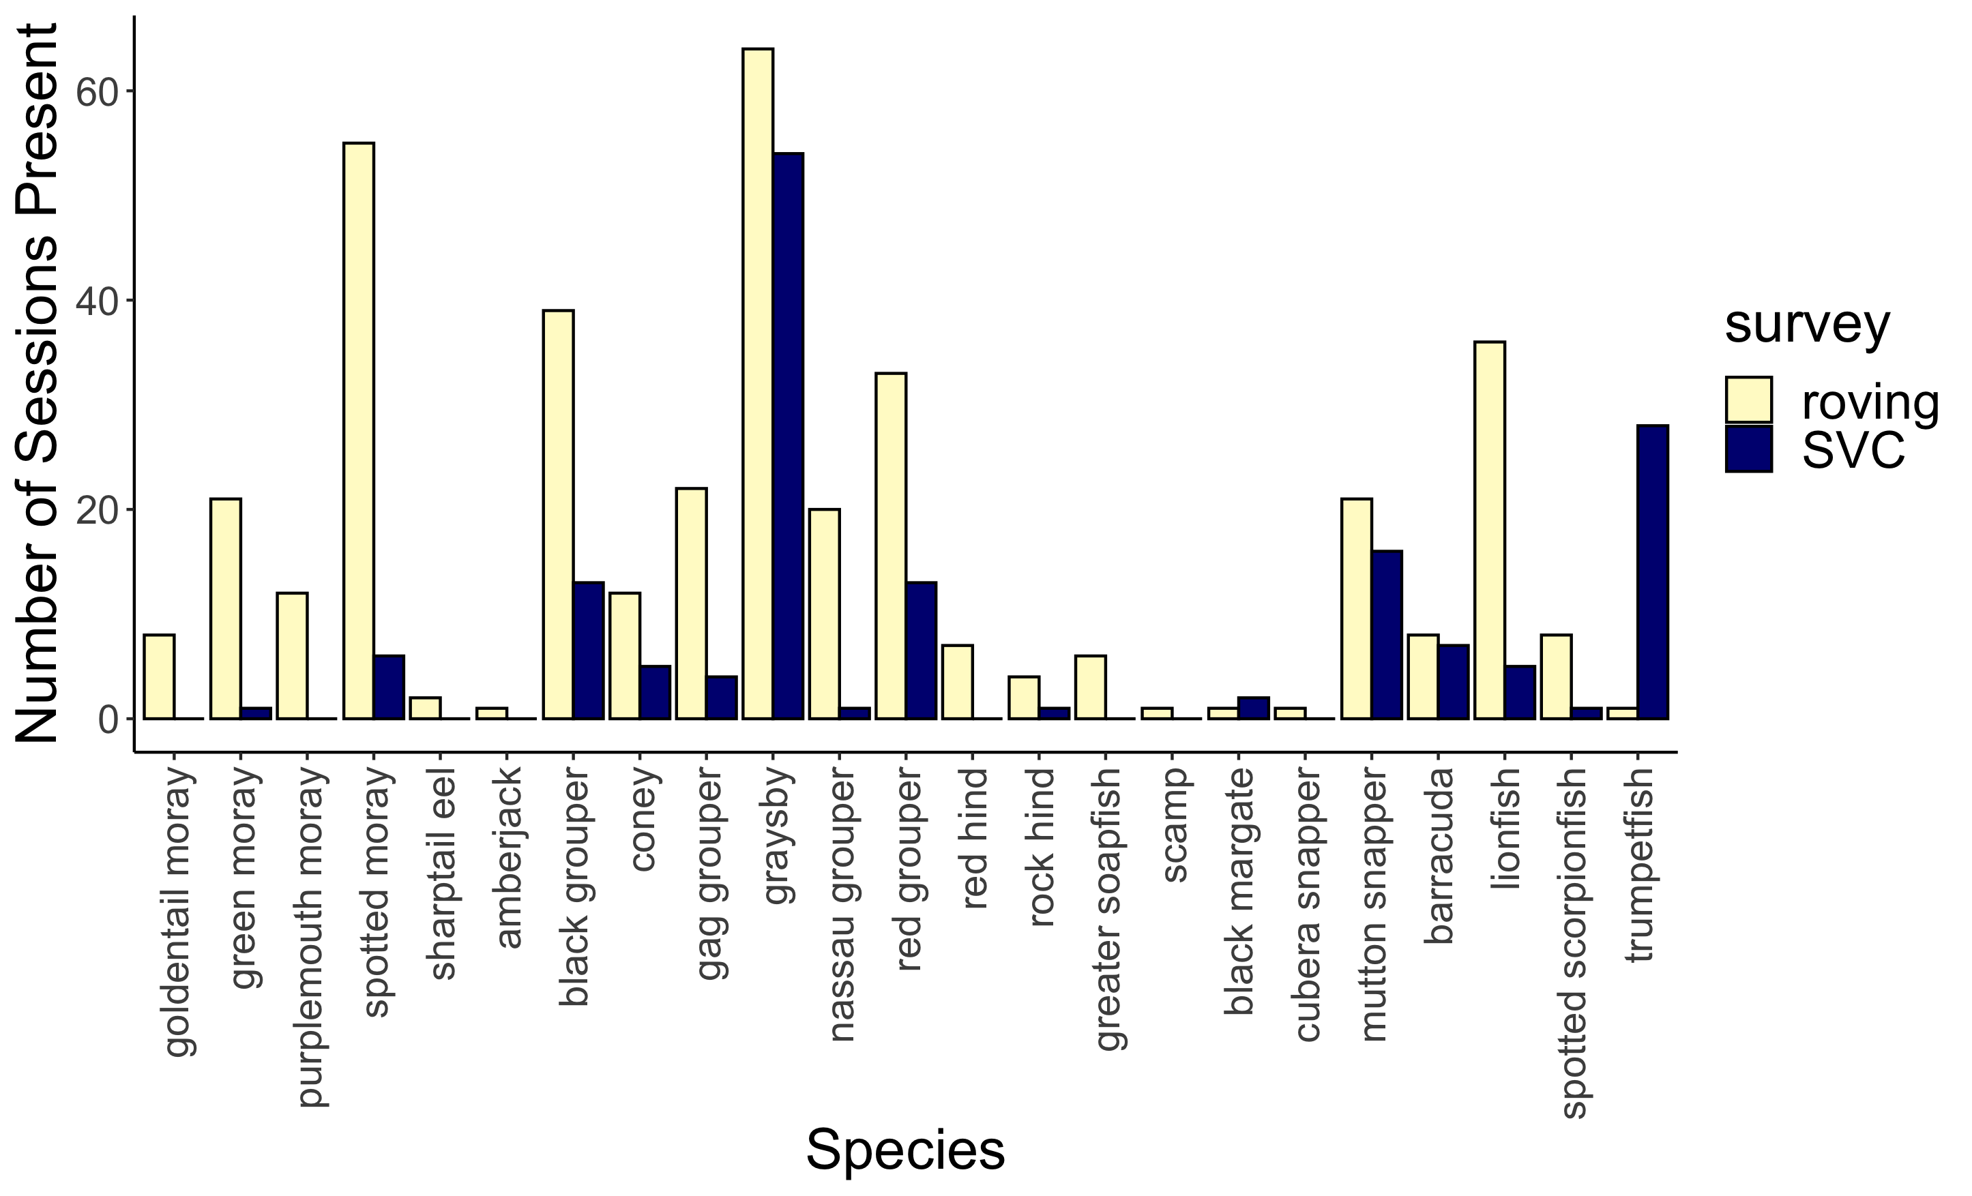
***
***
***
***
***
***
***
***
**
*
*
*
*

Slide 5
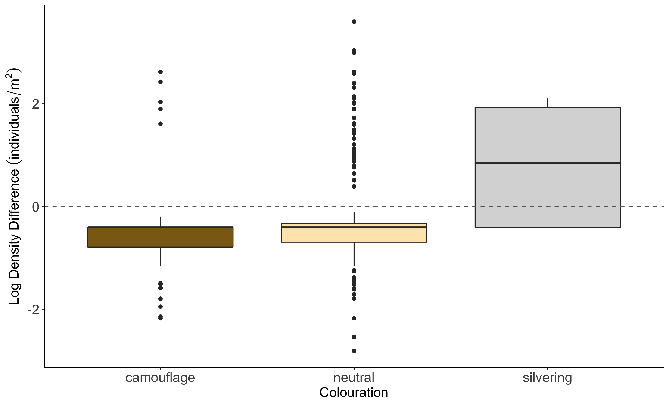
b
a
c

Slide 6
SVC vs. Transect Figures

Slide 7
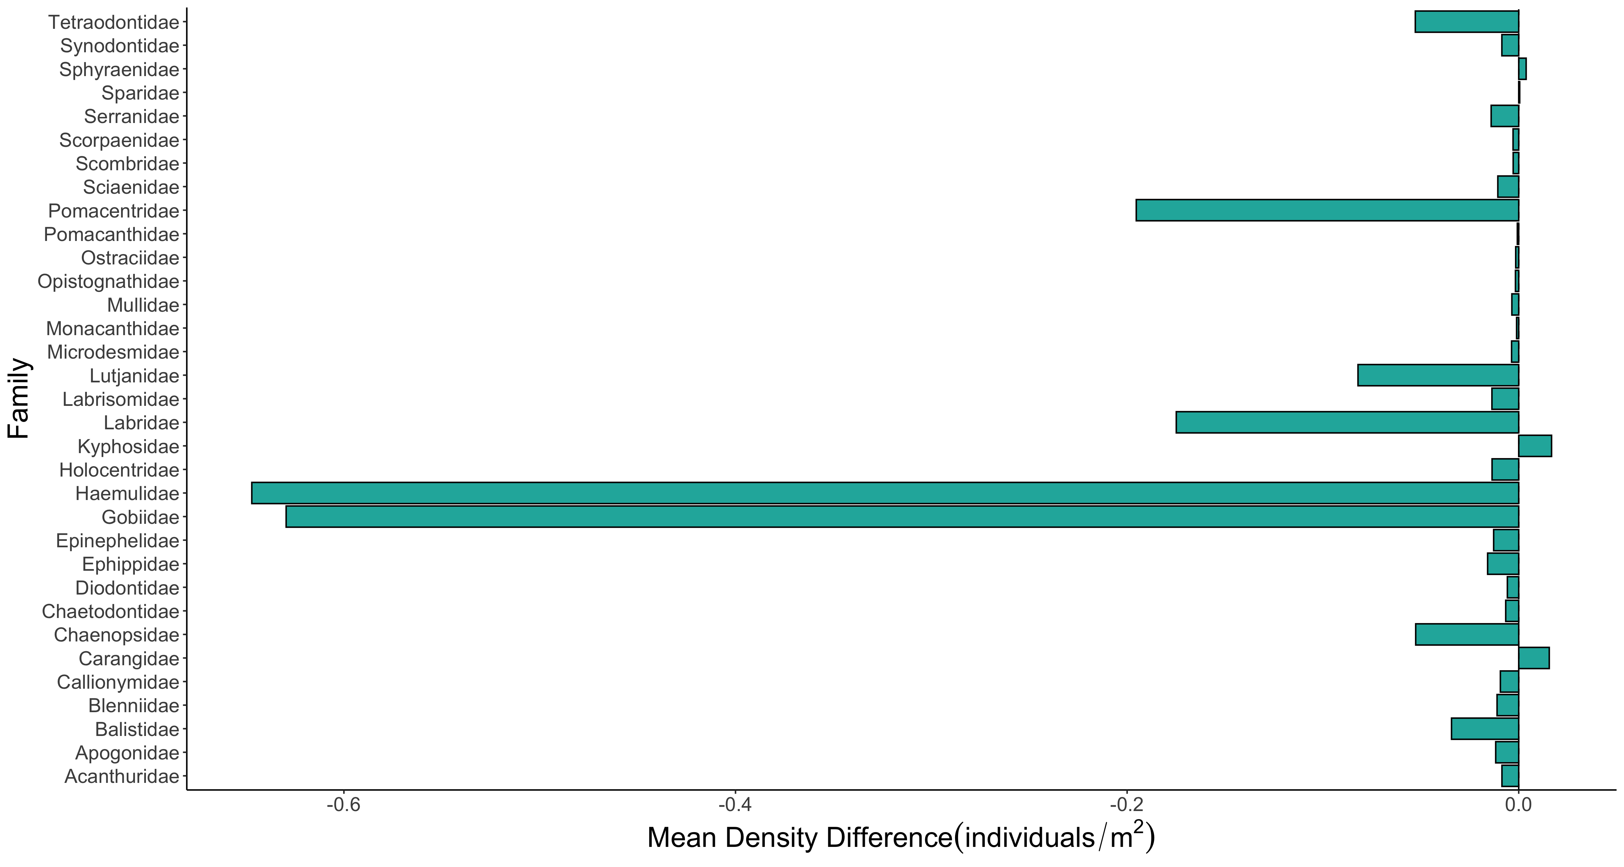

Slide 8
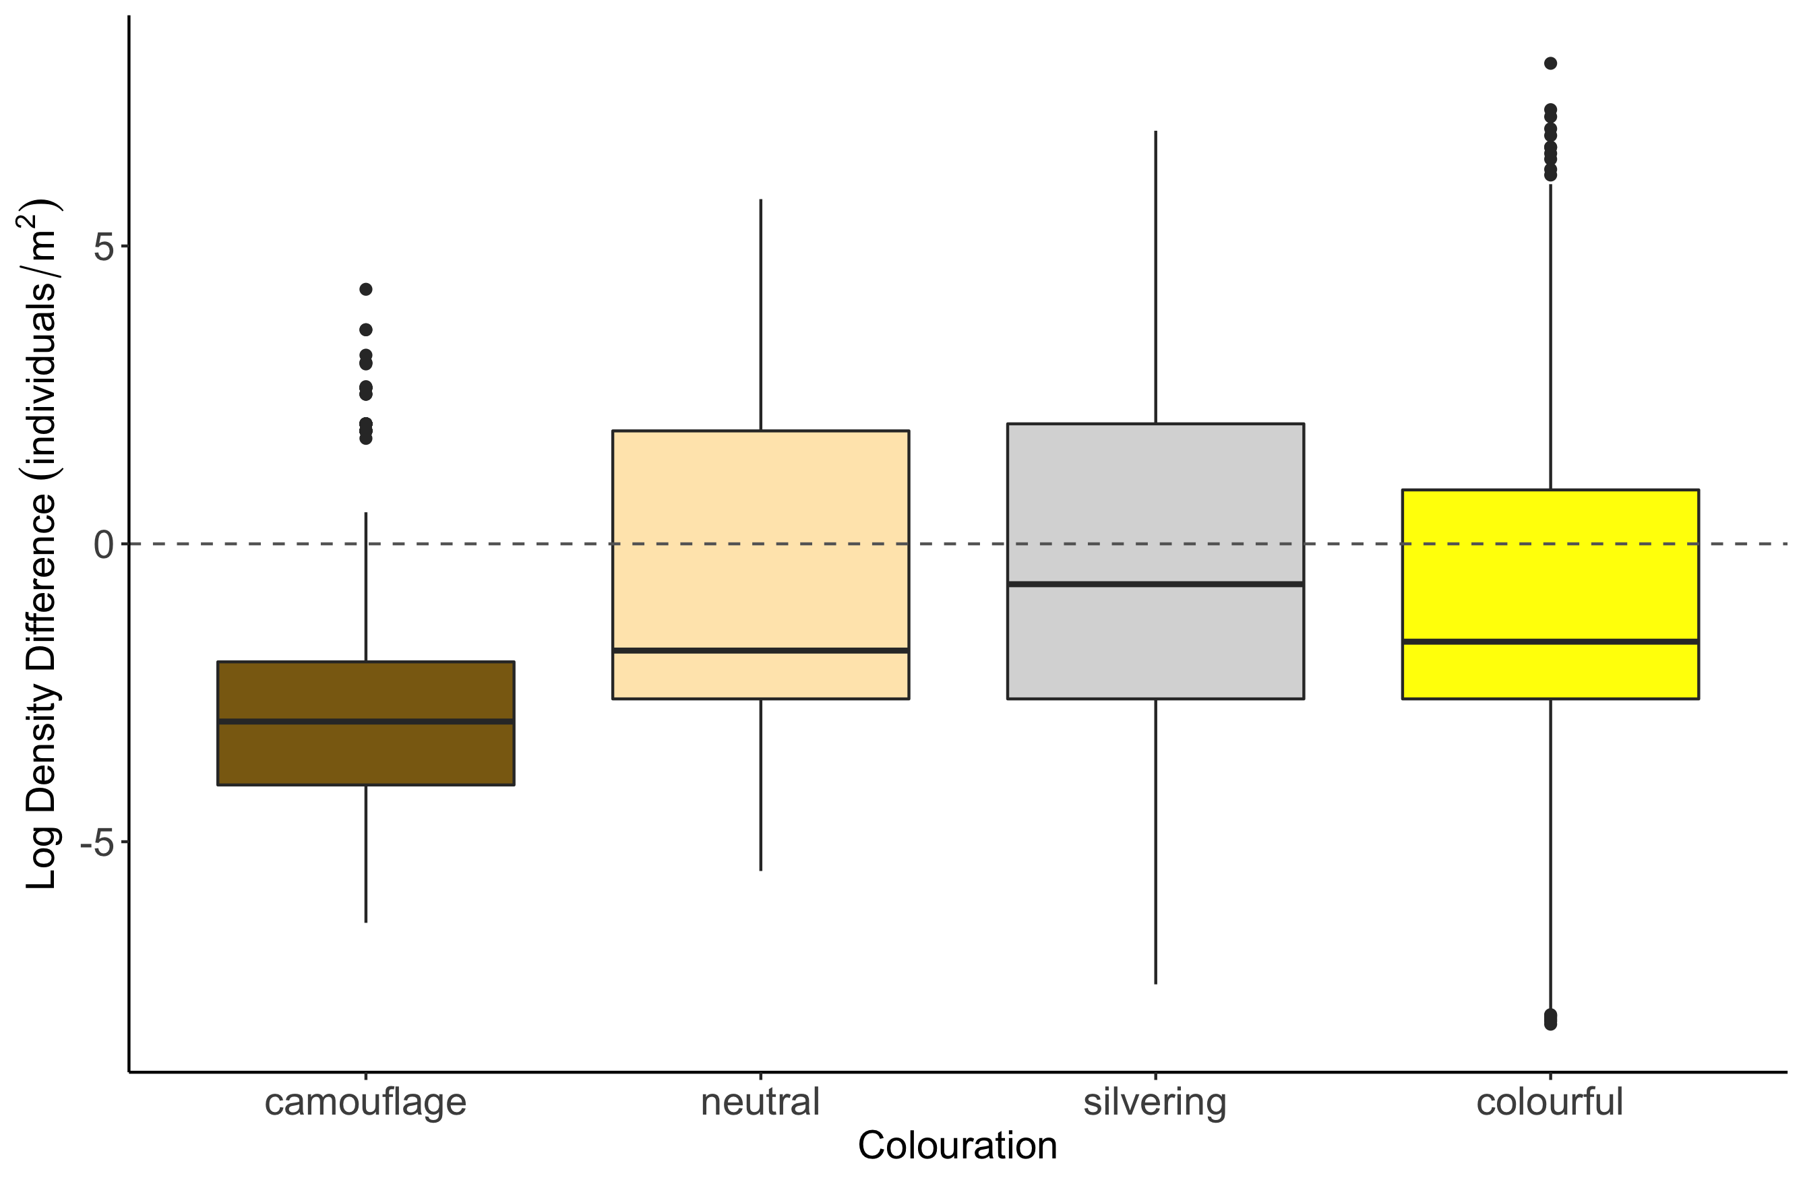
c
b
b
a

Slide 9
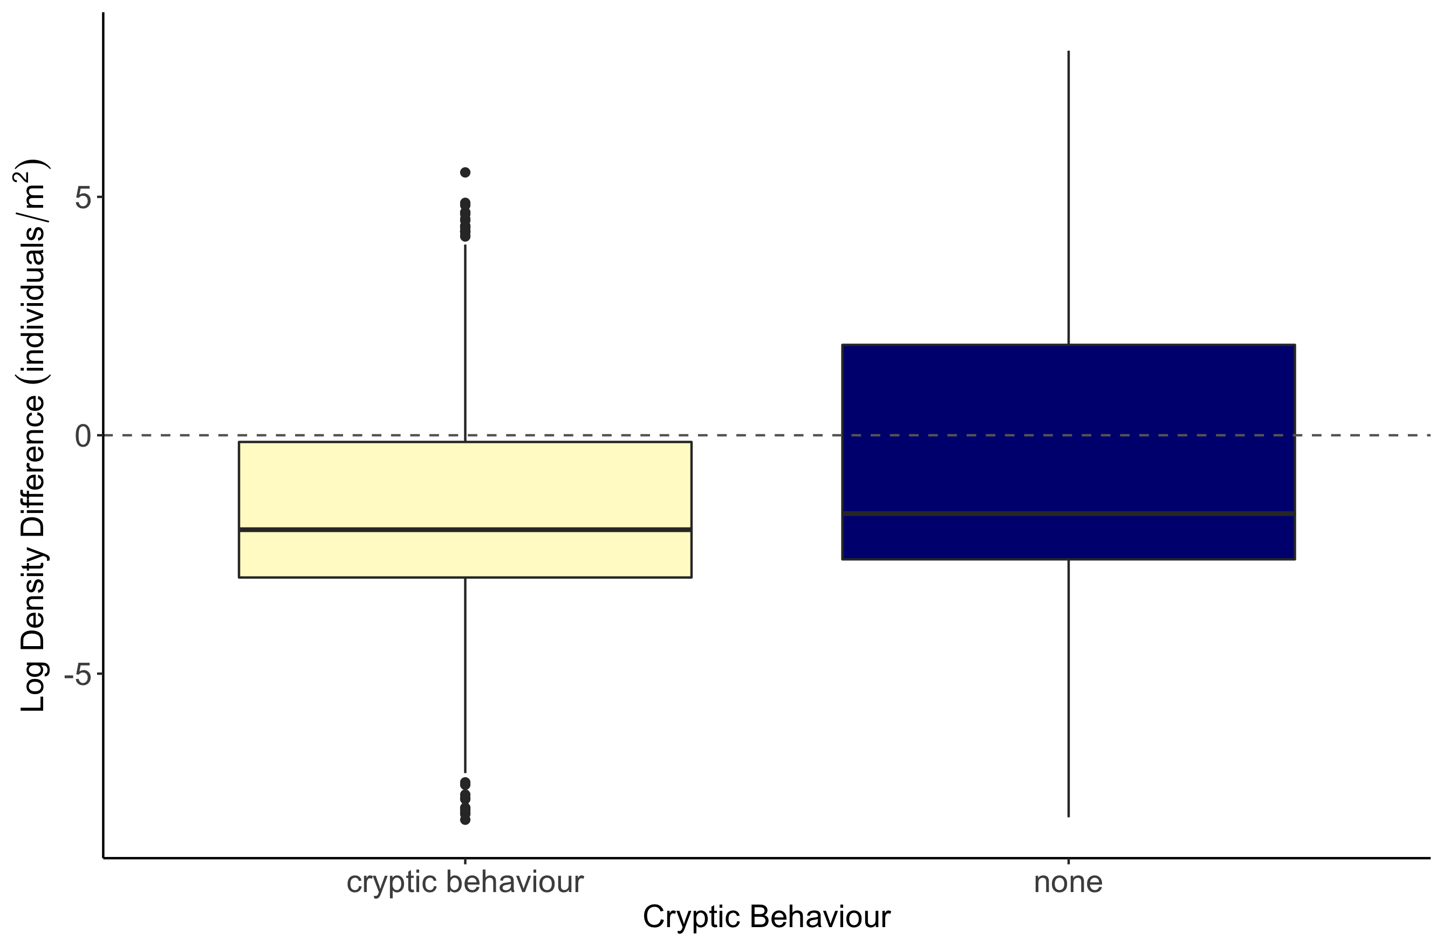
b
a

Slide 10
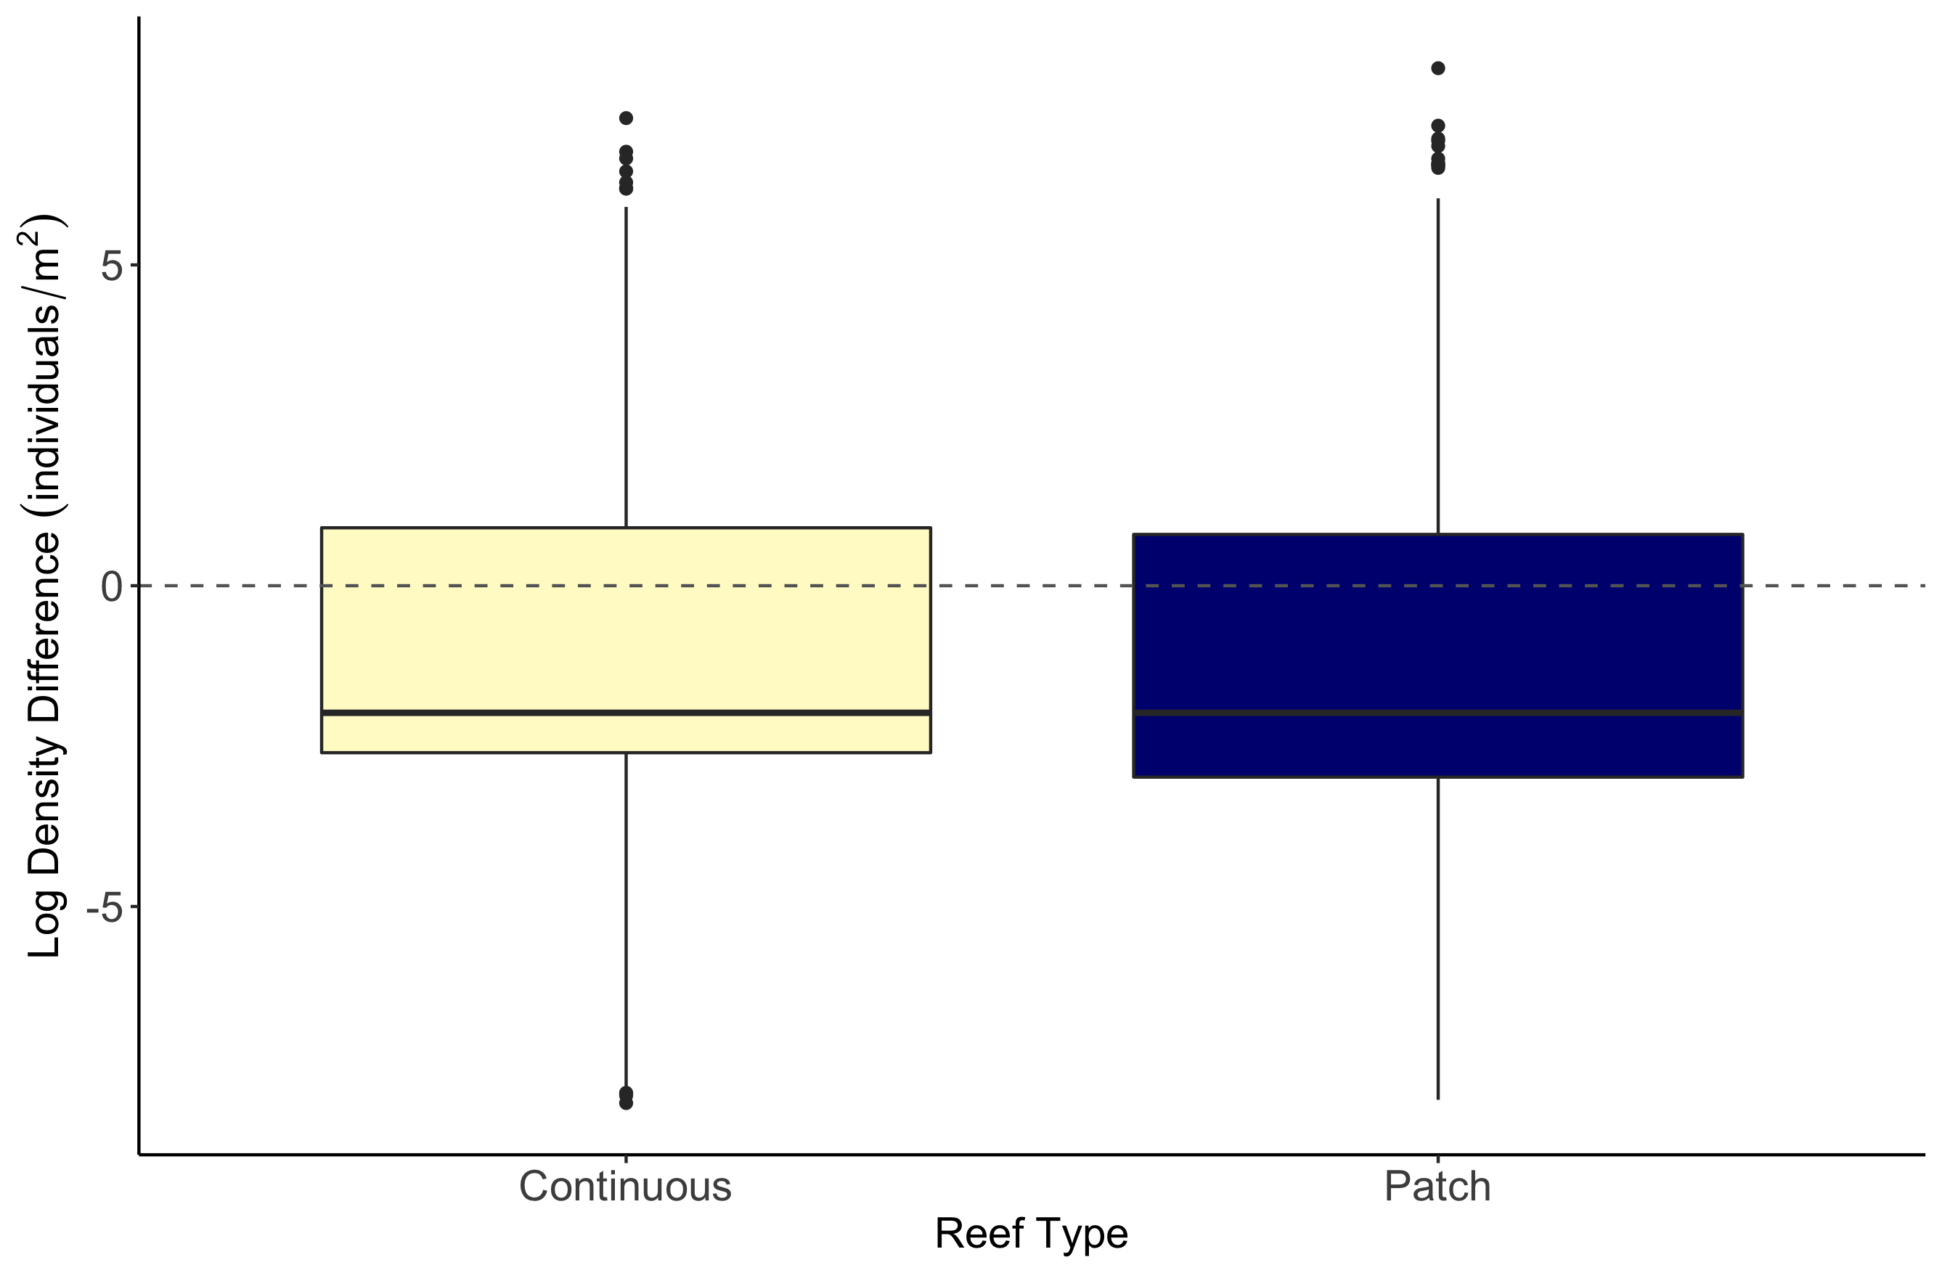
b
a

Slide 11
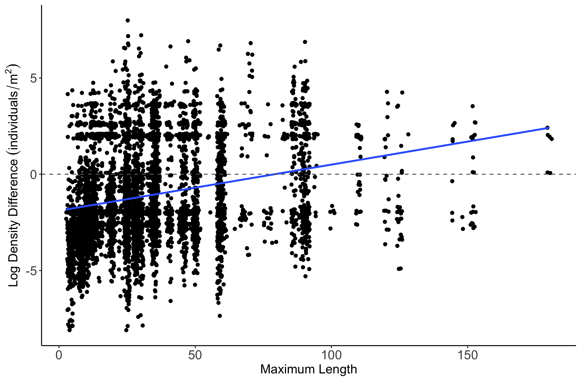
Estimate = 0.0077157
z value = 4.307
p-value = 1.65e-05

Slide 12
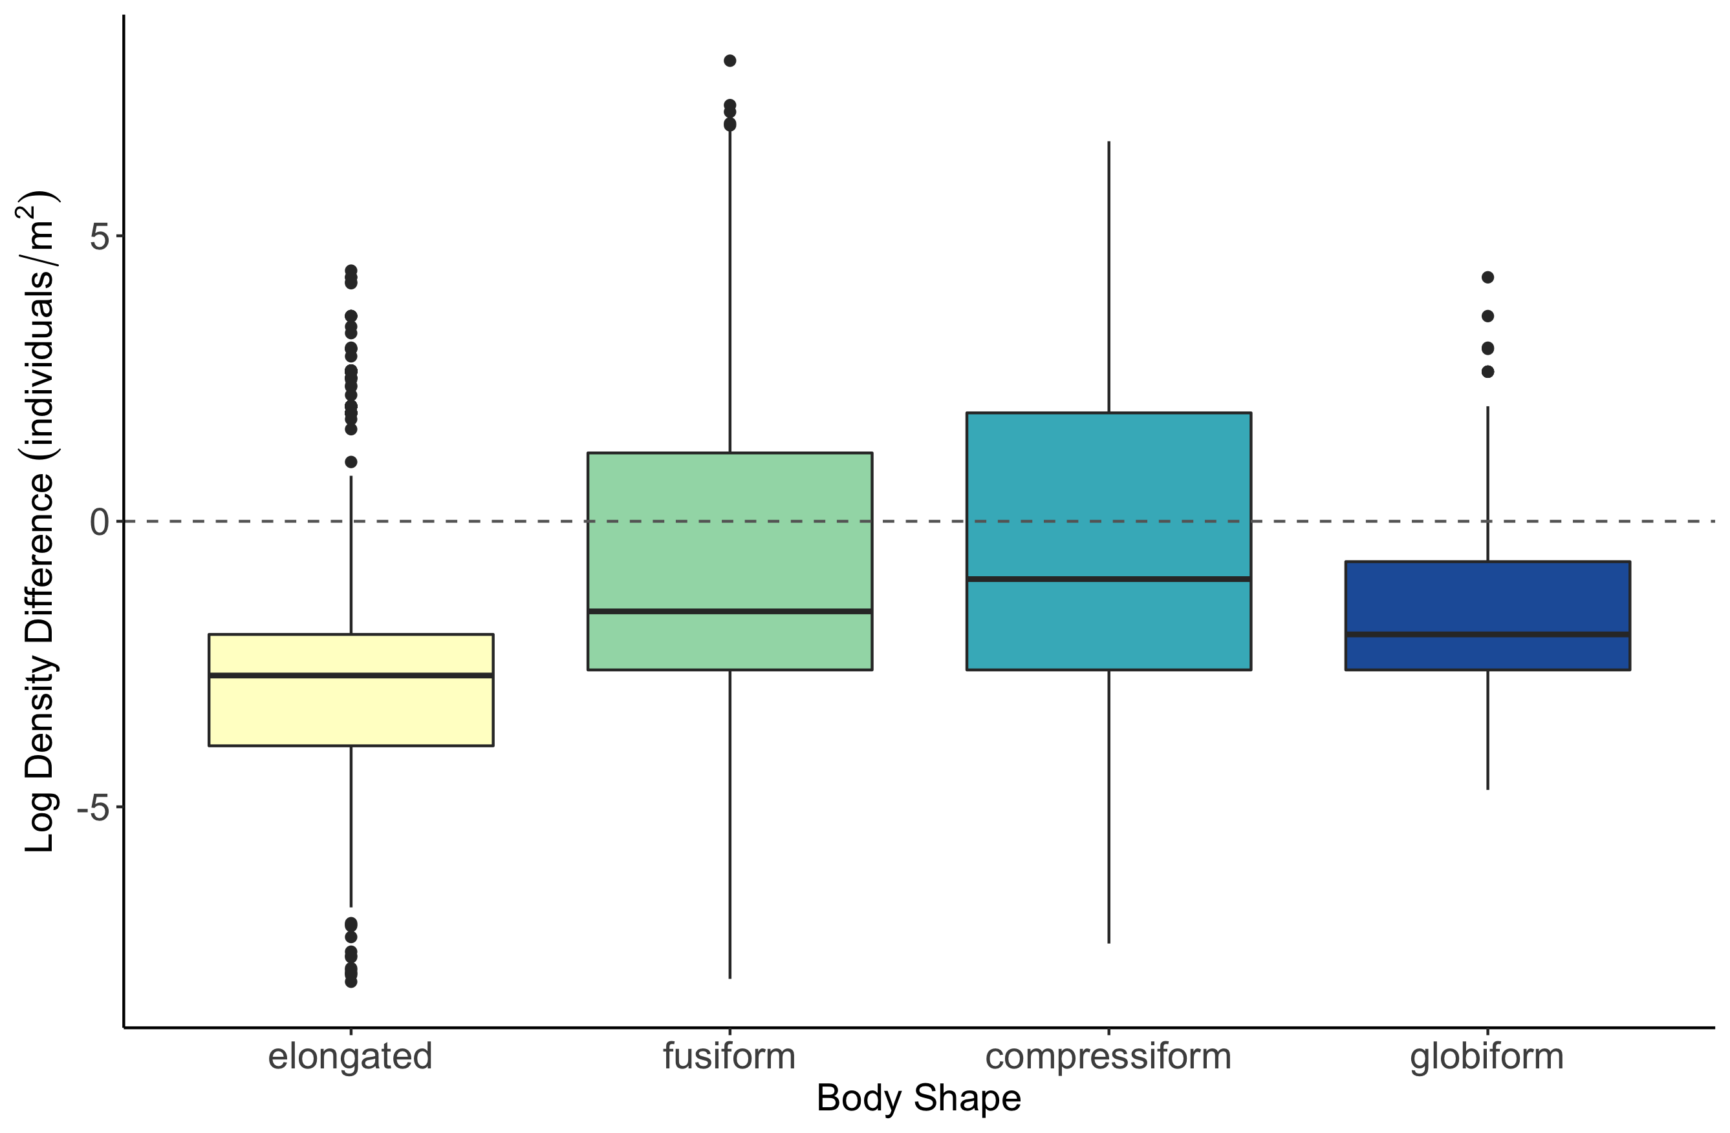
b
c
a
d

Slide 13
