Slide 1
ServiceX
G. Watts (for the ServiceX Teram)
April 25, 2022

Slide 2
Understand what ServiceX is
Understand Where ServiceX is Useful
Basic Usage of ServiceX
How to access ServiceX
Pointers to More Advanced Information

Slide 3
GRID
root://
ServiceX
Columnar Data
Pandas, awkward, ROOT
http://
Converting data to a columnar format
Thinning/Slimming the data to be exported

Slide 4
Jupyter Notebooks
Raw Python Programs
vscode
ROOT files, parquet files, awkward arrays, pandas dataframes
Python Ecosystem
ServiceX
ROOT (C++)
(experimental)
A Query Langage, func_adl is used to control ServiceX
User writes func_adl query
Submits query to ServiceX
ServiceX processes query
User pulls data from ServiceX internal cache

Slide 5
Language Integrated Query
monads

Slide 6
Understand what ServiceX is
Understand Where ServiceX is Useful
Basic Usage of ServiceX
How to access ServiceX
Pointers to More Advanced Information

Slide 7
You want only a small portion of the dataset
Your files are located on the GRID
Your data is in an experiment specific format

Slide 8
You want only a small portion of the dataset
Your files are located on the GRID
Your data is in an experiment specific format
Isn’t designed to do operations like histogramming!
Files are located on fast disk locally and you have DASK

Slide 9
Understand what ServiceX is
Understand Where ServiceX is Useful
Basic Usage of ServiceX
How to access ServiceX
Pointers to More Advanced Information

Slide 10

Event 1
Event 2
Event 3
Event 4
Jets
Jet 1
Px
Py
Pz
Pt
$η$
Jet 2
Px
Py
Pz
Electrons
Electron 1
Px
Py
Pz
…
Jets
Jet 1
Px
Py
Pz
Electrons
Electron 1
Px
Py
Pz
Electron 2
Px
Py
Pz
Jets
Jet 1
Px
Py
Pz
Jet 2
Px
Py
Pz
Jet 3
Px
Py
Pz
…
Event Data

Slide 11
Event 1
Event 2
Event 3
Event 4
Event DB
Event DB
Event DB
Event DB
Event Data
We can build a query on each Event DB…
… and apply it to each event?

Slide 12
Event 1
Event 2
Event 3
Event 4
Event DB
Event DB
Event DB
Event DB
Event Data
Example: We want the $p_{x}, p_{y}, p_{z}$ of all jets with $p_{T}>30$ GeV and $\left|η\right|<2.4$
… and apply it to each event?

Slide 13
Steam of Events (Source)
Event 1
Event 2
Event 3
Event 4
Event Database
Event DB
Event DB
Event DB
Event DB
filter
Example: We want the $p_{x}, p_{y}, p_{z}$ of all jets with $p_{T}>30$ GeV and $\left|η\right|<2.4$
What we want
… and apply it to each event?

Slide 14
Let's build a query to do this!
(01_central_jets.ipynb)

Slide 15

What is Select?
j1
f(j1)
j2
f(j2)
j3
f(j3)
$$stream.Select(lambda s:f\left(s\right))$$
j4
f(j4)
j4
f(j4)

Slide 16
What Does SelectMany do?
Concatenates lists of arrays!
[[1, 2], [3, 4], [5, 6]].SelectMany(lambda arr: arr)
[1, 2, 3, 4, 5, 6]
More Generally…
result = []
for arr in array:
r = f(arr)
for item in r:
result.append(item)
return result
array.SelectMany(lambda arr: f(arr))

Slide 17
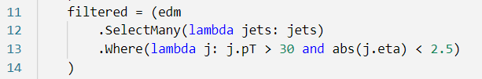
From a stream of events to a stream of jets
edm – a stream of events
filtered – a stream of jets

Slide 18
Let's build a query that looks at events!
(02_events_of_jets.ipynb)

Slide 19

What about axis=1?
Event 1
Stream of events
filtered = (edm
.Select(lambda jets: jets.Where(lambda j: j.pT > 30 and abs(j.eta) < 2.5))
)
Jets
Jet 1
Px
Py
Pz
Pt
$η$
Jet 2
Px
Py
Pz
Stream of jets, one collection per event
Stream of single jets

Slide 20
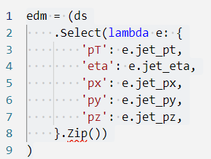
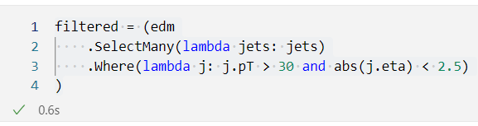
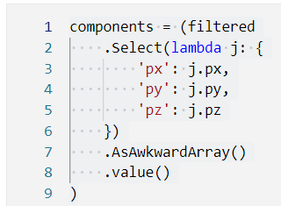
Usage Patterns
Using a dictionary & Zip
Flat Ntuple File
Build Event Data Model
Filter
Select columns for output
Using Where
Using Select and a dictionary

Slide 21
What if you already have an EDM?
(03_atlas_xAOD.ipynb)

Slide 22
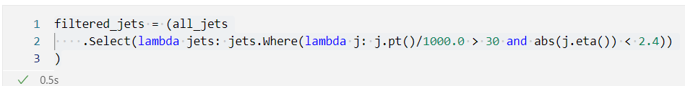
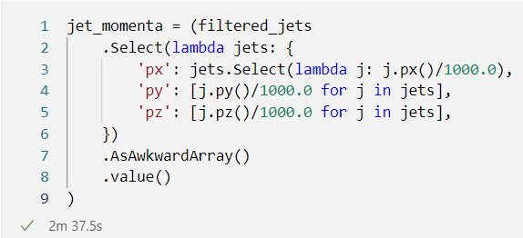
Usage Patterns
xAOD File
Build Event Data Model
Filter
Select columns for output
Using Where
Using Select and a dictionary

Slide 23
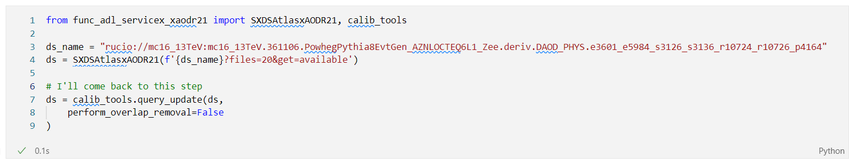
What was this?
The backend runs the full xAOD calibrations!
It uses the default setup in recent R21 releases
Overlap removal requires all events to have a PV, and some do not, and there is no filter currently…
This is a 600 file dataset, and some files have been deleted from the GRID!
Full dataset run takes ~15-20 minutes, depending on how much is cached in XCache

Slide 24
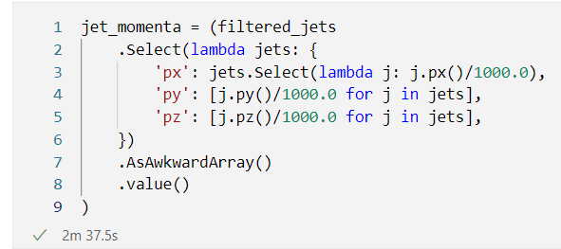
And this?
Fairly arbitrary functions are possible
You can inject C++ functions as well
These two statements are equivalent (px/py excepting!)
Several other python syntactic sugar options available.

Slide 25
Understand what ServiceX is
Understand Where ServiceX is Useful
Basic Usage of ServiceX
How to access ServiceX
Pointers to More Advanced Information

Slide 26
ServiceX Instances
There are a number of instances of ServiceX around. The most notable ones are:
Open Data: https://coffea-opendata.casa
Chicago ATLAS Analysis Facility: https://af.uchicago.edu/

Slide 27
Extra Information
All ServiceX instances require an account. To get an account go to [https://coffea-opendata.casa/](https://coffea-opendata.casa/), log in, and wait to be approved.

Slide 28
Understand what ServiceX is
Understand Where ServiceX is Useful
Basic Usage of ServiceX
How to access ServiceX
Pointers to More Advanced Information

Slide 29

What have I missed?
Predicates
Select, Where, SelectMany
Aggregate, Count, Sort, etc.
Language Features
Variable Capture
Functions (like abs)
Lambda Capture
Return only jets that are near by a MC particle
Return only missing $E_{T}$ for events with 2 or more central jets
Extensibility
New transformers
New data sources
Query Caching
Ability to share run queries with an analysis team
Running directly out of the ServiceX cache rather than downloading files

Slide 30
Data
Available Transformers
Flat ntuples
ATLAS xAOD R21 datafiles
CMS Run 1 AOD datafiles (*)
Ongoing project to make it simpler to add to this list!
Data Sources
Files available over open network via http:// or root://
CMS or ATLAS rucio datasets
CERN open data records (as long as they are sensibly used)

Slide 31
Some other places to look
Lots of details about ATLAS xAOD access: https://gordonwatts.github.io/xaod_usage/intro.html
Using the uproot backend: https://github.com/masonproffitt/func-adl-demo/blob/master/demo.ipynb
Coming soon: basic and advanced users manual for func_adl.

Slide 32
What are we working on?
Leaky Abstractions
CMS Run 2 & Beyond Data
New drop of OpenData
This is a distributed system
Capturing errors for common mistakes is not straight forward!
More robust running on GRID datasets
Better integration with other existing T2 tools (e.g. batch, iDDS, etc.)
Analysis-Team EDM
Each analysis has a particular view of the data
Cleaning, preselection, etc.
Sharing this should be as easy as checking out a common repo
Better sharing of pre-run results withing a group
Smoother connection with coffea

