Slide 1
ServiceX
G. Watts (for the ServiceX Teram)
April 25, 2022

Slide 2
What is ServiceX

Slide 3
GRID
root://
ServiceX
Columnar Data
Pandas, awkward, ROOT
http://
Converting data to a columnar format
Thinning/Slimming the data to be exported

Slide 4
Do use it for
Filtering Data
Translating a binary format to columnar (e.g. ATLAS xAOD or CMS Run 1 AOD)
Pushing data to hist or awkward
Front end for coffea
Reading data from the GRID
Don’t use it for
Histogramming Data
Reading data that is locally available via a distributed input system

Slide 5
Goals of this tutorial

Slide 6
ServiceX Concepts

Slide 7

Event 1
Event 2
Event 3
Event 4
Jets
Jet 1
Px
Py
Pz
Pt
$η$
Jet 2
Px
Py
Pz
Electrons
Electron 1
Px
Py
Pz
…
Jets
Jet 1
Px
Py
Pz
Electrons
Electron 1
Px
Py
Pz
Electron 2
Px
Py
Pz
Jets
Jet 1
Px
Py
Pz
Jet 2
Px
Py
Pz
Jet 3
Px
Py
Pz
…

Slide 8
Event 1
Event 2
Event 3
Event 4
Event DB
Event DB
Event DB
Event DB
Example: We want the $p_{x}, p_{y}, p_{z}$ of all jets with $p_{T}>30$ GeV and $\left|η\right|<2.4$
Apply this to each “event database”

Slide 9
Steam of Events (Source)
Event 1
Event 2
Event 3
Event 4
Event Database
Event DB
Event DB
Event DB
Event DB
filter
Example: We want the $p_{x}, p_{y}, p_{z}$ of all jets with $p_{T}>30$ GeV and $\left|η\right|<2.4$
What we want
Apply this to each “event database”

Slide 10
Let's build a query to do this!
(01_central_jets.ipynb)

Slide 11

What is Select?
j1
f(j1)
j2
f(j2)
j3
f(j3)
$$stream.Select(lambda s:f\left(s\right))$$
j4
f(j4)
j4
f(j4)

Slide 12
What Does SelectMany do?
Concatenates lists of arrays!
[[1, 2], [3, 4], [5, 6]].SelectMany(lambda arr: arr)
[1, 2, 3, 4, 5, 6]
More Generally…
result = []
for arr in array:
r = f(arr)
for item in r:
result.append(item)
return result
array.SelectMany(lambda arr: f(arr))

Slide 13
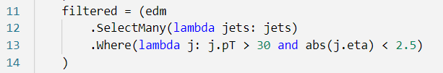
From a stream of events to jets
edm – a stream of events
Filtered – a stream of jets

Slide 14
Let's build a query that looks at events!
(02_select_many.ipynb)

Slide 15

What about axis=1?
Event 1
Stream of events
filtered = (edm
.Select(lambda jets: jets.Where(lambda j: j.pT > 30 and abs(j.eta) < 2.5))
)
Jets
Jet 1
Px
Py
Pz
Pt
$η$
Jet 2
Px
Py
Pz
Stream of jets, one collection per event
Stream of single jets

Slide 16
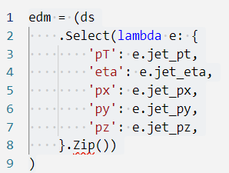
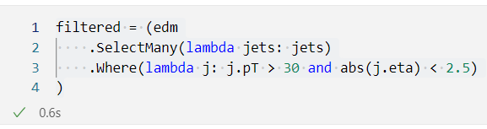
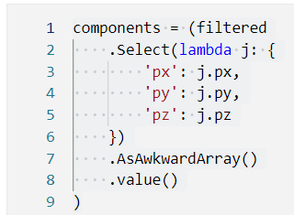
Usage Patterns
Using a dictionary & Zip
Flat Ntuple File
Build Event Data Model
Filter
Select columns for output
Using Where
Using Select and a dictionary

Slide 17
What if you already have an EDM?
(03_atlas_xAOD.ipynb)

Slide 18
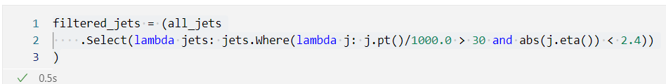
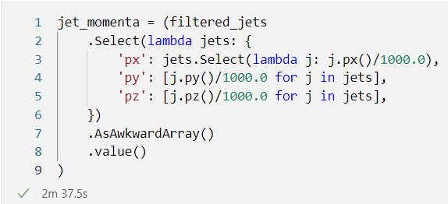
Usage Patterns
xAOD File
Build Event Data Model
Filter
Select columns for output
Using Where
Using Select and a dictionary

Slide 19
Extra Information

