Slide 1
IRIS SAXPY Tutorial
Jungwon Kim
October 21, 2021

Slide 2
Goal: Portable SAXPY using IRIS
S[] = A * X[] + Y[]
Machine A
Machine B
AMD
CPU
AMD
GPU
Intel
CPU
NVIDIA
GPU

Slide 3
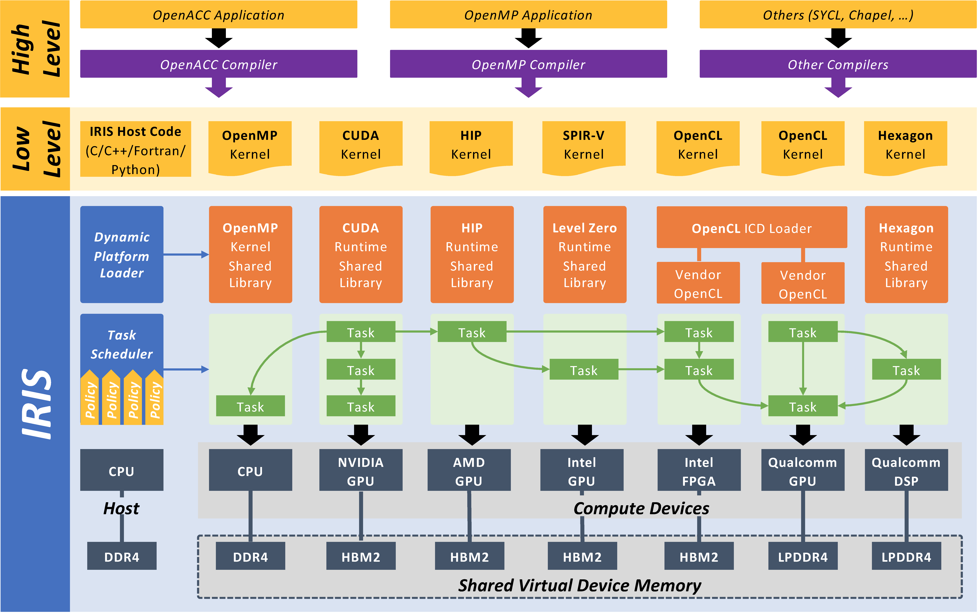
A Task with Four Commands
S[] = A * X[] + Y[]
IRIS Overview
task
H2D(X)
H2D(Y)
Kernel
S[] = A * X[] + Y[]
D2H(S)

Slide 4
A Task with Four Commands
S[] = A * X[] + Y[]
CUDA/HIP Kernel for NVIDIA/AMD GPU
task
extern "C" __global__
void saxpy(float* S, float A, float* X, float* Y) {
int i = blockIdx.x * blockDim.x + threadIdx.x;
S[i] = A * X[i] + Y[i];
}
H2D(X)
H2D(Y)
Kernel
S[] = A * X[] + Y[]
D2H(S)

Slide 5
A Task with Four Commands
S[] = A * X[] + Y[]
OpenMP Kernel for CPU
task
#include <iris/iris_openmp.h>
static void saxpy(float* S, float A, float* X, float* Y, IRIS_OPENMP_KERNEL_ARGS) {
int i;
#pragma omp parallel for shared(S, A, X, Y) private(i)
IRIS_OPENMP_KERNEL_BEGIN(i)
S[i] = A * X[i] + Y[i];
IRIS_OPENMP_KERNEL_END
}
H2D(X)
H2D(Y)
Kernel
S[] = A * X[] + Y[]
D2H(S)

Slide 6
A Task with Four Commands
S[] = A * X[] + Y[]
Host code
task
iris_mem mem_S, mem_X, mem_Y;
iris_mem_create(SIZE * sizeof(float), &mem_S);
iris_mem_create(SIZE * sizeof(float), &mem_X);
iris_mem_create(SIZE * sizeof(float), &mem_Y);
iris_task task;
iris_task_create(&task);
iris_task_h2d(task, mem_X, 0, SIZE * sizeof(float), X);
iris_task_h2d(task, mem_Y, 0, SIZE * sizeof(float), Y);
void* saxpy_params[4] = { mem_S, &A, mem_X, mem_Y };
int saxpy_params_info[4] = { iris_w, sizeof(A), iris_r, iris_r };
iris_task_kernel(task, "saxpy", 1, NULL, &SIZE, NULL, 4, saxpy_params, saxpy_params_info);
iris_task_d2h(task, mem_S, 0, SIZE * sizeof(float), S);
iris_task_submit(task, iris_gpu, NULL, 1);
H2D(X)
H2D(Y)
Kernel
S[] = A * X[] + Y[]
D2H(S)

Slide 7
Two Tasks
S[] = A * X[] + Y[]
CUDA/HIP Kernel for NVIDIA/AMD GPU
task0
task1
extern "C" __global__ void sax(float* S, float A, float* X) {
int i = blockIdx.x * blockDim.x + threadIdx.x;
S[i] = A * X[i];
}
extern "C" __global__ void spy(float* S, float* Y) {
int i = blockIdx.x * blockDim.x + threadIdx.x;
S[i] += Y[i];
}
H2D(X)
H2D(Y)
Kernel
S[] = A * X[]
Kernel
S[] += Y[]
D2H(S)

Slide 8
Two Tasks
S[] = A * X[] + Y[]
OpenMP Kernel for CPU
task0
task1
static void sax(float* S, float A, float* X, IRIS_OPENMP_KERNEL_ARGS) {
int i;
#pragma omp parallel for shared(S, A, X) private(i)
IRIS_OPENMP_KERNEL_BEGIN(i)
S[i] = A * X[i];
IRIS_OPENMP_KERNEL_END
}
static void spy(float* S, float* Y, IRIS_OPENMP_KERNEL_ARGS) {
int i;
#pragma omp parallel for shared(S, Y) private(i)
IRIS_OPENMP_KERNEL_BEGIN(i)
S[i] += Y[i];
IRIS_OPENMP_KERNEL_END
}
H2D(X)
H2D(Y)
Kernel
S[] = A * X[]
Kernel
S[] += Y[]
D2H(S)

Slide 9
Two Tasks
Host Code
S[] = A * X[] + Y[]
task0
task1
iris_task task0;
iris_task_create(&task0);
iris_task_h2d(task0, mem_X, 0, SIZE * sizeof(float), X);
void* sax_params[3] = { mem_S, &A, mem_X };
int sax_params_info[3] = { iris_w, sizeof(A), iris_r };
iris_task_kernel(task0, "sax", 1, NULL, &SIZE, NULL, 3, sax_params, sax_params_info);
iris_task_submit(task0, iris_gpu, NULL, 0);
iris_task task1;
iris_task_create(&task1);
iris_task_h2d(task1, mem_Y, 0, SIZE * sizeof(float), Y);
void* spy_params[2] = { mem_S, mem_Y };
int spy_params_info[2] = { iris_rw, iris_r };
iris_task_kernel(task1, "spy", 1, NULL, &SIZE, NULL, 2, spy_params, spy_params_info);
iris_task_d2h(task1, mem_S, 0, SIZE * sizeof(float), S);
iris_task_depend(task1, 1, &task0);
iris_task_submit(task1, iris_cpu, NULL, 1);
H2D(X)
H2D(Y)
Kernel
S[] = A * X[]
Kernel
S[] += Y[]
D2H(S)

Slide 10
Two Tasks: Relaxed Memory Consistency
Synchronization
Point
Host Code
S[] = A * X[] + Y[]
task0
task1
iris_task task0;
iris_task_create(&task0);
iris_task_h2d(task0, mem_X, 0, SIZE * sizeof(float), X);
void* sax_params[3] = { mem_S, &A, mem_X };
int sax_params_info[3] = { iris_w, sizeof(A), iris_r };
iris_task_kernel(task0, "sax", 1, NULL, &SIZE, NULL, 3, sax_params, sax_params_info);
iris_task_submit(task0, iris_gpu, NULL, 0);
iris_task task1;
iris_task_create(&task1);
iris_task_h2d(task1, mem_Y, 0, SIZE * sizeof(float), Y);
void* spy_params[2] = { mem_S, mem_Y };
int spy_params_info[2] = { iris_rw, iris_r };
iris_task_kernel(task1, "spy", 1, NULL, &SIZE, NULL, 2, spy_params, spy_params_info);
iris_task_d2h(task1, mem_S, 0, SIZE * sizeof(float), S);
iris_task_depend(task1, 1, &task0);
iris_task_submit(task1, iris_cpu, NULL, 1);
H2D(X)
H2D(Y)
Kernel
S[] = A * X[]
Kernel
S[] += Y[]
D2H(S)
GPU
CPU
mem_S
copy
mem_S

Slide 11
Two Tasks: Intelligent Device Selector
Host Code
S[] = A * X[] + Y[]
task0
task1
iris_task task0;
iris_task_create(&task0);
iris_task_h2d(task0, mem_X, 0, SIZE * sizeof(float), X);
void* sax_params[3] = { mem_S, &A, mem_X };
int sax_params_info[3] = { iris_w, sizeof(A), iris_r };
iris_task_kernel(task0, "sax", 1, NULL, &SIZE, NULL, 3, sax_params, sax_params_info);
iris_task_submit(task0, iris_gpu, NULL, 0);
iris_task task1;
iris_task_create(&task1);
iris_task_h2d(task1, mem_Y, 0, SIZE * sizeof(float), Y);
void* spy_params[2] = { mem_S, mem_Y };
int spy_params_info[2] = { iris_rw, iris_r };
iris_task_kernel(task1, "spy", 1, NULL, &SIZE, NULL, 2, spy_params, spy_params_info);
iris_task_d2h(task1, mem_S, 0, SIZE * sizeof(float), S);
iris_task_depend(task1, 1, &task0);
iris_task_submit(task1, iris_locality, NULL, 1);
H2D(X)
H2D(Y)
Kernel
S[] = A * X[]
Kernel
S[] += Y[]
D2H(S)
GPU
GPU → optimal
mem_S
mem_S

Slide 12
A Graph with Two Tasks
Host Code
S[] = A * X[] + Y[]
iris_graph graph;
iris_graph_create(&graph);
iris_task task0;
iris_task_create(&task0);
iris_task_h2d(task0, mem_X, 0, SIZE * sizeof(float), X);
void* sax_params[3] = { mem_S, &A, mem_X };
int sax_params_info[3] = { iris_w, sizeof(A), iris_r };
iris_task_kernel(task0, "sax", 1, NULL, &SIZE, NULL, 3, sax_params, sax_params_info);
iris_graph_task(graph, task0, iris_gpu, NULL);
iris_task task1;
iris_task_create(&task1);
iris_task_h2d(task1, mem_Y, 0, SIZE * sizeof(float), Y);
void* spy_params[2] = { mem_S, mem_Y };
int spy_params_info[2] = { iris_rw, iris_r };
iris_task_kernel(task1, "spy", 1, NULL, &SIZE, NULL, 2, spy_params, spy_params_info);
iris_task_d2h(task1, mem_S, 0, SIZE * sizeof(float), S);
iris_task_depend(task1, 1, &task0);
iris_graph_task(graph, task1, iris_locality, NULL);
iris_graph_submit(graph, iris_default, 1);
graph
task0
task1
H2D(X)
H2D(Y)
Kernel
S[] = A * X[]
Kernel
S[] += Y[]
D2H(S)

Slide 13
Building a Graph from JSON
Host Code
S[] = A * X[] + Y[]
graph
task0
task1
void* json_inputs[9] = { &SIZE, &SIZECB, S, &A, X, Y, mem_S, mem_X, mem_Y };
iris_graph graph;
iris_graph_create_json("graph.json", json_inputs, &graph);
iris_graph_submit(graph, iris_default, 1);
H2D(X)
H2D(Y)
Kernel
S[] = A * X[]
Kernel
S[] += Y[]
D2H(S)

Slide 14
Building a Graph from JSON
JSON
S[] = A * X[] + Y[]
graph
task0
task1
{
"iris-graph": {
"inputs": [ "user-size", "user-size-cb", "user-S", "user-A", "user-X", "user-Y", "user-memS", "user-memX", "user-memY" ],
"graph": {
"tasks": [
{
"name" : "task0",
"h2d": ["user-memX", "user-X", "0", "user-size-cb"],
"kernel": ["sax", ["user-size"], ["user-memS", "user-A", "user-memX"], ["w", "4", "r"] ],
"target": "iris_gpu"
},
{
"name" : "task1",
"h2d": ["user-memY", "user-Y", "0", "user-size-cb"],
"kernel": ["spy", ["user-size"], ["user-memS", "user-memY"], ["rw", "r"] ],
"d2h": ["user-memS", "user-S", "0", "user-size-cb"],
"depends": ["task0"],
"target": "iris_locality"
}]}}}
H2D(X)
H2D(Y)
Kernel
S[] = A * X[]
Kernel
S[] += Y[]
D2H(S)

Slide 15
IR b/w IRIS and SnowWhite
IRIS
Snow
White
JSONs & Kernels
SPIRAL

