Slide 1
IRIS Custom Policy
Jungwon Kim
IRIS mini workshop 2022
January 5, 2022

Slide 2
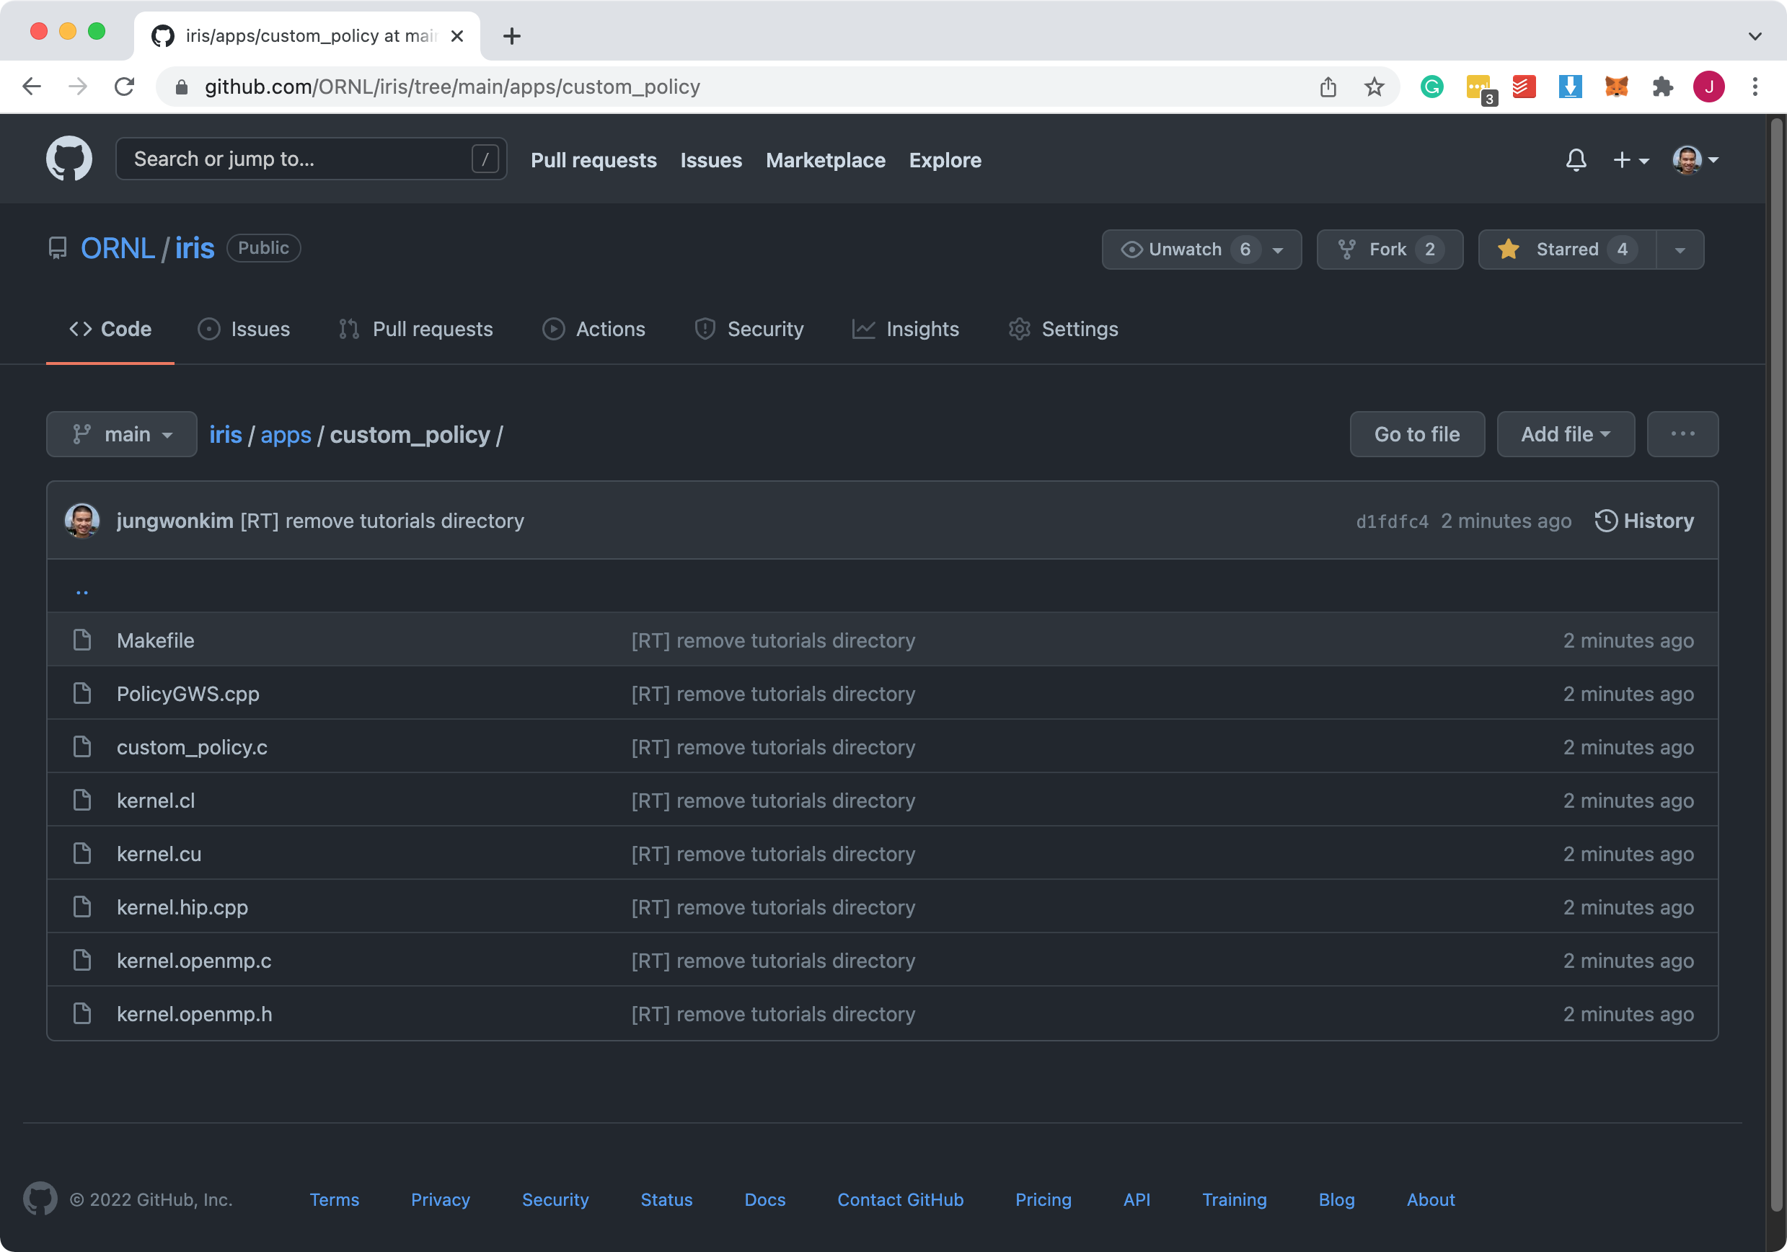
Application: tutorials/custom_policy
https://github.com/ORNL/iris/tree/main/apps/custom_policy

Slide 3
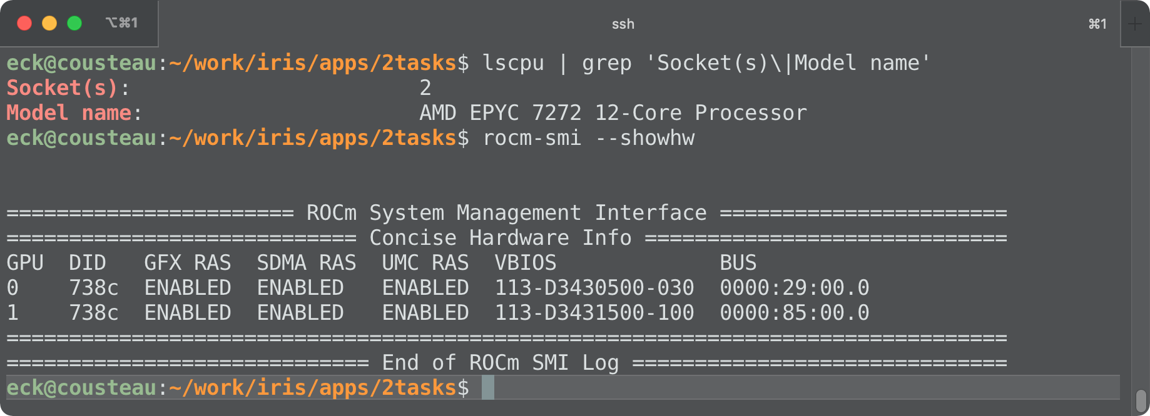
Machine: ExCL/Cousteau
2x AMD EPYC 7272 CPUs + 2x AMD MI100 GPUs

Slide 4
IRIS Custom Policies
Users can write their own device selection policies and plug them in the IRIS task scheduler
Task Scheduler
CPU
Task
gws <= X
Kernel Cmd
global
workitem
size (gws)
GPU
Device Type
Random
RoundRobin
Custom GWS
gws > X

Slide 5
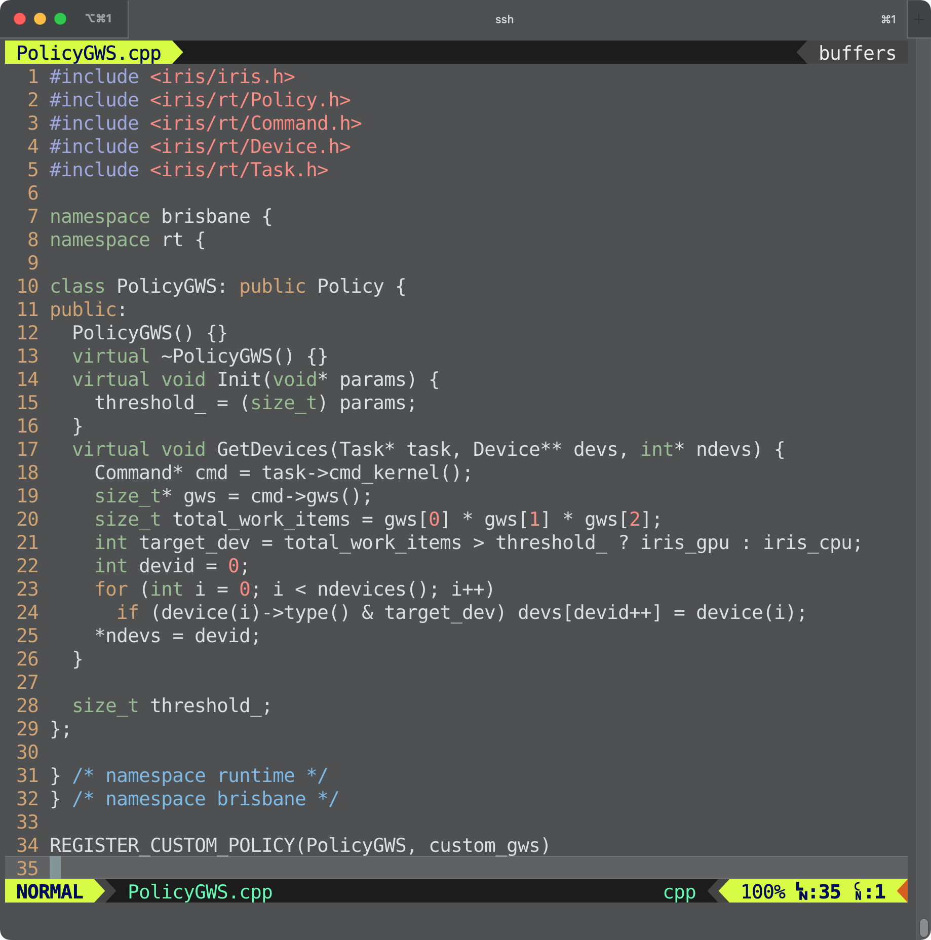
custom_policy/PolicyGWS.cpp
Implement a new subclass of Policy
Init()
GetDevices()
Call REGISTER_CUSTOM_POLICY( class_name, policy_name)
Build a shared library
g++ -std=c++11 -fPIC -shared -o libPolicyGWS.so PolicyGWS.cpp

Slide 6
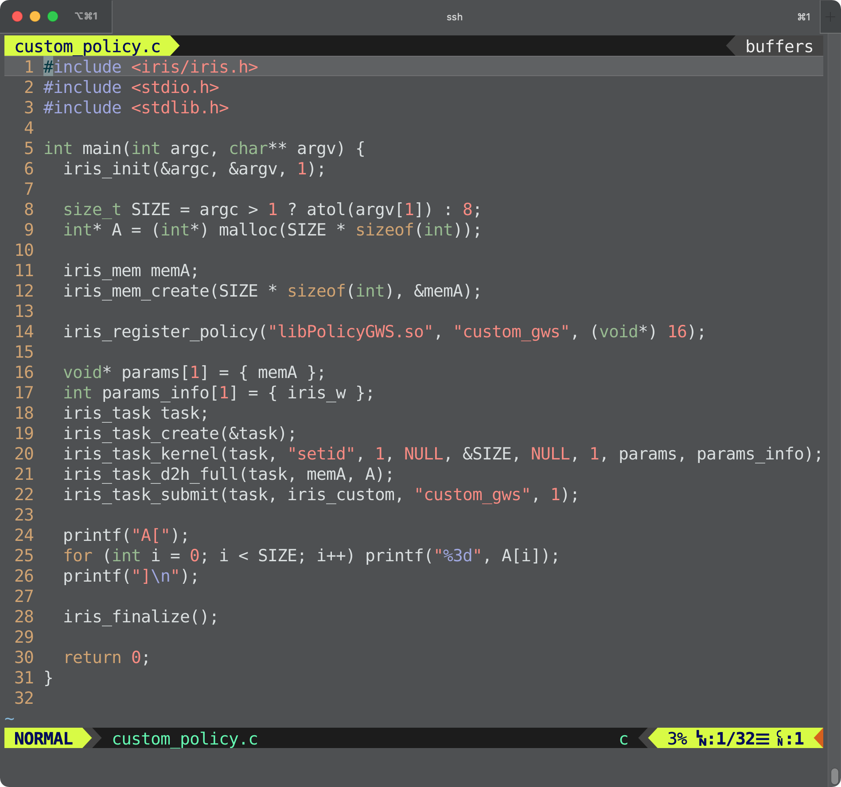
custom_policy/custom_policy.c

Slide 7
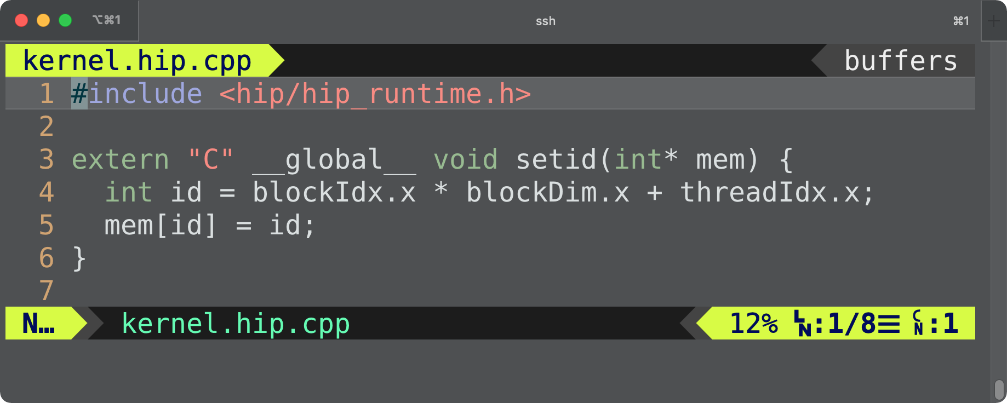
custom_policy/kernel.hip.cpp

Slide 8
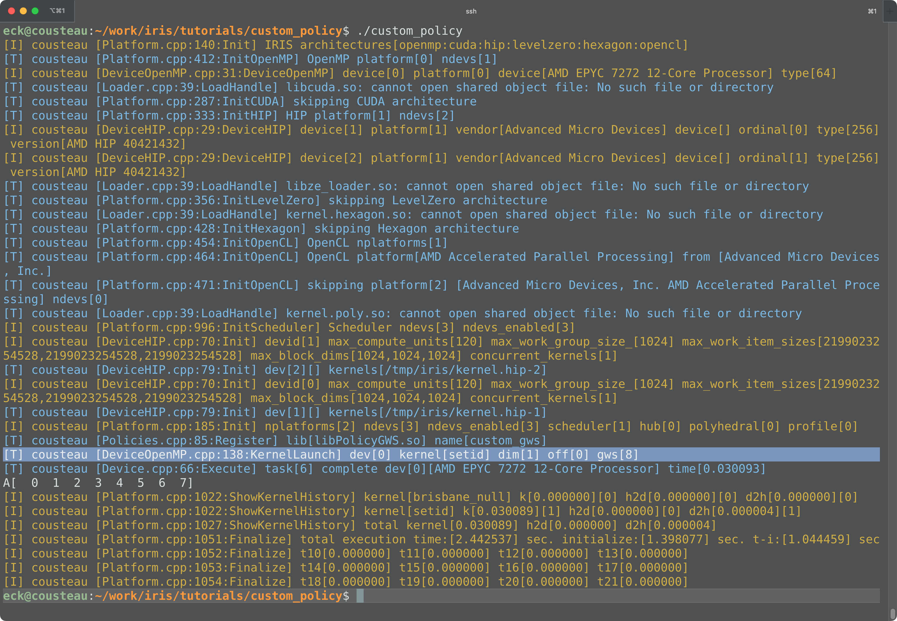
custom_policy/custom_policy 8 → CPU

Slide 9
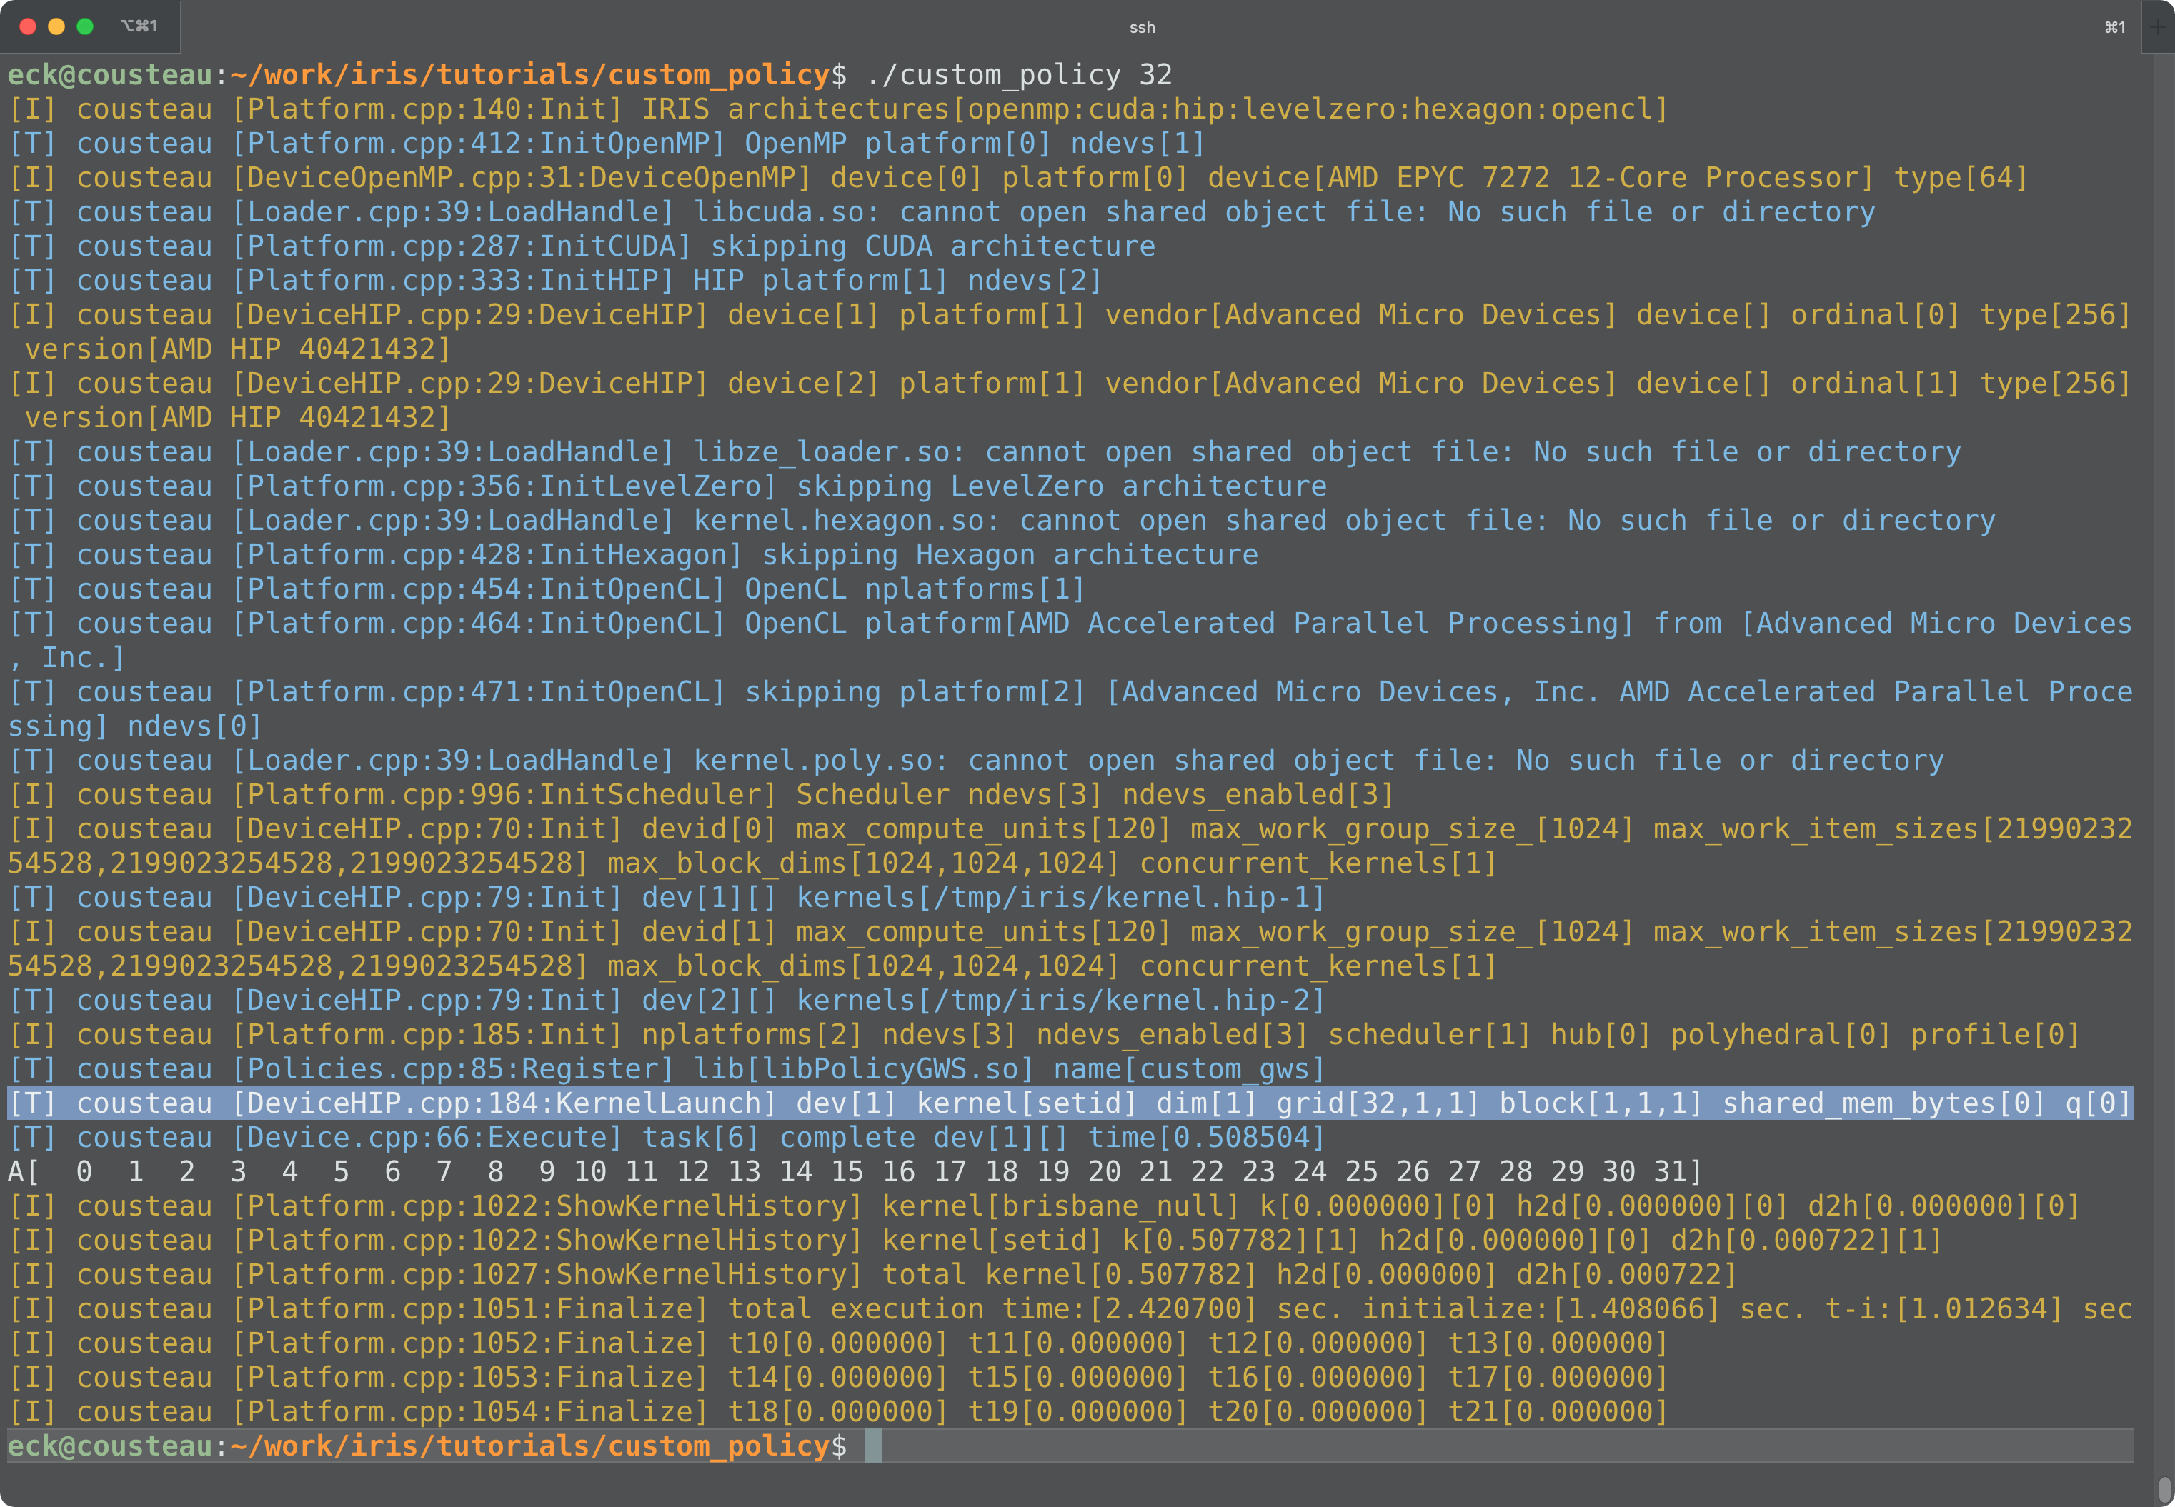
custom_policy/custom_policy 32 → GPU

