Slide 1
HUNTER (WIP)
Python framework and simulator for exploring task schedulers for heterogeneous systems.
Able to model the RANGER hardware scheduler and the IRIS runtime system in an event-based simulator.
Task graphs are specified as a connection and computation matrices or as an IRIS compliant task specification.
Enables exploration into various scheduling policies by providing an environment for training and testing schedules including:
Reinforcement learning
Monte Carlo
PEFT
Enables exploration into hardware accelerator design by allowing the accelerator systems to be modeled at a high level.

Slide 2
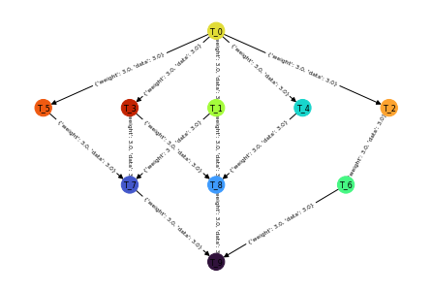
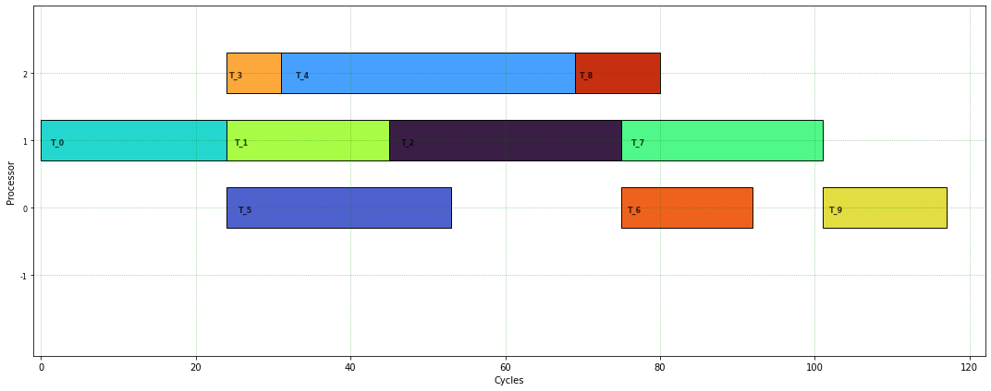
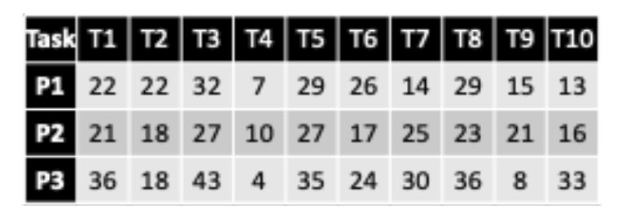
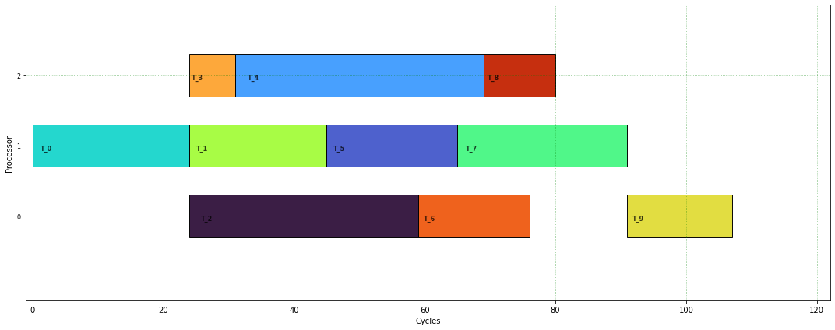
HUNTER Example
Task DAG
PEFT Schedule
Computation Matrix
Best Schedule
Method | Makespan
PEFT | 117
Best Possible | 107

