Slide 1
IRIS Custom Policy
Jungwon Kim
IRIS mini workshop 2022
January 5, 2022

Slide 2
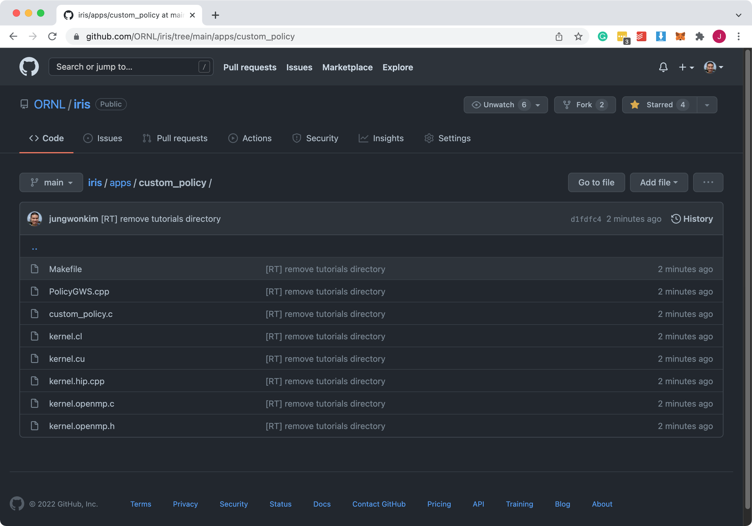
Application: apps/custom_policy
https://github.com/ORNL/iris/tree/main/apps/custom_policy

Slide 3
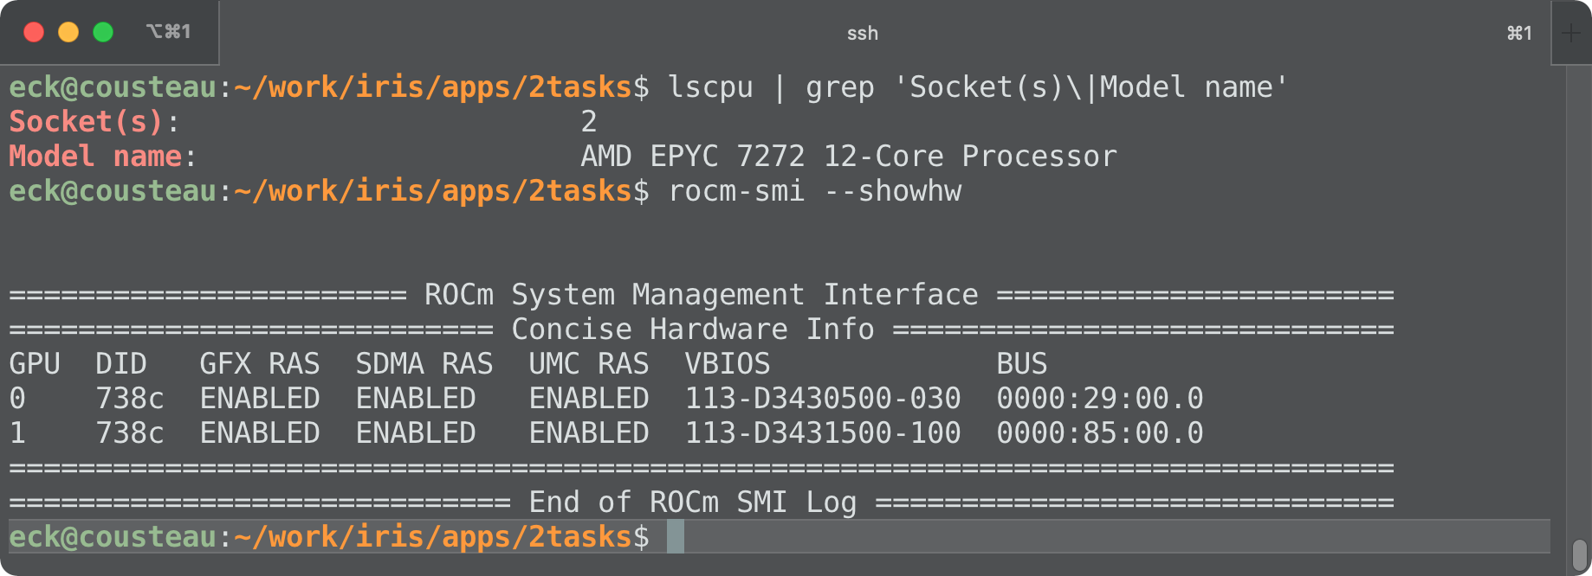
Machine: ExCL/Cousteau
2x AMD EPYC 7272 CPUs + 2x AMD MI100 GPUs

Slide 4
IRIS: Intelligent Runtime System
IRIS can provide intelligent policies
Device selection policies
Kernel selection policies
Task Scheduler
Device Type
Locality-aware
RoundRobin
Profile-based
Built-in Device Selection Policies

Slide 5
Pluginable Custom Policies
Users can write their own device selection policies and plug them in IRIS at run time
Outside of IRIS
IRIS
Task Scheduler
CPU
Task
gws <= X
User's Policy
Shared Library
Kernel Cmd
global
workitem
size (gws)
GPU
Custom GWS
RoundRobin
Locality-aware
Profile-based
gws > X
Built-in Policies

Slide 6
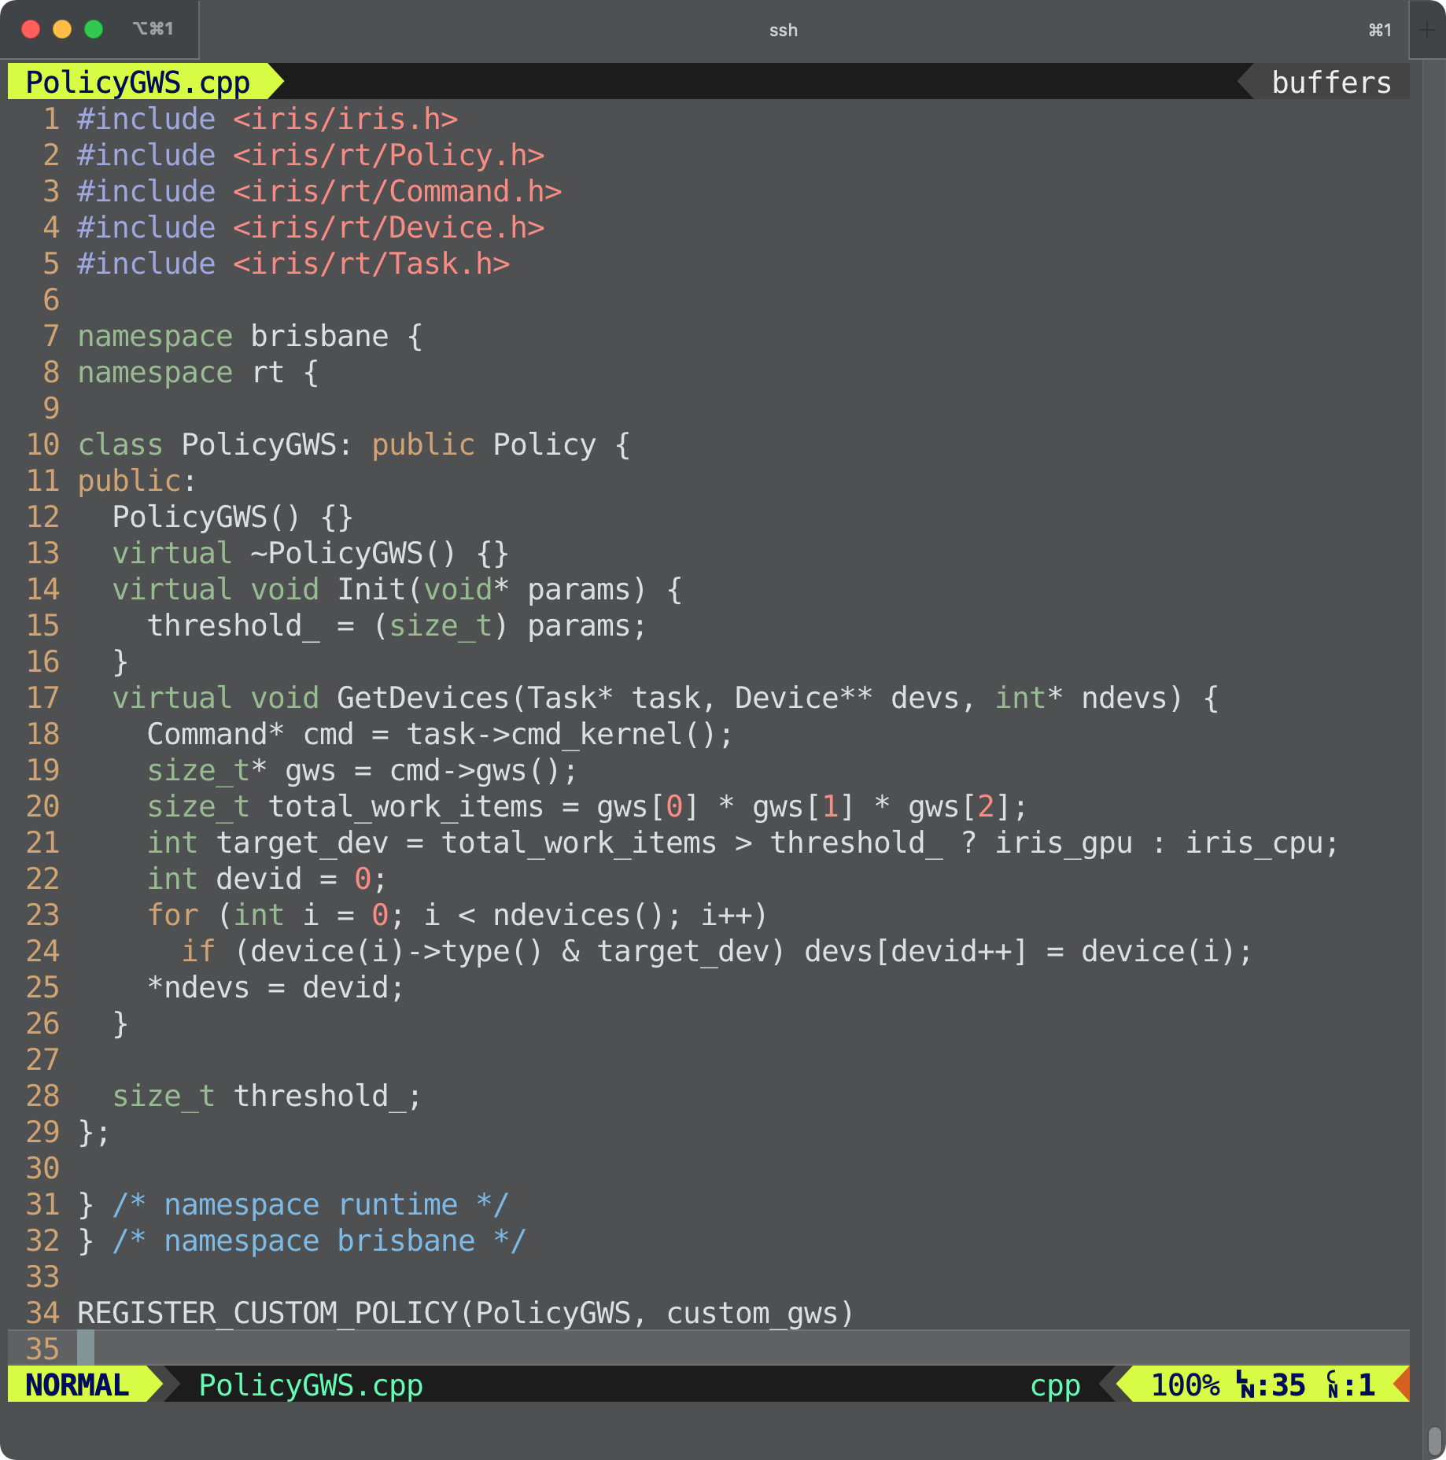
custom_policy/PolicyGWS.cpp
Implement a new subclass of Policy
Two virtual functions: Init(), GetDevices()
Call REGISTER_CUSTOM_POLICY( class_name, policy_name)
Build a shared library
g++ -std=c++11 -fPIC -shared -o libPolicyGWS.so PolicyGWS.cpp

Slide 7
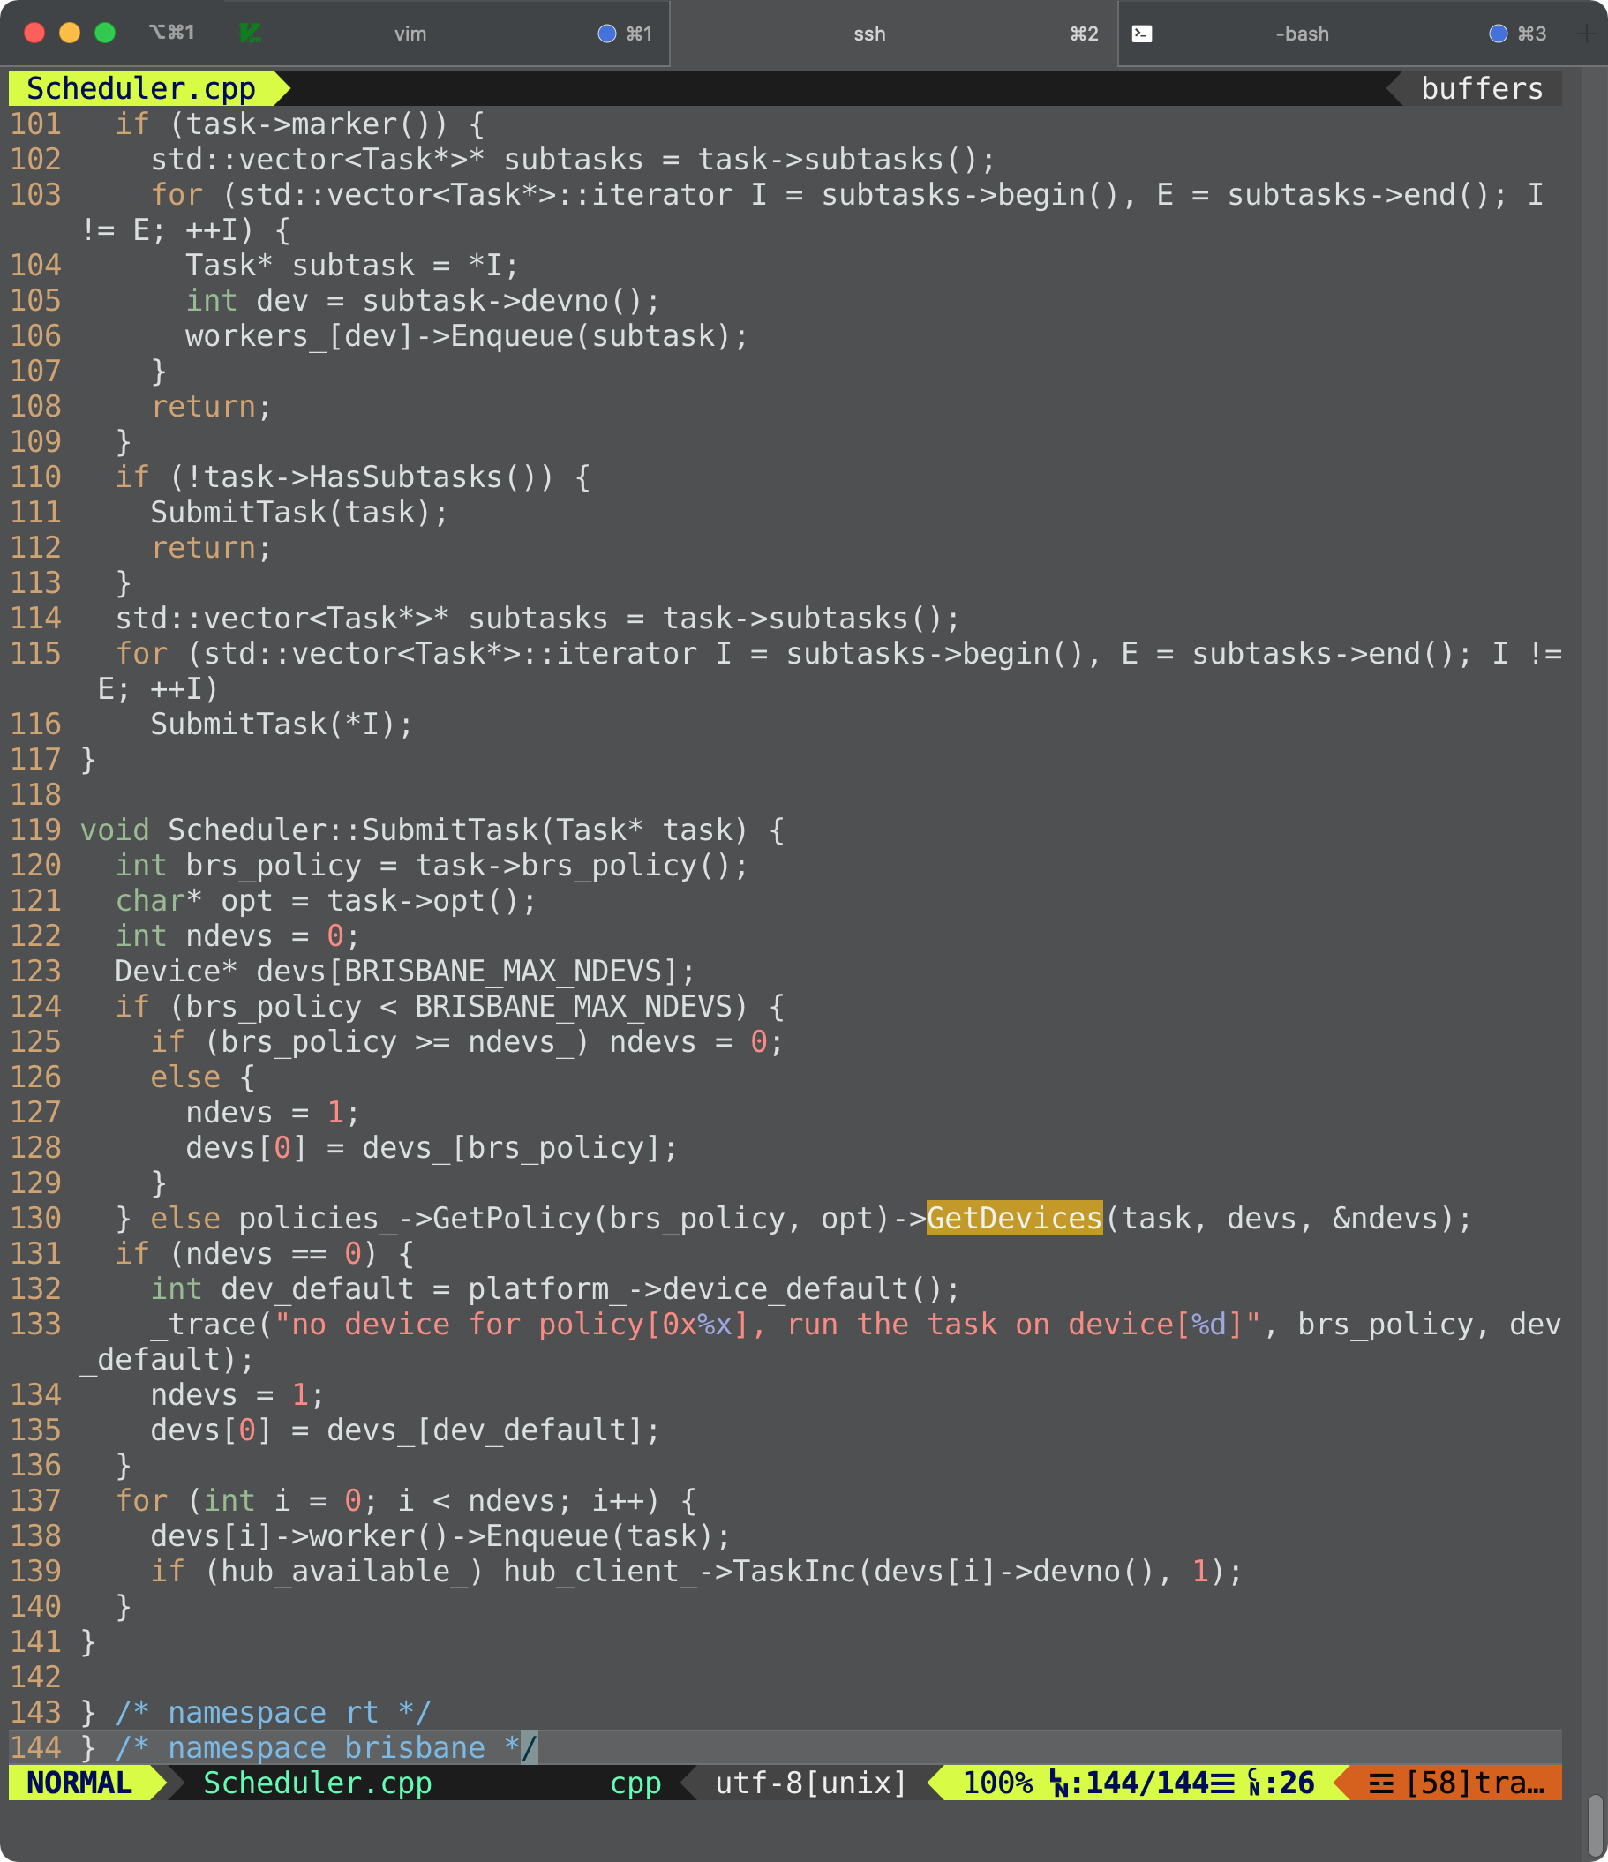
src/runtime/Scheduler.cpp

Slide 8
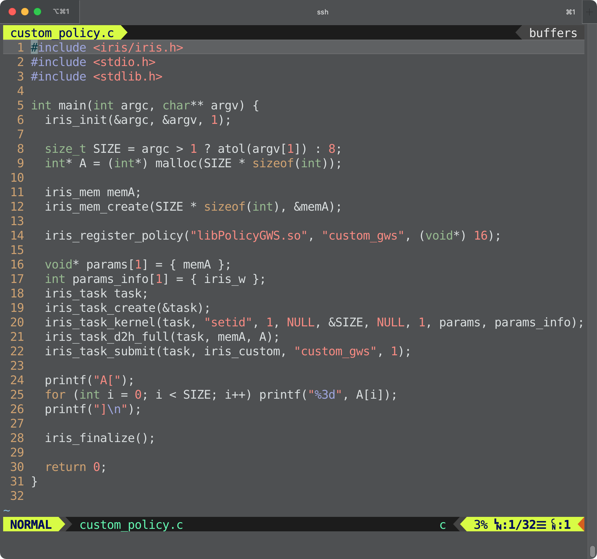
custom_policy/custom_policy.c
iris_register_policy( shared_library_path, policy_name, init_params);
iris_task_submit(… iris_custom, policy_name, …);

Slide 9
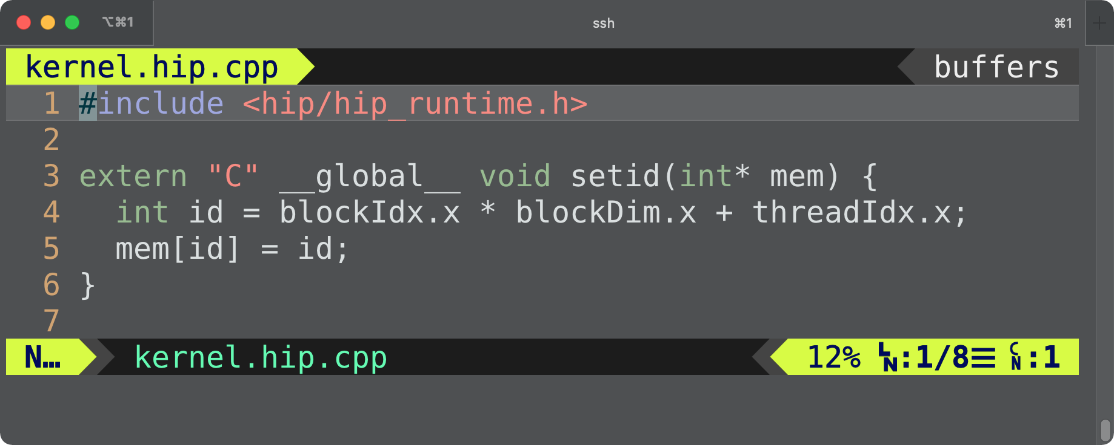
custom_policy/kernel.hip.cpp

Slide 10
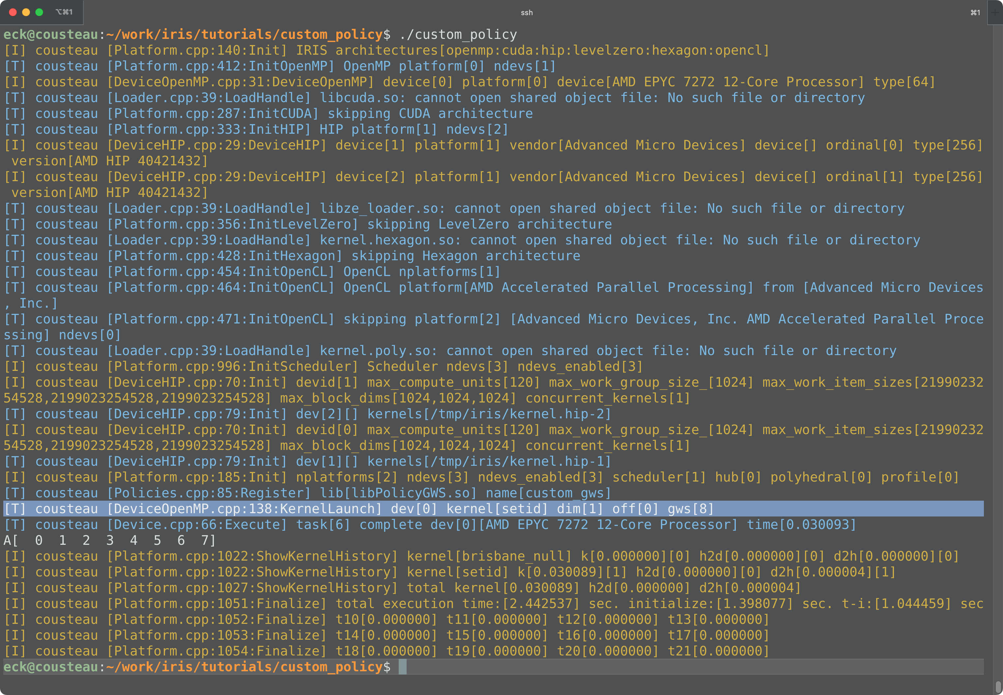
custom_policy/custom_policy 8 → CPU

Slide 11
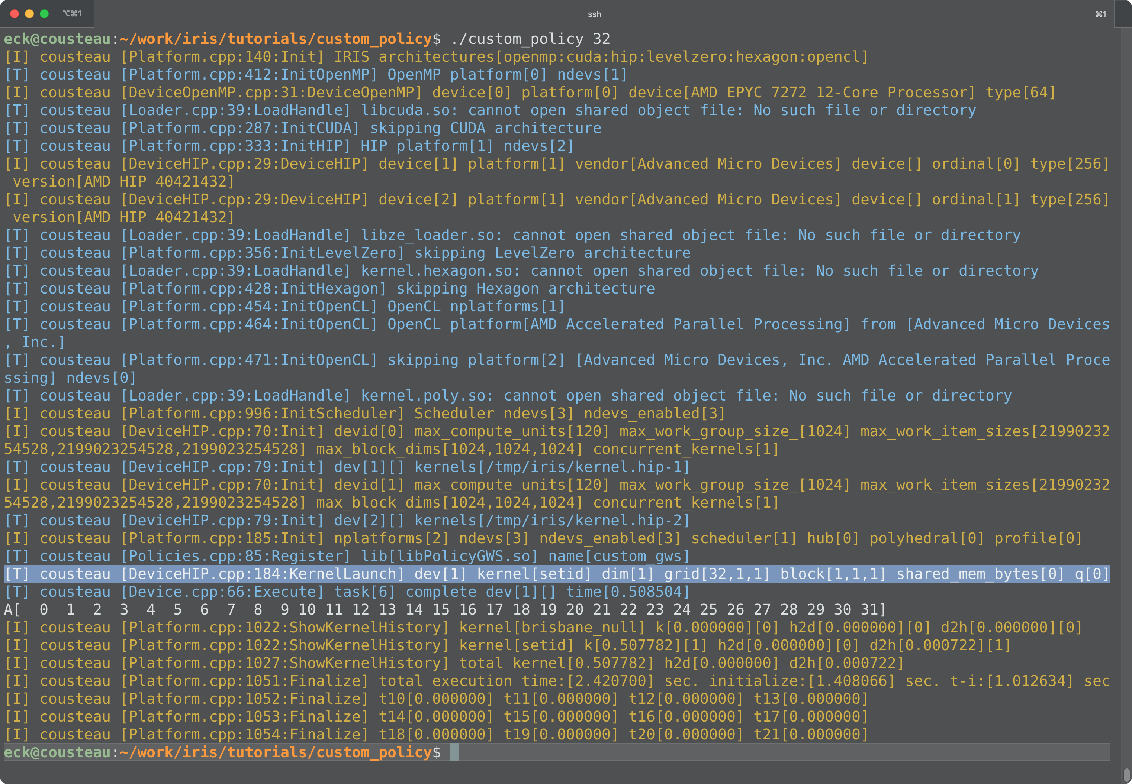
custom_policy/custom_policy 32 → GPU

