Slide 1

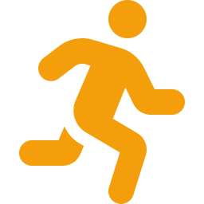
ACL
Pivot point
Real-Time Rotational Torque Detection & Haptic Warning System
TEAM MEMBERS
Harshil Mishra
Shreesh Tripathi
Bhargavi Deo
Nandan Krishna S
Kamalnath
Intra Prodex
Notes:
1

Slide 2




PROBLEM STATEMENT
Why are athletes still getting injured despite wearing braces?
How ACL Injuries Happen
The Critical Gap
Knee twists too fast during landing or pivoting
Tibial internal rotation exceeds safe threshold
Ligament absorbs full torque - then snaps
Non-contact injuries are most common (70%+)
No real-time warning before ligament snaps
Twist angle is invisible to the naked eye
Traditional braces are purely passive
No field-ready monitoring solution exists
The Data
Current Braces Are Blind
₹3–8 Lakh surgery + 9–12 months recovery
High recurrence: 15–25% re-injury rate
Athletes in football, basketball, badminton most at risk
68.6 ACL tears per 100,000 population in India
Resist forward movement, not hidden rotation
No sensors to detect rotational torque
Cannot trigger any warning in real-time
Notes:
2

Slide 3
RESEARCH & LITERATURE REVIEW
The scientific foundation of our solution
Mechanism of Non-Contact ACL Injuries
Tibial Internal Rotation & ACL Strain
PMC · 2022
PMC · 2024
01
ACL ruptures predominantly occur through tibial internal rotation combined with knee valgus - NOT direct contact. Landing/pivoting biomechanics are the primary culprit.
02
Excessive tibial internal rotation beyond 15°-20° significantly increases ACL loading. This threshold is measurable via differential IMU readings across the joint.
Insight: Rotation is the root cause.
Insight: Gives us our exact Red Zone threshold (15°–20°) for haptic alerts.
Knee Flexion Angles & ACL Injury Risk
Design of Real-Time ACL Monitoring System
medRxiv · 2025
ResearchGate · 2024
03
ACL injuries peak at low knee flexion angles (< 30°). Athletes land stiff-legged during fatigue, increasing rotational risk. Real-time feedback can correct this.
04
IMU-based systems using ESP32 can achieve sub-100ms response latency for joint angle calculations. Differential processing between two sensors is validated as accurate.
Insight: Validates need for in-field, real-time monitoring rather than lab analysis.
Insight: Confirms our ESP32 + dual MPU-6050 architecture is technically feasible.
Notes:
3

Slide 4
EXISTING SOLUTIONS & THEIR GAPS
Every current solution fails athletes
Solution
What It Does
Critical Limitation
Conclusion
DonJoy / Breg
Functional Braces
Rigid mechanical frame; limits extreme flexion & extension
100% passive - zero sensor data, cannot detect or warn about hidden rotational torque
Blind to rotation
Vicon Optical
Motion Capture
Sub-millimeter 3D tracking of all joint kinematics via camera arrays
Requires lab setup with multiple cameras. Completely unusable on sports fields or clinics
Lab-only, costs lakhs
Smart Compression
Sleeves (e.g. Athos)
Track general metrics (steps, jump height) via embedded single sensors
No rigid support frame - cannot absorb torque. No differential angle processing or haptic alert
No rigid support, no haptics
Our Dynamic
Knee Ankle Support
Dual IMU + rigid frame + real-time differential processing + haptic biofeedback
Currently requires per-athlete calibration.
Field-ready, real-time, way less cost than our competitors
No existing solution combines mechanical support + real-time sensing + haptic alert in a field-deployable, affordable package.
Notes:
4

Slide 5


OUR SOLUTION - SYSTEM OVERVIEW
A two-part system: physical protection with technological integration
PART 1 - MECHANICAL FRAME
PART 2 - IoT MONITORING BRAIN
1
Dual Cuff Frame
1
Dual MPU-6050 IMU Array
Tapered thigh + calf cuffs for secure fit
One sensor on thigh, one on calf
2
Aluminum Rods
2
ESP32 Controller
Lateral rigid rods absorb rotational torque
Pulls data from both IMUs, calculates parameters
+
3
Revolute Hinge
3
Differential Processing
Lap-joint pin mirrors knee's natural rotation axis
Based on Thigh rotation & Calf rotation
4
Sliding Slot
4
Haptic Alert
Calf rod slot allows free bending, resists twist
ERM motor fires when angle > Red Zone
5
Strap System
5
Bluetooth Logging
D-Ring Velcro locks frame to bone movement
Streams movement data to smartphone/coach app
Notes:
5

Slide 6





MECHANICAL DESIGN
External skeleton engineered to protect without restricting natural athletic movement
Dual Tapered Cuff Frame
Lateral Aluminum Rods
Two cuffs (Thigh & Calf) shaped wider at top, narrower at base - mirroring leg anatomy for anti-slip fit. Prevents the brace from sliding during dynamic movement.
Rigid rods mounted on the lateral (outer) side. Thigh rod fixed via two bolts for a solid femoral anchor. Calf rod secured through a sliding oval slot.
Revolute Hinge (Lap Joint)
Kinematic Sliding Slot
D-Ring Velcro Strap System
Two rods joined at the knee via a lapped pin joint, mimicking the knee's primary flexion axis. Metal stiffness resists the twisting forces that cause ACL tears.
The calf rod's bolt sits in a vertical oval slot - allows free knee bending (flexion) while maintaining constant lateral and rotational guidance of the lower leg.
Loop-back Velcro straps threaded through integrated D-ring slots. Creates high-pressure compression lock ensuring sensors stay perfectly synced with bone movement.
Notes:
6

Slide 7



IOT & SENSING ARCHITECTURE
How the system reads, processes, and reacts to dangerous rotation in milliseconds
MPU-6050 (Thigh)
MPU-6050 (Calf)
ESP32 Controller
Differential Processing
Haptic Output
▶
▶
▶
▶
I2C Address: 0x68
Tracks femur orientation via 6-axis gyro+accel
I2C Address: 0x69
AD0 pin bridged HIGH to offset address
Pulls data from both IMUs via I2C bus
High-frequency real-time processing
Twist Angle = Calf Yaw − Thigh Yaw
Calculated every sensor cycle
Digital signal to ERM motor
Alert fires if angle > Red Zone
AD0 Address Trick
Differential Formula
Bluetooth Data Logging
Two identical MPU-6050 chips share one I2C bus. The calf sensor's AD0 pin is wired HIGH, shifting its I2C address from 0x68 → 0x69 to avoid collision.
Twist Angle (°) = Thigh Gyro Yaw − Calf Gyro Yaw
This net rotation isolates the knee's internal/external rotation irrespective of whole-body movement.
ESP32's onboard BLE module streams timestamped angle data to a smartphone. Movement patterns are logged for post-session coach/doctor review.
Notes:
7

Slide 8



HAPTIC FEEDBACK LOOP
From dangerous angle to corrective warning
SAFE ZONE (0°–15°)
WARNING (15°–20°)
RED ZONE (>20°) - ALERT FIRES
01
Athlete Pivots
02
ESP32 Calculates Twist Angle
03
Red Zone Threshold Crossed
04
ERM Motor Fires
05
Athlete Self-Corrects
During a landing or cut, the knee begins rotating. Both MPU-6050 sensors capture real-time orientation data independently.
→
The controller subtracts calf yaw from thigh yaw to compute the exact internal rotation of the knee joint in real time.
→
If the differential angle exceeds 15°-20°, the ESP32 identifies a high-risk event. A trigger signal is generated.
→
The embedded Eccentric Rotating Mass vibration motor activates, delivering a sharp tactile pulse directly against the athlete's skin.
→
The physical sensation is an instant reflex trigger. The athlete adjusts stance or landing mechanics before reaching ligament failure threshold.
Vibration alert is instantaneous; the athlete feels it before the ligament reaches its mechanical failure point.
Notes:
8

Slide 9







KEY FEATURES SUMMARY
6 integrated features that set the Dynamic Knee Ankle Support apart
Kinematic Sliding Slot
Dual-Node IMU Array
Real-Time ESP32 Processing
Oval slot on calf rod, free bending, constant rotational resistance
Two MPU-6050s track femur vs. tibia orientation independently
High-frequency on-device computation
Haptic Biofeedback Alert
Load-Sharing Mitigation
Bluetooth Data Logging
Instant tactile pulse when knee enters dangerous Red Zone
Rigid frame absorbs mechanical stress alongside the ligament
Streams movement patterns wirelessly to coach/doctor app
Notes:
9

Slide 10
COST ANALYSIS
A ₹1,950 solution vs. alternatives
Category
Component
Cost
Cost Comparison vs. Alternatives
Microcontroller & Sensors
ESP32 + 2× MPU-6050 IMU
₹800
Vicon Motion Capture
Haptic Feedback
ERM Vibration Motor + Driver
₹150
₹20–50 Lakh
Power Supply
3.3V Li-ion Battery + Switch
₹100
DonJoy Brace
Wearable Base
Compression Knee Sleeve
₹450
₹5,000–15,000
3D Printed Frame
PETG / Nylon / CF-PLA Filament
₹300
Smart Sleeves
₹3,000–8,000
Mechanical Fasteners
M4 Shoulder Bolts + Nyloc Nuts
₹150
Wiring & Misc
Jumper Wires, connectors
₹0
Our Solution
₹1,950
TOTAL ESTIMATED COST
~₹1,950
At ₹1,950, our device is 2.5–8× cheaper than passive-only braces, and over 1,000× cheaper than lab systems.
Notes:
10

Slide 11


TARGET MARKET
A multi-tier addressable market from grassroots sports to professional rehabilitation
PRIMARY MARKET
SECONDARY MARKET
TERTIARY MARKET
Athletes — College & Professional
Post-Surgical Rehab Patients
Institutions & Training Bodies
Channels:
Channels:
Channels:
Football • Basketball • Badminton • Volleyball • Wrestling
Physiotherapy clinics • Orthopaedic hospitals • Sports medicine centres
Sports academies
School/college sports programs
Why they need us:
Why they need us:
Why they need us:
High-ACL-risk sports with frequent pivot, cut, and landing movements. First adopters who directly benefit from real-time injury prevention.
Recovering athletes need biomechanical monitoring to avoid re-injury. Our device provides data-driven rehab with haptic correction for safe return-to-sport.
Institutional procurement for injury prevention monitoring across squads. Coach dashboards and data analytics create ongoing subscription value.
68.6 ACL tears per 100,000 population
15–25% re-injury rate post-ACL reconstruction
Global sports medicine market: $9.2B (2024)
Global sports medicine market projected to reach $15.3B by 2030 — growing at 6.5% CAGR (Grand View Research)
Notes:
11

Slide 12





RISKS & LIMITATIONS
Transparent risk assessment - and our mitigation roadmap for each
Sensor Drift Over Time
Comfort
Per-Athlete Calibration
Risk:
Risk:
Risk:
Gyroscope bias accumulates → angle readings become inaccurate after extended use.
Rigid frame may cause discomfort in long matches; athletes may remove brace.
Each user requires individual calibration for accurate Red Zone thresholds.
Mitigation:
Mitigation:
Mitigation:
Periodic re-calibration protocol + drift-correction algorithm in firmware.
Comfortable padding, lightweight materials, comfort-testing iterations.
Auto-calibration routine on first use; ML-based adaptive baseline.
Not a Medical Replacement
Regulatory Pathway
Battery Life Constraints
Risk:
Risk:
Risk:
Device is a warning system — cannot prevent all injuries or replace clinical assessment.
Medical device clearance required before clinical or commercial deployment.
3.3V Li-ion battery limits continuous operation — replacement/recharging during matches.
Mitigation:
Mitigation:
Mitigation:
Clear usage guidelines + medical professional integration in dashboard.
Plan: Start as sports training aid
Low-power ESP32 sleep modes; wireless charging coil integration planned.
Notes:
12

Slide 13




FUTURE PROSPECTS
The roadmap from prototype to AI-powered sports safety platform
ML & Predictive Analytics
Personalized Fatigue-Risk Baselines
Leveraging Bluetooth-logged biomechanical data, machine learning models will learn each athlete's unique movement patterns and establish personalized baselines. The system will predict fatigue-related injury risk BEFORE kinematics enter the danger zone.
Each athlete's 'normal' rotation profile varies. Adaptive calibration will auto-adjust Red Zone thresholds based on individual biomechanics, sport type, and real-time fatigue levels detected from gait pattern degradation.
ML on ESP32
Anomaly detection
Long-term pattern learning
Adaptive thresholds
Fatigue modelling
Sport-specific profiles
Miniaturisation & Wireless Charging
Coach & Doctor Dashboard App
Replacing current components with miniaturized alternatives and integrating a wireless charging coil will reduce device weight by 40%+. Form factor will shrink to a discreet sensor patch worn beneath athletic gear.
A cross-platform mobile/web app providing coaches and physiotherapists with real-time biomechanical dashboards, session reports, injury risk heatmaps, and long-term trend analysis for entire squads.
miniaturization
wireless charging
Sub weight
App
Squad analytics
Injury risk heatmaps
Notes:
13

Slide 14
THANK YOU

Slide 15
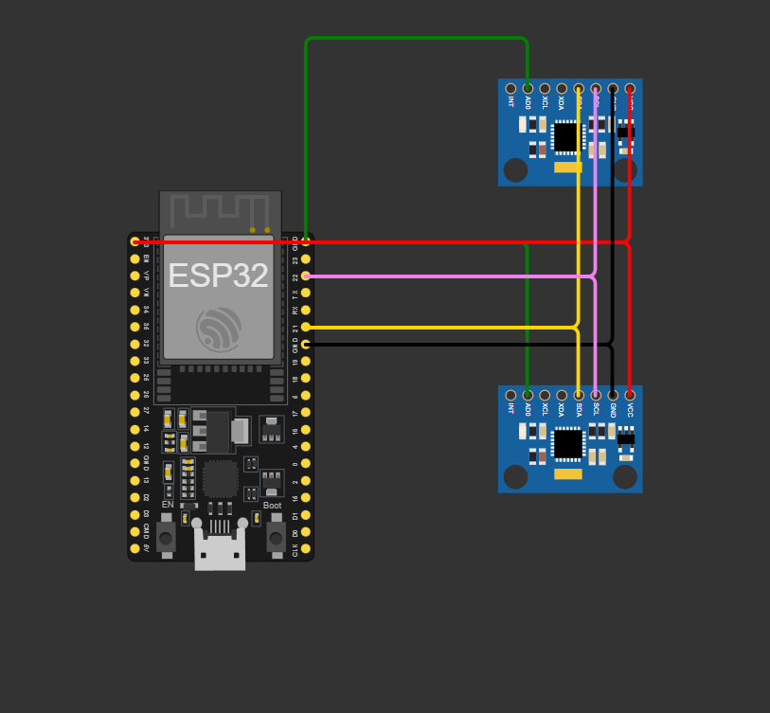
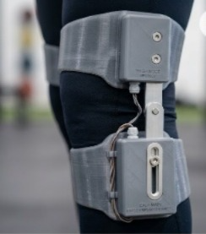
APPENDIX - Circuit Diagram & Visual representation
Notes:
14

Slide 16
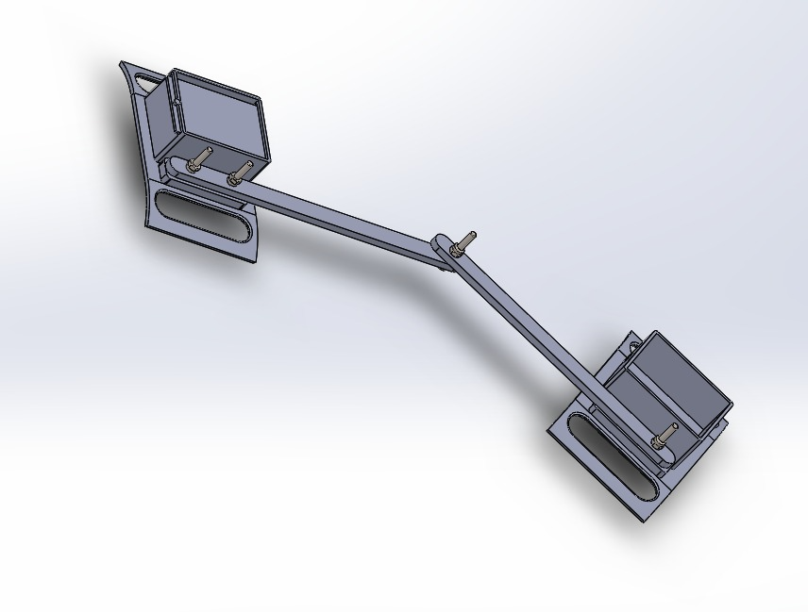
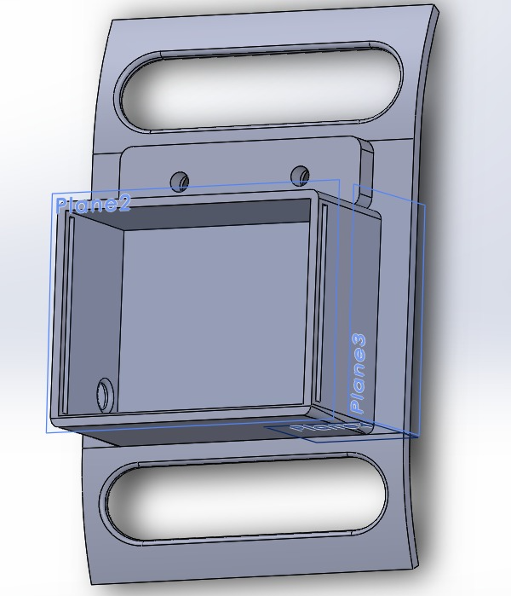
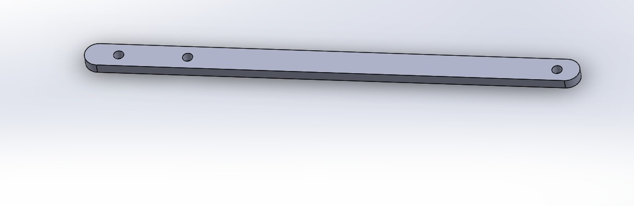
APPENDIX – CAD & References
Mechanism of non contact ACL injuries
PMC · 2022
Tibial internal rotation
PMC · 2024
Relation of Kneeflexion angles with ACL injuries
medRxiv · 2025
Design and Development of a Real-time Monitoring System for ACL Injury Prevention
ResearchGate · 2024
ESP32 programming guide
Notes:
15

