Slide 1
DEMO

Slide 2
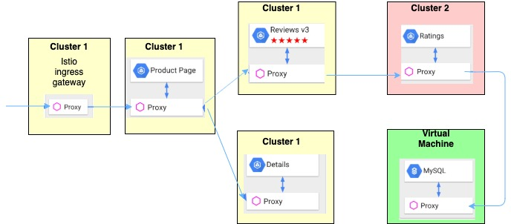
Overview

Slide 3
Info
Cluster 1:
us-east
K8s: v1.14.6+IKS
Ingress gateway public IP
Cluster 2:
us-south
K8s: v1.15.5+IKS
Ingress gateway public IP
VM running mysql

Slide 4
Steps
VM
Show DB info in vm
Cluster 2
add mysql db on cluster 2 into mesh
Install ratings on cluster2
Cluster 1
Create service entry for ratings svc(running in cluster 2)
Modify reviews-v3 env variable
Deploy productpage + details + reviews v3
Access product page via ingress gateway public IP in cluster 1
Update DB in VM
Access productpage again to get latest db changes!

