Slide 1
Lending Club Case Study
- Duc Luong
- Dnyaneshwari Chidrawar

Slide 2

Business Objective
The company wants to understand the driving factors behind loan default
The variables which are strong indicators of default.
The company can utilise this knowledge for its portfolio and risk assessment.

Slide 3
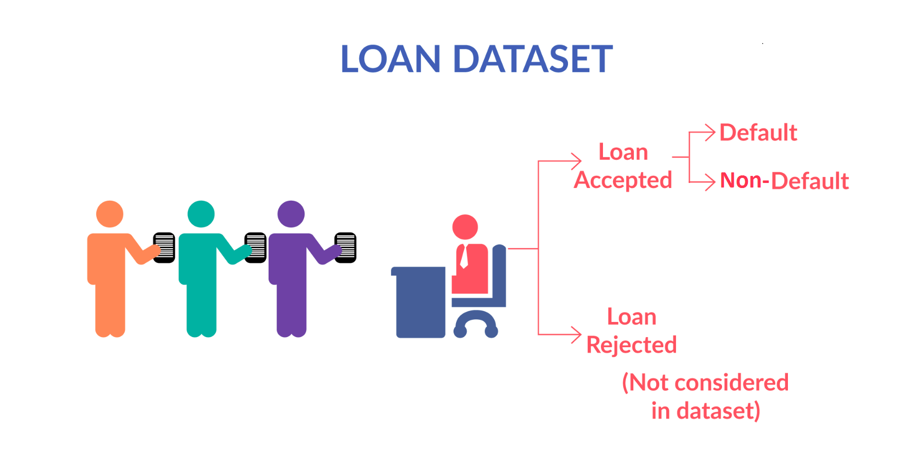
Abstract
When a person applies for a loan, there are two types of decisions that could be taken by the company:
Loan accepted: If the company approves the loan, there are 3 possible scenarios described below:
Fully paid: Applicant has fully paid the loan (the principal and the interest rate)
Current: Applicant is in the process of paying the instalments, i.e. the tenure of the loan is not yet completed. These candidates are not labelled as 'defaulted'.
Charged-off: Applicant has not paid the instalments in due time for a long period of time, i.e. he/she has defaulted on the loan
Loan rejected: The company had rejected the loan (because the candidate does not meet their requirements etc.).

Slide 4

Data Cleaning
Originally data set contains 39717 rows and 111 columns. We have cleaned the data in following steps -
Dropped Empty Columns : 54 empty columns dropped
Dropped Single Valued Columns : 9 columns had single value throughout the rows
Dropped Unique Field : 3 fields had unique value for all rows, no use in analysis
Dropped fields which have more than 90% missing values : removed 2 fields
Dropped fields which have most of the numbers at 0 and remaining are outliers : removed 4 fields
Dropped unnecessary fields which wont help in analysis : Removed 14 fields like “title”, “zip_code”
After data cleaning, our concrete data set contains only 25 columns/fields

Slide 5
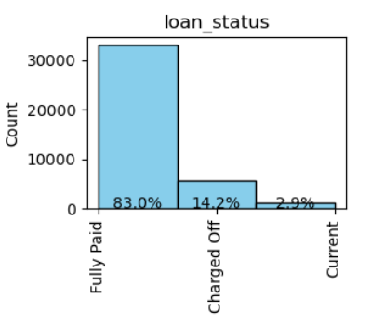
Loan Status
14.2% of loans gets defaulted.

Slide 6
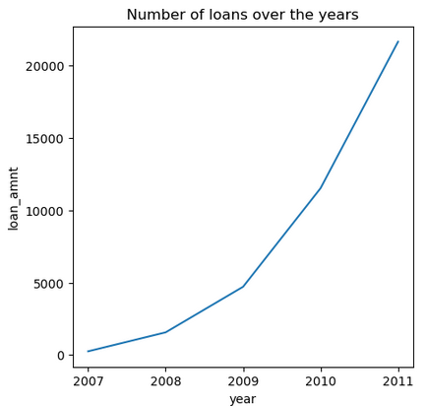
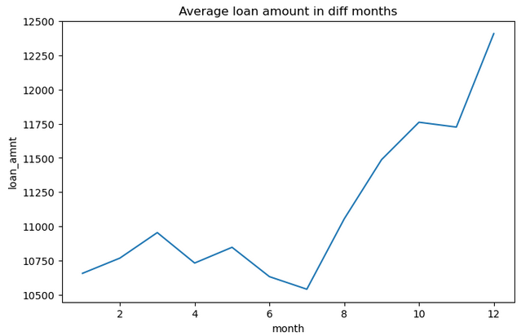
Loan vs Time Period
Number of loan applicants are increasing over the period of time.
Total borrowers in 2011 is highest i.e. 21K
On an average loan amount given to the borrowers is high in 2nf half of the year compared to first half

Slide 7
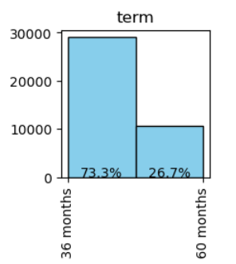
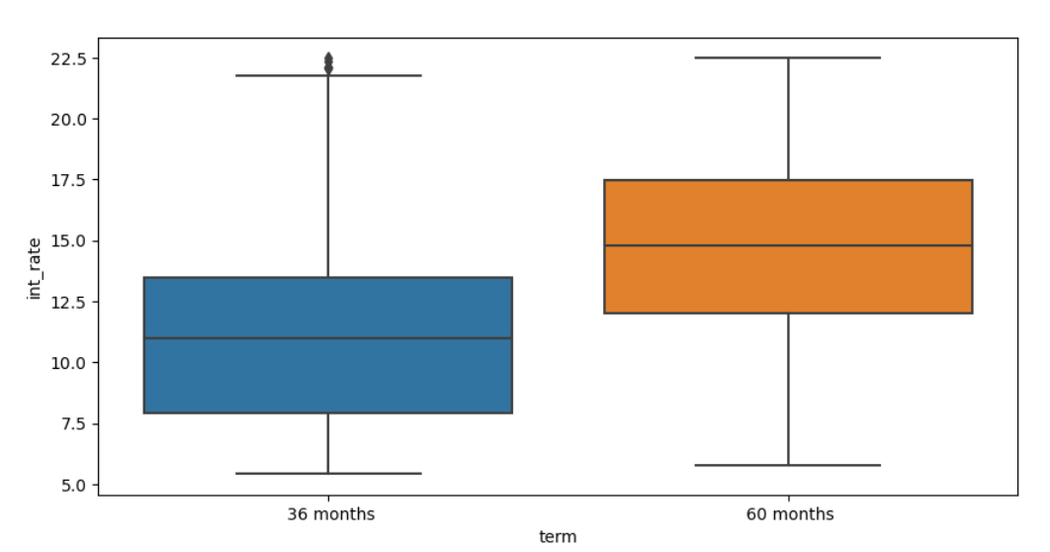
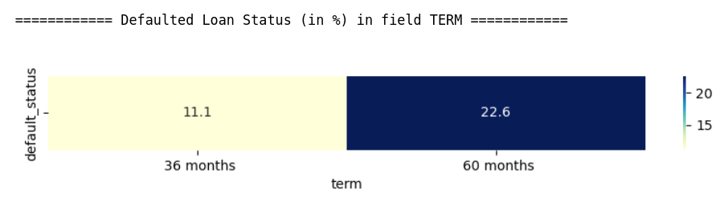
Term, Interest rate, Default Status
Most of the loans (73%) have 36 months tenure where as only 26% loans have 60 months tenure.
Interest rate for 60 months tenure loans is higher than that of 36 months loan.
And chances of 60 months loan getting default is double (22.6%) that of 36 months loans (11.1%)

Slide 8
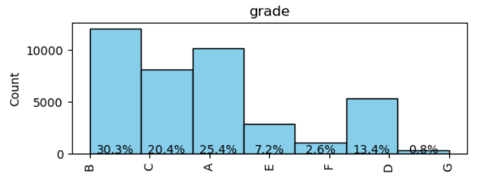
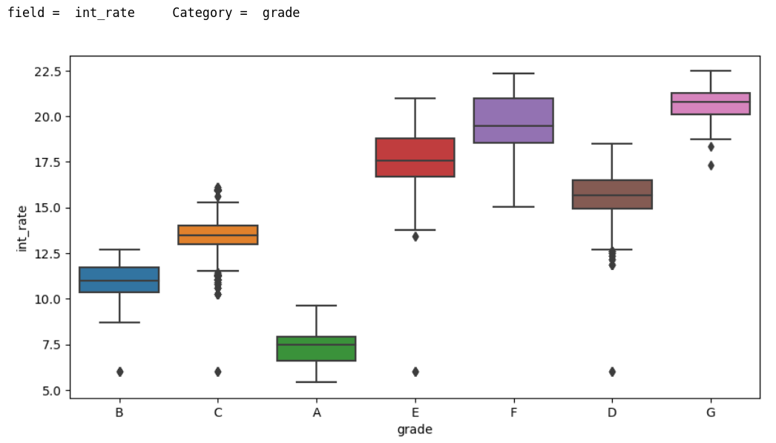
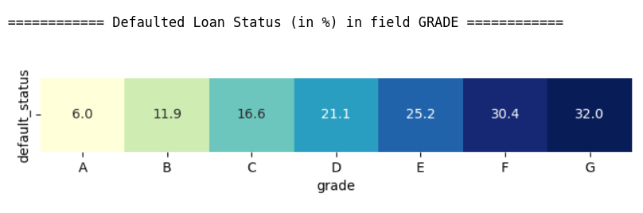
Grade, Interest rate, Default Status
75% loans are Grade A(25%), B(30%), C(20%)
Interest rates and Default rates are low for A, B, C grades.
Interest rate is gradually increasing for the A, B, C, D, E, F, G grade loans
There is a 32% chance of G grade loans getting defaulted.
Higher the grade, higher is the interest rate, high chances of getting default

Slide 9
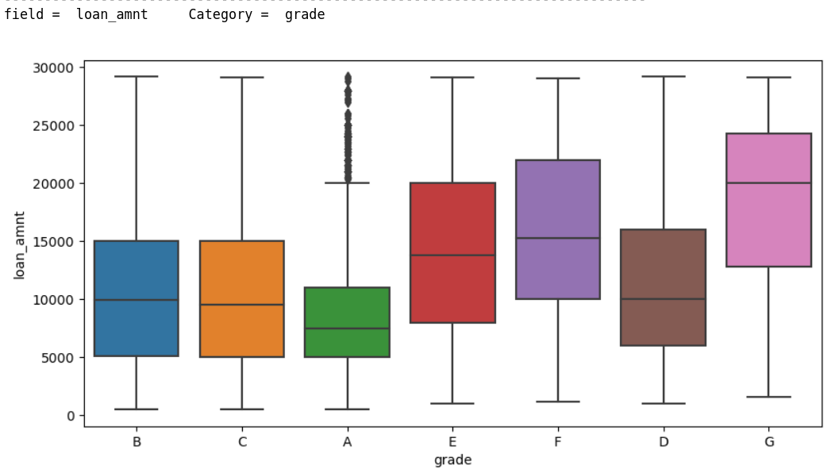
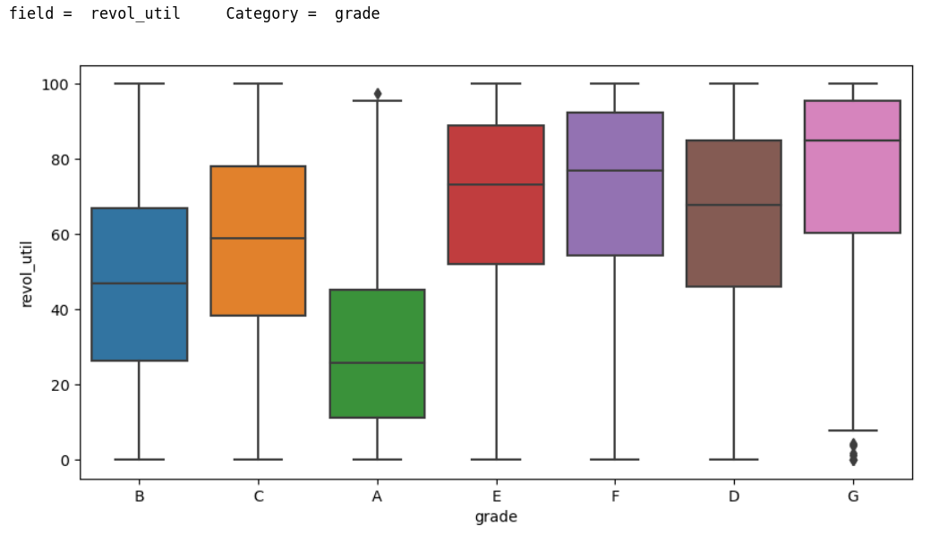
Loan Amount, Grade & Revolving Line Utilization Rate
Loan amount applied by the borrower for G grade loans is highest where as for A grade Loans is lowest.
Upper grade loans (D, E, F, G) - Borrower is taking high amount of loan and also has very high revolving line utilization rate (amount of credit relative to all amount of available revolving credit he has).
Upper grade loans : high risky because high Revoliving Line Utilization Rate - high interest rate - high chance of Default loan - Also high loan amount applied by borrowers - loss is high if a loan is defaulted

Slide 10
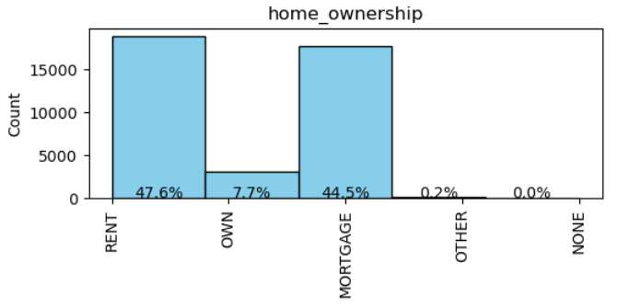
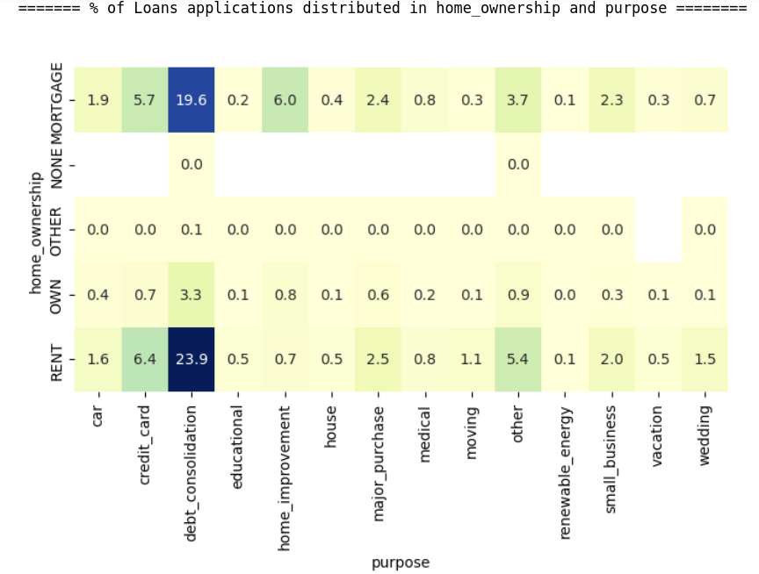
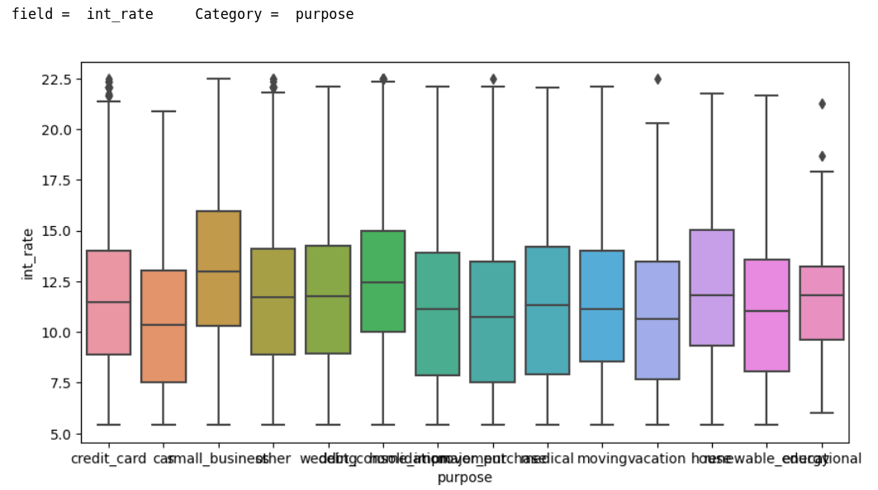
Home Ownership
Most of the borrowers dont have their own house. 92% (47% + 45%) borrowers either pay "Rent" or "Mortgage" their house.
But only 1% borrowers''purpose' of the loan is 'house'. And 47% borrowers' purpose is 'debt_consolidation'.
May be because home loan interest rate is high

Slide 11
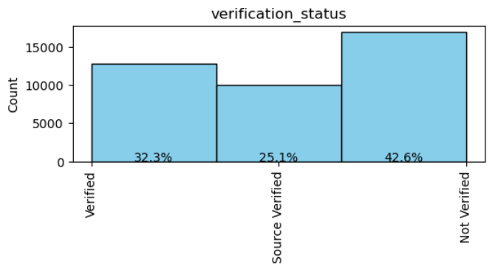
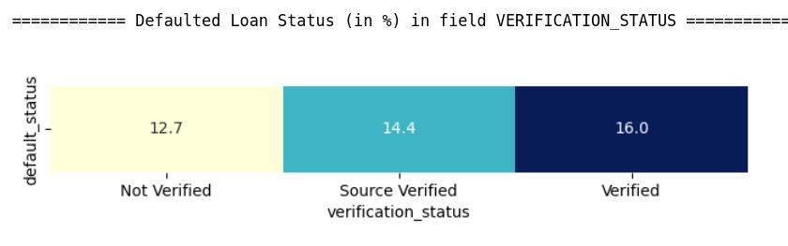
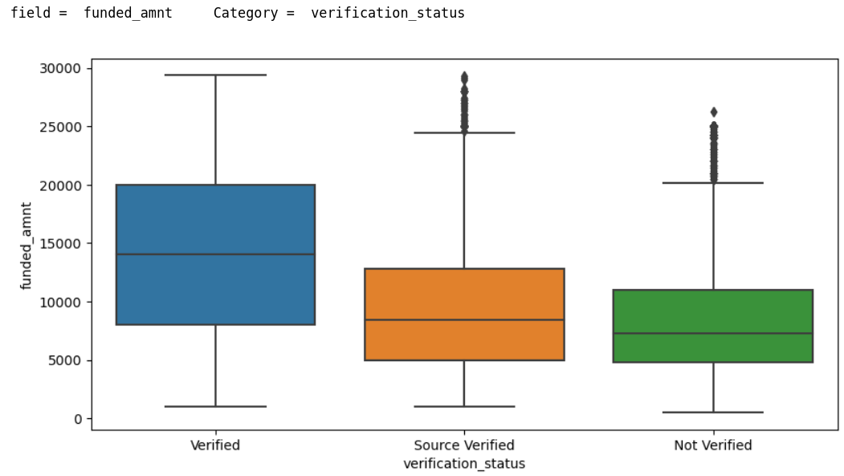
Verification Status
42% of the borrowers' income is 'not verified' which is risky.
Chance of non-verified loan getting defaulted is 12 %
Total amount funded by the company to non-verified loans is less compared to verified loans

Slide 12
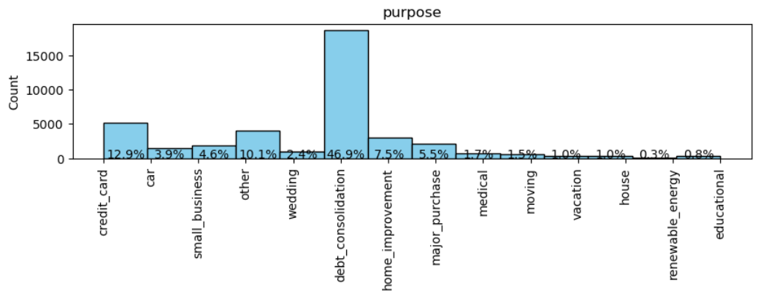
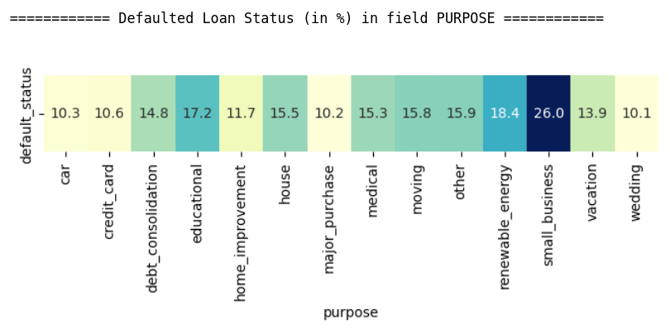
Purpose
Debt_consolidation is the most common pupose of the loan (47%) and has 14.8% chances of getting default.
Loans with small business purpose have highest chances (26%) of getting defaulted.
Whereas loans for wedding, car or major purchase have lowest chances (only 10%) of getting defaulted.

Slide 13
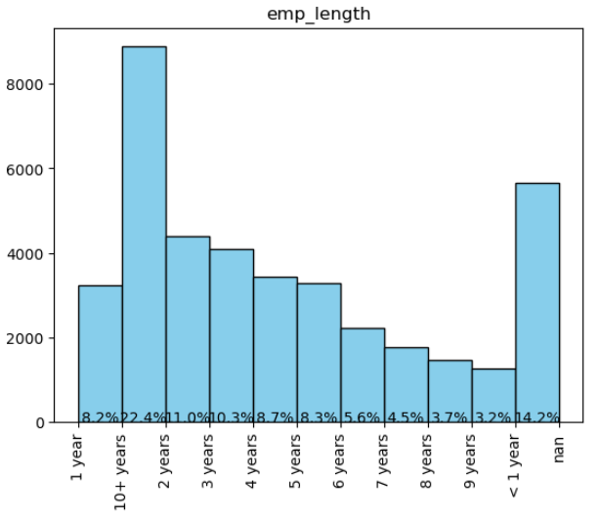
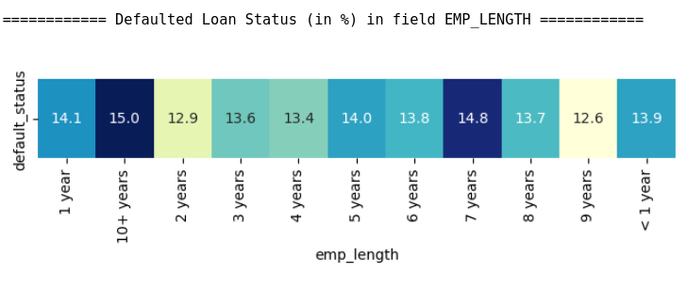
Employment Length
Most of the borrowers (22.4%) have 10+ years of employment length.
There is a 15% chance of loan getting default when employment length of the borrower is 10+ years.

Slide 14
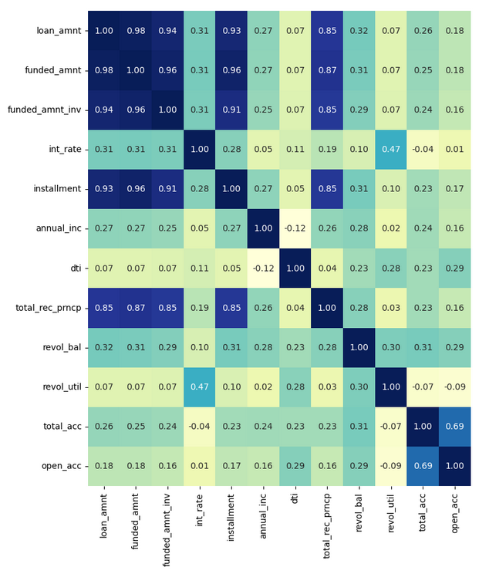
Correlation Between the fields
Very high correlation between loan amount applied by the borrower and funded amount (loan amount committed by the investor to the borrower). We can say that if loan application of the borrower gets passed by company, then he gets almost full amount of the loan applied.
Certainly loan amount, monthly installment and principal received are highly correlated. Higher the loan amount, higher is monthly installment and and higher is principal received vice versa.
Number of open credit lines is also highly correlated with total number of credit lines in the borrower's credit file.
Revol_util, int_rate - Moderately high correlation
Higher the amount of credit the borrower is using, higher is the risk of loan repayment. Thats why higher is the interest rate, and vice-versa.

Slide 15
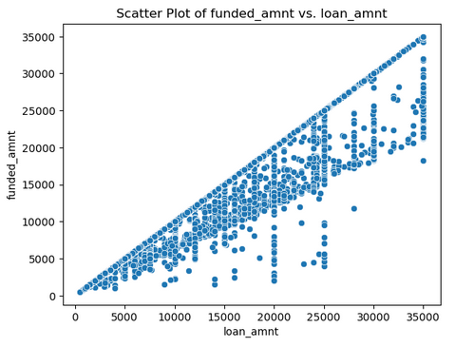
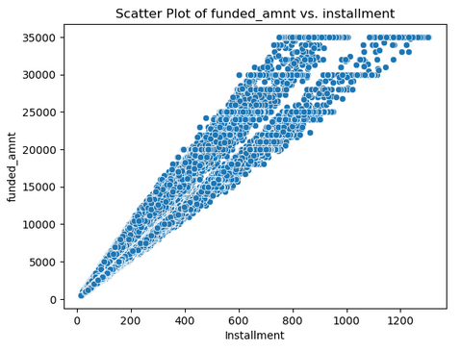
Loan Amount, Funded Amount, Installment
Funded amount by the company is always less than or equal to loan amount applied by borrower.
Funded amount by the company is highly correlated with monthly installment paid by the borrower.
There is a high correltion between loan amount, funded amount and installment

Slide 16
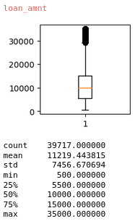
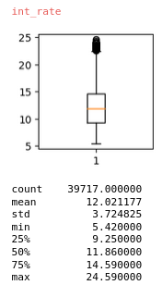
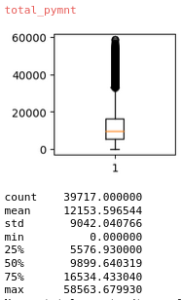
Loan Amount, Interest rate, Total Received principal
Avg loan amount applied by the borrower is 11.2K
Avg interest rate for the loan is 12%
Avg payment received by the LC is 12.2k. Ideally it should be (11.2 * 1.12 =) 12.5k but because of some default loans, company is getting 12.2k payment.
Company is making profit.
If the company reduces the default loans in future, then LC can make more profits.

Slide 17
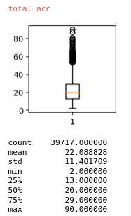
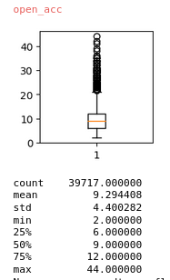
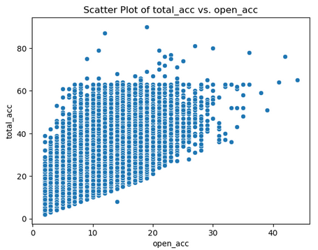
total_acc & open_acc
Avg total number of credit lines in borrowers credit file is 22
Out of that on an avg total number of open credit lines is 9
total_acc and open_acc is moderately high correlated.

Slide 18
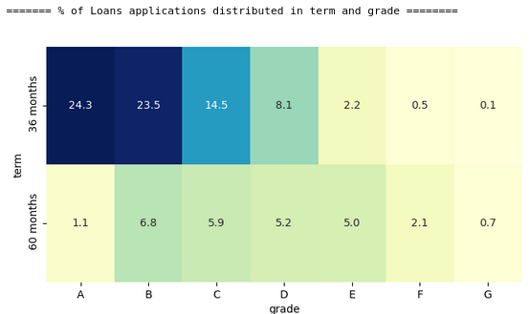
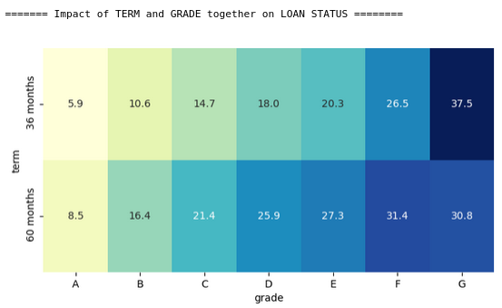
Term and Grade - Loan Status
Highest number of loans (24%) have 36 months tenure with grade A and have lowest default rate (5.9%). This is very good for company.
The company has only 0.1% of total loans with 36 months tenure and G grade. And these loans have highest risk of 37.5% of default rate.

Slide 19
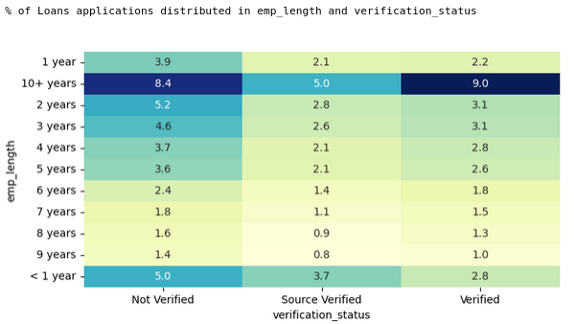
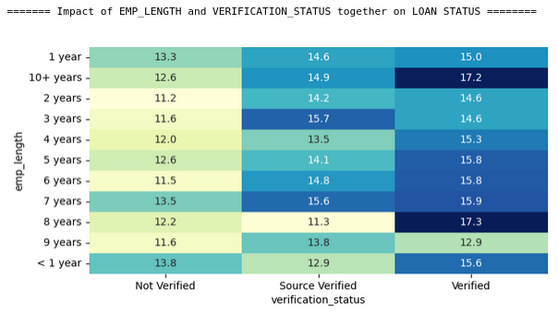
Emp_length and Verification Status - Loan Status
Borrowers who have 10+ years of employment years and whose income is verified by lending company are highest 9%. And thier default rate is maximum i.e. 17.2%.
This is not a good situation for the company.
This is the criteria where company should look into it.

Slide 20
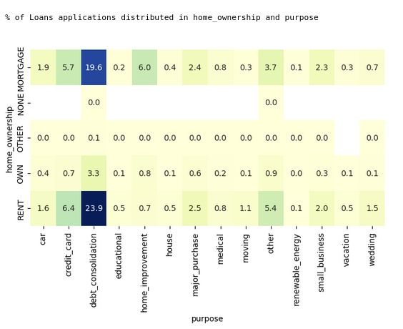
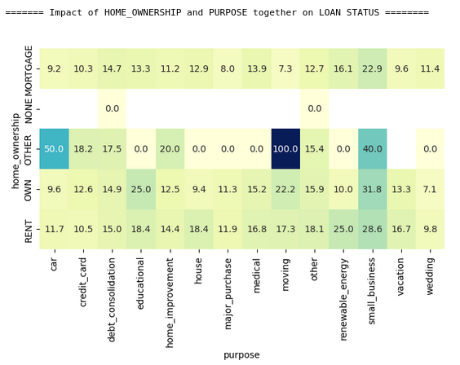
Home_ownership & Purpose - Loan Status
High chunk of loans (23.9% + 19.6% = 43.5%) are taken for debt_consolidation purpose and the borrowers of these loans stays in rented house or Mortgaged thier house.
And there is almost 15% chance of loan getting defaulted which is high and serious.

Slide 21
Conclusion
On an average 14% of the loans gets defaulted.
Driving Factors for Loan Default are:
High Interest Rate -
Lengthy tenure Loans - Chances of getting dafaulted is double (22%) that of less tenure loans (11%).
Upper Grade Loans -

