Slide 1
Lending Club Case Study
- Duc Luong
- Dnyaneshwari Chidrawar

Slide 2

Business Objective
The company wants to understand the driving factors behind loan default
The variables which are strong indicators of default.
The company can utilise this knowledge for its portfolio and risk assessment.

Slide 3

Data Cleaning
Original data set contains 39717 rows and 111 columns
Dropped 54 Empty Columns
Dropped 9 columns with Single Valued throughout the rows
Dropped 3 columns which had Unique value for all rows
Dropped 2 fields which had more than 90% missing values
Dropped 4 fields which had most numbers at 0 and remaining were outliers
Dropped 14 unnecessary fields which wont help in analysis (e.g. “title”, “zip_code”)
After cleaning data, our final data set contains only 25 columns/fields

Slide 4
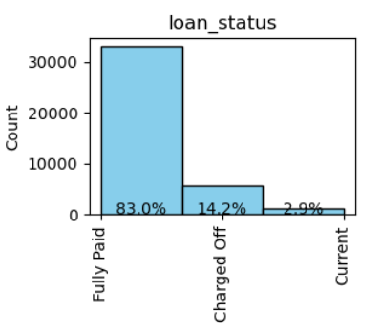
Loan Status
14.2% of loans get defaulted.

Slide 5
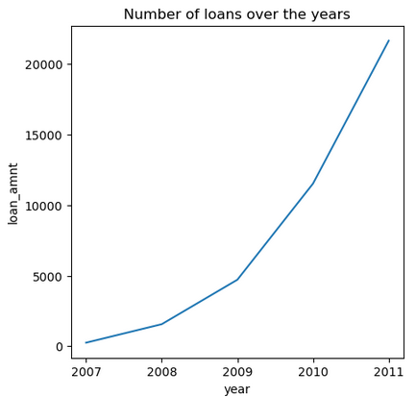
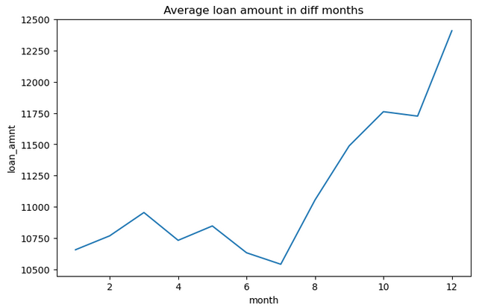
Loan vs Time Period
Number of loan applicants are increasing over the period of time.
Total borrowers in 2011 is highest i.e. 21K
On an average loan amount given to the borrowers is high in 2nd half of the year

Slide 6
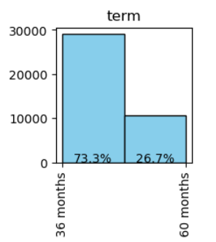
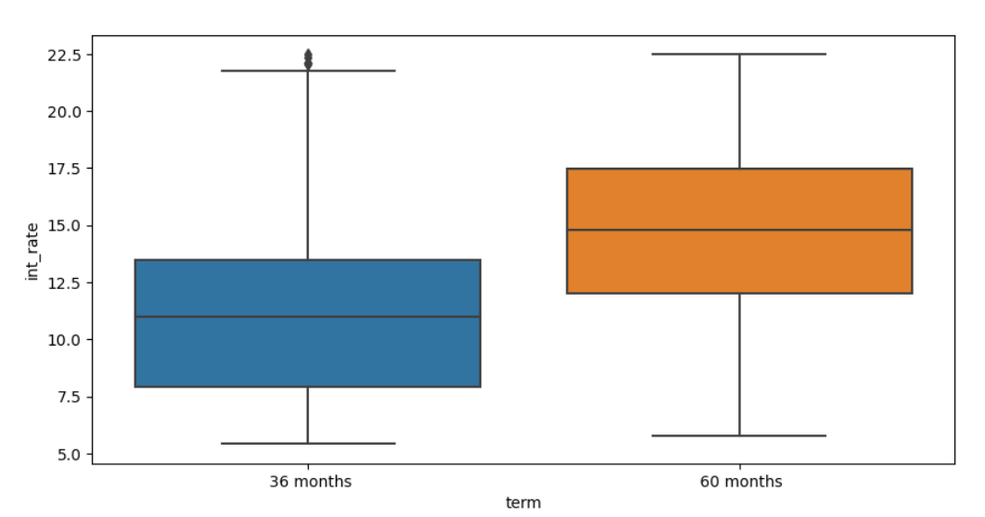
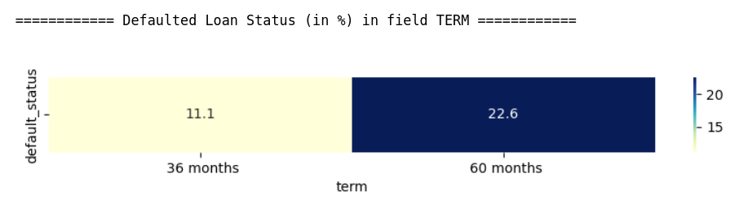
Term, Interest rate, Default Status
73% of loans have 36 months tenure where as only 26% loans have 60 months tenure.
Loans with 60 month tenure have higher interest rate than loans with 36 months
Loans with 60 months tenure have double chance (22.6%) of getting defaulted than that of 36 months (11.1%)
% of defaulted loans for different terms

Slide 7
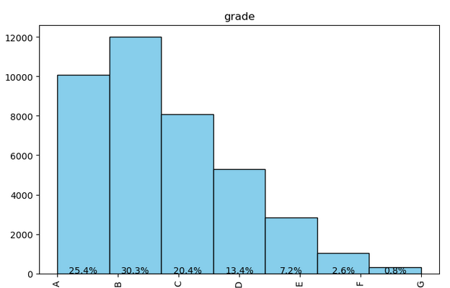
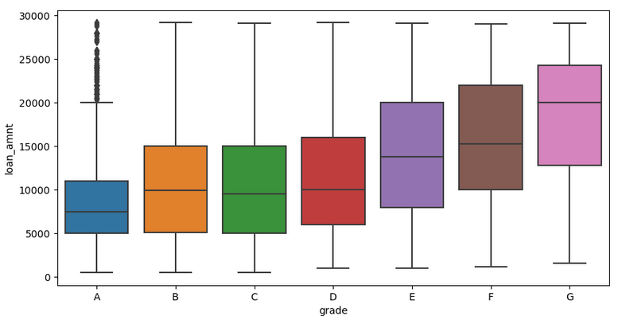
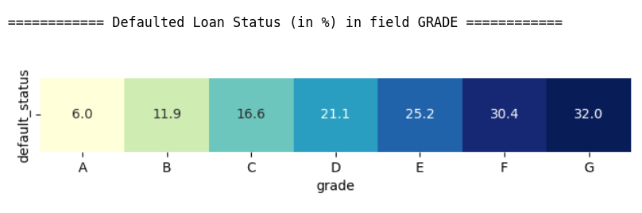
Grade, Interest rate, Default Status
75% loans are of grade A(25%), B(30%), C(20%)
Interest rates and default rates are low for A, B, C grades.
Interest rate is gradually increasing for the loans with grades A, B, C, D, E, F, G
There is a 32% chance of G grade loans getting defaulted.
Higher the grade, higher is the interest rate, higher chance of getting defaulted

Slide 8
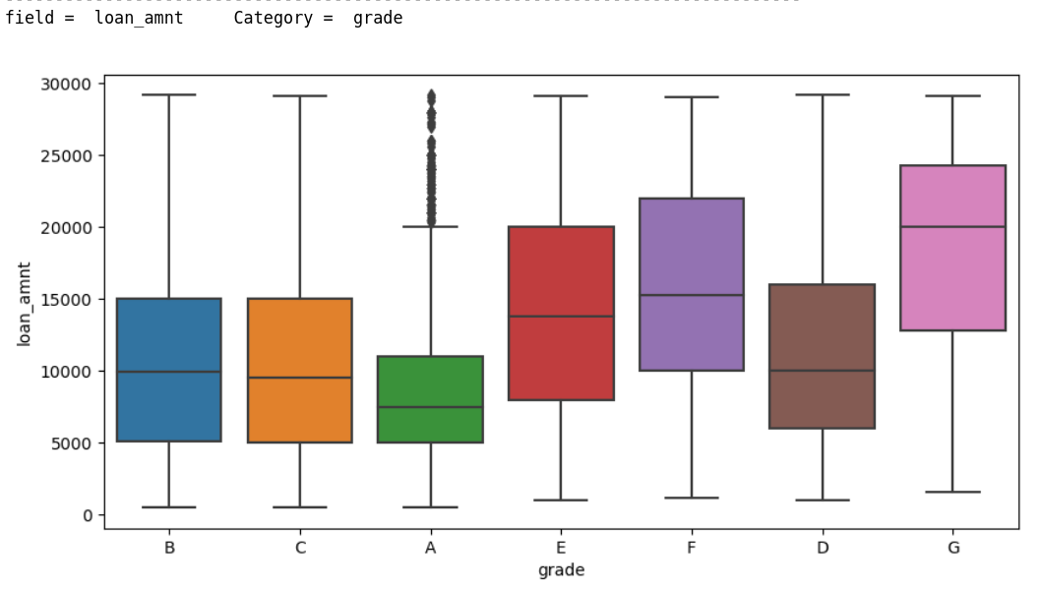
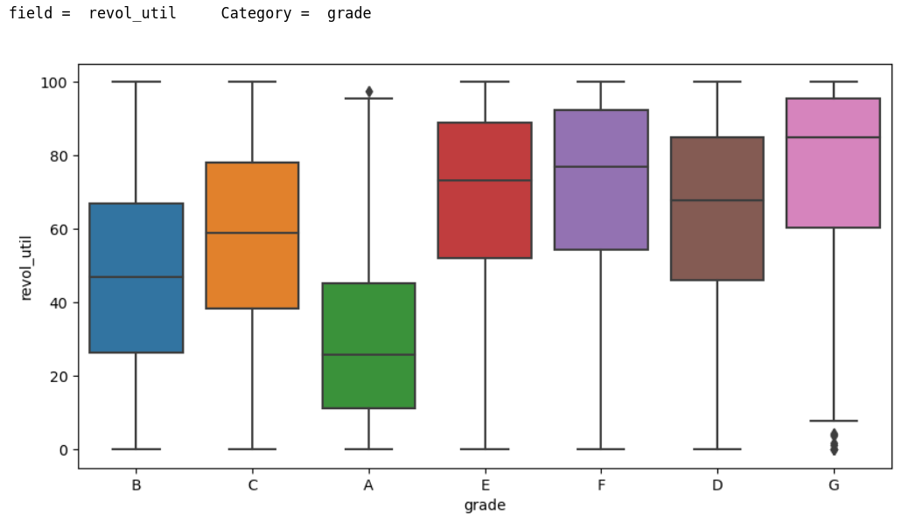
Loan amount, Grade & Revolving line utilization rate
Loan amount applied by the borrower for G grade loans is highest where as for A grade Loans is lowest.
For upper grade loans possess high loan amount applied by borrowers - loss is high if a loan is defaulted
Upper grade loans have higher line utilization rate and that correlates with higher % of defaults

Slide 9
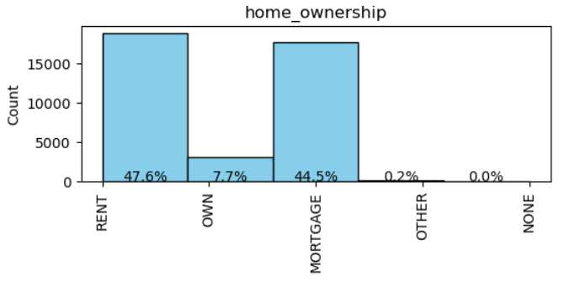
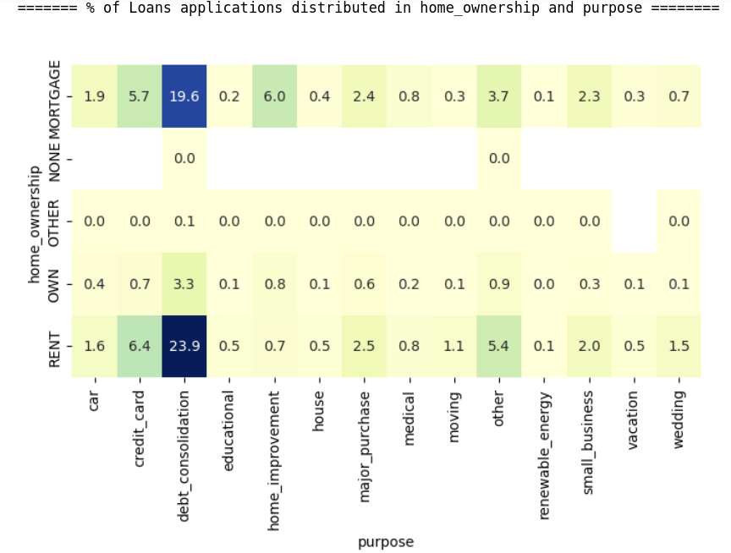
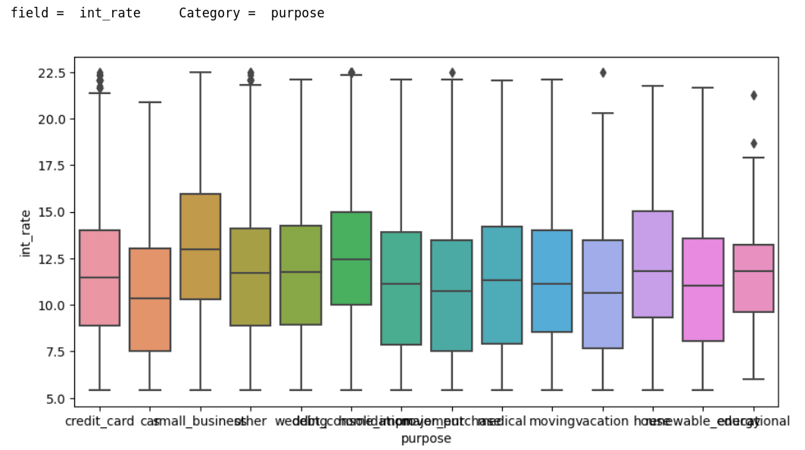
Home Ownership
47% of the borrowers don’t have house (paying rent) but only 1% of loans are home loans.
home loans are not getting sold effectively. maybe because of higher interest rate
And 47% borrowers' purpose is 'debt_consolidation'.

Slide 10
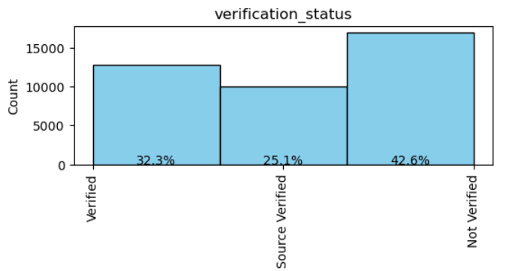
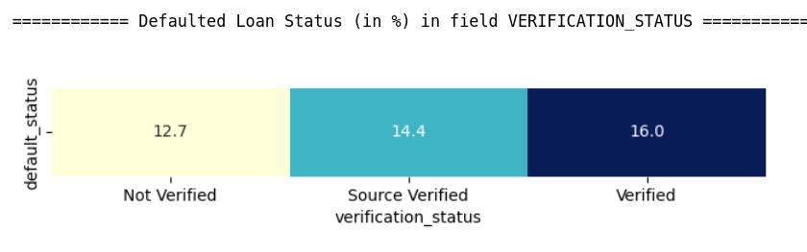
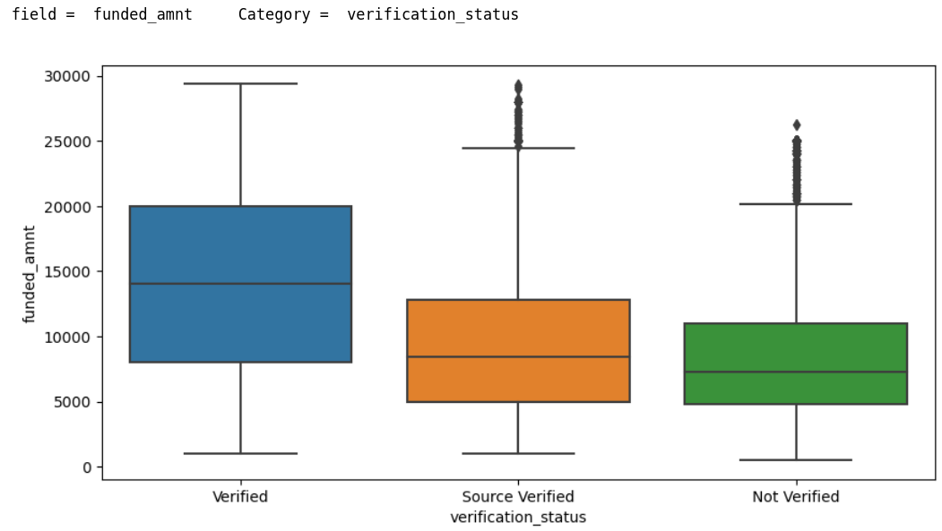
Verification Status
42% of the borrowers' income is 'not verified' which is risky.
Chance of non-verified loan getting defaulted is 12 %
Total amount funded by the company to non-verified loans is less compared to verified loans

Slide 11
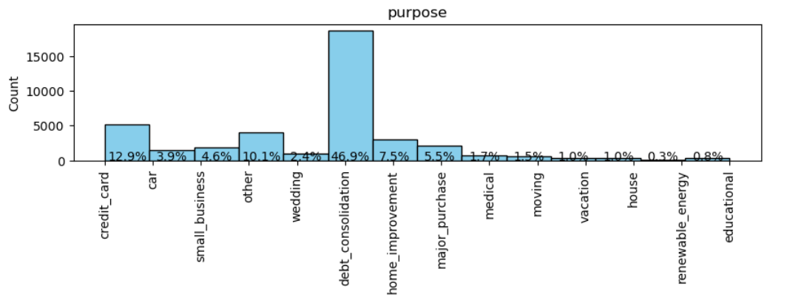
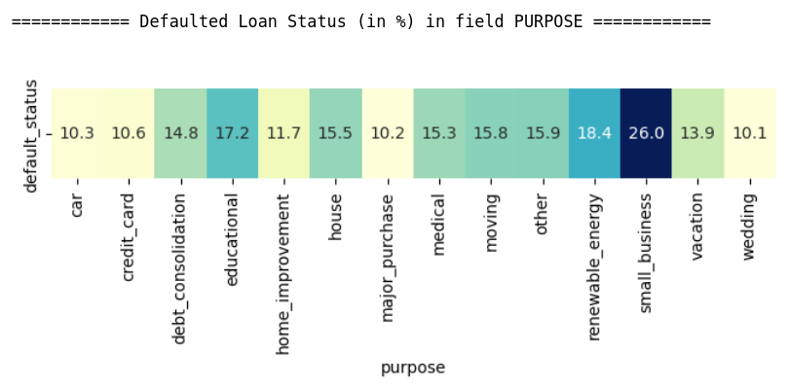
Purpose
Debt_consolidation is the most common pupose of the loan (47%) and has 14.8% chances of getting default.
Loans with small business purpose have highest chances (26%) of getting defaulted.
Whereas loans for wedding, car or major purchase have lowest chances (only 10%) of getting defaulted.

Slide 12
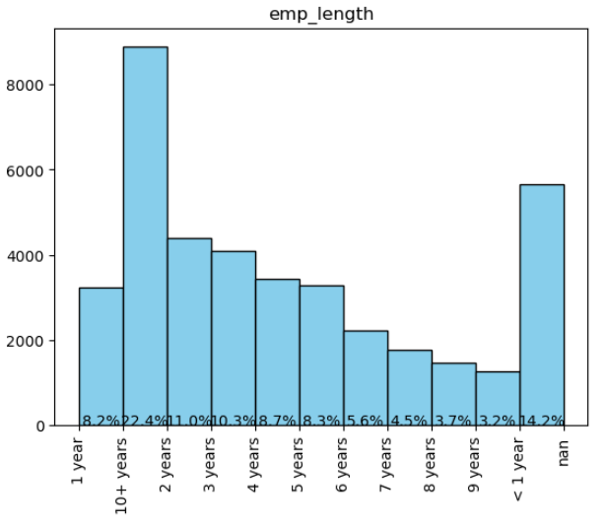
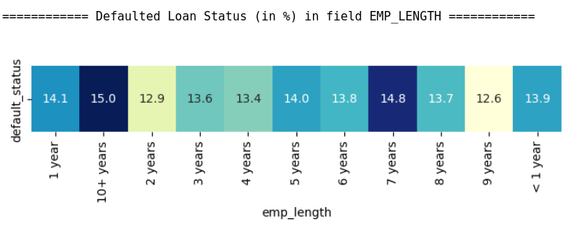
Employment Length
Majority of the borrowers (22.4%) have 10+ years of employment length.
There is a 15% chance of loan getting default when employment length of the borrower is 10+ years.

Slide 13
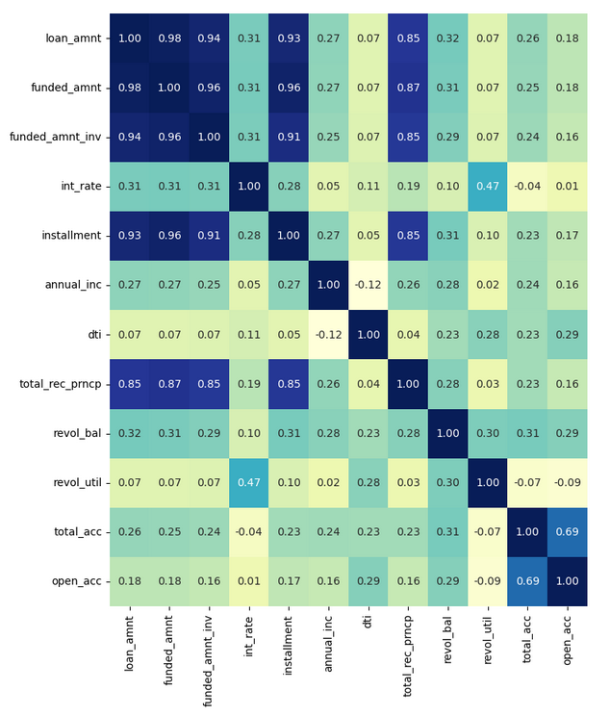
Correlation Between the fields
Very high correlation between loan amount applied by the borrower and funded amount committed by the investor. We can say that if loan application of the borrower gets passed by company, then he gets almost full amount of the loan applied.
Certainly loan amount, monthly installment and principal received are highly correlated. Higher the loan amount, higher is monthly installment and and higher is principal received vice versa.
Number of open credit lines is also highly correlated with total number of credit lines in the borrower's credit file.
Revol_util, int_rate - Moderately high correlation
Higher the amount of credit the borrower is using, higher is the risk of loan repayment. Thats why higher is the interest rate, and vice-versa.

Slide 14
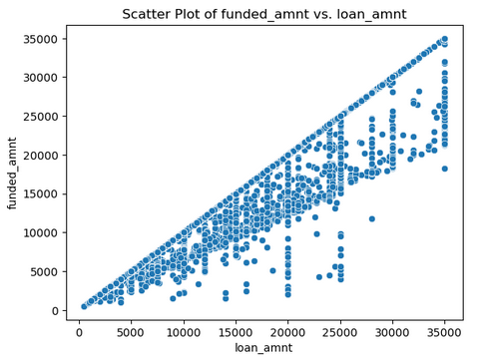
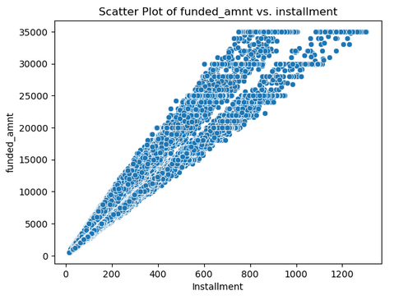
Loan Amount, Funded Amount, Installment
Funded amount by the company is always less than or equal to loan amount applied by borrower.
Funded amount by the company is highly correlated with monthly installment paid by the borrower.
There is a high correltion between loan amount, funded amount and installment

Slide 15
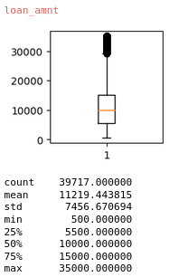
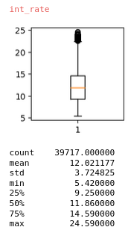
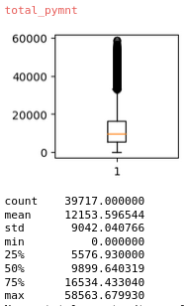
Loan Amount, Interest rate, Total Received principal
Avg loan amount applied by the borrower is 11.2K
Avg interest rate for the loan is 12%
Avg payment received by the LC is 12.2k. Ideally it should be (11.2 * 1.12 =) 12.5k but because of some default loans, company is getting 12.2k payment.
Company is making profit.
If the company reduces the default loans in future, then LC can make more profits.

Slide 16
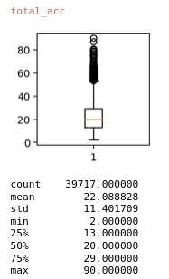
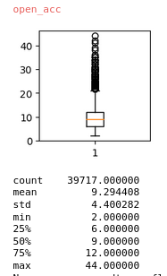
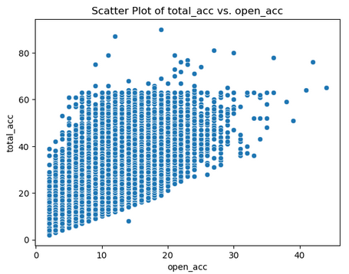
total_acc & open_acc
Avg total number of credit lines in borrowers credit file is 22
Out of that on an avg total number of open credit lines is 9
total_acc and open_acc is moderately high correlated.

Slide 17
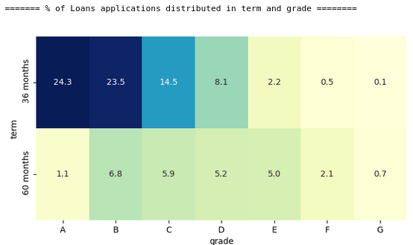
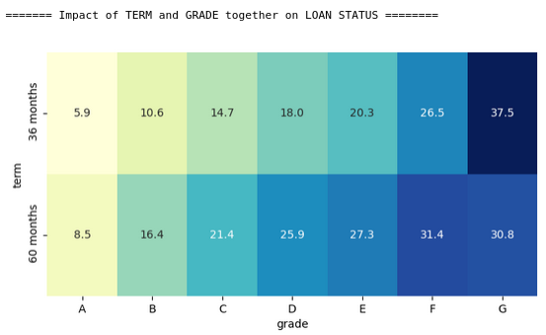
Term and Grade - Loan Status
Highest number of loans (24%) have 36 months tenure with grade A and have lowest default rate (5.9%). This is very good for company.
The company has only 0.1% of total loans with 36 months tenure and G grade. And these loans have highest risk of 37.5% of default rate.

Slide 18
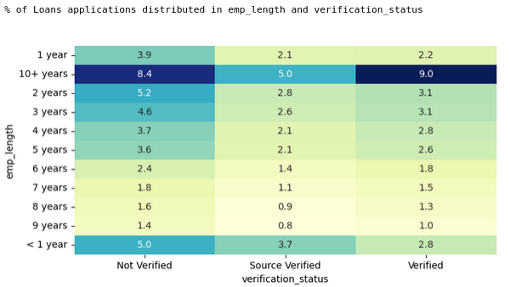
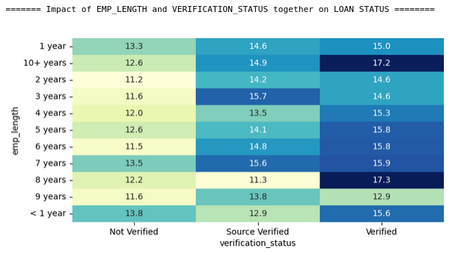
Emp_length and Verification Status - Loan Status
Borrowers who have 10+ years of employment years and whose income is verified by lending company are highest 9%. And thier default rate is maximum i.e. 17.2%.
This is not a good situation for the company.
This is the criteria where company should look into it.

Slide 19
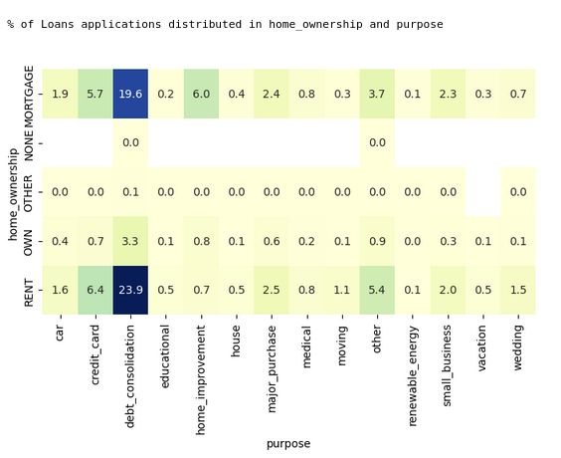
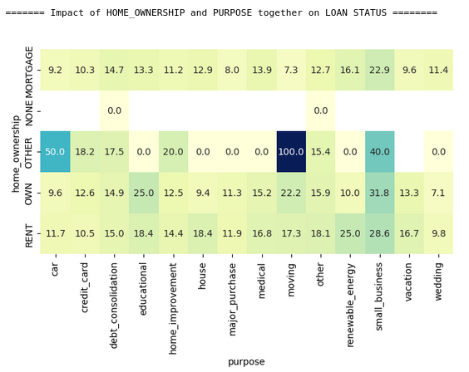
Home_ownership & Purpose - Loan Status
High chunk of loans (23.9% + 19.6% = 43.5%) are taken for debt_consolidation purpose and the borrowers of these loans stays in rented house or Mortgaged thier house.
And there is almost 15% chance of loan getting defaulted which is high and serious.

Slide 20
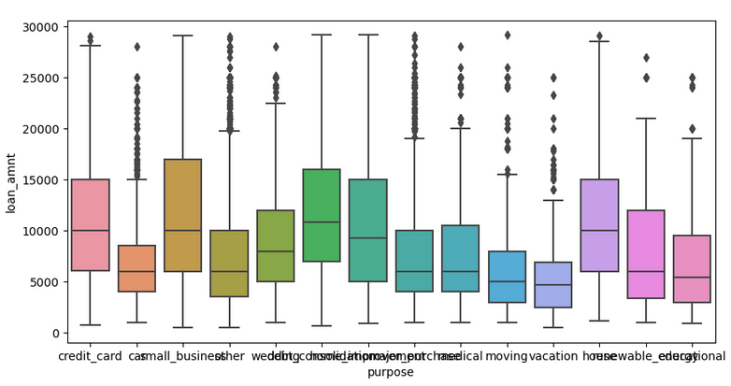
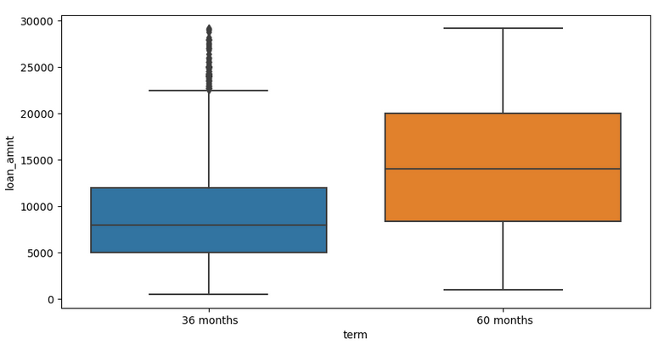
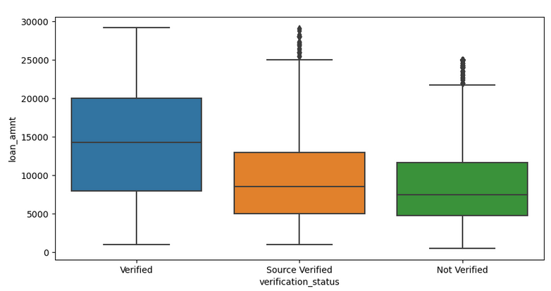
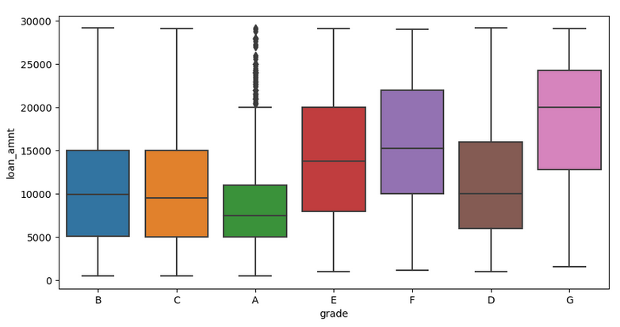
Loan Amount for different types of loans
On an average loan amount is high for :
60 month tenure loans
Verified borrower’s income loans
upper grade loans
small business, house, debt consolidation purpose loans

Slide 21
Conclusion
On an average 14% of the loans gets defaulted.
Driving Factors for Loan Default are:
Lengthy tenure Loans - Chances of getting dafaulted is double (22%) that of less tenure loans (11%).
Upper Grade Loans - Higher the grade, higher is the interest rate, and high chances of getting default
High Interest rates - Interest rate for 60 months tenure loans is higher than that of 36 months loan.
High Revol_util - Higher the amount of credit the borrower is using, higher is the risk of loan repayment.
High loan amount is given to 60 months tenure loans, upper grade loans, small business loans where chance of getting defaulted is very high.
Default rate for the borrowers, who have 10+ years of employment years and their income is also verified, is high

