Slide 1

Data Lake Value Proposition
Medical Data Processing Company
Max Luong
Udacity IPS Version 1.0

Slide 2
Agenda
What is a Data Lake
Components of a Data Lake
Data Lake vs Data Warehouse
Business Value of Data Lake Solution
Proposed Data Lake Architecture for Medical Data Processing system
Udacity IPS Ver. 1 2/2020

Slide 3
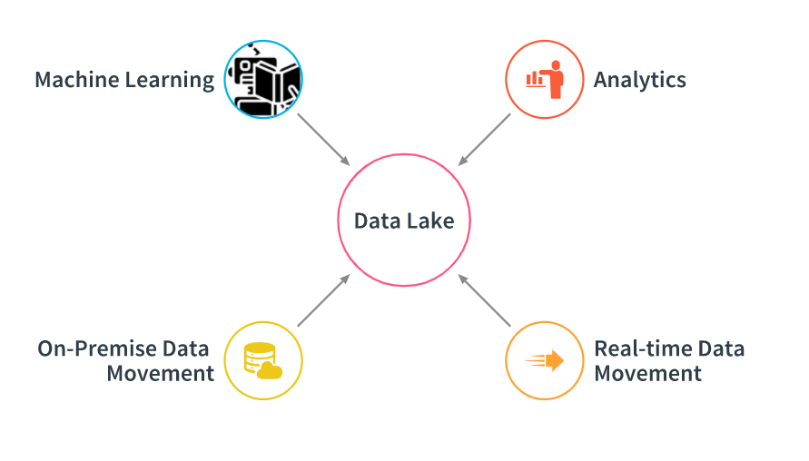
What is a Data Lake
Executive summary
Data Lake is a central place where we can bring together data, Machine Learning, and Analytics
Data can store data of any type, including unstructured, semi-structured, and structured
Can handle scaling of any size
Source: Udacity

Slide 4
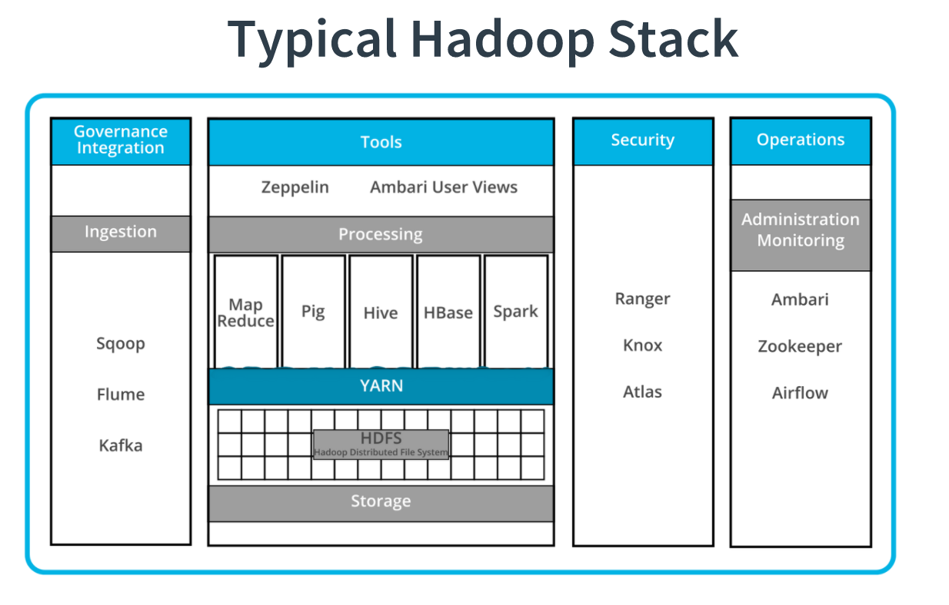
Components of Data Lake
Data Ingestion
Data storage
Data quality
Data Auditing
Data exploration
Data discover
Notes:
What elements are needed to make a data lake?
What different layers and/or tools involved?
Identify at least 3 in your high level list here.

Slide 5
Data Lake vs Data Warehouse
< Think about: Research if a Data Warehouse can still be a viable solution instead of a Data Lake? What is the difference between both? >
< You will complete this information on the next slide. Please provide at least 3 items for each. No need to add any content on this slide >
< Video tip: While presenting the differences, elaborate why a Data Lake solution makes more sense for Medical Data Processing Company over a Data Warehouse approach? How the Data Lake / Big Data characteristics different from Data warehouse>
Notes:
Research if a Data Warehouse can still be a viable solution instead of a Data Lake? What is the difference between both? >
< You will complete this information on the next slide. Please provide at least 3 items for each. No need to add any content on this slide >
< Video tip: While presenting the differences, elaborate why a Data Lake solution makes more sense for Medical Data Processing Company over a Data Warehouse approach? How the Data Lake / Big Data characteristics different from Data warehouse>

Slide 6
Data Warehouse
Data Lake
Relational data from transactional systems, operational databases, and line of business applications
Often designed prior to the data warehouse implementation but also can be written at the time of analysis (schema-on-write) (schema-on-read)
All data, including structured, semi-structured, and unstructured
Written at the time of analysis (schema-on-read)
Udacity IPS Ver. 1 2/2020

Slide 7
Data Warehouse
Data Lake
Fastest query results using local storage
Highly curated data that serves as the central version of the truth
Batch reporting, BI, and visualizations
Query results getting faster using low-cost storage and decoupling of compute and storage
Any data that may or may not be curated (i.e. raw data)
Machine learning, exploratory analytics, data discovery, streaming, operational analytics, big data, and profiling
Udacity IPS Ver. 1 2/2020

Slide 8
Business Value of Data Lake
Companies are looking for ways to store, organize and analyze a LARGE amount of enterprise data.
Companies are struggling with data silos. With each organization/department within the company having its own data and no cross-organization visibility
Access to data for the engineering and analytics team is hard, time-consuming process
Notes:
< Think about: Provide an executive level summary based on your analysis of problem statement. How would implementing a Data Lake solution help Medical Data Processing Company? Please identify at least 3 business outcomes of building a Data Lake?>
<Video tip: Explain “Why” Data Lake solution makes sense for Medical Data Processing Company. >

Slide 9
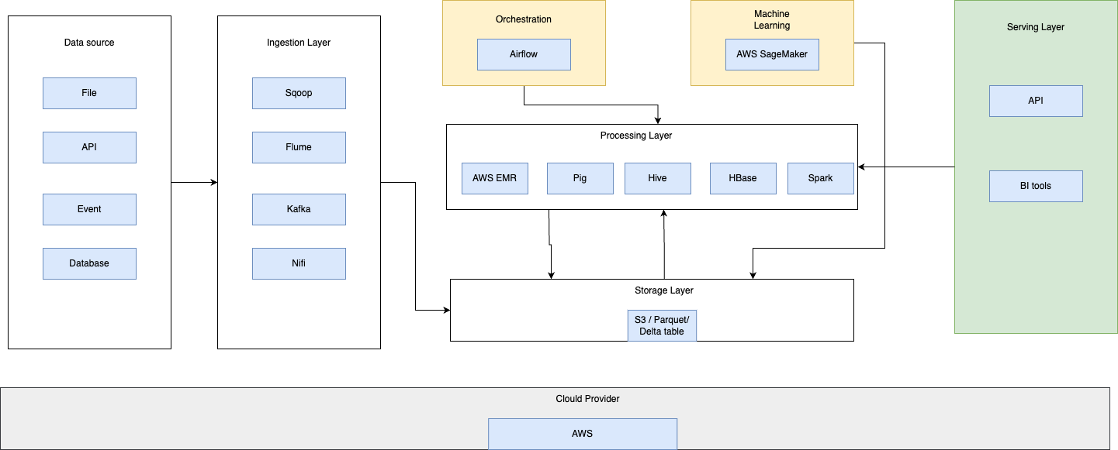
Data Lake Architecture

Slide 10
THANK YOU
Udacity IPS Version 1.0

