Slide 1


Data Governance @ SneakerPark
Prepared by: Max Luong
Submitted on: Jul, 27, 2023

Slide 2
Background
SneakerPark is an online shoe reseller that allows people to buy and sell used and new shoes. Buyers can bid for shoes or buy them outright, and sellers can set a price or sell to the highest bidder.
Each buyer and seller must have an active account in order to sell, bid, or purchase sneakers using SneakerPark’s website.
SneakerPark authenticates the shoes before shipping them to the buyer, so before listing an item, the seller must ship it to SneakerPark’s warehouse. Upon receipt, SneakerPark assigns an item number to each pair of sneakers and notifies the seller that they are now free to list their item. If the item is not listed within 45 days, SneakerPark returns it to the seller and sends an invoice to the seller for the shipping cost.
If the item is found to be inauthentic or in an unacceptable condition, it is also returned back to the seller in a similar fashion.
When the item sells, the buyer’s account is credited with the purchase price minus the SneakerPark service fee and shipping fees to deliver the item to the buyer.
Currently, SneakerPark only supports sales within the United States.

Slide 3
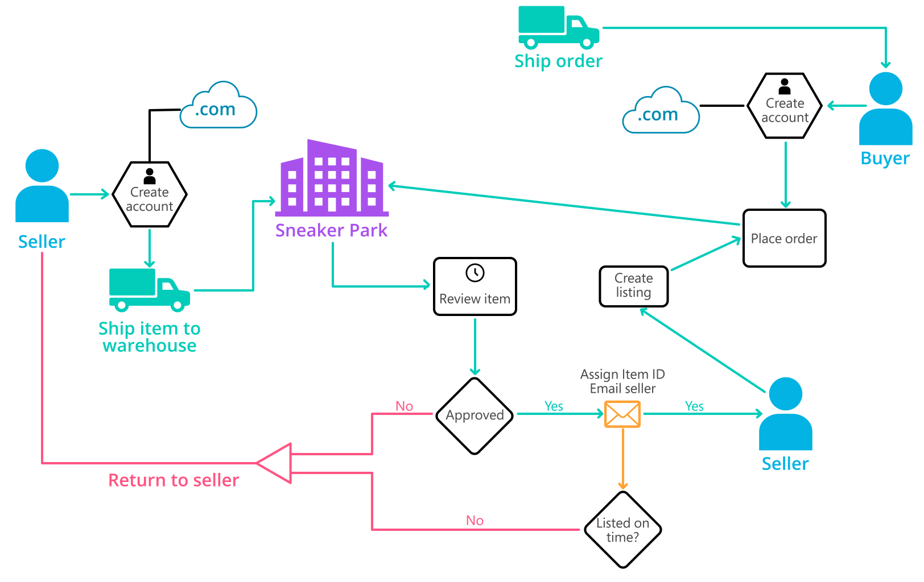
Background (cont’d)
Below you can see a diagram that will hopefully help you visualize some of SneakerPark's business processes. Keep in mind that it does not capture ALL processes and every nuance, but simply serves as another artifact to use in your project.

Slide 4
Step 1
Enterprise Data Catalog Part 1: Enterprise Data Model

Slide 5
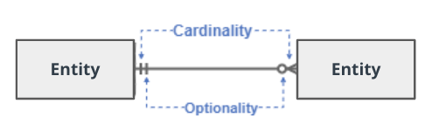
Create a conceptual data model that will provide SneakerPark with a holistic view of its data systems and help you grasp the organization's important entities and relationships, which will be instrumental as you move further in the project. You can use Lucidchart or any other diagramming tool of your choice, but please use the Crow’s Foot/IE Notation and please be sure to indicate both cardinality (the type of a relationship such as 1:N or N:N) and optionality (whether the relationship is optional or mandatory).

Slide 6
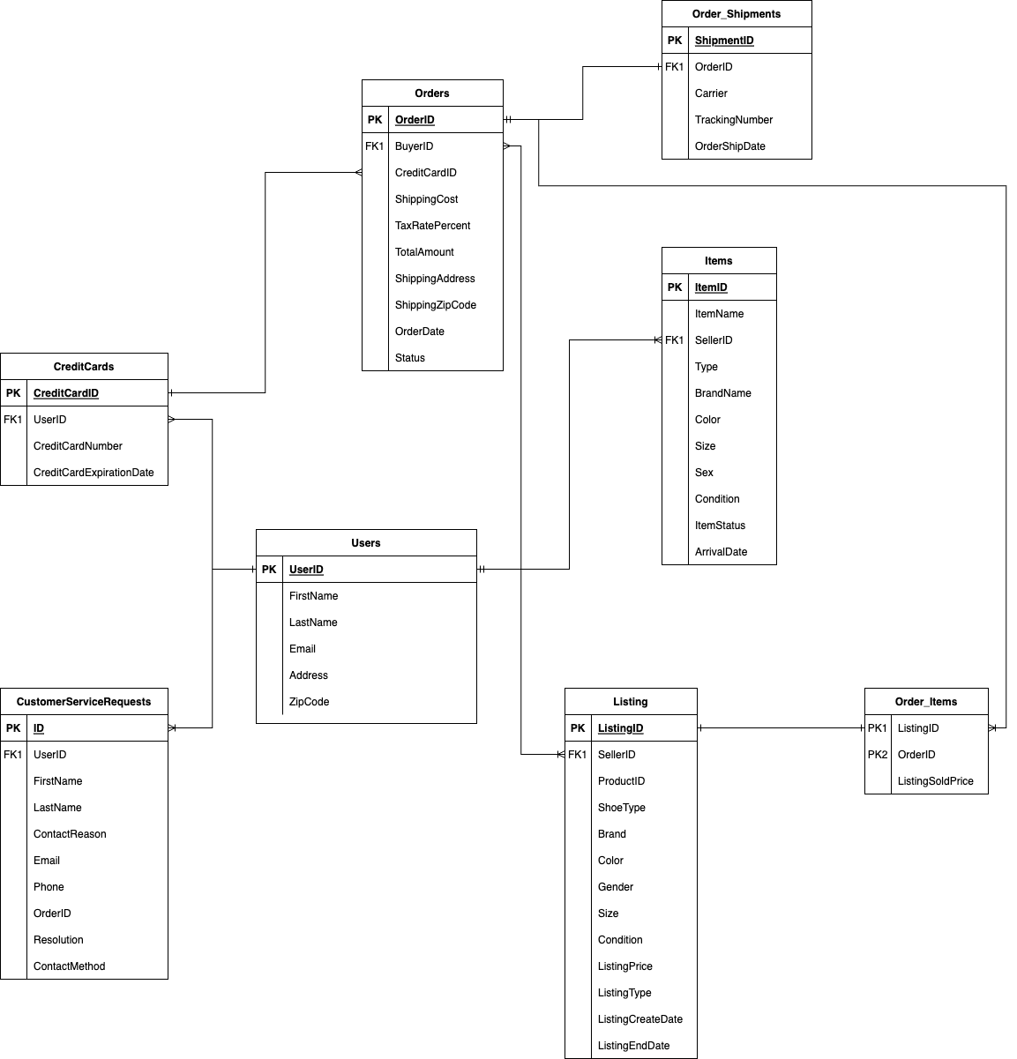
Enterprise Data Model

Slide 7
Step 2
Enterprise Data Catalog Part 2: Metadata

Slide 8
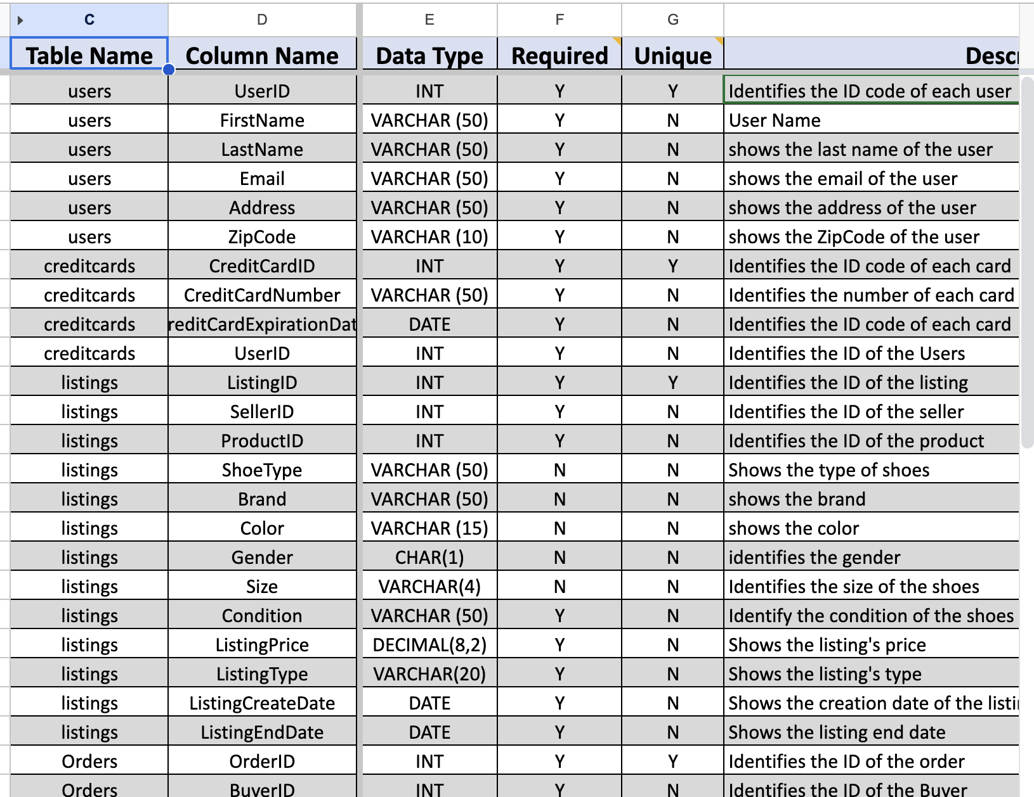
Data is filled in the excel file Max-sneakerpark-templates.xlsx

Slide 9
Step 3
Data Quality
Part 1: Profiling and Cleansing

Slide 10
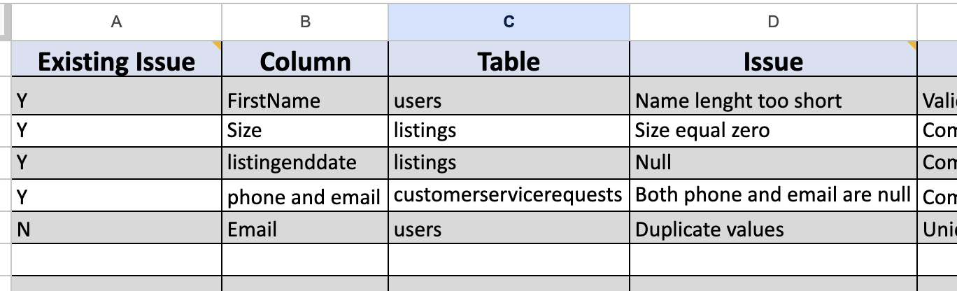

Slide 11
Step 4
Data Quality
Part 2: Monitoring

Slide 12
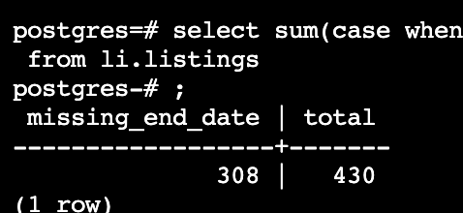
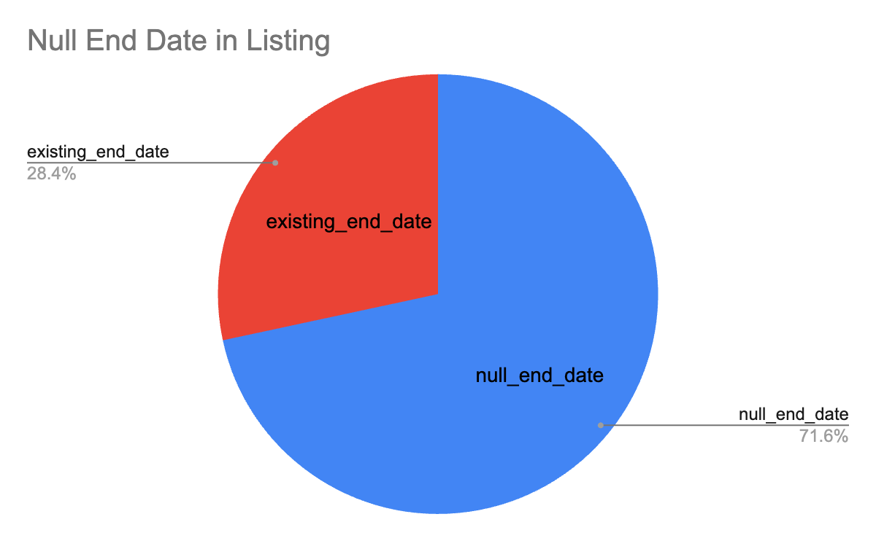

Slide 13
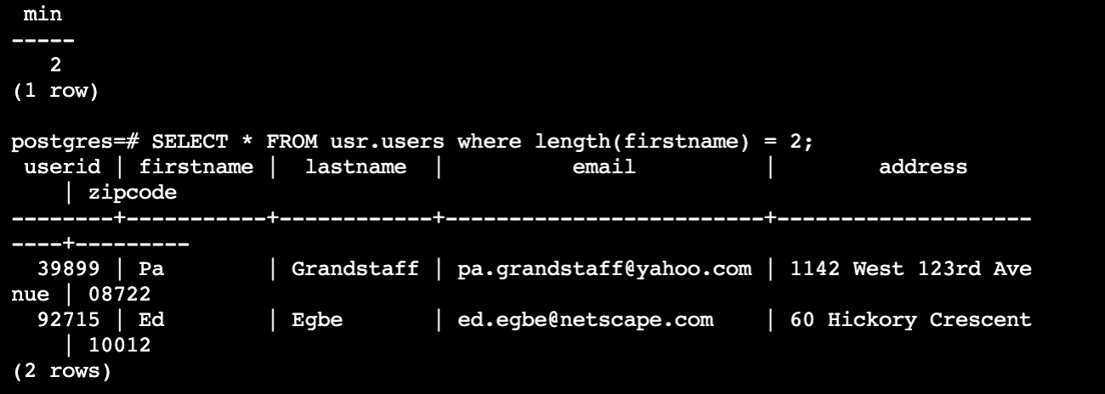
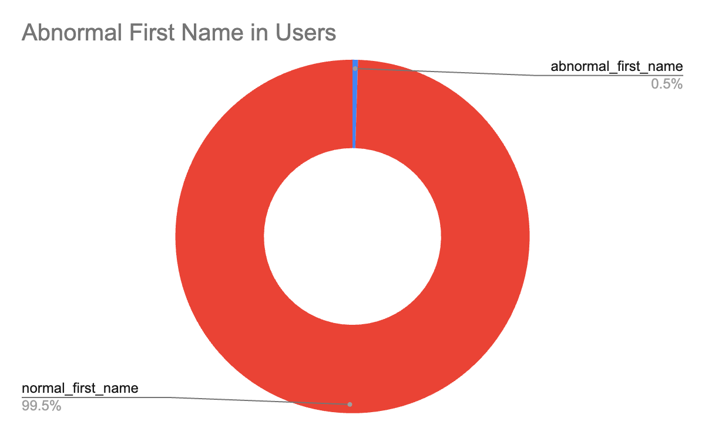

Slide 14
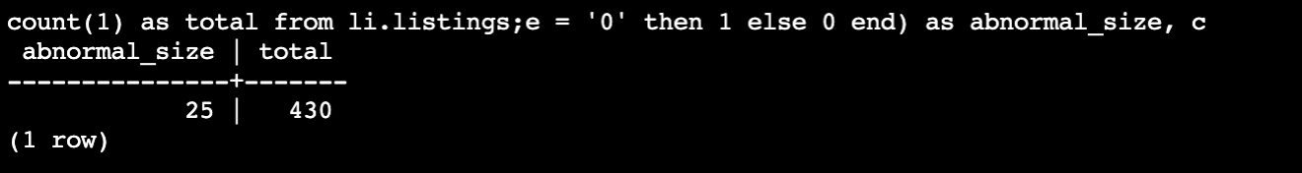
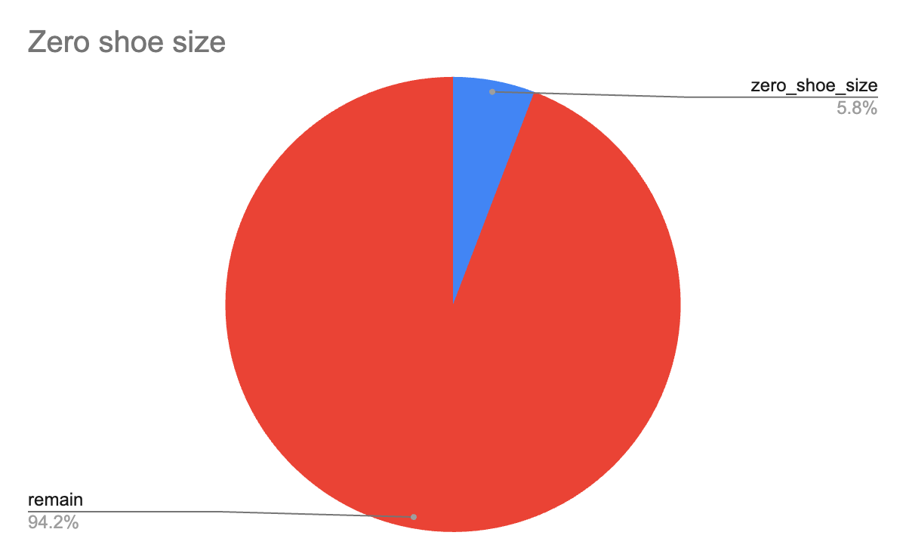

Slide 15
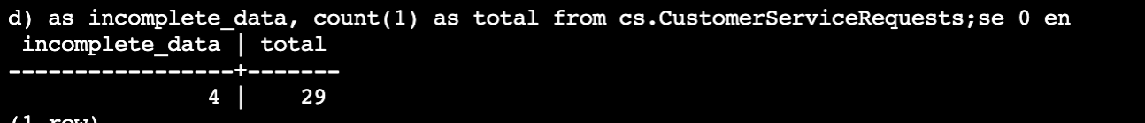
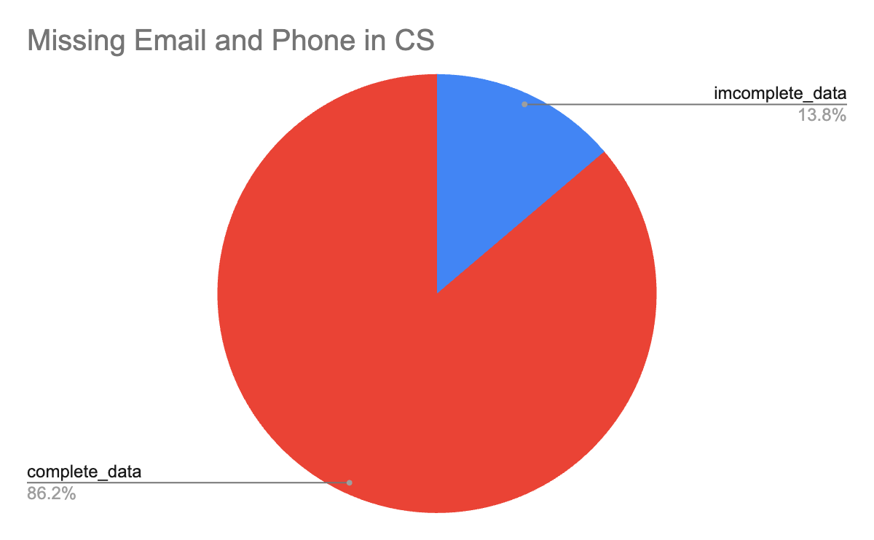

Slide 16
Step 5
Master Data Management
Part 1: MDM Architecture

Slide 17
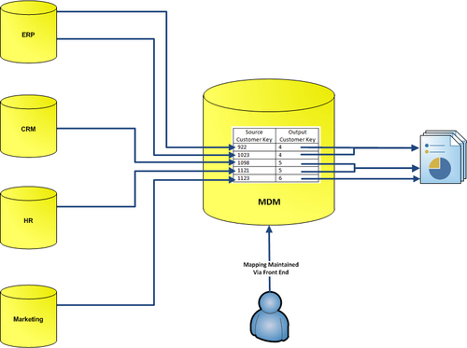
Registry MDM

Slide 18
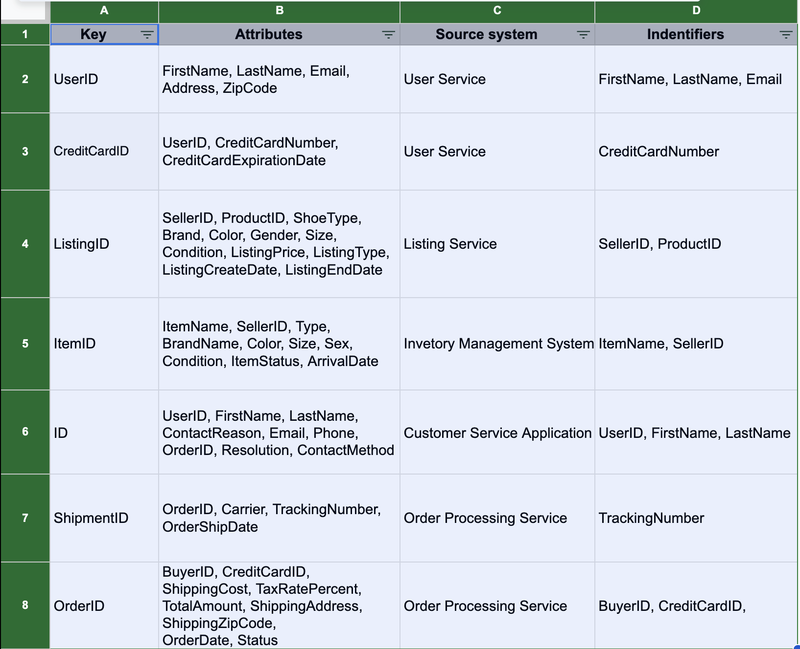

Slide 19
If you have a large number of source systems spread across the world, it can be difficult to establish an authoritative source. A Registry style approach can be used to analyze the data while avoiding the risk of overwriting information in the source systems. This will help you avoid potential compliance failure or other regulatory repercussions (which may vary from country to country) that could occur if source data is changed.
Registry style provides a read-only view of data without modifying master data and is a useful way to remove duplications and gain consistent access to your master data.
It offers low-cost, rapid data integration with the benefit of minimal intrusion into your application systems.

Slide 20
Step 6
Master Data Management
Part 2: Master Record

Slide 21
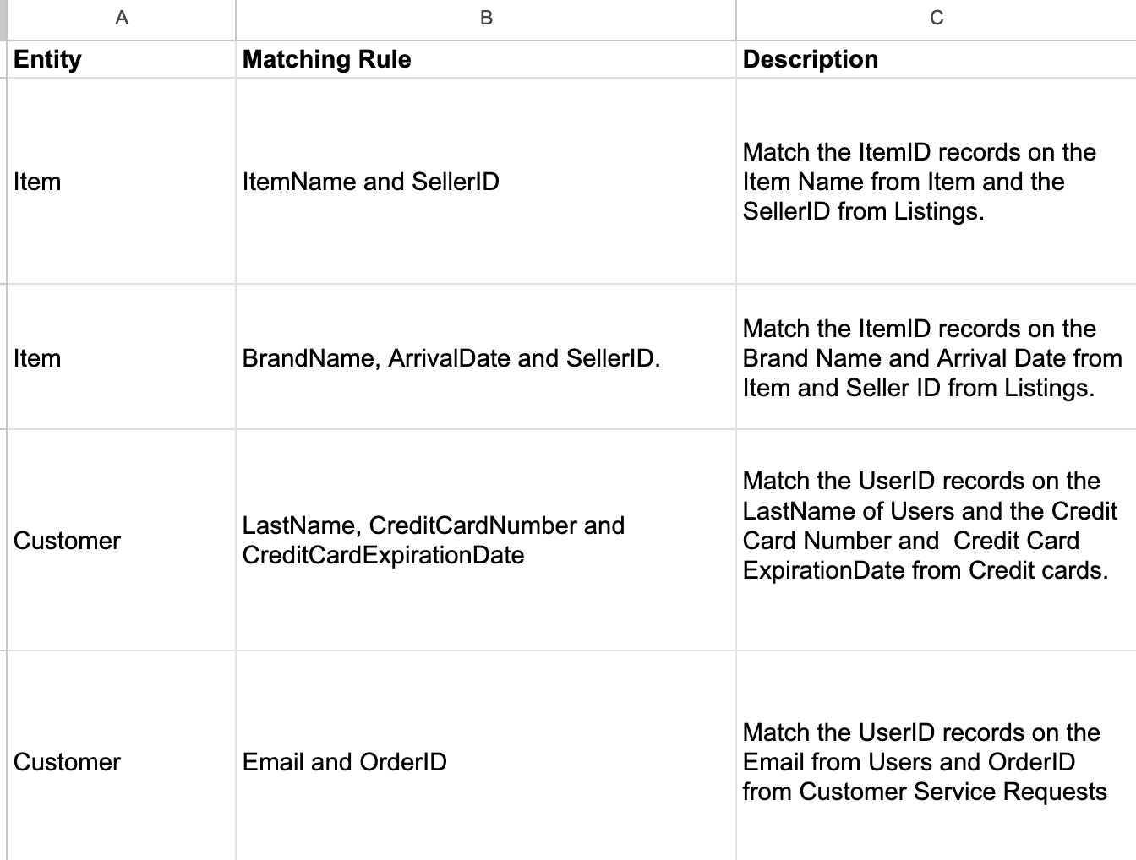

Slide 22
Step 7
Data Governance:
Roles and Responsibilities

Slide 23
Aspect | Data Admin | Data Steward | Data Custodian | Data User
Definition | Oversees the implementation of the entire data governance program | Act as a bridge between business and IT so that business users can access the right data | Deals with the movement, security, storage, and use of data | Uses data to draw insights from it for business decision-making
Top responsibility | - 1. Processes and transforms data for modeling while ensuring its integrity and usability - 2. Serves as the escalation points for resolving all data-related conflicts | - 1. Helps standardize data definitions, rules, and descriptions - 2. Helps define access policies and optimize data-related workflows and communication | - 1. Oversees data access and storage - 2. Identifies data stewards for various data domains and collaborates with them on data quality issues | - 1. Understand the data governance policies, standards, rules, and definitions - 2. Use tools from the modern data stack to extract value from data
Technical or business? | Both | Business | Technical | Business
The ideal fit | A seasoned or veteran data team member with a good grasp of both business and technical aspects | A senior data team member with deep domain knowledge and familiarity with the data stack | A senior engineer or scientist within the data team who can navigate through the modern data stack | Marketers, salespeople, researchers, senior executives and business managers
For now, I think is not necessary to hire new employees because the MDM architecture can be managed by me and the actual employees we can reskilling Jake and Jessica.

