Slide 1

Querying Using an ORM

Slide 2
Querying Using SQL
We can write SQL to query tables within a database
SQL queries return data from the tables that the SQL was executed against
SQL can be written and executed in a ‘.sql’ file
Trouble arises when we want to execute SQL within programming languages such as Python and JavaScript
How can we execute an SQL query against the database and access the data directly in our Python code?

Slide 3
The SQL Data to Code Problem
When we want to query a table using SQL and access the data in a programming language, it requires special packages and a lot of extra code to convert the data into something that our code can understand
In the past, developers would have to execute a raw SQL query using a special function (that returns the data in a large string) and parse the data manually
This is prone to many errors and increases development time dramatically
Lets take a look at what this would look like…

Slide 4
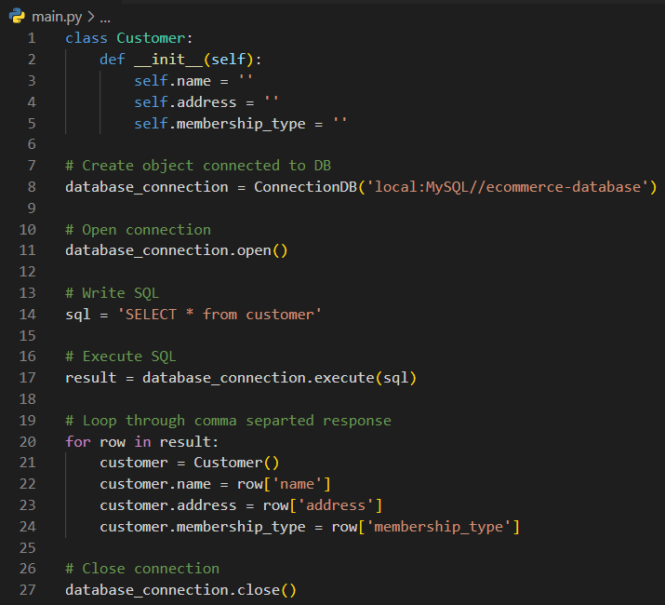
Old Way to Access Databases
When accessing databases with raw SQL queries, there are a number of steps that are required:
Open a connection to the database
Write an SQL query in a string variable
Pass the query to an execute function
Loop over every row in the query response
Manually map it to a Python data type/variable
Close connection

Slide 5
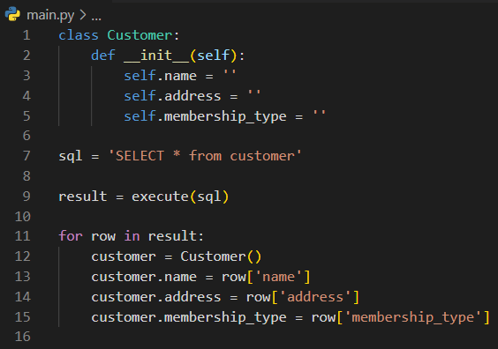
Old Way to Access Databases
When accessing databases with raw SQL queries, there are a number of steps that are required:
Write an SQL query in a string variable
Pass the query to an execute function
Loop over every row in the query response
Manually map it to a Python data type/variable

Slide 6
Improvements to Database Access
The majority of modern-day applications utilize a more code-based approach to querying databases
The past way of executing raw SQL is still used, however this is only in cases where the speed and efficiency of raw SQL outperforms the new approach
In the new approach, we can build entire applications without ever writing a line of SQL
This is done through something called an Object-Relational Mapper or “ORM”

Slide 7
Code First Approach - ORM
Modern applications built using an object-oriented programming language use object-relation mappers (ORM)
This way the developer can focus on the primary application code and avoid interreacting with the database tables through raw SQL
In each ORM approach, a series of class objects are created that define the desired structure of a table
It is through methods on these ORM class objects that we can query the database tables
We call these ORM class objects “models”

Slide 8
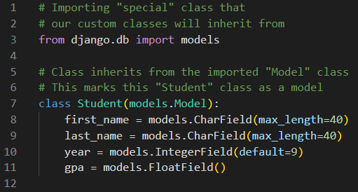
Models
Models are classes that the developer defines
Models typically inherit from special pre-built classes that mark the class as a model rather than a “normal” class

Slide 9
Model Properties
Model properties are defined and set equal to methods on the imported “models” package
The name of the class determines the name of the table in the database
The function we set each property equal to defines what columns the table should have as well as the data type that column should be
We can also set special instructions for that column such as “max_length” and a “default” value (and many more!)

Slide 10
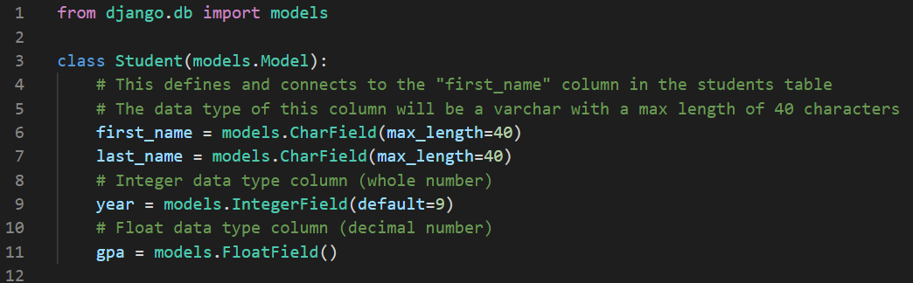
Model Properties Example

Slide 11
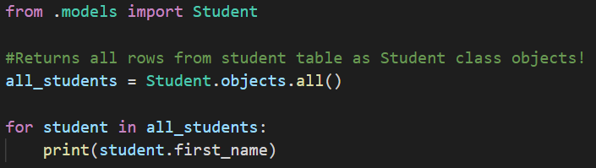
Querying Using ORM Models
Once our models are created, we can import them into our Python files to interact with our database tables all through Python code! (no raw SQL needed!)
Every model has an “objects” property which contains methods we can use for our queries

Slide 12
Query Structure
ORMs provide many helpful methods that allow you to find the data you're looking for on your database.
These Query Methods typically return results in a QuerySet, which is a collection similar to a List.
Side Note: We are currently learning about “Django’s” ORM
Django is a python web framework (collection of pre-written code)
We will be learning about Django soon!

Slide 13


Query Structure
Query methods will typically have a keyword argument passed in which specifies:
What column is being searched?
What term is being searched in that column?

Slide 14

.all()
Model.objects.all() - Returns a QuerySet of all objects from the model's table.

Slide 15
.filter()
Model.objects.filter(x=y) - Returns a QuerySet of all objects whose 'x' property has the value of 'y'.
Use this when you don't know how many rows might be found. This will work for any number or results, 0, 1, or more, without throwing an exception.
Note that if a single result is found, it will still be a QuerySet that contains the single item, NOT the item itself. So when searching for a single item by Primary Key, .get() is more appropriate

Slide 16
.exclude()
Model.objects.exclude(x=y) - Returns a QuerySet of all objects whose 'x' property DOES NOT equal 'y'.

Slide 17

.get()
Model.objects.get(x=y) - Returns a single database object whose 'x' property has the value of 'y'.
Typically used with Primary Key column or a unique Foreign Key.
Use this when you expect EXACTLY one row to be found. .get() will throw an exception if 0 or more than 1 rows are found. Often used with a try/catch!

Slide 18
.order_by()
Can be added to the end of any query!
Specifies which column to order by, and in what order (ascending or descending)
Adding a minus sign before the name indicates descending order.
You can order by multiple columns by using a comma!

Slide 19
Field Lookup Types
You may not always want to search for an exact match on a table!
Sometimes you will want an approximate or case-insensitive match, or a value comparison such as greater than or less than.
This can be achieved by specifying the lookup type after the column name.
If you don't specify a Field Lookup Type, it defaults to 'exact'

Slide 20


Field Lookup Types
__gt or __gte - greater than / greater than or equal
__lt or __lte - less than / less than or equal
__iexact - case insensitive match
__contains – search for partial matches
And more!
https://docs.djangoproject.com/en/4.0/topics/db/queries/#field-lookups

Slide 21

Querying QuerySets
A QuerySet is a data structure used to hold information returned from a database.
It is similar to a list in that it can be iterated over either in a view function or in a template.
QuerySets themselves can be queried to further narrow-down your dataset!

Slide 22
Creating Rows Using a Model
To create a new row in a table, use the “create” function on the model’s objects property
Provide values for each class property in the create function’s arguments

Slide 23
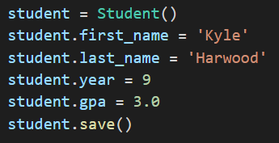
Creating Rows Using a Model #2
We can also create a new record by instantiating the class into an object and then calling the objects “save” function
Provide values for each class property individually

Slide 24
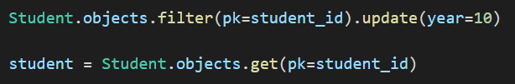
Updating Rows Using a Model
To update a row in a table, use the “update” function on the model’s objects property
Provide values for properties in the class you would like to update
Use “filter” to get the specific row to update
Update does NOT return the updated row object

Slide 25
Deleting Rows Using a Model
To update a row in a table, use the “delete” function on the model’s objects property
Use “filter” to get the specific row to delete

