Slide 2
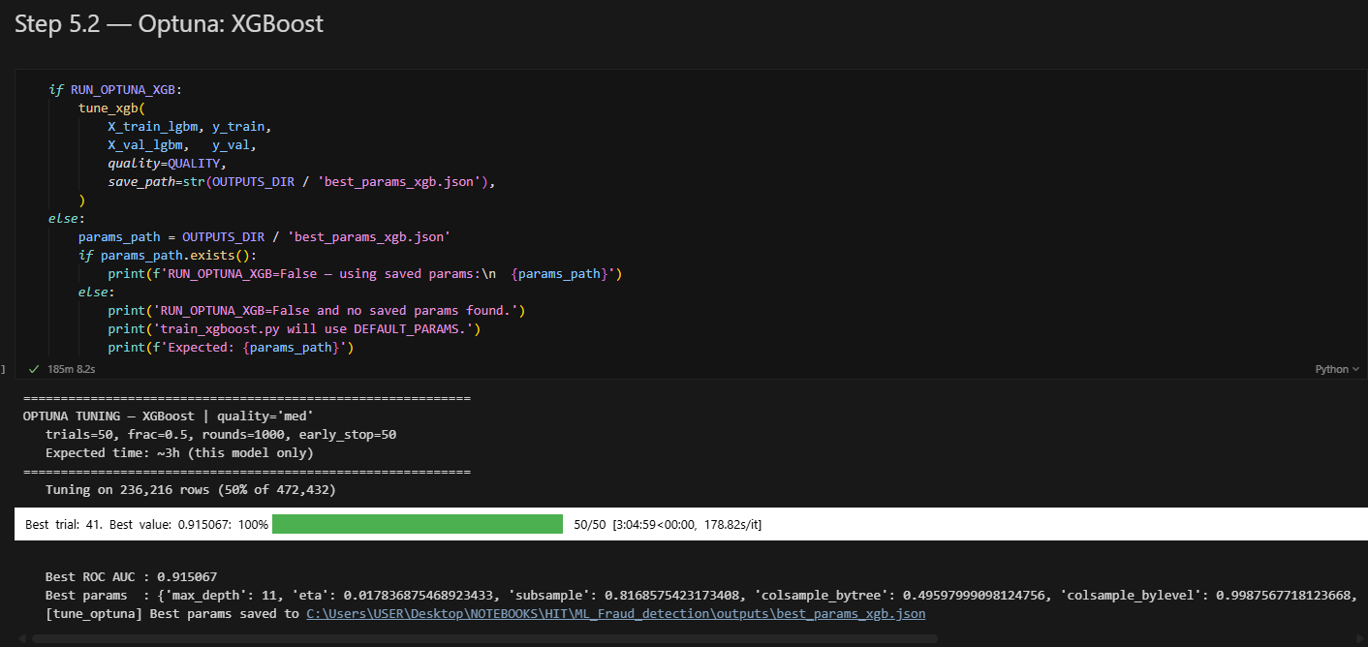
Hyperparameters Tuning for each ML-model
Tuning for XGBoost - more than 3 hours

