Slide 1
Categorical analysis with advanced Visualization Q1: Income of foreign-born vs. natives per states Q2: Absorption of the population per US-states
Irena Shtelman Kravitz
Sept 2019

Slide 2
Q1: Top 20 US-states where is the highest percentage of Foreign-born with the high income (65+K) out of total_FB VS Natives the high income (65+K) out of total_Natives.
Dataset: Census 2017, table: 'acs5'
Dataset description:
Mix of population with income from Total,
Mix of 35K+ Income from Total,
and the same measures for Foreign Born only, 2017.
Target dataset: 'FB_vs_Native_States_Income’
Q1:
Is there a difference in income between Foreign born and Natives in top US-states with Income 65+K?
The target categories:
1. Top 25 US-states Foreign born with Income 65+K VS Natives with Income 65+K out of Total state population.
2. Top 20 US-states Foreign born with Income 65+K out of total Foreign born VS Natives with Income 65+K out of Total Natives.

Slide 3
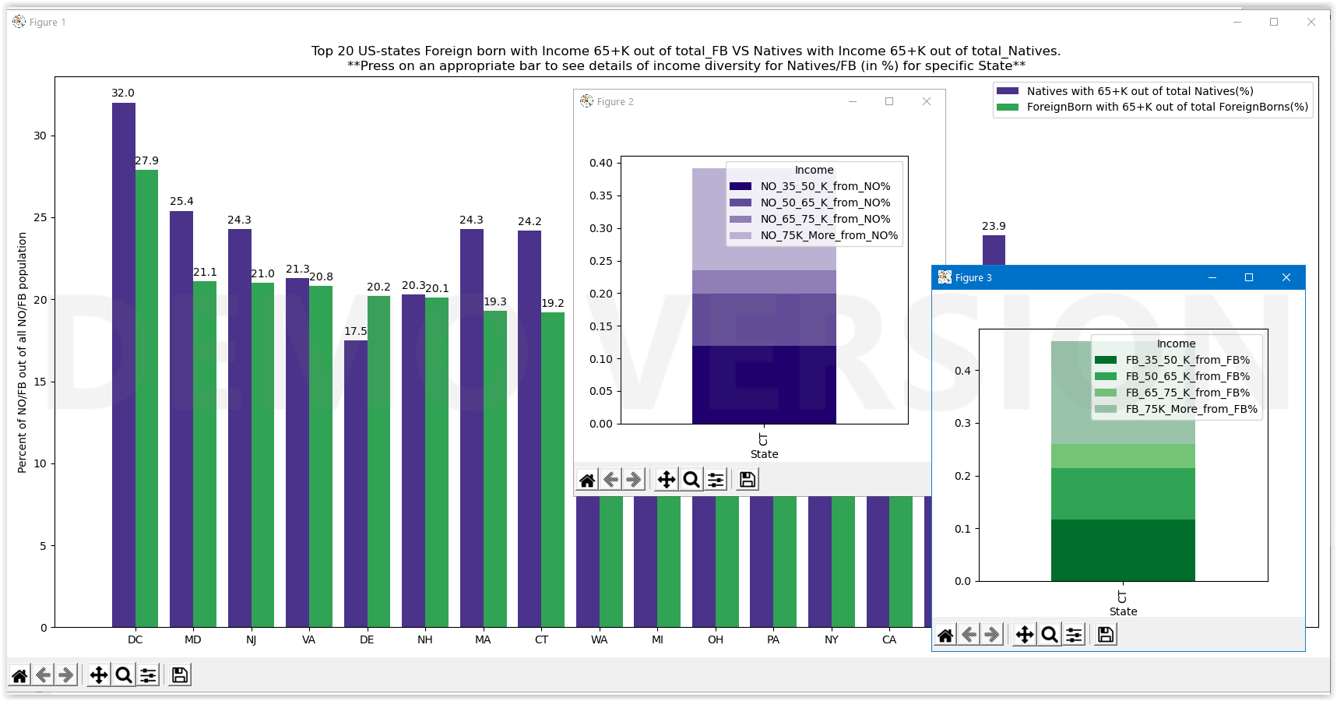
2) Top 20 US-states Foreign born with Income 65+K out of Total Foreign Born VS Natives with Income 65+K out of Total Natives.
Click on a bar to see details of income diversity for Natives/Foreign Born (%) for specific State.

Slide 4
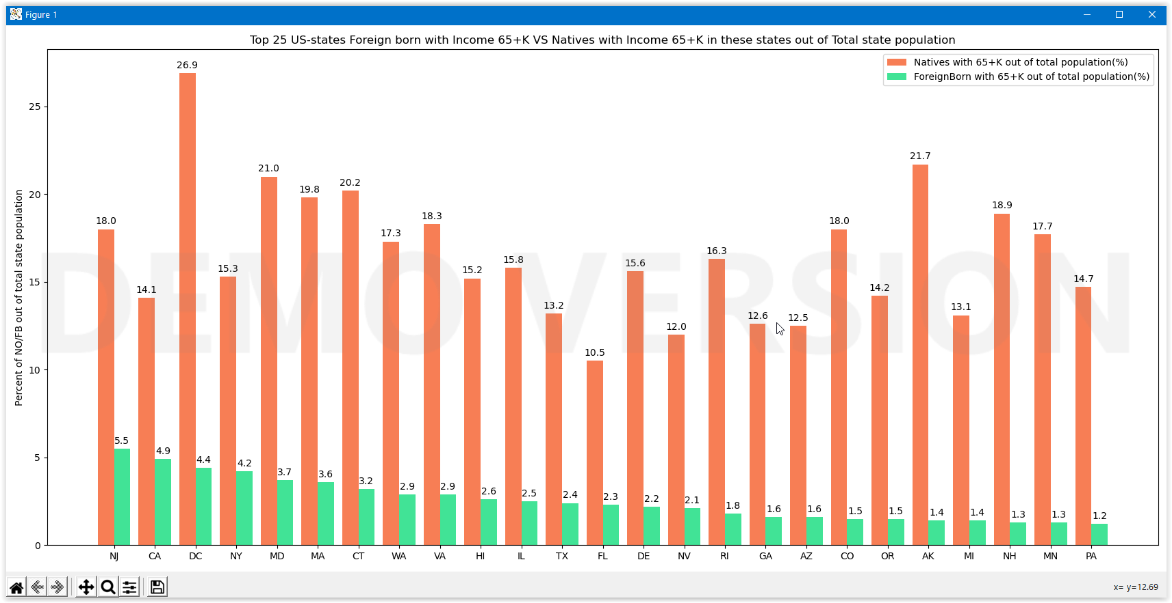
Top 25 US-states Foreign born with Income 65+K VS Natives with Income 65+K in these states
out of Total state population

Slide 5

Dataset: Census 2017, table: 'acs5'
Dataset description:
Mix of population with income from Total,
Mix of 35K+ Income from Total,
and the same measures for Foreign Born only, 2017.
Target dataset: 'StatesCitizenship2017’
Percentage of Naturalized US-citizens with non US-citizen from Total State Population
Q2:
Is there any difference between the absorption of the population in different US-states?
('acs5' 2017, Census)

Slide 6
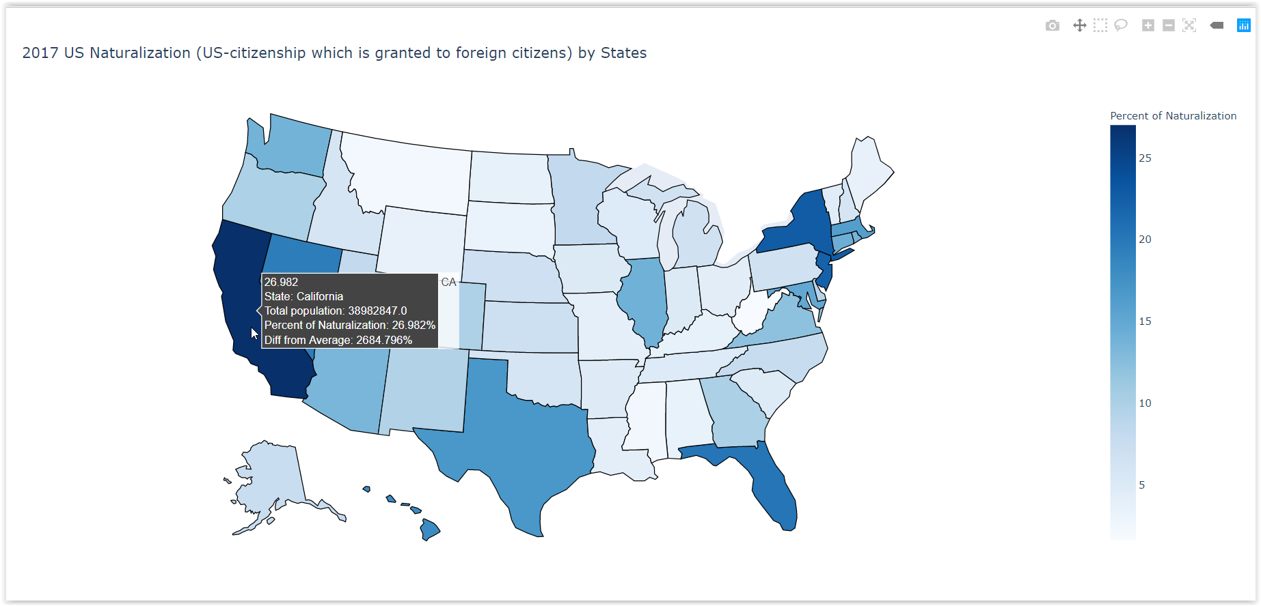
Map graph:

Slide 7


