Slide 1
Visualization project
Irena Shtelman Kravitz
Sept 2019

Slide 2

Project proposal:
Categorical analysis
Developing Advanced Visualization tools

Slide 3
Q1: States Income: Foreign born vs. Natives ('acs5' 2017, Census)
Original Dataset: Census 2017, original table: 'acs5'
Dataset description:
Mix of population with income from Total,
Mix of 35K+ Income from Total,
and the same measures for Foreign Born only, 2017.
Target dataset: 'FB_vs_Native_States_Income’
Q2:
Is there a difference in income between Foreign born and Natives in top US-states with Income 65+K?
The target categories:
1. Top 25 US-states Foreign born with Income 65+K VS Natives with Income 65+K out of Total state population.
2. Top 20 US-states Foreign born with Income 65+K out of total Foreign born VS Natives with Income 65+K out of Total Natives.

Slide 4
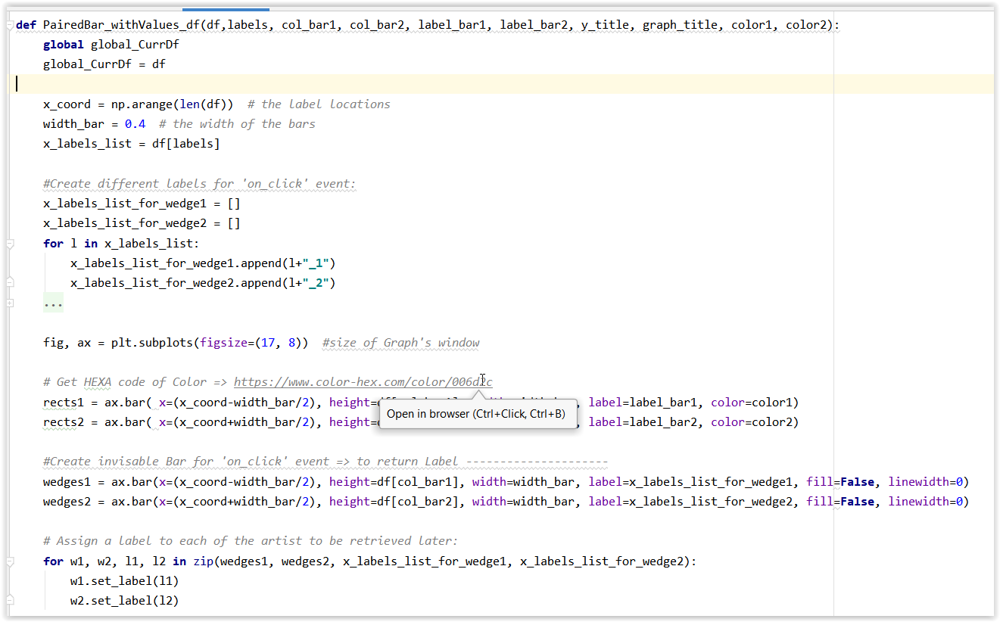
Paired Bars Implementation:

Slide 5
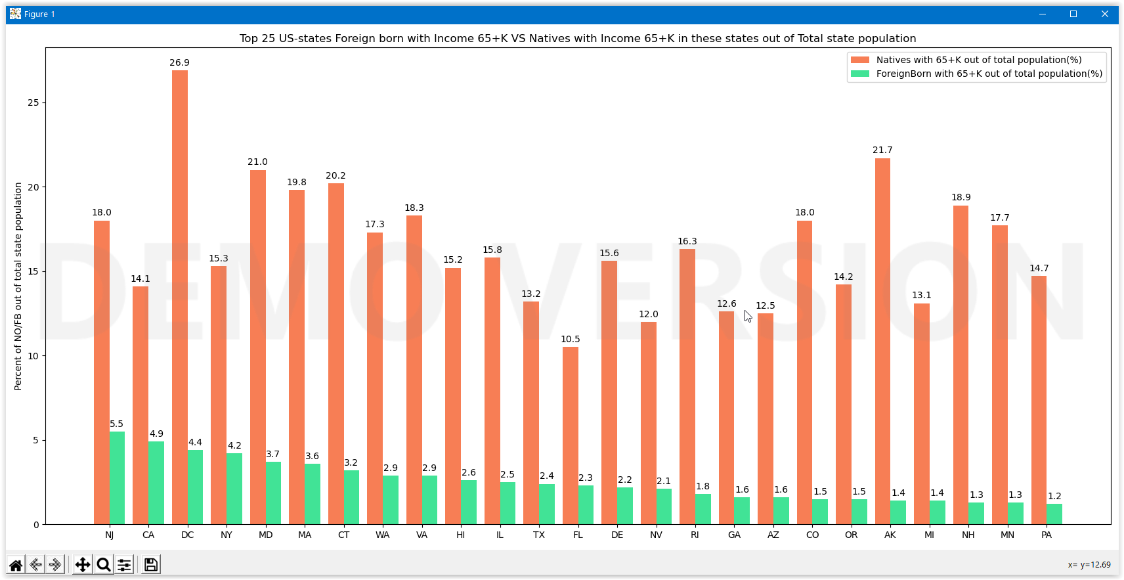
Top 25 US-states Foreign born with Income 65+K VS Natives with Income 65+K in these states
out of Total state population

Slide 6
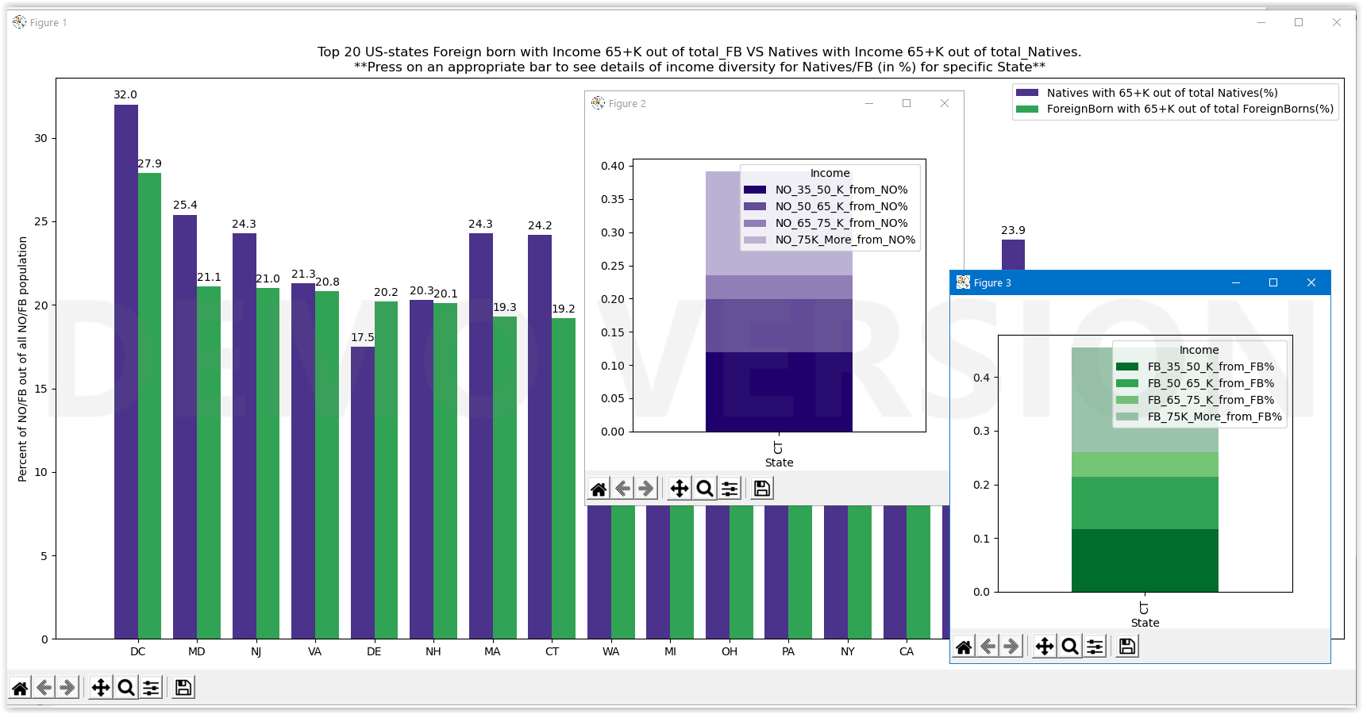
2) Top 20 US-states Foreign born with Income 65+K out of Total Foreign Born VS Natives with Income 65+K out of Total Natives.
Click on a bar to see details of income diversity for Natives/Foreign Born (%) for specific State.

Slide 7
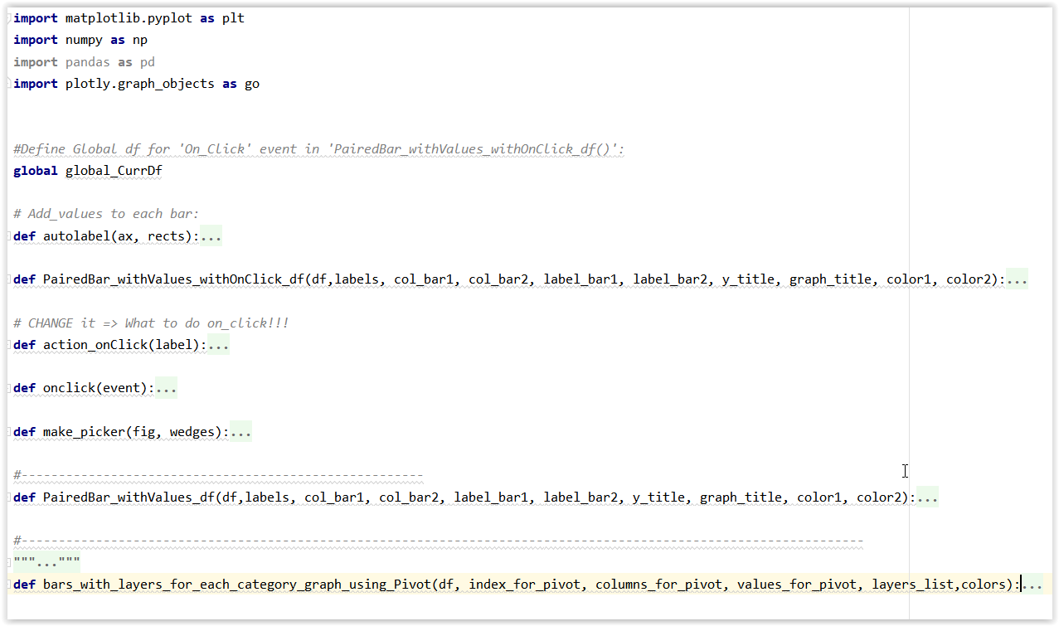
Paired Bars OnClick Implementation:

Slide 8

Original Dataset: Census 2017, original table: 'acs5'
Dataset description:
Mix of population with income from Total,
Mix of 35K+ Income from Total,
and the same measures for Foreign Born only, 2017.
Target dataset: 'StatesCitizenship2017’
Percentage of Naturalized US-citizens with non US-citizen from Total State Population
Q2:
Is there any difference between the absorption of the population in different US-states?
('acs5' 2017, Census)

Slide 9
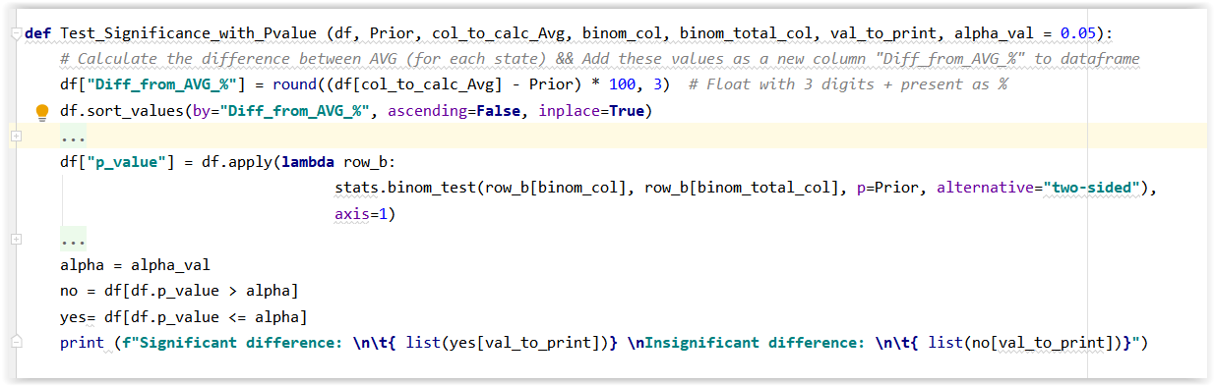
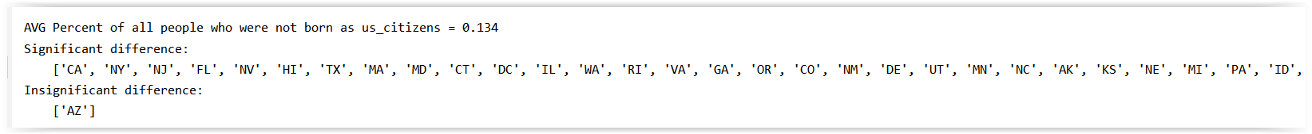
Statistical exam of Significant Difference (by using P-value, with alpha = 0.00001)

Slide 10
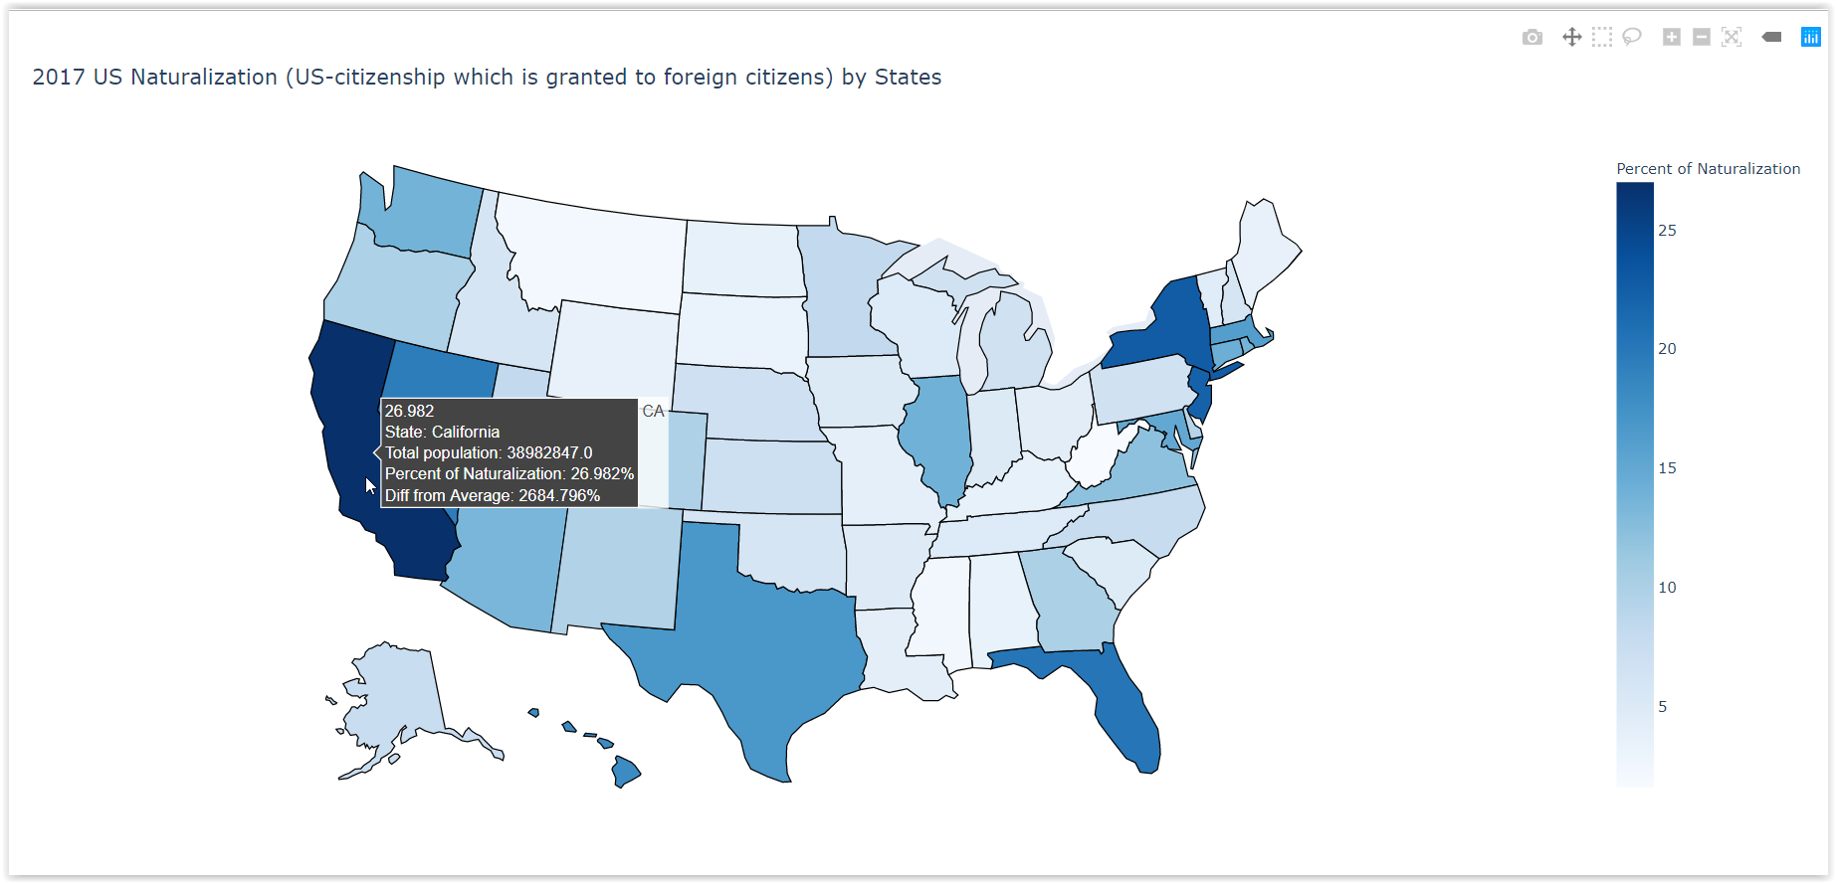
Map graph:

Slide 11
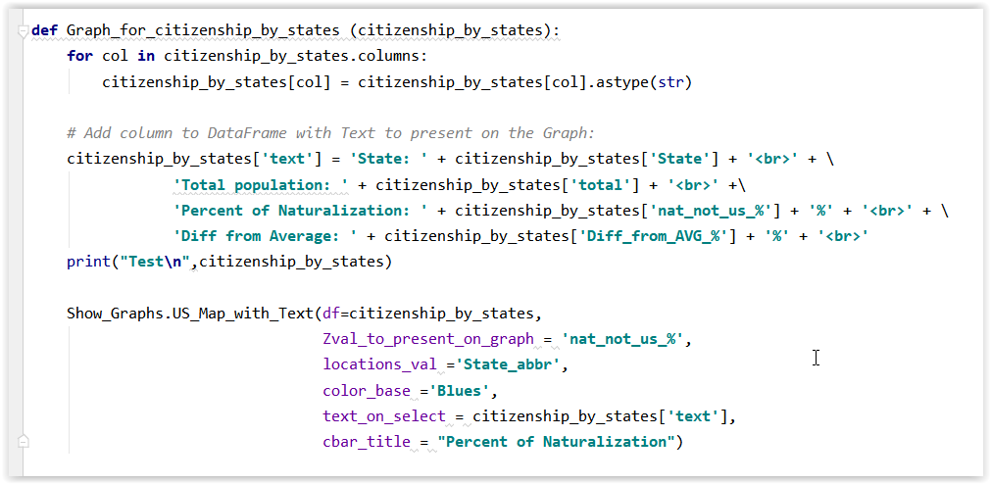
Map implementation:

Slide 12
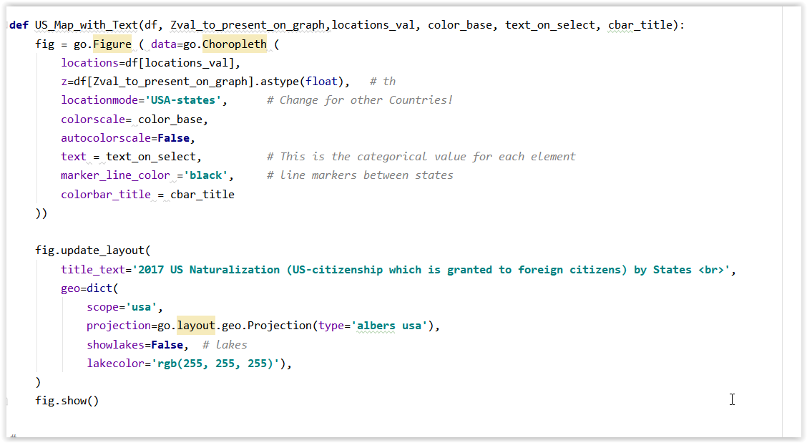
Map implementation –
continue:

Slide 13


