Slide 1

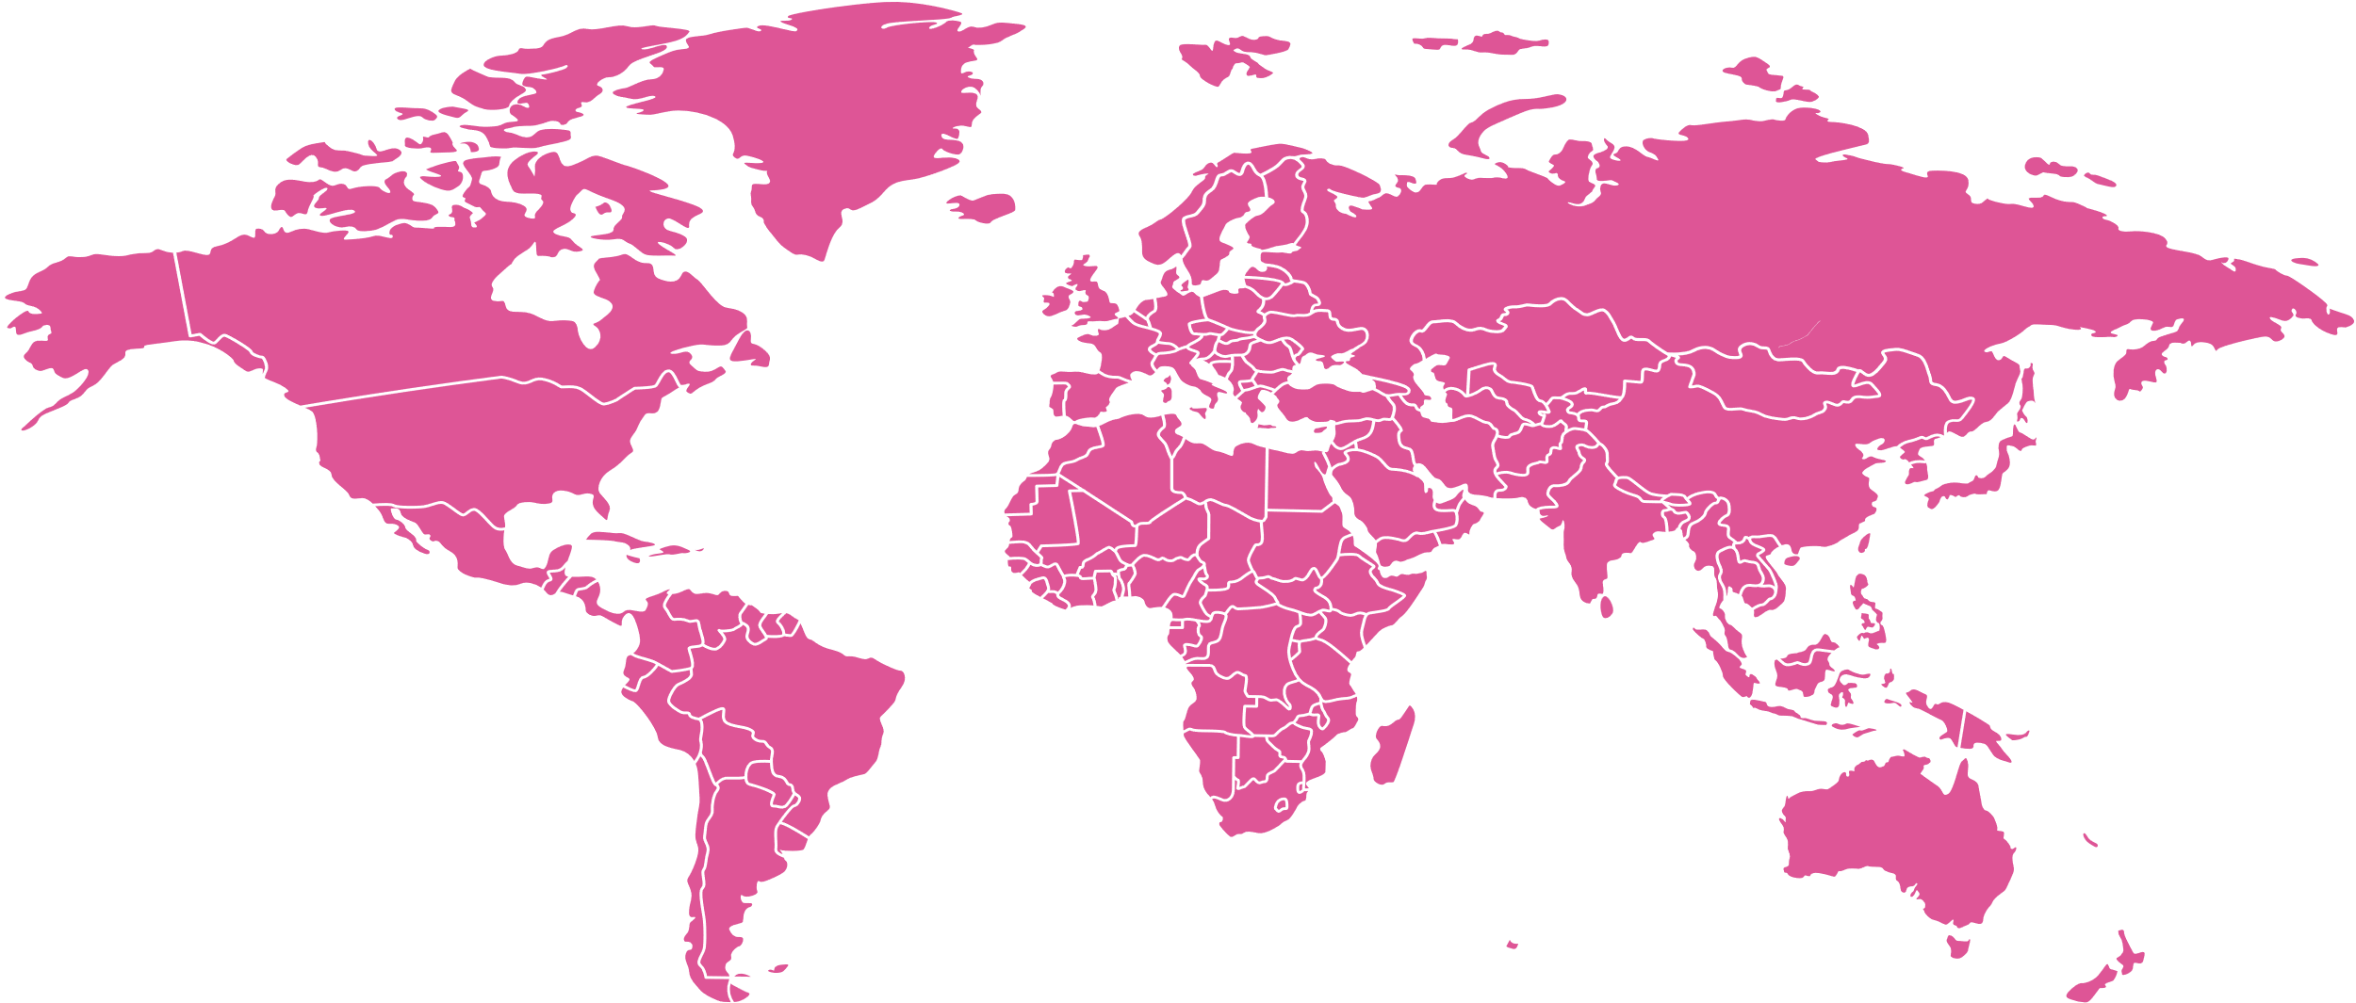


Heart Failure Prediction
A MODEL FOR PREDICTING MORTALITY CAUSED BY HEART FAILURE

Slide 2


Problem Statement
HEALTH PARAMETERS THAT CONTRIBUTE
Heart Failure is a critical condition affecting millions globally, leading to high mortality rates and significant healthcare costs.
Early identification of at-risk patients can aid in preventive measures, improving patient outcomes, and alleviating the burden on healthcare systems

Slide 3

Key Objectives
HEALTH PARAMETERS THAT CONTRIBUTE
Develop a Predictive Model
Visualize Patient Profiles
Provide Actionable Insights
Identify Key Risk Factors
Analyze significant clinical features
Use machine learning for prediction.
Highlight risk profiles for clinicians
Recommendations for effective intervention strategies

Slide 4

Key Objectives
Improved Patient Outcomes
Resource Optimization
Cost Reduction
Early detection and personalized treatment plans
Efficient allocation of medical resources
Early intervention reduces healthcare costs
Data-Driven Decision Making
Enhanced Preventive Care
Personalized Medicine
Informed healthcare policies
Tailored treatments based on individual risk factors
Development of preventive care programs

Slide 5

An Overview of the Dataset
Cardiovascular diseases (CVDs) are the number 1 cause of death globally, taking an estimated 17.9 million lives each year, which accounts for 31% of all deaths worldwide.
Heart failure is a common event caused by CVDs and this dataset contains 12 features that can be used to predict mortality by heart failure.

Slide 6
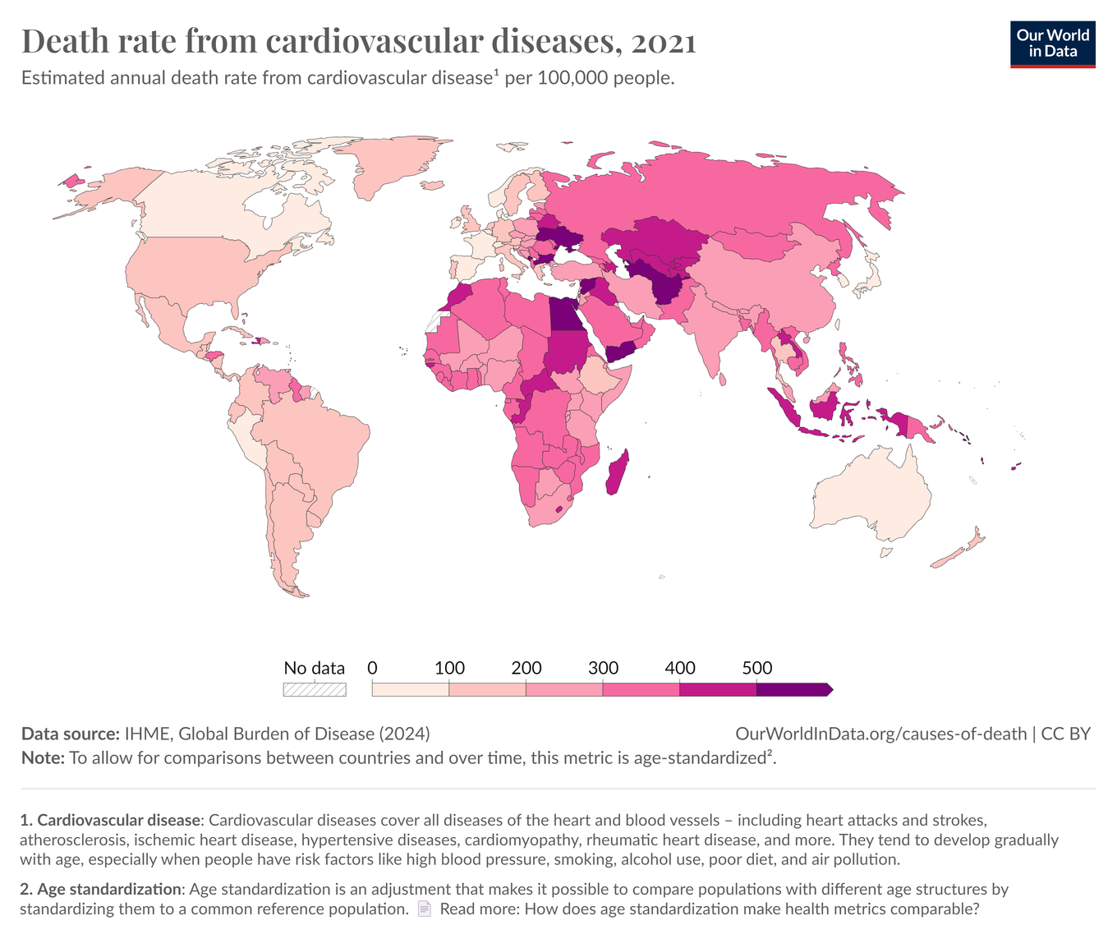
An Overview of the Current State
DEATH RATE FROM CARDIOVASCULAR DISEASES, 2021
Estimated annual death rate from cardiovascular disease per 100,000 people.
Deaths from cardiovascular disease (CVD) jumped globally from 12.1 million in 1980 to 20.5 million in 2021

Slide 7
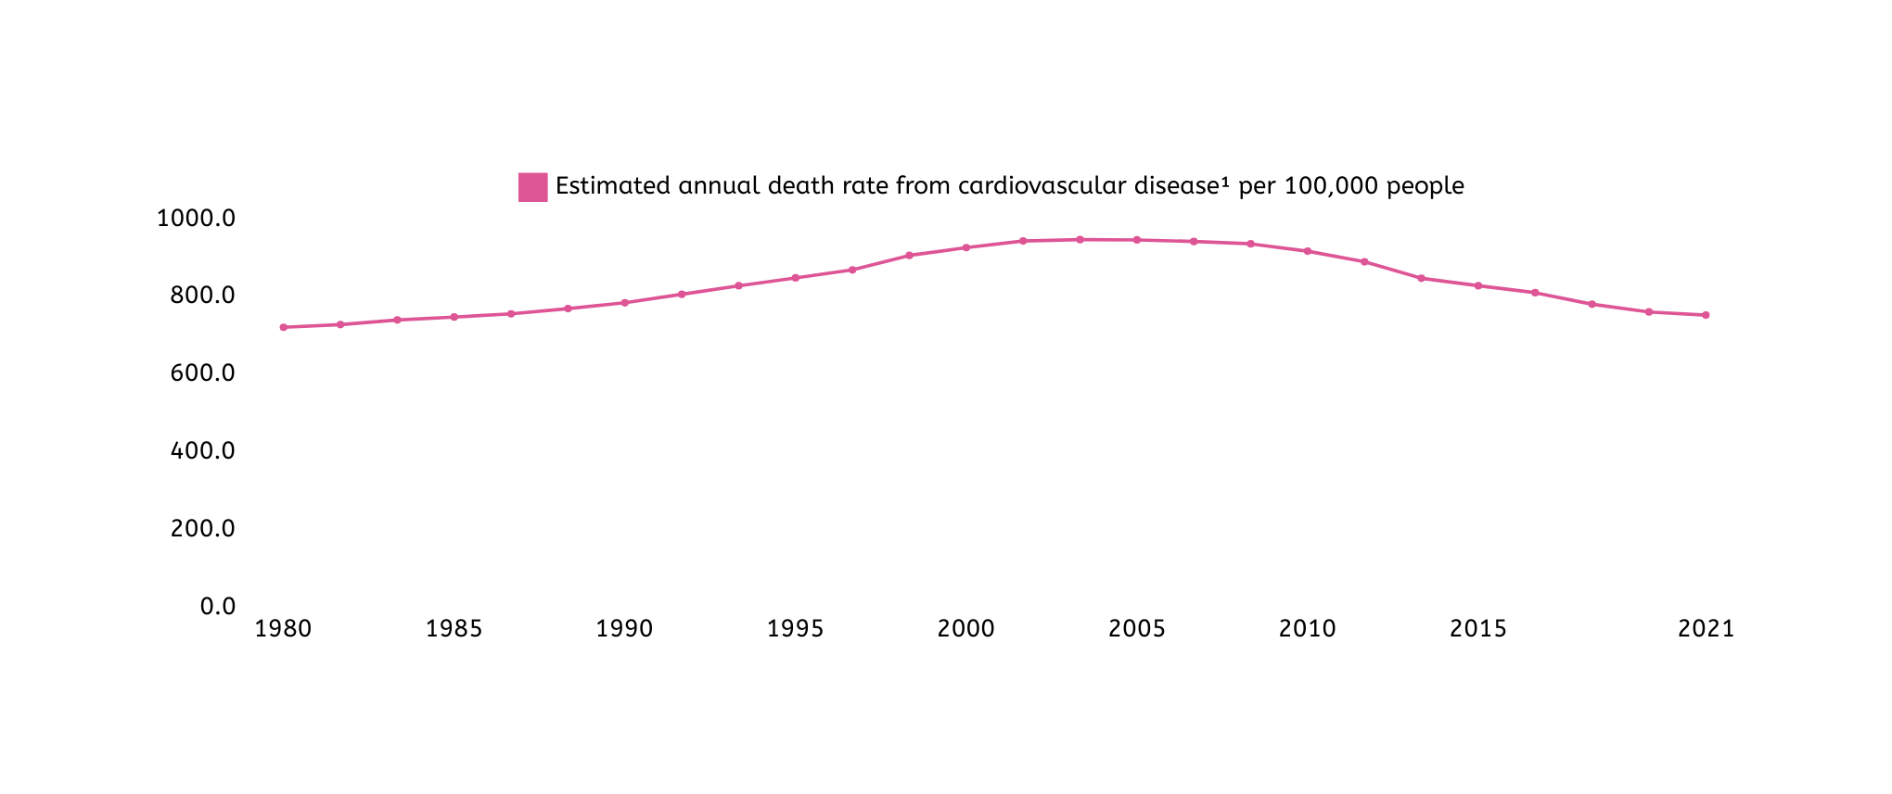
An Overview of the Current State
DEATH RATE FROM CARDIOVASCULAR DISEASES, 1980 TO 2021
NURU: 750

Slide 8
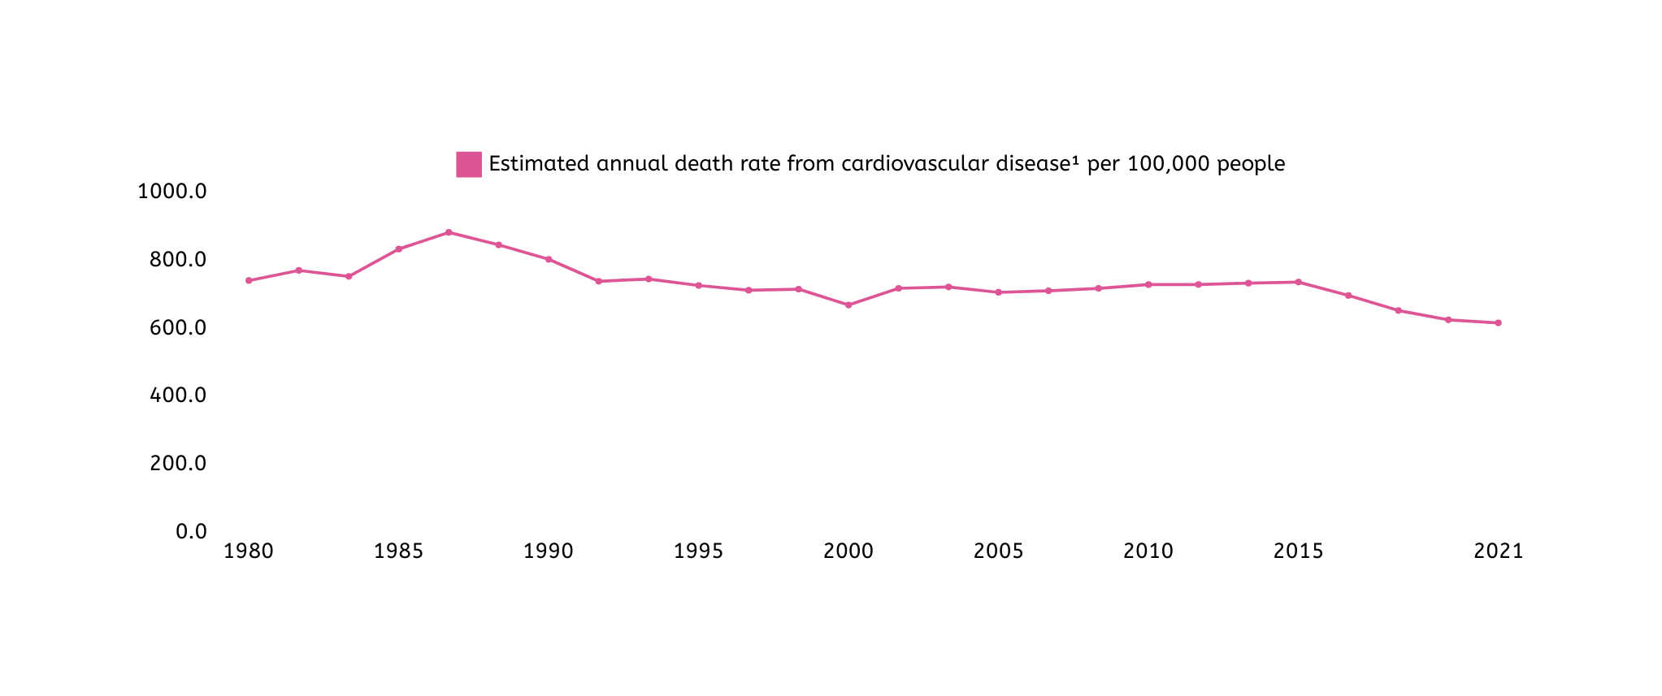
An Overview of the Current State
DEATH RATE FROM CARDIOVASCULAR DISEASES, 1980 TO 2021
EGYPT: 612

Slide 9
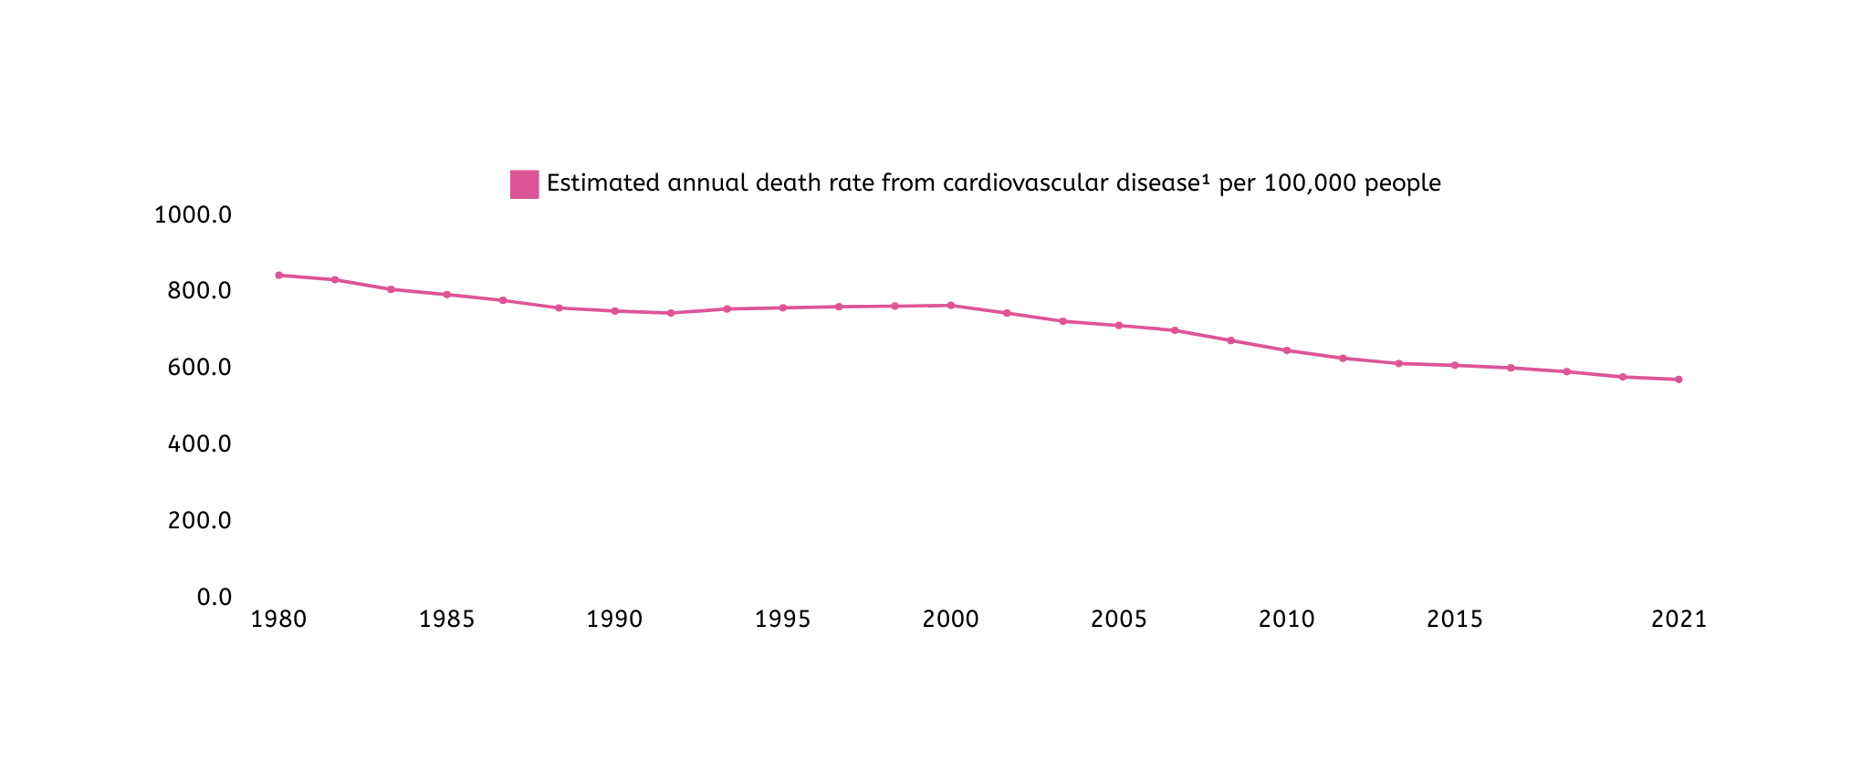
An Overview of the Current State
DEATH RATE FROM CARDIOVASCULAR DISEASES, 1980 TO 2021
AFGANISTAN: 567

Slide 10
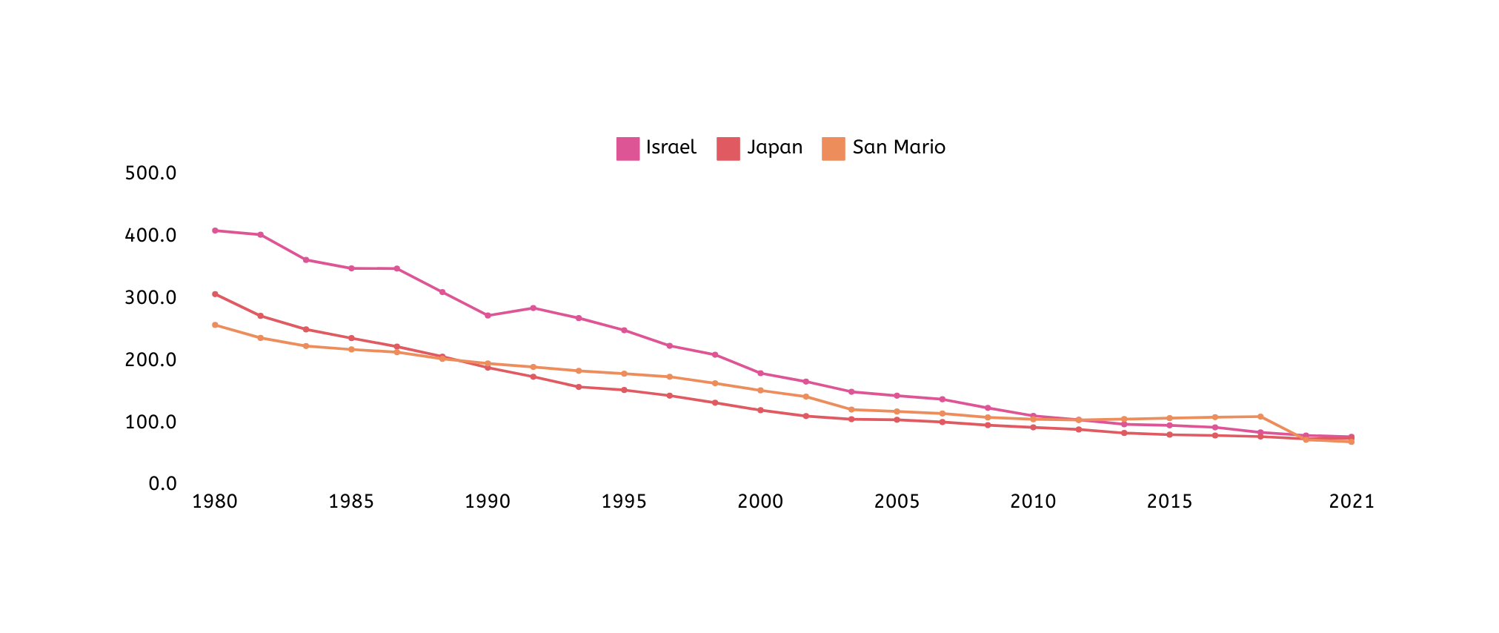
An Overview of the Current State
DEATH RATE FROM CARDIOVASCULAR DISEASES, 1980 TO 2021
COUNTRIES WITH LOWEST CASES OF DEATHS DUE CVD’S

Slide 11
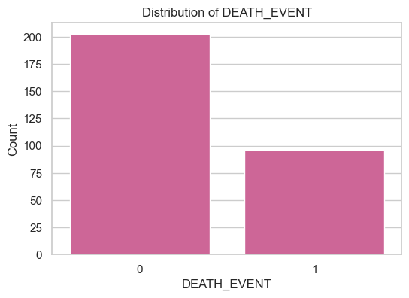
Understanding the Dataset
ANALYZING THE DISTRIBUTION OF A DEATH EVENT
The distribution of the target variable (DEATH_EVENT) shows that there are more survivors (0) than deaths (1) in the dataset.

Slide 12
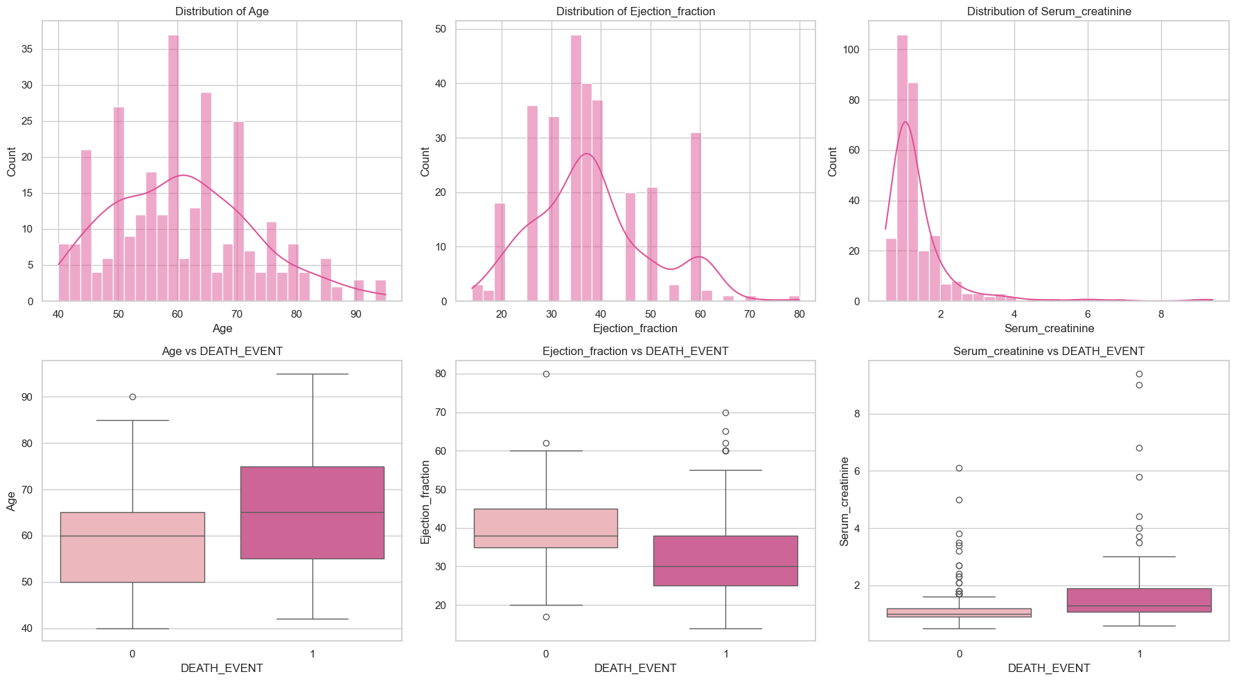
Understanding our dataset
ANALYZING THE DISTRIBUTION OF AGE
AGE
EJECTION FRACTION
SERUM CREATINE

Slide 13
Understanding our dataset
INFLUENCE ON PATIENT'S LIFE.
EJECTION FRACTION
SERUM CREATININE
AGE

Slide 14
Major Risk Factors for CVD’s
HEALTH PARAMETERS THAT CONTRIBUTE THE MOST TO DEVELOPMENT OF CVD’S
136%
28%
26%
Increase of deaths in patients with High Serum Creatinine
Increase of deaths in patients with High Blood Pressure
Increase of deaths in patients with Anaemia

Slide 15
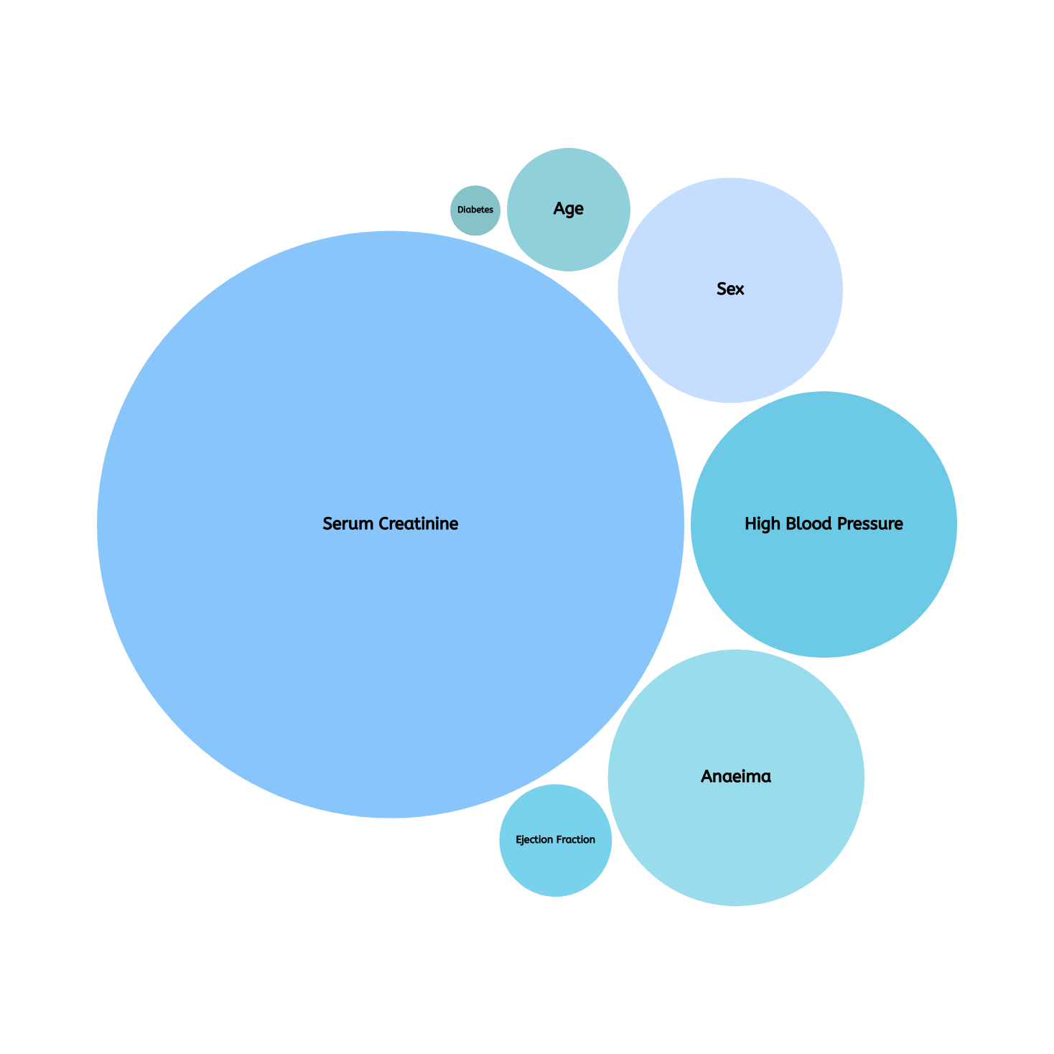
What contributes to mortality in heart failure patients?

Slide 16
Predictive Model
PERSON 1
Feature | Data | Dataset Avg
Age | 65 | 60.833893
Anaemia | 1 | 0.431438
Creatinine Phosphokinase | 52 | 581.839465
Diabetes | 0 | 0.418060
Ejection Fraction | 25 | 38.083612
High Blood Pressure | 1 | 0.351171
Platelets | 276000 | 263358.02
Serum Creatinine | 1.3 | 1.393880
Serum Sodium | 137 | 136.625418
Sex | 0 | 0.648829
Smoking | 0 | 0.321070
Time | 16 | 130.260870
Low Risk
Probability of death: 0.18
Prediction for Person 1
Actual Value of Death_Event = 0

Slide 17
Predictive Model
PERSON 2
Feature | Data | Dataset Avg
Age | 35 | 60.833893
Anaemia | 1 | 0.431438
Creatinine Phosphokinase | 92 | 581.839465
Diabetes | 1 | 0.418060
Ejection Fraction | 29 | 38.083612
High Blood Pressure | 1 | 0.351171
Platelets | 126000 | 263358.02
Serum Creatinine | 1.9 | 1.393880
Serum Sodium | 165 | 136.625418
Sex | 0 | 0.648829
Smoking | 1 | 0.321070
Time | 16 | 130.260870
High Risk
Probability of death: 0.67
Prediction for Person 2
Actual Value of Death_Event = 1

Slide 18
Predictive Model
PERSON 2
Feature | Data | Dataset Avg
Age | 45 | 60.833893
Anaemia | 1 | 0.431438
Creatinine Phosphokinase | 981 | 581.839465
Diabetes | 0 | 0.418060
Ejection Fraction | 30 | 38.083612
High Blood Pressure | 0 | 0.351171
Platelets | 136000 | 263358.02
Serum Creatinine | 1.1 | 1.393880
Serum Sodium | 137 | 136.625418
Sex | 1 | 0.648829
Smoking | 0 | 0.321070
Time | 11 | 130.260870
High Risk
Probability of death: 0.95
Prediction for Person 3
Actual Value of Death_Event = 1

Slide 19

Conclusion
The data shows that advanced age, reduced ejection fraction, and the presence of anaemia significantly correlate with increased mortality risk.
Conversely, the absence of diabetes and smoking, as well as normal serum sodium levels, are positive indicators.

Slide 20
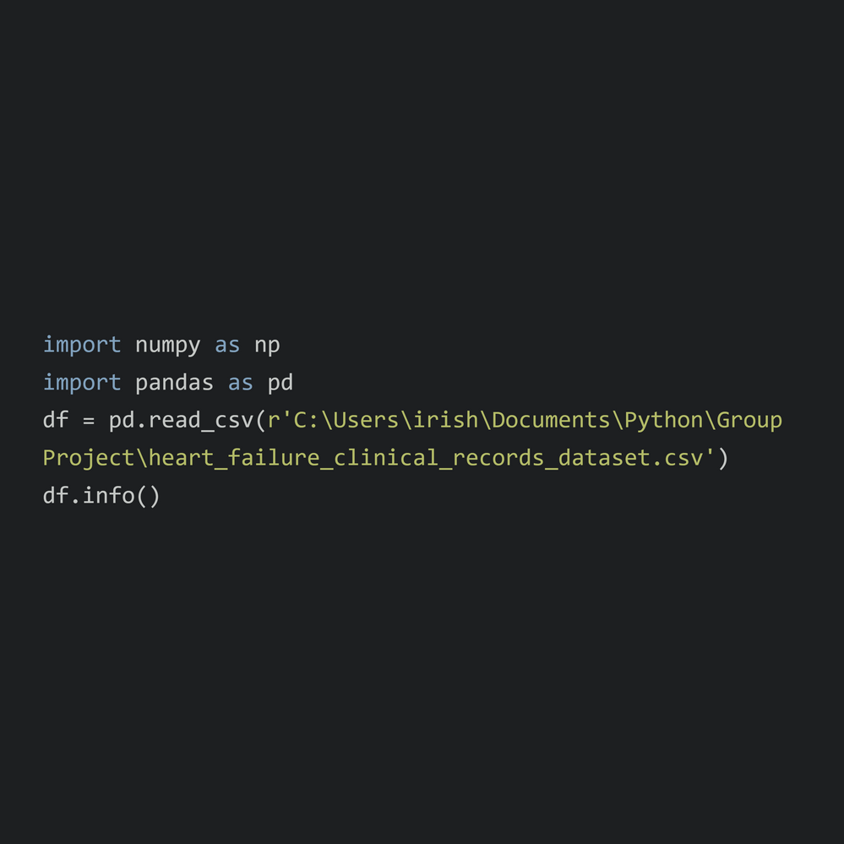
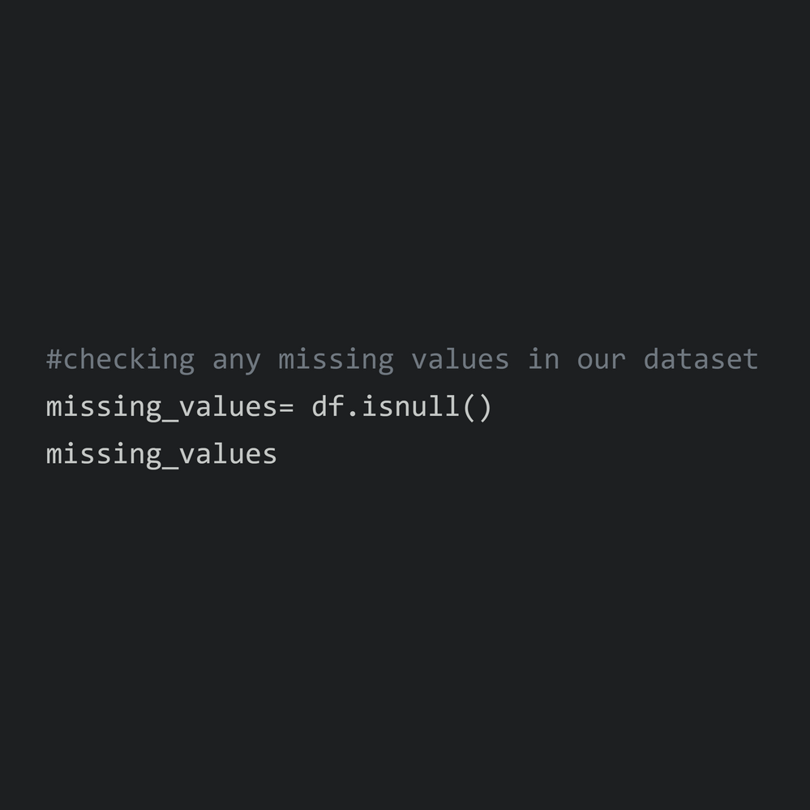
Working with Python
IMPORTING, CLEANIG & ANALYZING THE DATASET

Slide 21

Thank You!

