Slide 1
Data Analysis iWear & APDM Xueyao Li

Slide 2
1. iWear

Slide 3
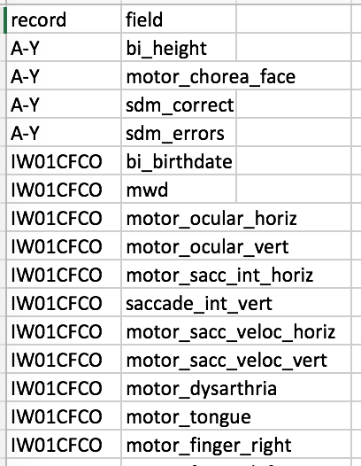
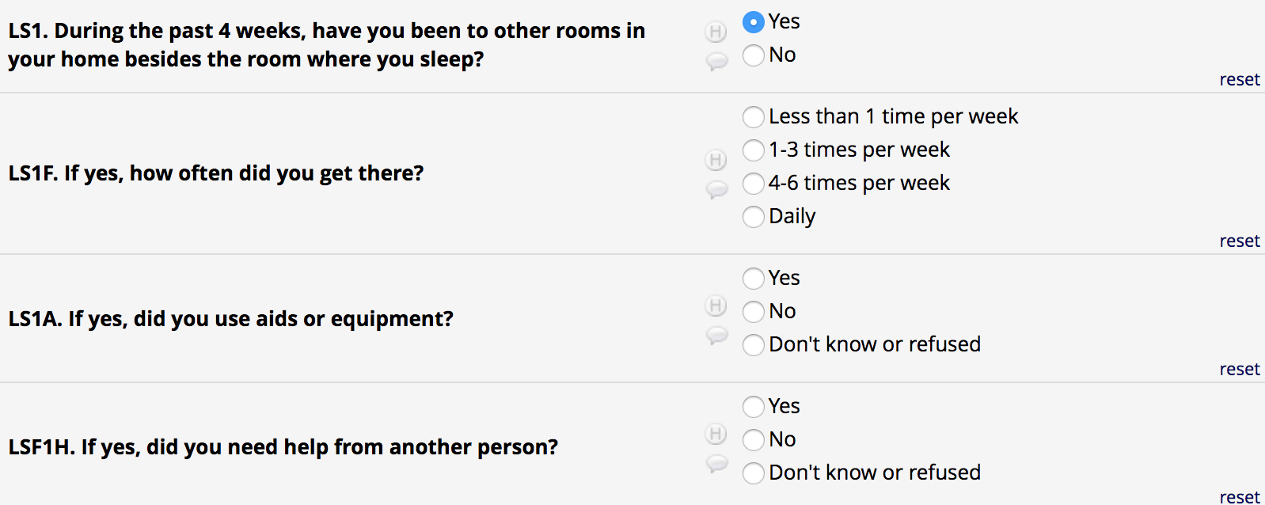
Data Cleaning
78 participants & 537 variables
5 sites
Logical questions

Slide 4
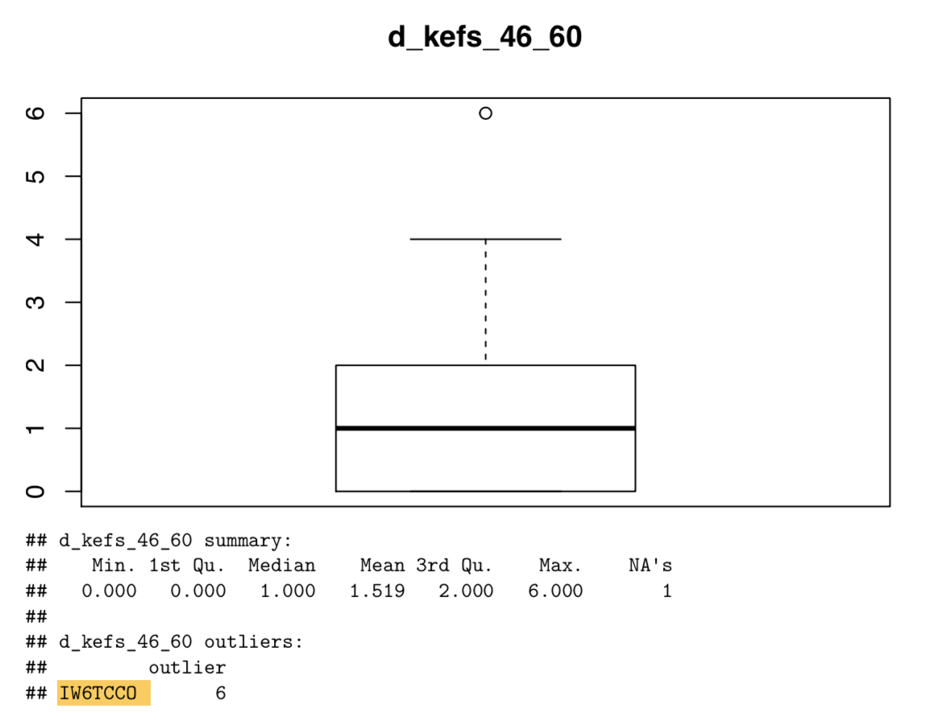
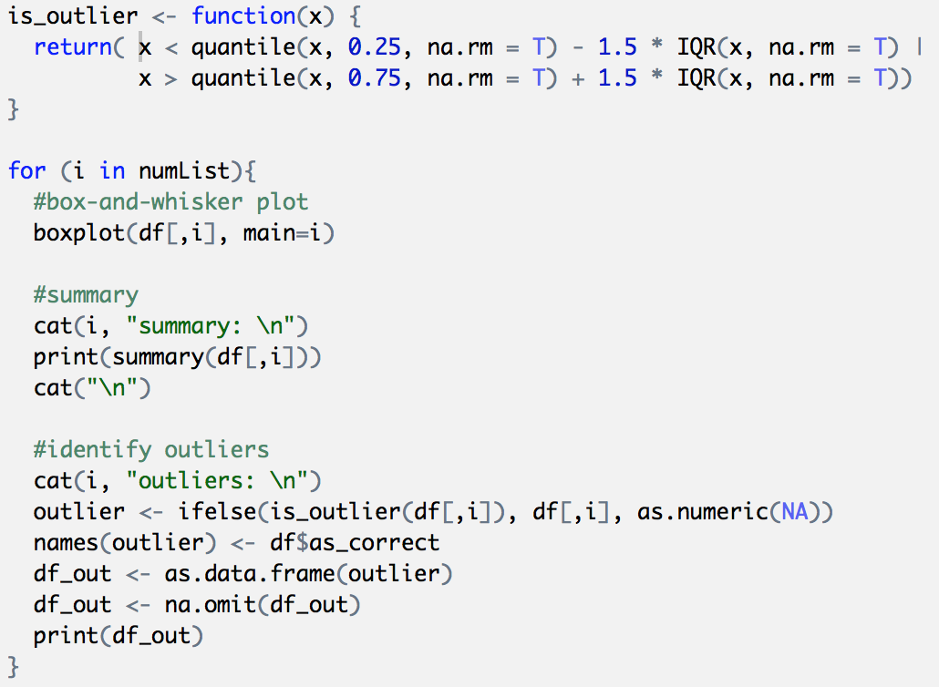
Outlier Analysis

Slide 5
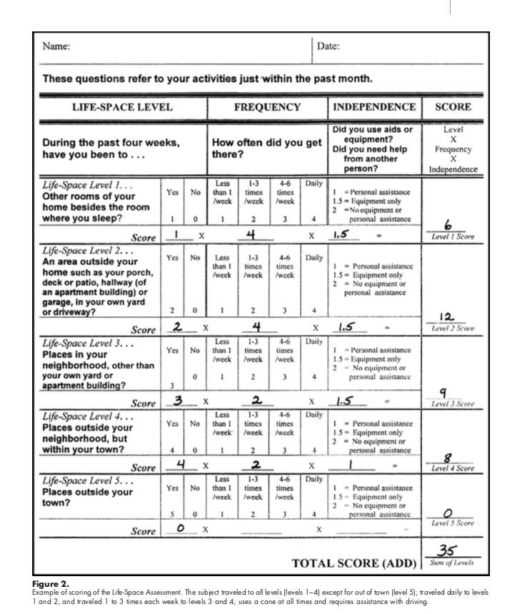
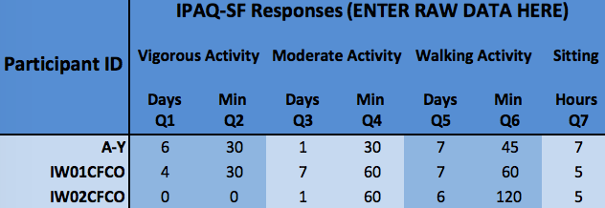
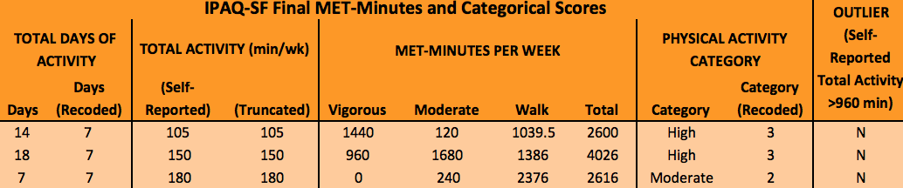
Calculation
Lifespace
IPAQ – Pre/Post

Slide 6
2. APDM

Slide 7
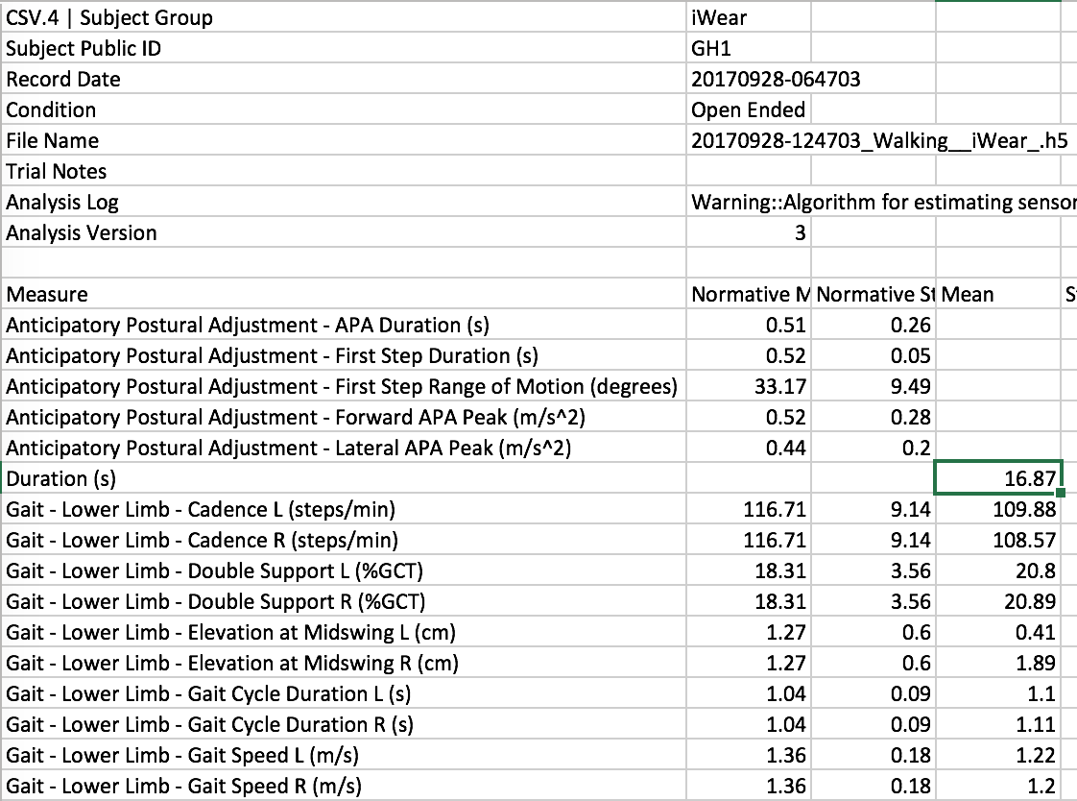
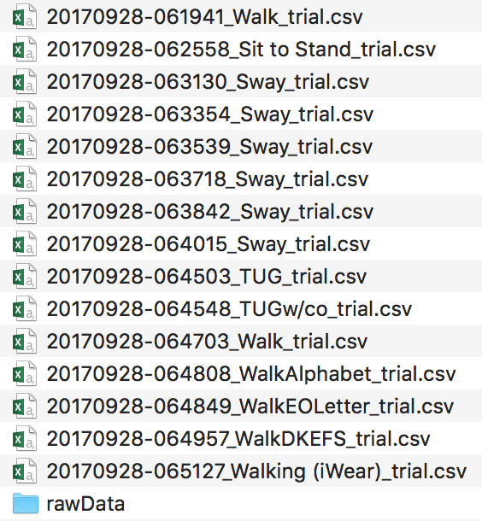
Data Integration

Slide 8
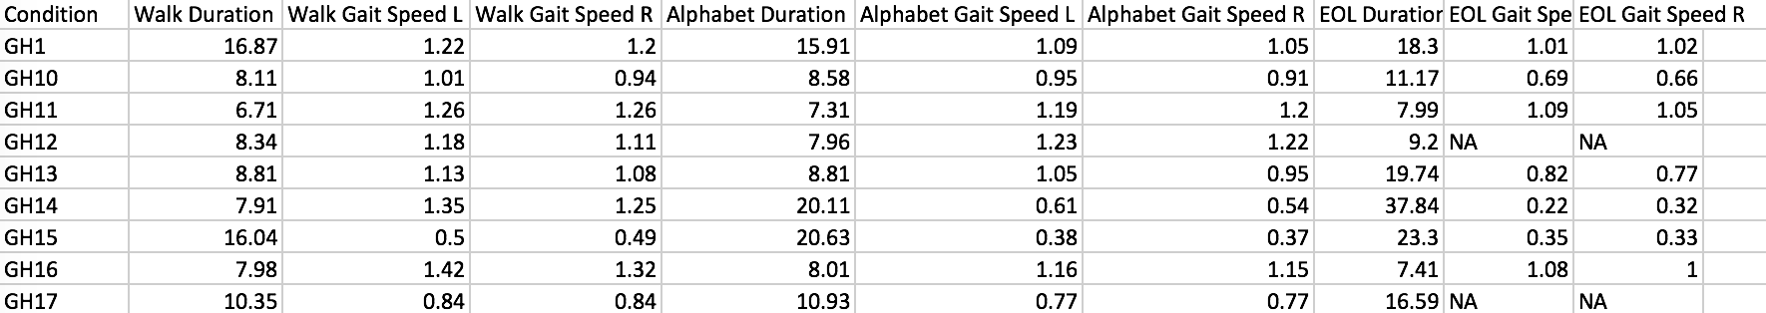

Slide 9
3. Dual Task

Slide 10
To examine the relative contributions of participant characteristics and motor and cognitive factors to the ability to walk while performing cognitive tasks.

Slide 11
Process
Cognitive: Correct Response Rate
Motor: Gait Speed, Sway Area, Duration
ANOVA
DTE

Slide 12
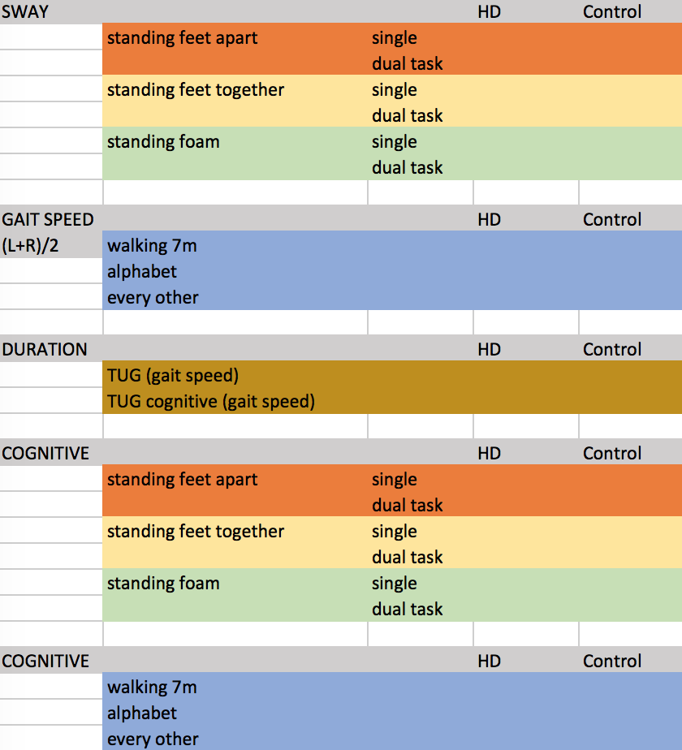
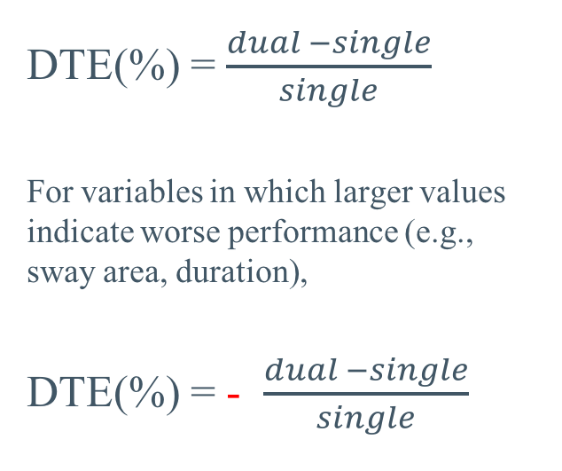
DTE
DTE(%) = $\frac{dual −single}{single}$
For variables in which larger values indicate worse performance (e.g., sway area, duration),
DTE(%) = - $\frac{dual −single}{single}$

Slide 13
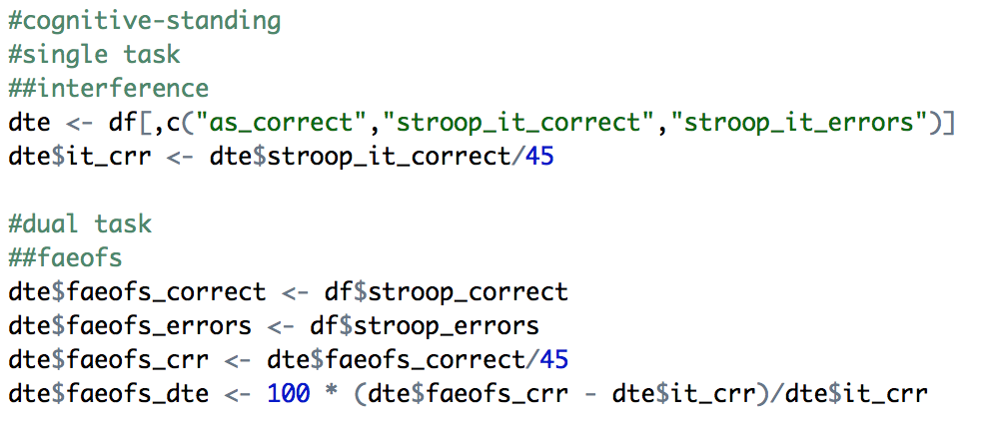
Cognitive - Standing

Slide 14
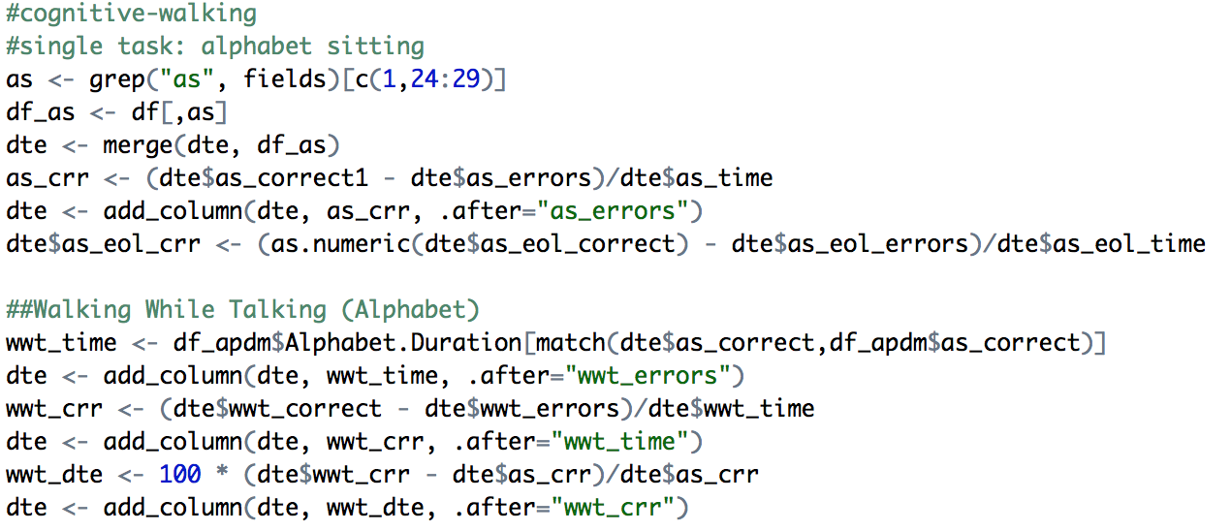
Cognitive - Walking

Slide 15
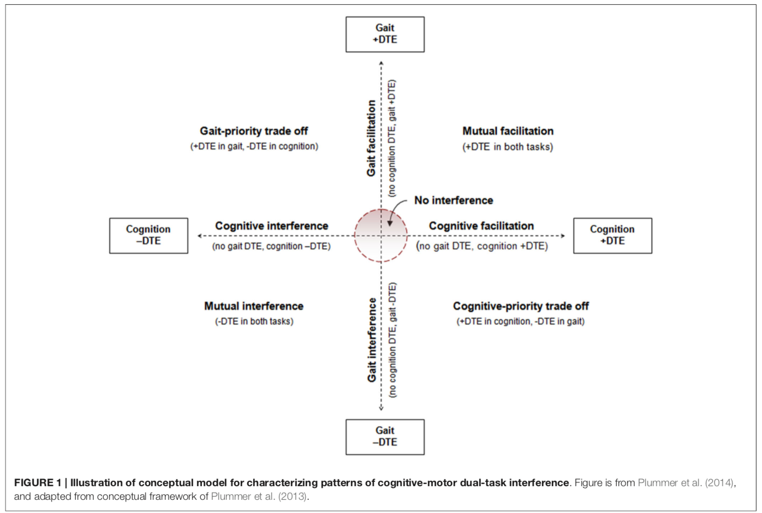
Illustration of conceptual model for characterizing patterns of cognitive-motor dual-task interference.

Slide 16
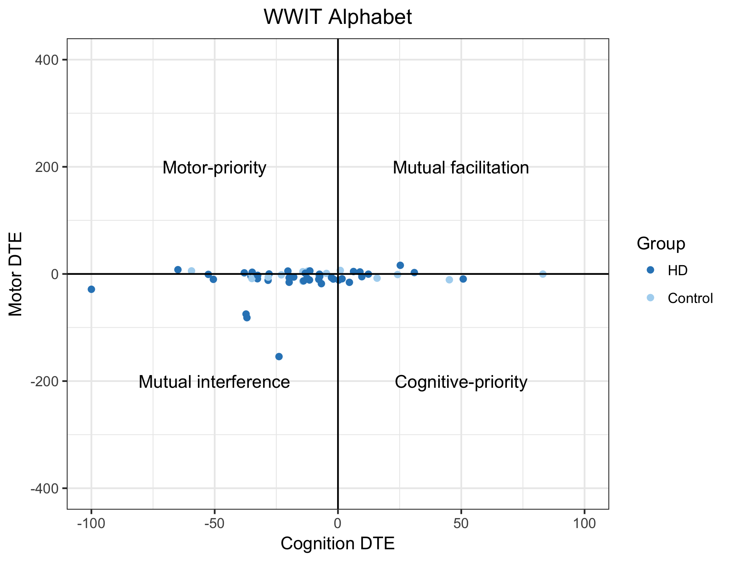

Slide 17

THANKS!
Any questions?

