Slide 1
Data Preprocessing and Analysis Xueyao Li

Slide 2
Missing-data Imputation
1
IPD Dataset

Slide 3
Discard data
Complete-case analysis: exclude all units for which the outcome or any of the inputs are missing.
Available-case analysis: study with subsets of the data; simply exclude a variable or set of variables because of their missing-data rates.
Lead to biased estimates and large standard errors of estimates.

Slide 4
Impute data
Mean imputation
Replace each missing value with the mean of the observed data for this variable.
Distort the distribution for this variable and relationships between variables; Lead to complications with summary measures including underestimates of the standard deviation.
Random imputation
Randomly sample missing values from the observed data for this variable.
Regression prediction
Fit a regression to the observed data and then use that to predict the missing values.

Slide 5
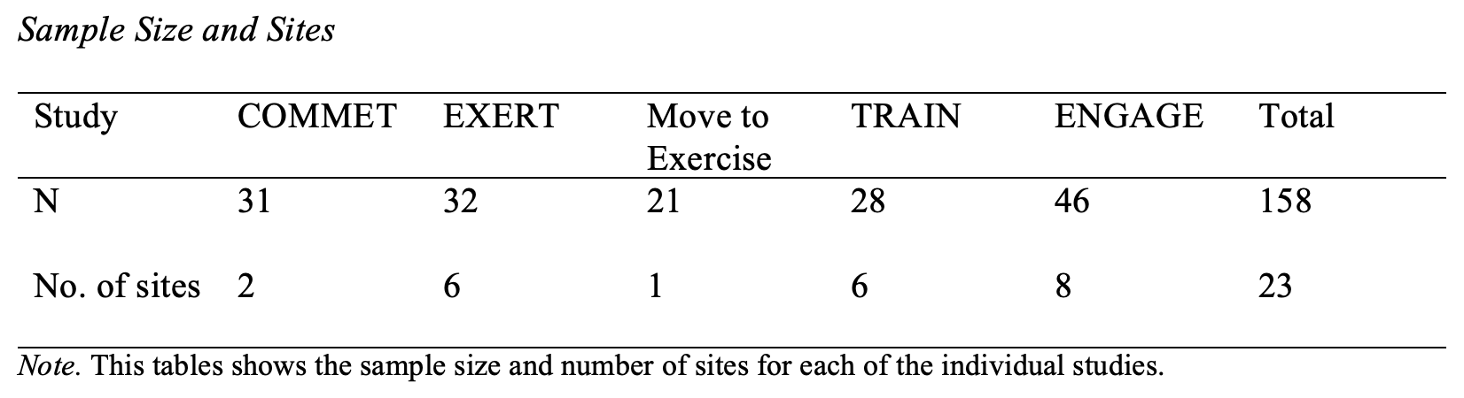
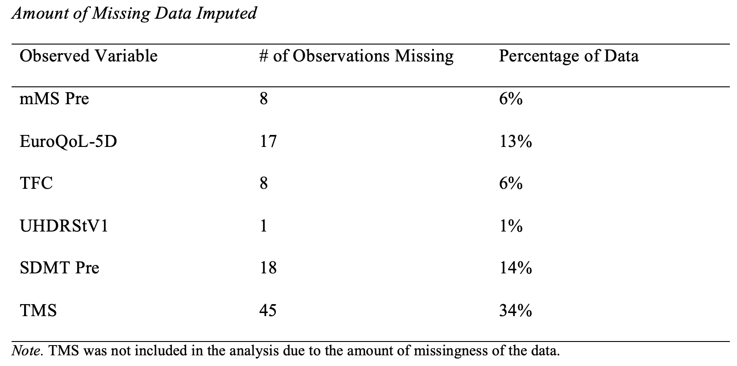
Count missing data rates and exclude TMS
Exclude participants with missing outcome data (modmotscpost)
Random imputation
Create 20 imputed datasets and run analysis on all the 20 datasets

Slide 6
Data Integration
2
APDM Dataset

Slide 7
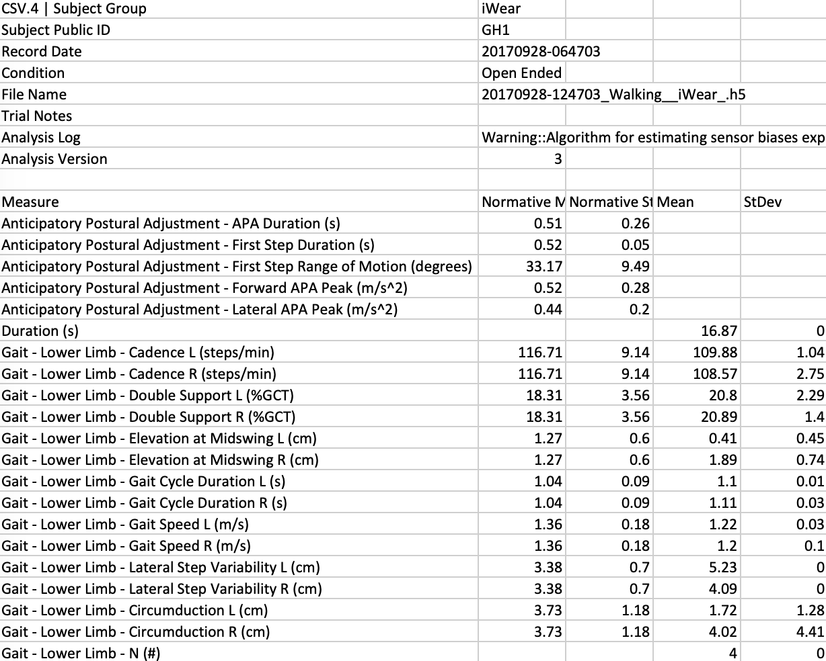
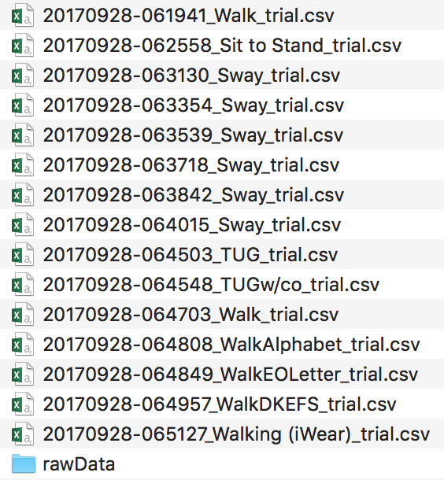

Slide 8
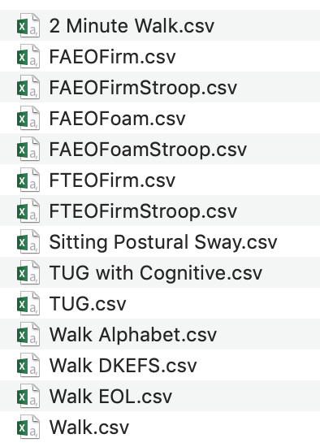
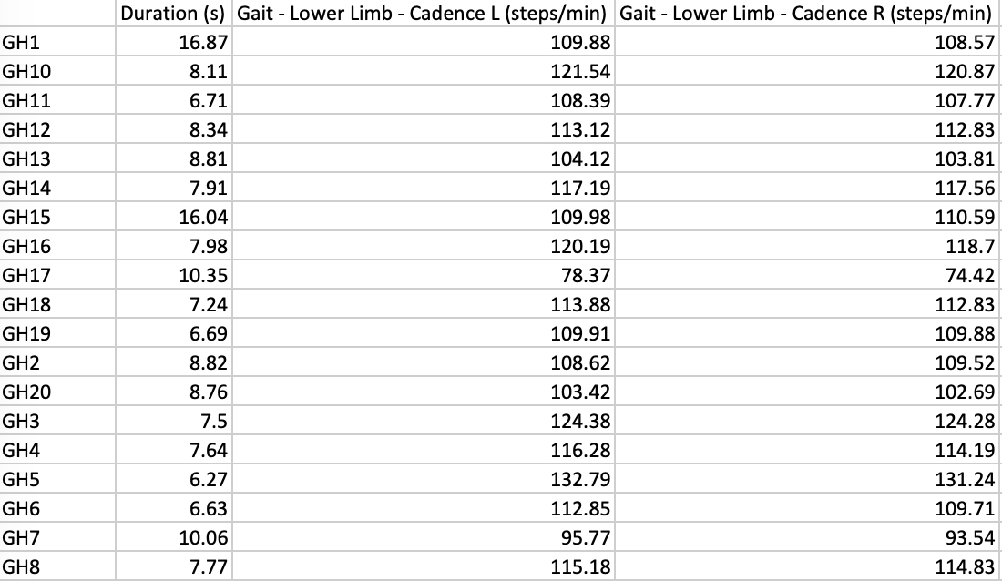

Slide 9
Correlation and Regression
3
Dual Task Analysis on iWear and APDM Datasets

Slide 10
iWear Subscores
Balance Subscore: Sum of Tandem Walk and Retropulsion Pull Tests from UHDRS Motor
Chorea Subscore: Sum of Maximal Chorea Measures (i.e, Face, BOL, Trunk, RUE, LUE, RLE, LLE)
Dystonia Subscore: Sum of Maximal Dystonia and Rigidity
Chorea Eye Subscore: Sum of Ocular Pursuit, Saccade Initiation and Saccade Velocity
Chorea Total Subscore: Sum of Chorea Subscore and Chorea Eye Subscore

Slide 11
Correlation
Plot these subscores against the standing (Feet Apart, Eyes Open, Firm Surface) and sitting (Sitting Postural Sway) task outcome measures of Jerk, Mean Velocity, RMS Sway and Sway Area.

Slide 12
Regression
Subscore ~ FeetApart + FeetTogether + Sitting
Subscore ~ FeetApartStroop + FeetTogetherStroop
Subscore ~ FeetApart + FeetTogether + FeetApartStroop + FeetTogetherStroop
Subscore ~ FeetApart + FeetTogether + FeetApartStroop + FeetTogetherStroop + Sitting

Slide 13
Regression
Check the multicollinearity and recursively remove variables with VIF > 10
Select variables through stepwise selection and best subset selection
Compare models using ANOVA

Slide 14
Thanks!
Any questions ?

