Slide 1

VedaR – an R package for analysing TIMES data Nov 2021 Iris Oren Operational Research Analyst Energy & Climate Change Analysis – Scottish Government Iris.Oren@gov.scot

Slide 2
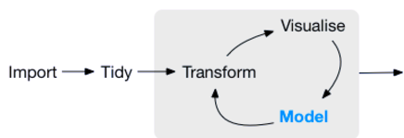
R – what and why?
Language and environment for statistical computing and graphics
Flexible: users write code to meet requirements
Powerful: tens of thousands of packages (and growing)
Open-source: anyone can contribute to development
Reproducible analysis: Anyone with input data + scripts can replicate results
R-environment
Input data
Output data
R-packages
Communication
Complete reports
Websites
Interactive dashboards
User-scripts
https://rviews.rstudio.com/2017/06/08/what-is-the-tidyverse/

Slide 3
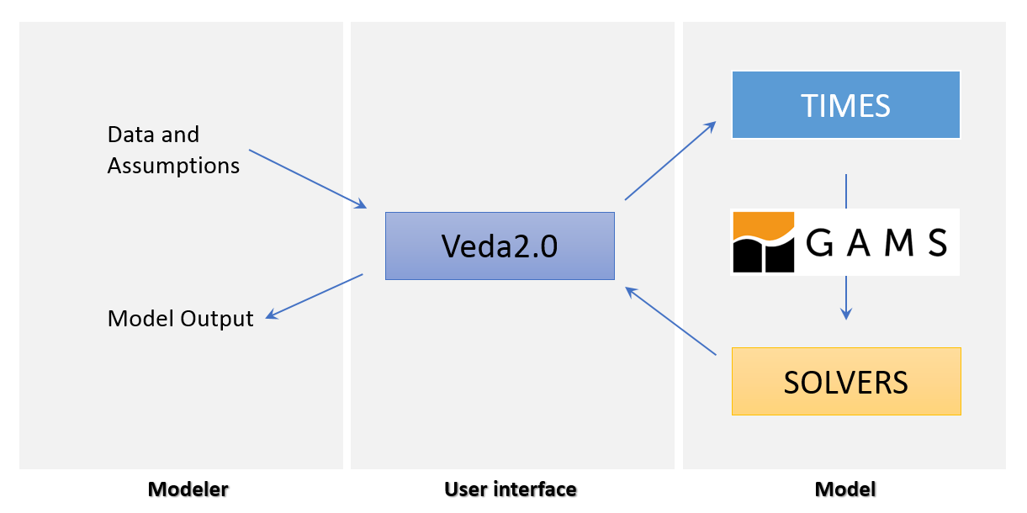

Veda-TIMES workflow
Output post-processing/presentation

Slide 4

Veda-TIMES workflow
VedaR
Output post-processing/presentation

Slide 5
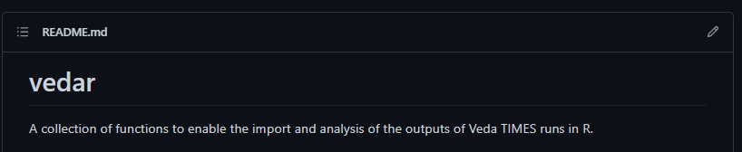
VedaR
https://github.com/DataScienceScotland/vedar
Import
import_vd()
import_vde()
import_vds()
prep_data()
define_sector_from_list()
Analysis
Any R-based analysis/data visualisation
make_graph_from_veda_df()
check_in_path()
make_res()
syscost()

Slide 6
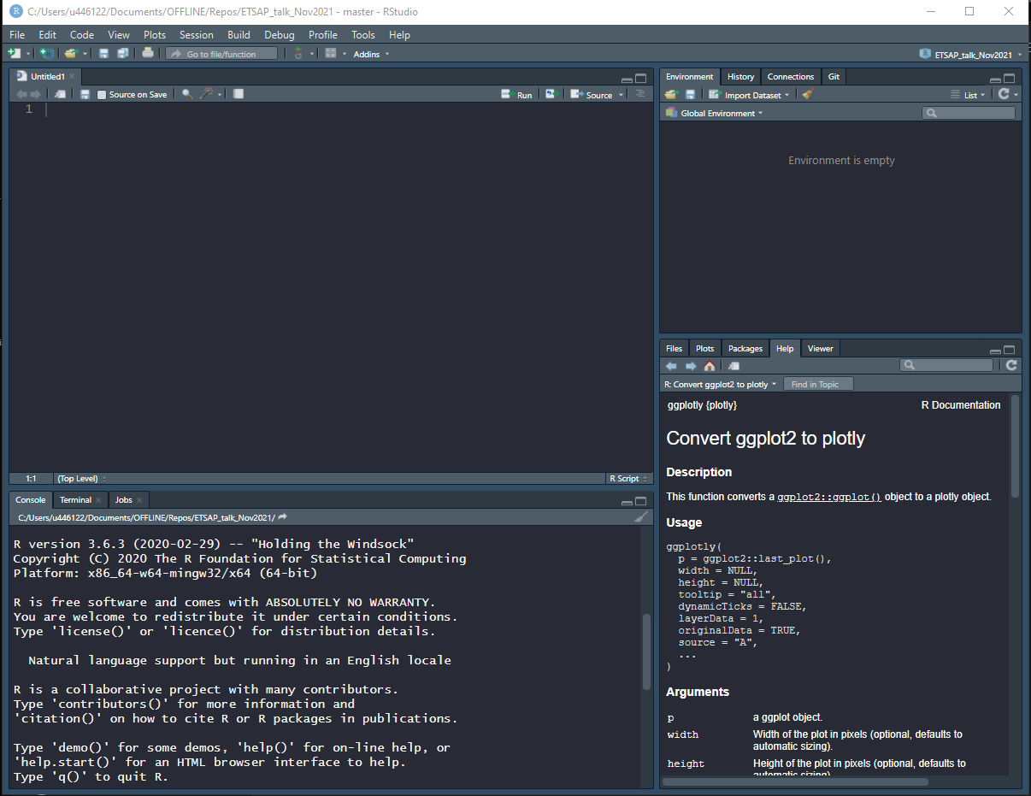
Using R and VedaR
Requirements
R (v3.6.3 or later)
RStudio : Integrated development environment for using R
Install VedaR
Install any additional packages as required (install.packages(“package_name”))

Slide 7
Using R and VedaR
Demo

Slide 8
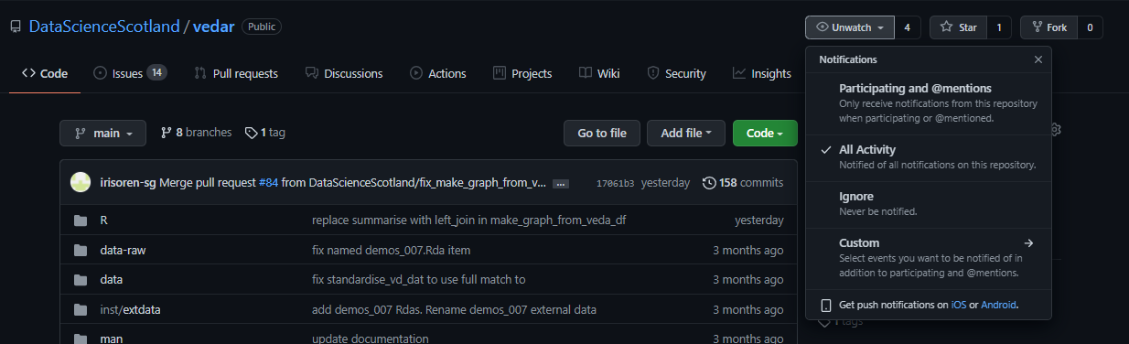
VedaR
Keeping up to date with VedaR
Under development
Get notified of updates by watching repo (you will need to be logged in to your GitHub account)
Refer to the vignette file(s) to learn how to use functions.

Slide 9
Open-source in the community
Numerous additional features planned (see GitHub issues page)
Anyone can contribute!
Contributions to code
Feedback on existing functions
Issues/bugs
Usability
Suggest additional functionality

