Slide 1

VedaR – an R package for analysing TIMES data Nov 2021 Iris Oren Operational Research Analyst Energy & Climate Change Analysis – Scottish Government Iris.Oren@gov.scot

Slide 2
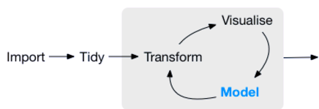
R – what and why?
Language and environment for statistical computing and graphics
Flexible: users write code to meet requirements
Powerful: tens of thousands of packages (and growing)
Open-source: anyone can contribute to development
Reproducible analysis
R-environment
Input data
Output data
R-packages
Communication
Complete reports
Websites
Interactive dashboards
User-scripts
https://rviews.rstudio.com/2017/06/08/what-is-the-tidyverse/

Slide 3
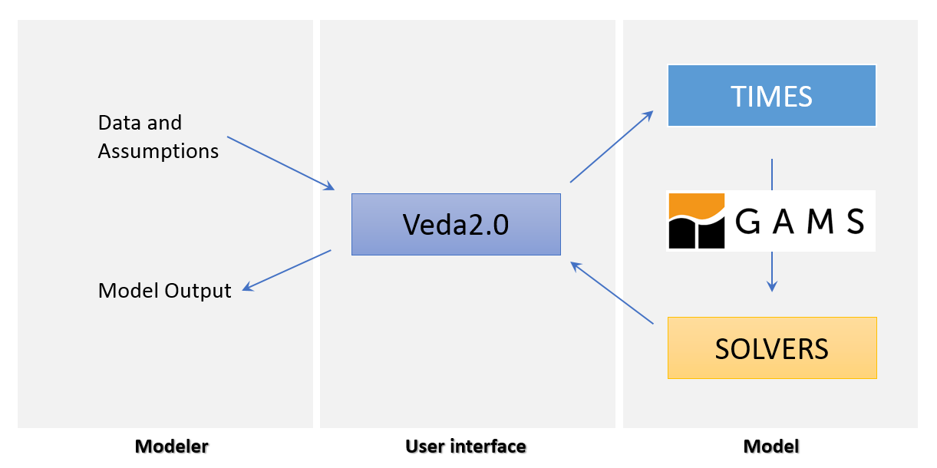

Veda-TIMES workflow
Output post-processing/presentation

Slide 4

Veda-TIMES workflow
VedaR
Output post-processing/presentation

Slide 5
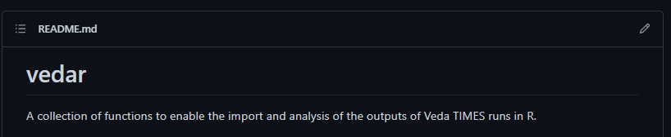
VedaR
Import
import_vd()
import_vde()
import_vds()
prep_data()
define_sector_from_list()
Analysis
Any R-based analysis/data visualisation
make_graph_from_veda_df()
check_in_path()
make_res()
syscost()

Slide 6
VedaR
Package GitHub

Slide 7
VedaR
VedaR Vignette

Slide 8
Open-source in the community
Planned features

Slide 9
Open-source in the community
Contributions to code
Feedback on existing functions
Issues
Usability
Additional functionality

