Slide 1
Quantitative Analysis of Human Gait Using Motion Measurement Systems for Clinical Applications
Team member 1
Team member 2
Team member 3

Slide 2
Index
Background
Objective
Specific goals
Data collection
Application

Slide 3
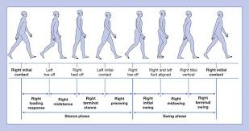
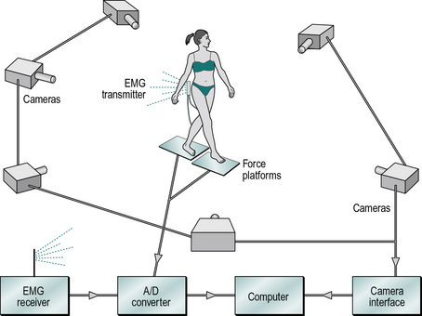
BACKGROUND

Slide 4

Objective
Develop and validate gait analysis using motion captutrs and OpenSIm.
Quantify joint kinematics and kinetics during walking.
Assess its potential application in clinical rehabilitation.

Slide 5
Specific goals
EXRACT RELEVANT GAIT PARAMETERS
COLLECT GAIT DATA
COMPARE THE RESULTS
PROCESS THE DATA
DISCUSS

Slide 6
Data collection
Reflective
markers
FORCE PLATES
NORMAL SPEED GAIT
SLOW SPEED GAIT
FAST SPEED GAIT

Slide 7
Application
Computational function to calculate quantitative gait parameters

Slide 8
"Wanderer, there is no path, the path is made by walking"
Antonio Machado

