Slide 1
HELP DESK ANALYTICS | TECHNICAL CAPSTONE
Help Desk Ticket SLA and Volume Forecasting
TECHNICAL CAPSTONE
Retrospective resolution/SLA-reference analysis
CORE PREDICTION
Daily Ticket-arrival forecasts for the next week and month
STATUS
Historical experiment, not operational approval or current performance evidence
Data scope: 27,348 Ticket records · 2016-01-03 to 2023-03-14 UTC · Historical analysis

Slide 2
Problem framing and measures
• Retrospective: compare elapsed resolution time with configured priority references.
• Predictive: count exact Ticket-type issues created per UTC day; evaluate 7- and 30-day paths.
• Primary metrics: reference attainment by priority; forecast MAE/RMSE, WAPE/sMAPE and interval coverage.
• No live alert is defined. SLA references are project-configured assumptions, not verified policy.
KEY TAKEAWAY | Two lenses — SLA hindsight and daily volume foresight — measured with transparent, assumption-labelled metrics.
Help Desk Ticket SLA and Volume Forecasting | Historical analysis
02 / 12

Slide 3
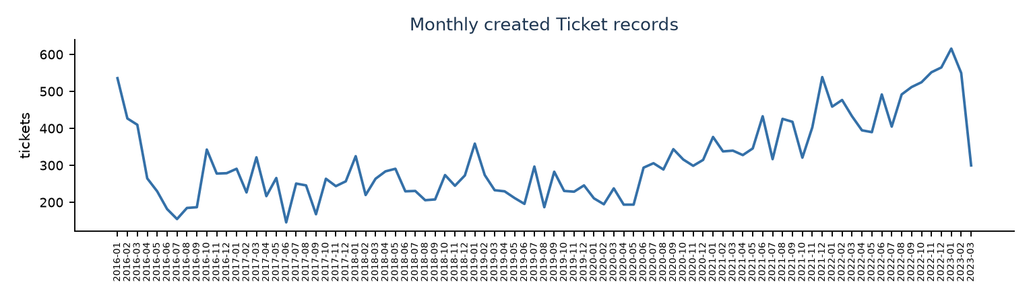
Source, scope and data quality
• Identity: Kaggle v1 bytes and Mendeley v2 digest match. Original CC BY 4.0 conflicts with Kaggle's CC0 label.
• 66,691 issue rows, 58 fields; exact Ticket type is the analysis cohort.
• 27,348 scoped Ticket records, 2016-01-03 to 2023-03-14 UTC.
• Documentation states 2016 to March 2023, but the file contains pre-2016 timestamps; earlier rows are profiled and excluded.
• 344/2,628 dates have no Ticket rows; treated as zero under unverified coverage assumption.
• Monthly created-Ticket counts (notebook 02, EDA): volume varies across months and thins out in later years.
KEY TAKEAWAY | A verified 27,348-ticket cohort (2016–2023) forms the analysis base, with coverage gaps explicitly flagged.
Help Desk Ticket SLA and Volume Forecasting | Historical analysis
03 / 12

Slide 4
Retrospective reference results
• Reference attainment by priority (exact Ticket type, 2016+, Done resolution, mapped priority, valid nonnegative duration):
Priority | Reference | Met / Assessed | Attainment
Critical | 4h | 524 / 2,124 | 24.7%
High | 8h | 576 / 3,146 | 18.3%
Low | 24h | 72 / 304 | 23.7%
Medium | 24h | 2,161 / 11,161 | 19.4%
Overall | n/a | 3,333 / 16,735 | 19.9%
• Blocker/Highest mapped to Critical 4h; High 8h; Medium 24h; Low/Lowest 24h; unknown excluded.
• Duration is UTC wall-clock time from issue_created to issue_resolution_date; business-hour calendars and pause rules are not verified.
• Results are reference comparisons, not contractual compliance or live warnings.
KEY TAKEAWAY | Only 19.9% of assessed tickets met their priority reference — attainment is low across every priority.
Help Desk Ticket SLA and Volume Forecasting | Historical analysis
04 / 12

Slide 5
Key numerical measures at a glance
• Selected forecast model performance on the later, untouched historical test split, by horizon:
Horizon | Selected model | Test MAE | Test RMSE | Test WAPE | Test sMAPE | 90% coverage
7-day | XGBoost autoregression (28-day lags) | 5.05 | 7.72 | 30.4% | 49.0% | 86.6%
30-day | ETS (weekly additive) | 4.67 | 7.20 | 27.5% | 41.3% | 87.7%
• Data scale: 66,691 source rows; 27,348 scoped Ticket records; 2,628 calendar days (2016-01-03 to 2023-03-14).
• 344 dates (13.1%) have no Ticket rows, treated as zero under an unverified coverage assumption.
• Retrospective reference attainment overall: 3,333 / 16,735 assessed tickets (19.9%).
• Feature reduction: 10/34 training-only MI-selected features; PCA used 26 components for 95% of target-related variance.
KEY TAKEAWAY | Forecasts miss by about 5 tickets/day with ~87% interval coverage, while SLA attainment sits at 19.9%.
Help Desk Ticket SLA and Volume Forecasting | Historical analysis
05 / 12

Slide 6
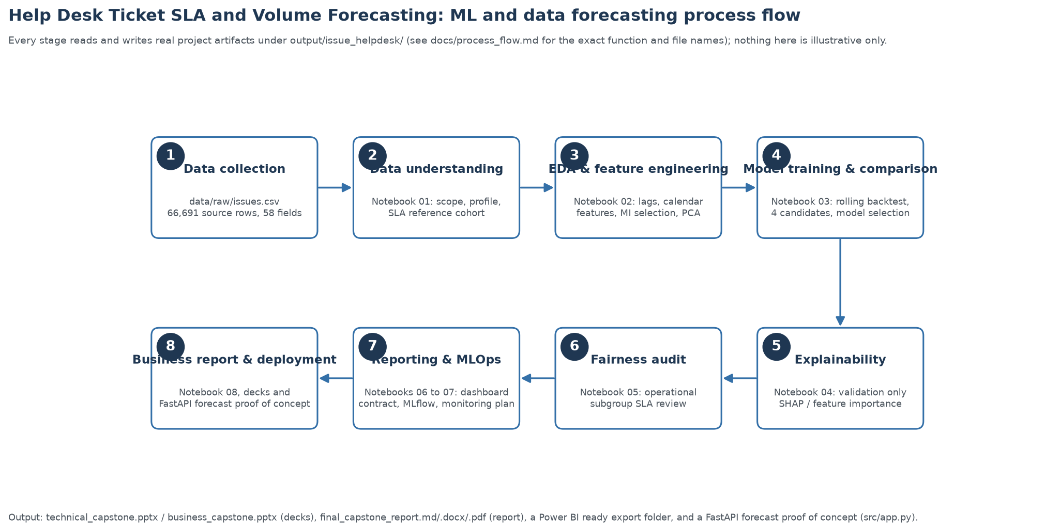
Process flow: source to decks
• Eight notebooks, one canonical output/issue_helpdesk/ folder, then decks/report/app read from it:
• Full step-by-step mapping with exact function and file names: docs/process_flow.md.
KEY TAKEAWAY | A single reproducible pipeline of eight notebooks feeds every deck, report and app output.
Help Desk Ticket SLA and Volume Forecasting | Historical analysis
06 / 12

Slide 7
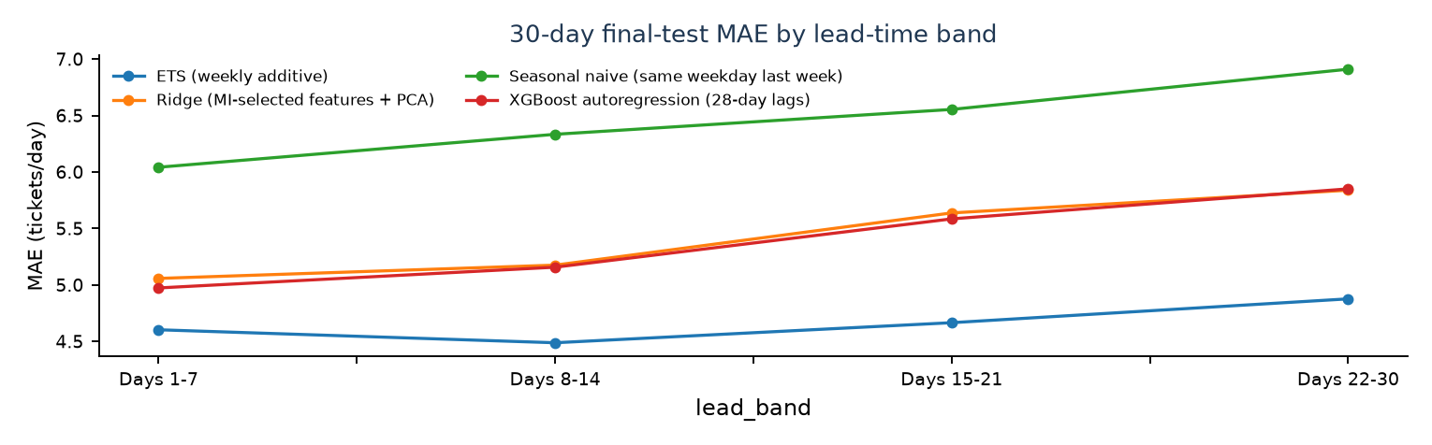
Seven-day and month-ahead forecast design
• Target: daily counts of exact Ticket records; UTC calendar.
• Separate 7- and 30-day expanding-window forecasts; the month horizon predicts daily counts, not one monthly total.
• 30-day experiment: 48 validation origins; 48 later test origins.
• Compared seasonal naive, additive weekly ETS, XGBoost autoregression, and MI-selected/PCA Ridge.
• Validation MAE selects a model separately for each horizon; test remains separate.
• 30-day final-test MAE by lead-time band (notebook 03): error typically grows with lead time, one reason a 7-day path is tracked separately.
KEY TAKEAWAY | Horizon-specific models, chosen on validation and judged on a held-out test, keep the evaluation honest.
Help Desk Ticket SLA and Volume Forecasting | Historical analysis
07 / 12

Slide 8
Candidate comparison
• 30-day validation winner: ETS (weekly additive) (MAE 4.39 tickets/day).
Model | Validation MAE | Validation RMSE | Test MAE
ETS (weekly additive) | 4.39 | 6.09 | 4.67
XGBoost autoregression (28-day lags) | 4.68 | 6.71 | 5.42
Ridge (MI-selected features + PCA) | 4.78 | 6.86 | 5.45
Seasonal naive (same weekday last week) | 5.41 | 7.80 | 6.49
• 30-day selected-model test MAE 4.67, RMSE 7.20, WAPE 27.5%, sMAPE 41.3%.
• 7-day comparison: XGBoost autoregression (28-day lags), test MAE 5.05 tickets/day (its own validation-selected model).
KEY TAKEAWAY | Weekly ETS wins the 30-day horizon (test MAE 4.67), cutting error ~28% versus the seasonal naive baseline.
Help Desk Ticket SLA and Volume Forecasting | Historical analysis
08 / 12

Slide 9
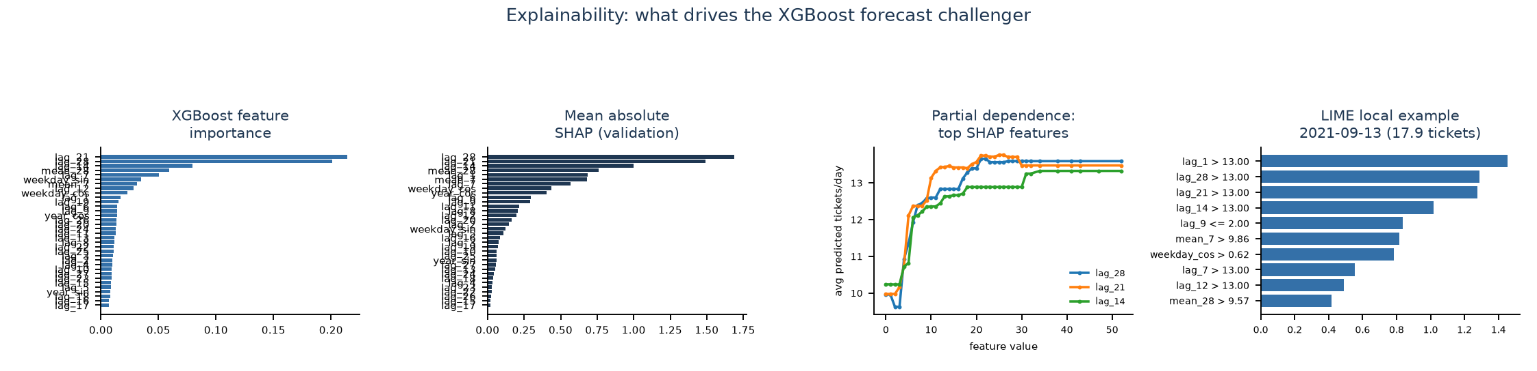
Uncertainty and explanation
• MAE is the typical daily miss; RMSE emphasizes larger errors. WAPE/sMAPE express relative error.
• Selected-model 90% test interval coverage: 87.7%; calibrated on validation residuals.
• Panel: XGBoost SHAP, not ETS. Separate ETS state/residual evidence is linked in the report; fitted residuals are not test errors.
• Leading XGBoost validation features: lag_21, lag_28, lag_14. Validation-only SHAP highlights: lag_28, lag_21, lag_14; importance is association, not causation. Feature selection kept 10/34 MI-selected features.
KEY TAKEAWAY | Intervals are well calibrated (87.7% vs. 90% target), and recent weekly lags drive the forecast.
Help Desk Ticket SLA and Volume Forecasting | Historical analysis
09 / 12

Slide 10
Ethics and fairness limitations
• No approved protected demographic attributes: protected-group fairness cannot be assessed.
• Priority attainment uses priority-specific reference values; group rates need contextual interpretation.
• One aggregate forecast series cannot test allocation fairness across queue, site or shift.
• Small masked-project groups should not be ranked; retain human review and investigate persistent under-forecasting.
• Missing demographics, measured ROI or production are not automatic academic failures; explicit rubric requirements still apply.
KEY TAKEAWAY | Fairness cannot be fully assessed with current data, so human review remains essential.
Help Desk Ticket SLA and Volume Forecasting | Historical analysis
10 / 12

Slide 11
Deployment, MLOps and Power BI proof
• Selected model persisted and served via a FastAPI POC (src/app.py); MLflow run 269964acc543 logs the same parameters and metrics for reproducibility.
• MLflow experiment 'helpdesk_volume_forecast': validation MAE 4.39, test MAE 4.67.
• Power BI ready export folder (fact_tickets_sla.csv, 4 report pages, 4 rendered sample screenshots) covers both the after the fact SLA report and the volume forecast, rebuilt from source data on every run so it scales to a larger dataset.
• Power BI Desktop is not installed in this environment, so the screenshots are rendered stand ins from the same export tables, not native .pbix captures.
• Monitoring plan defines retrain triggers (schedule, drift, new source coverage) before any of this becomes an operational service.
KEY TAKEAWAY | The model is reproducible and demo-ready end to end, but not yet an operational service.
Help Desk Ticket SLA and Volume Forecasting | Historical analysis
11 / 12

Slide 12
Integration readiness and conclusion
• Ready locally: data profile, cohort rules, rolling backtest, validation selection, error/interval outputs and monitoring plan.
• Not ready: verified coverage, current arrivals, approved SLA rules, segmented forecasts or production integration.
• Next: confirm source range/zero days and policy; test on current future data against the seasonal baseline.
• Conclusion: stronger historical prototype, not an operationally validated staffing or compliance system.
KEY TAKEAWAY | A strong historical prototype — the next step is validating on current data before operational use.
Help Desk Ticket SLA and Volume Forecasting | Historical analysis
12 / 12

