Slide 1
Memory Game
Irit Ashuri
204605109

Slide 2
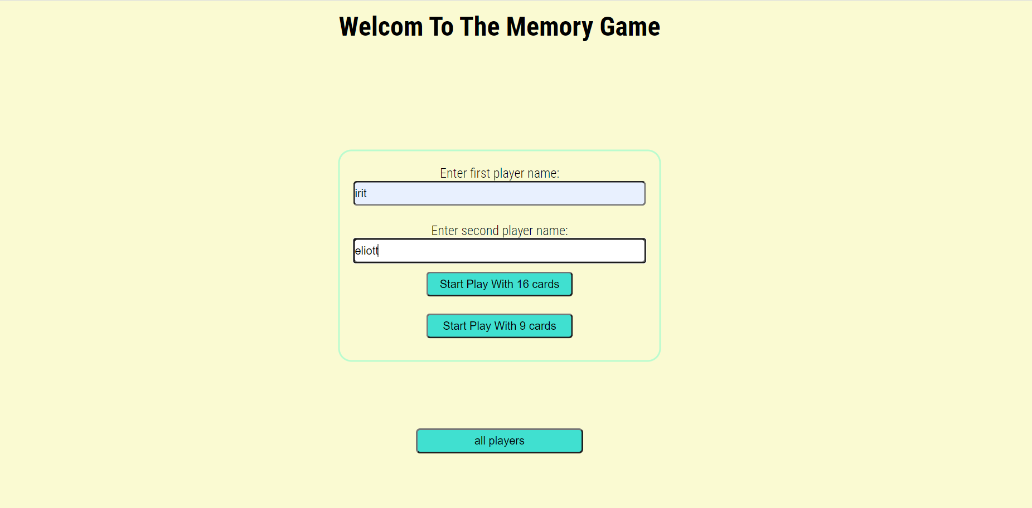
Home Screen
enterPlayer.html page
The home screen is the screen through which you can enter the game.
You need to enter the names of the 2 players and choose which game you want to play-
16 cards or 9 cards.
You can choose to enter a page that shows all the players who have ever played the game and the number of their victories.

Slide 3
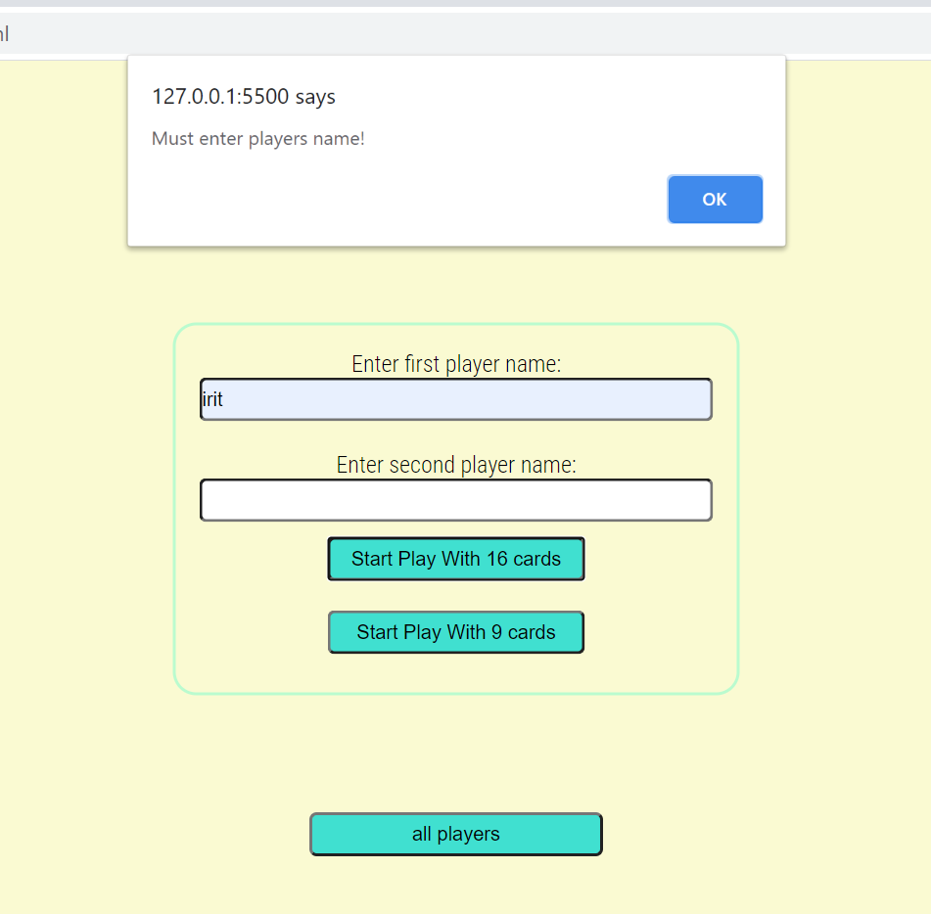
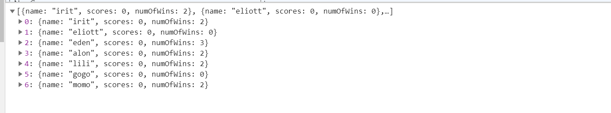
If the names of the players are not entered, a warning message will appear, and it will not be possible to enter the game.
When entering the game, it will look for the names of the players in local storage and if it does not find them, it will create new players in the game list with 0 victories. Otherwise, it will use the existing players and their number of victories. Also, there is an array of 2 players currently playing that updated accordingly.
All player are stored in Local Storage

Slide 4
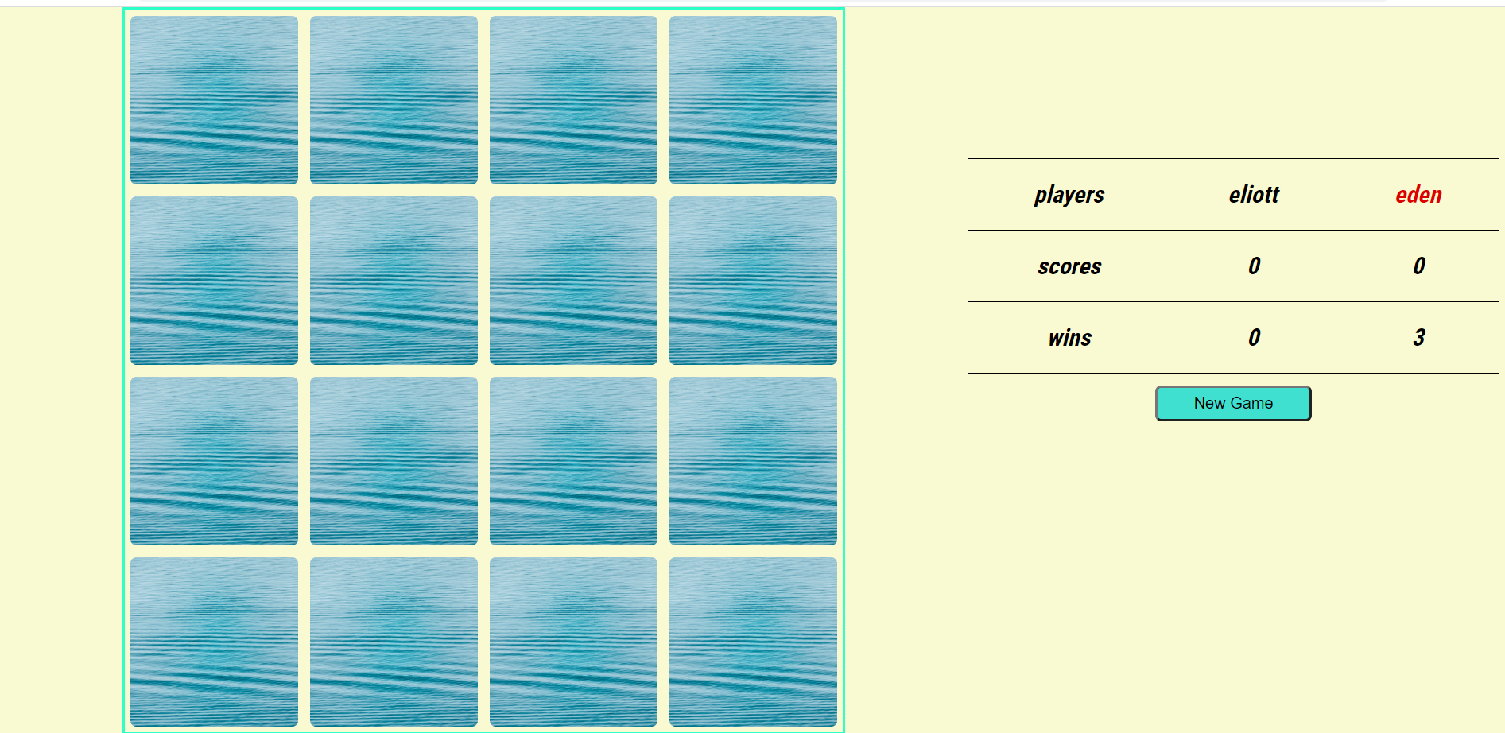
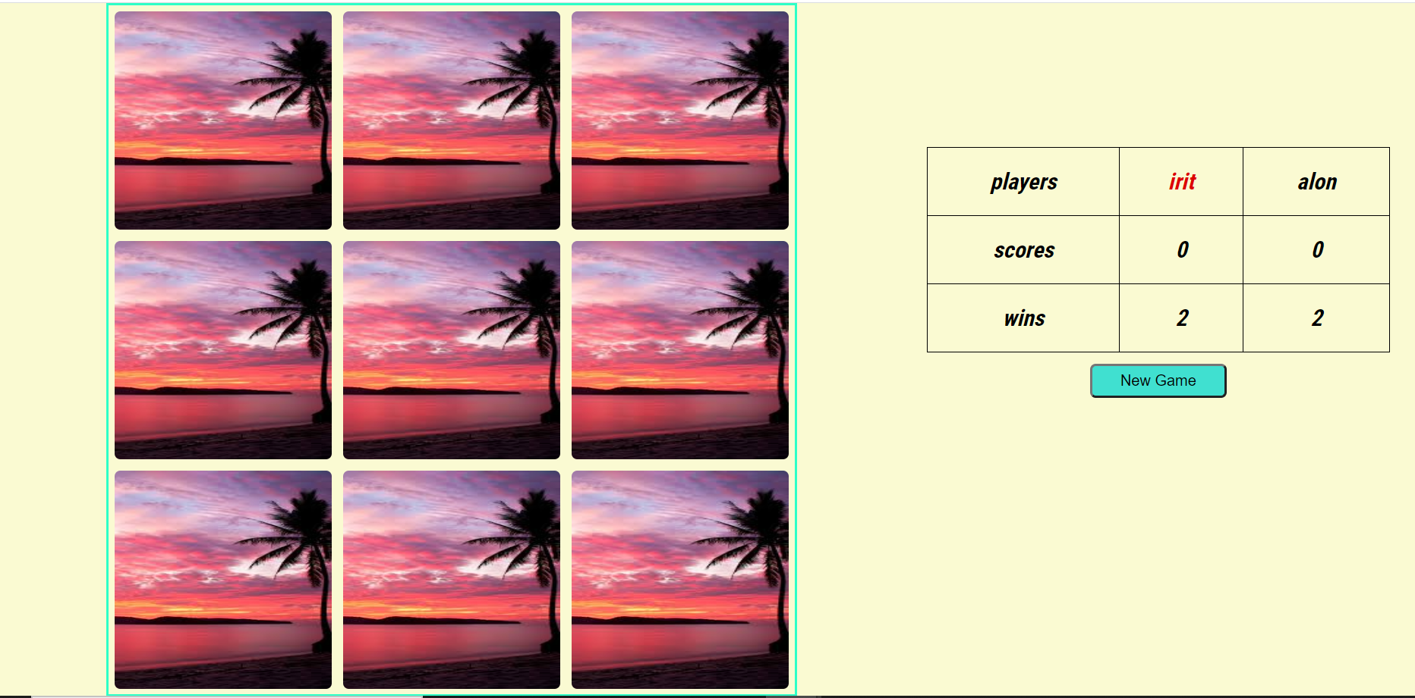
9 Cards Game
16 Cards Game
In a 9-card game - there is an unnecessary card

Slide 5
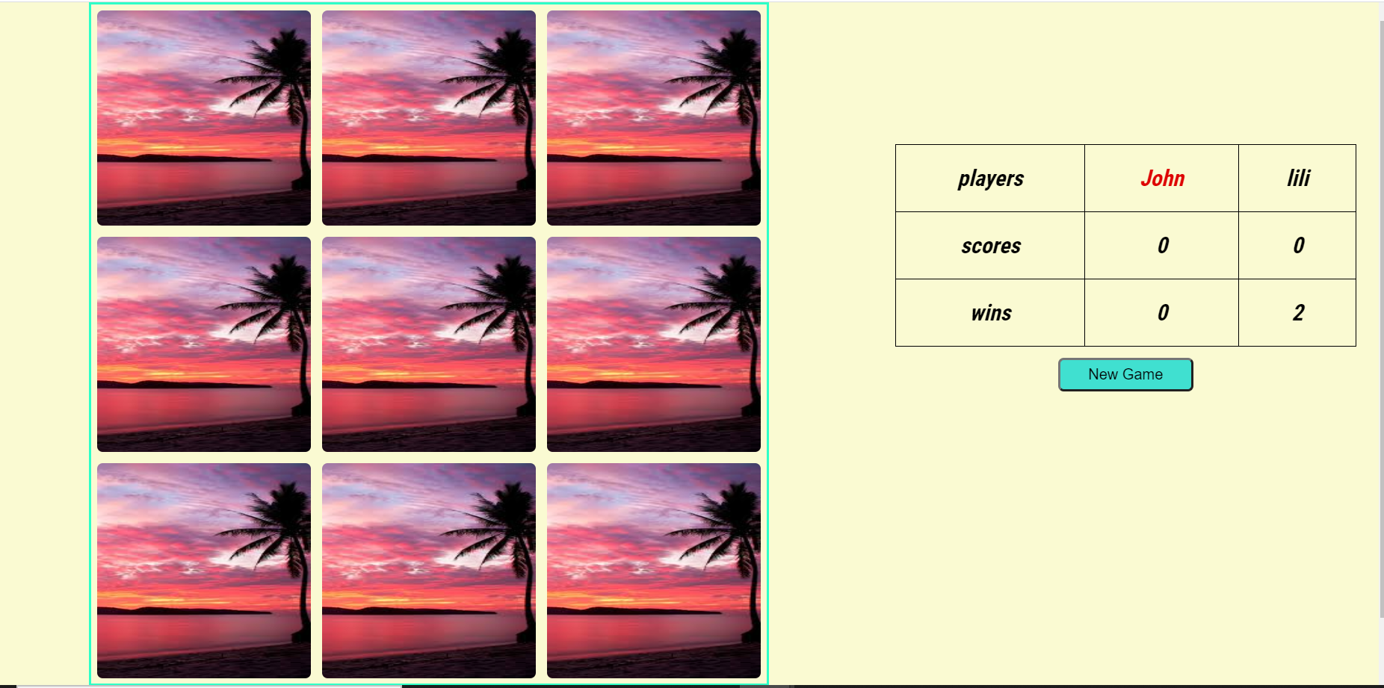
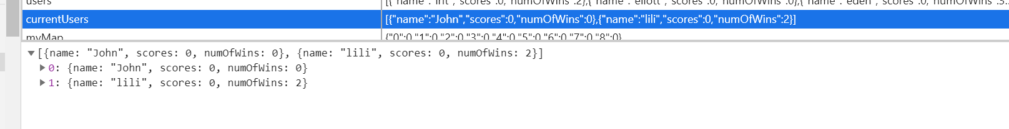
The Game
- In the game, the cards will be reversed, the names of the two participants who are currently playing, their points in the current game, and their total number of victories. - The turn of the player to play will be marked in red and the first turn will be set randomly at the beginning of the game (In practice it is determined by the previous game stored in local storage- if there is no previous game, the first game in the lineup). - Also will appear a button which allow going back to the main menu
Current players array on Local Storage

Slide 6
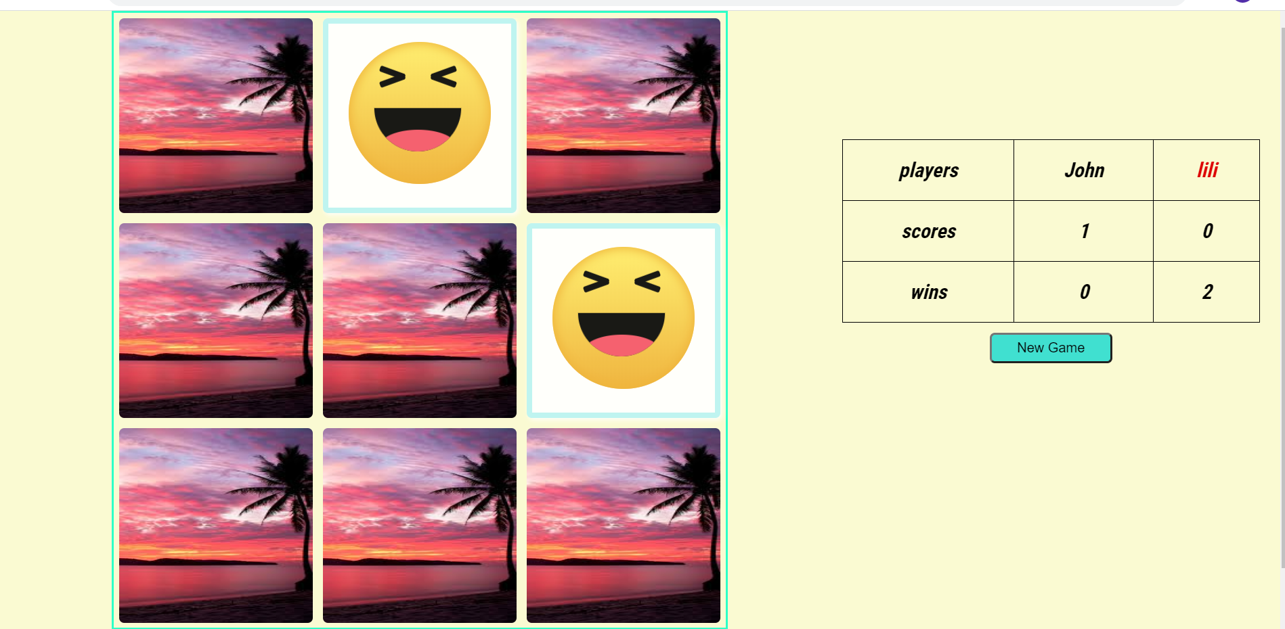
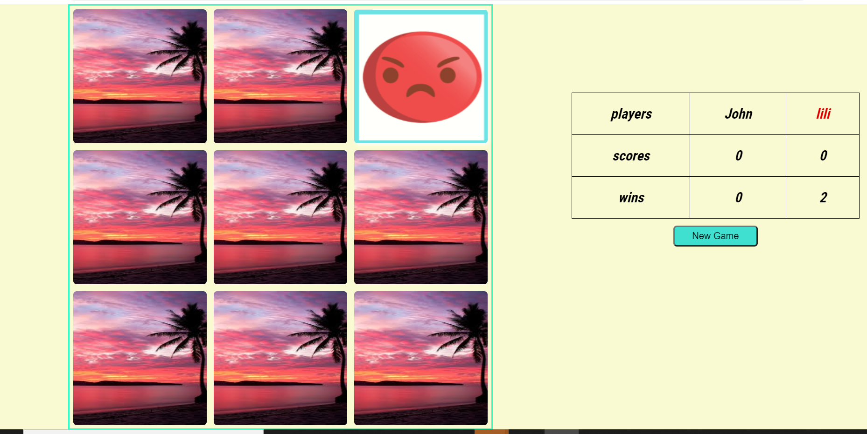
Once the game starts the order of the cards is set randomly. The order of the cards is kept In the local storage and it does not change after page refreshing Unless we click on the New Game button or go back to the main menu and from there select a new game.
Each time the turn change.
When there is a match between the cards they will remain upside down and it will not be possible to turn them back. The points of the player who found the match will be updated accordingly. In the picture you can see that John found a match, so he has a point, now it's Lili's turn.
Once we have made 2 different cards - they will be flipped back. It is not possible to start a new turn until the cards are flipped back.

Slide 7
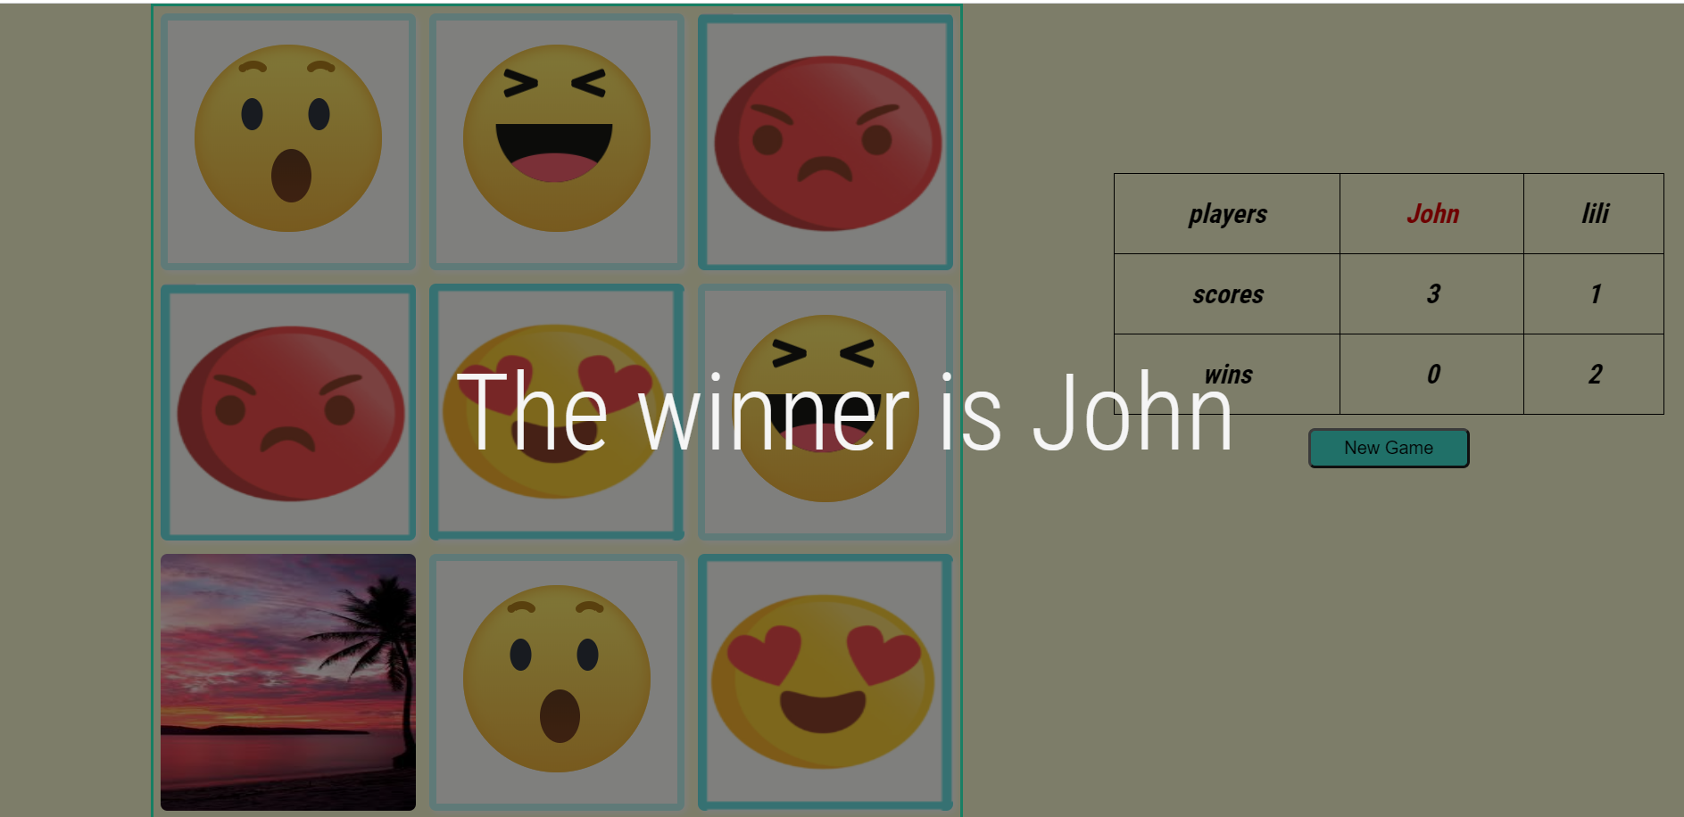
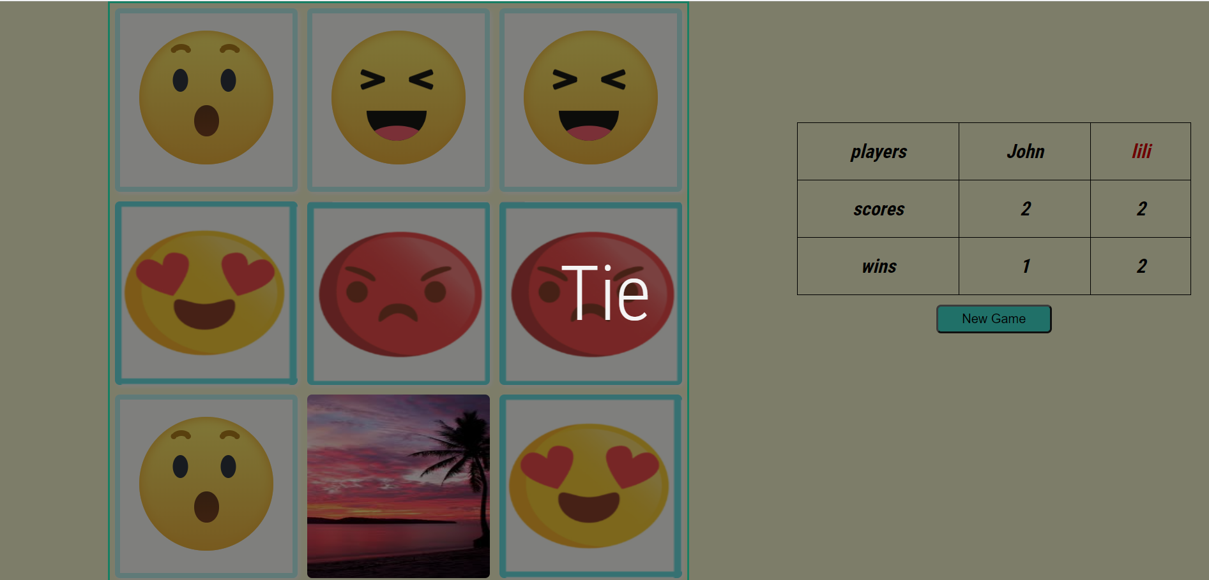
At the end of the game, a message with the name of the winner or with a message of equality, if any, will pop up on the screen. Once clicked on the screen the ad will disappear.
It can be seen that John won the previous game, so his number of wins went up on display in the new game.

Slide 8
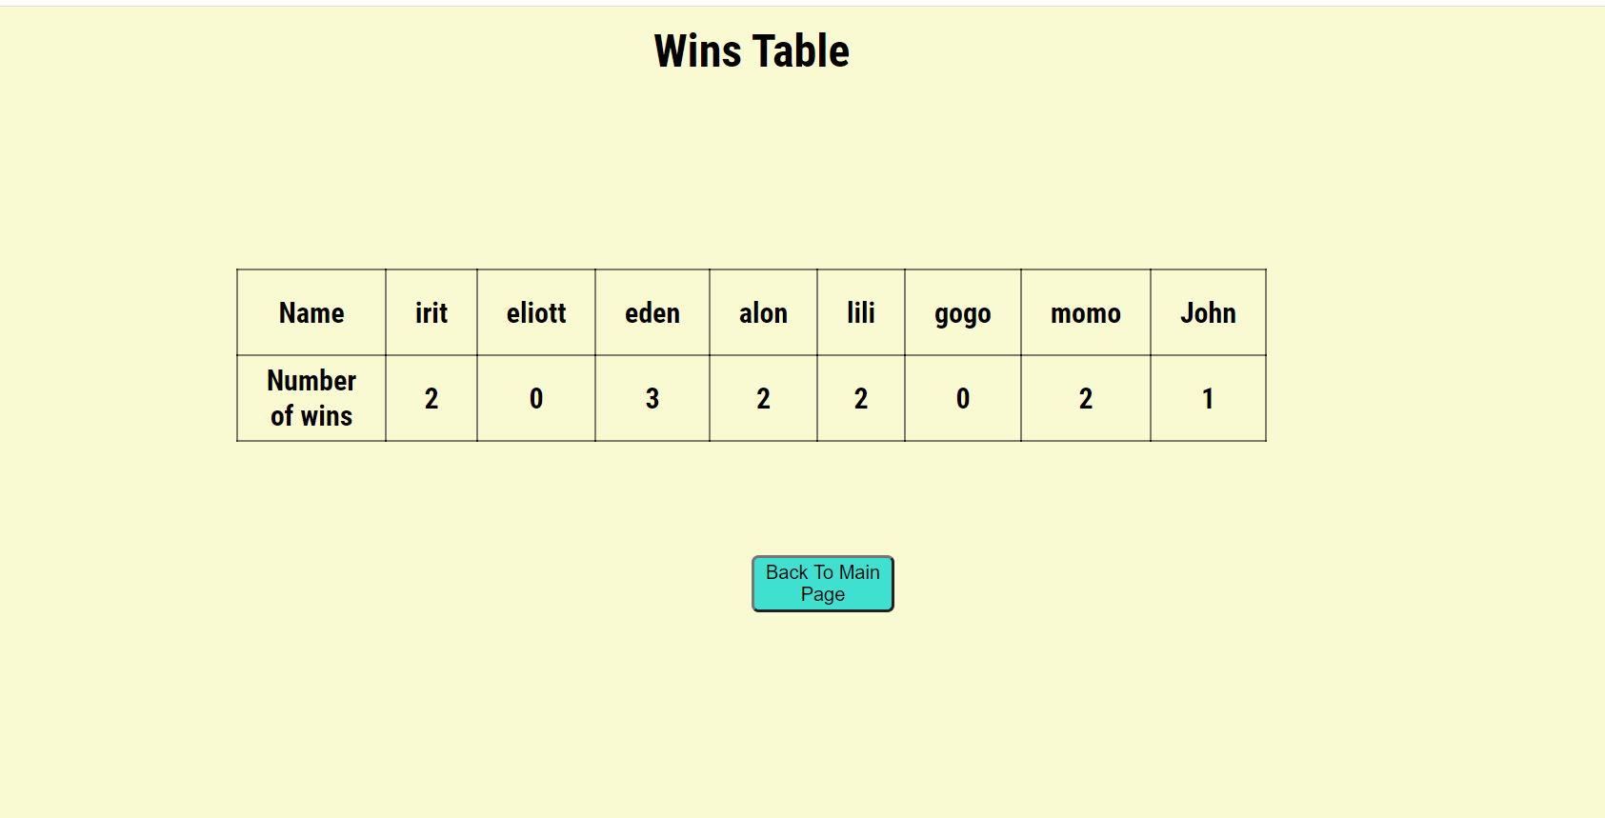
Victories Table
When we click on the "All Players" button on the main screen, we will reach a page where a table is displayed in which all the names of the game participants and their total number of victories appear.

Slide 9
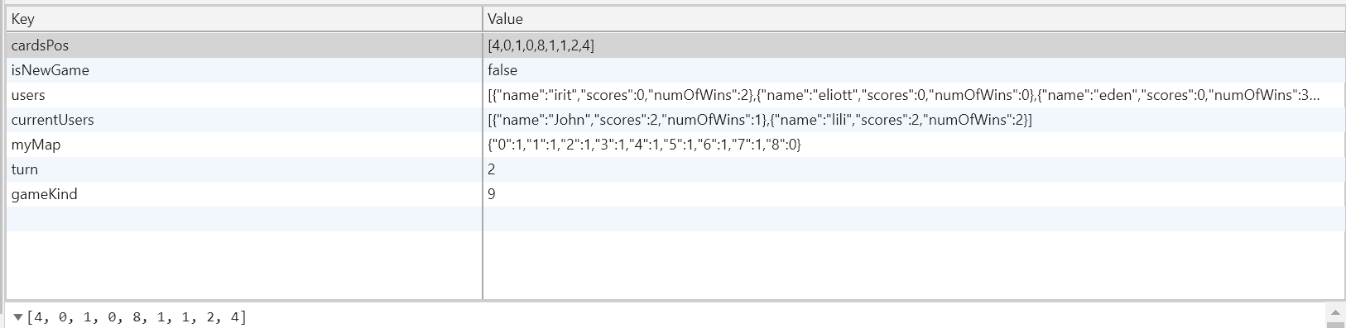
Local storage
cardPos - An array that saves the card positions so that they do not change after a page refreshing. It is updated with each new game.
isNewGame- A Boolean variable that determines whether or not we are in a new game for non-change in a page refresh.
users – All participants are saved in jason format.
currentUsers – Current game participants are saved in json format and updated with each new game.
myMap – An array in JSON format that defines the cards that have been matched with the number 1 according to their id and so when the page is refreshed they will remain inverted.
Turn- A variable that determining who turn is it at any given moment.
gameKind – Is it a 9-card or 16-card game.

