Slide 1
COMS4995: Applied Machine Learning Project Deliverable 2
MUSIC GENRE CLASSIFICATION
Riya Gupta rg3332
Shahad Althobaiti sa3986
Avik Dhupar ad3910
Yujia Xie yx2619
Forest Shi fs2751

Slide 2
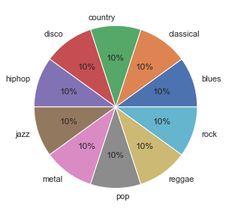
Dataset Overview
We use the popular GTZAN dataset [1] as part of our project. Since the dataset has already been cleaned, there was no cleaning and sanitization required.
The dataset consists of:
genres original: Directory containing 100 each of 30-second-long samples of 10 musical genres
images original: Directory containing 100 each of Mel Spectrograms of 10 musical genres
features_3_sec.csv: CSV file containing the mean and variance of features of each audio file in ‘genres original’, computed over a 3 second sample
features_30_sec.csv: CSV file containing the mean and variance of features of each audio file in ‘genres original’, computed over a 30 second sample.
Key Features: Spectral Centroid, Spectral Rolloff, Spectral Bandwidth, Zero-Crossing Rate, Chroma feature, Mel Frequency Cepstral Coefficients (MFCC)
The pie charts on the right shows the classes distribution in the dataset. Luckily, we have a balanced dataset.
[1] https://www.kaggle.com/andradaolteanu/gtzan-dataset-music-genre-classification

Slide 3
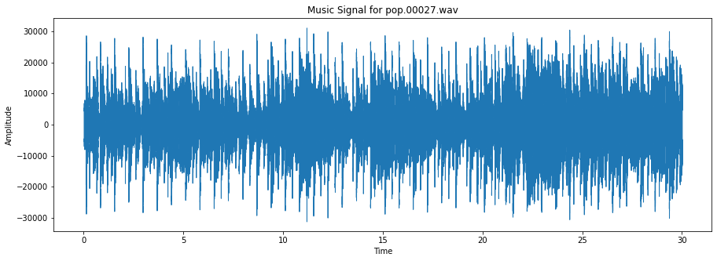
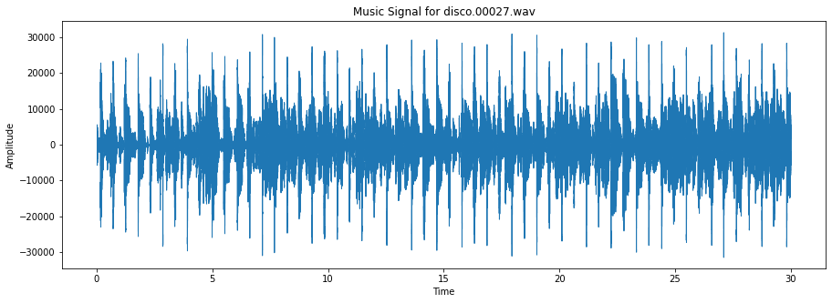
Initial data exploration (using librosa i.e. direct audio processing)
Here, we plot the amplitude over time for a two randomly chosen samples – pop.00027.wav and disco.00027.wav. We can see how the amplitude varies uniquely for both the pop and disco samples – The Disco samples have evenly spaced peaks, attributed to the continuous beats, whereas Pop samples also have the continuous beats, interleaved with more content, most likely attributed to the vocals and various acoustic instruments.

Slide 4
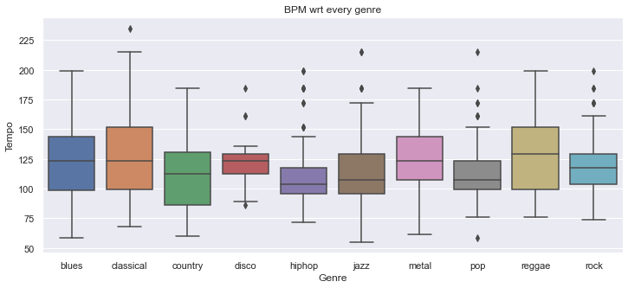
Initial data exploration (using features from csv)
As we can see from the boxplot, in genres Blues, Country, Metal & Reggae there are no outliers. All the samples in the dataset for these genres are normally spaced and the distances between the samples from random population for these genres is not abnormal

Slide 5
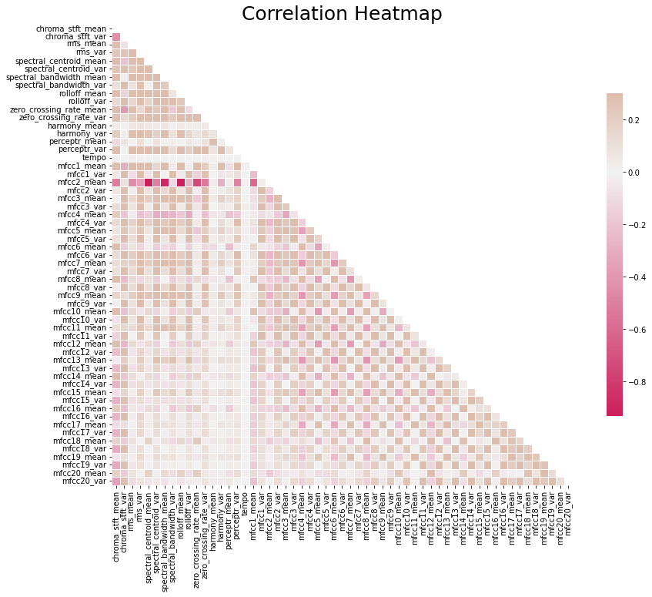
Data Cleaning and Encoding (using features from 3 sec csv)
Dataset : feature_3_sec.csv
As we can see from the correlation heatmap, most of the variables do not have a high correlation with other variables. We can filter out the extremely highly correlated pairs. If using 0.8 as the threshold of the absolute value of correlation, we delete ['spectral_bandwidth_mean', 'rolloff_mean','rolloff_var', 'zero_crossing_rate_mean', 'zero_crossing_rate_var', 'harmony_var'].
Further, we observed that all values except the target were already numeric, therefore no encoding was required.

Slide 6
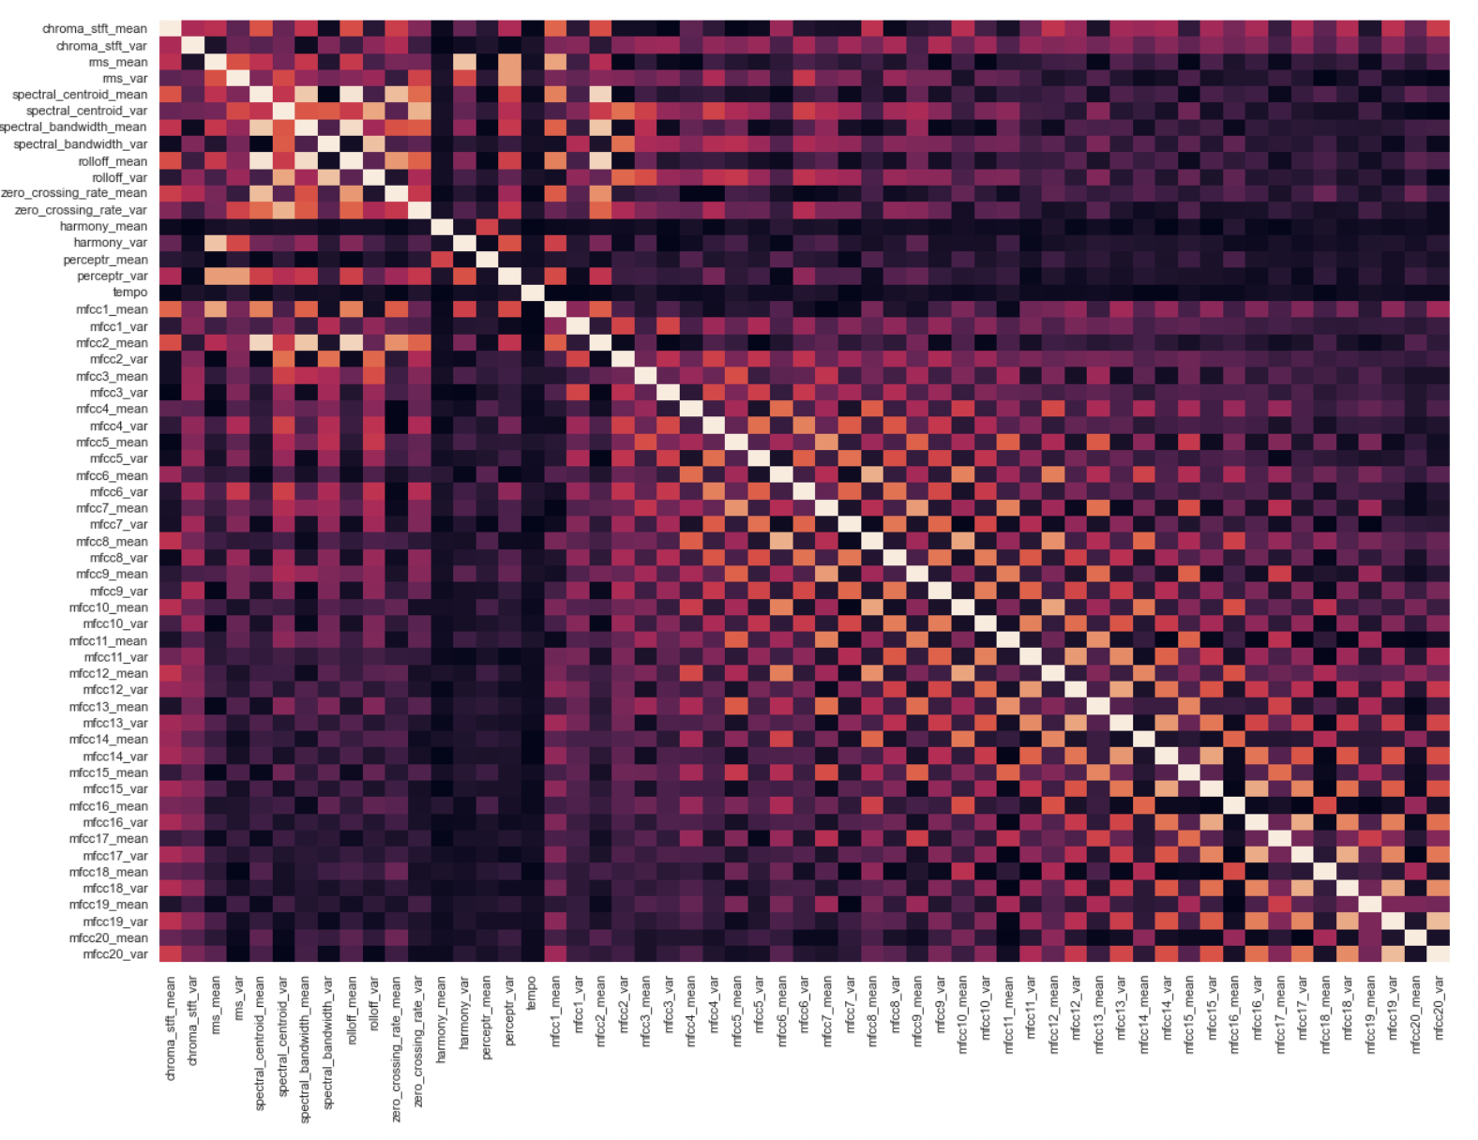
Data Cleaning and Encoding (using features from 30 sec csv)
Dataset : feature_30_sec.csv
As we can see from the correlation heatmap, most of the variables do not have a high correlation with other variables. We can filter out the extremely highly correlated pairs. If using 0.9 as the threshold of the absolute value of correlation, we delete
['spectral_bandwidth_mean', 'rolloff_mean', 'mfcc2_mean']

Slide 7
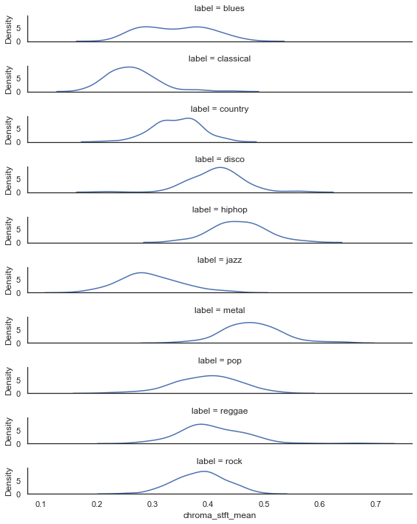
Insights from data exploration (using features from 30 sec csv)
In this ridgeplot, we note how the KDE distribution of the chroma representation varies for each genre. For instance, the chroma values are below 0.35 for most data points classified as Classical, as opposed to metal, where the majority data points are above 0.4.
Density

Slide 8
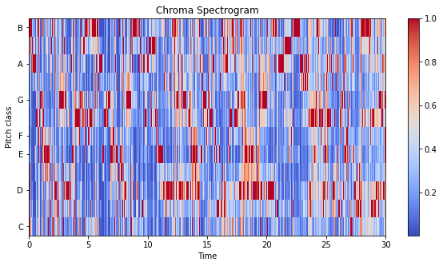
Insights from data exploration (using librosa i.e. direct audio processing)
Consider this spectrogram that is generated by taking the short-time fourier transform of the sample (pop.00027.wav), and then deriving the chroma representation. We make an interesting observation with respect to pitch class C. Few points are marked red, so we are able to conclude that this sample is not in the key of C or Cm (or their relative minor and major, Am and E flat respectively)
Conversely, a large number of Rock and Blues songs are in the keys of A, D, E & G. Therefore, it may be helpful to use the chroma information as a data point.

Slide 9
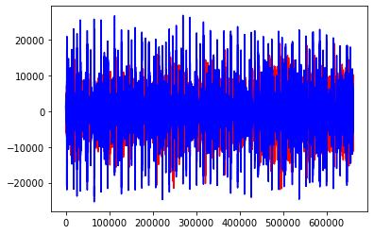
Insights from data exploration (using librosa i.e. direct audio processing)
In this spectrogram, we plot the harmonic and percussive content of the sample (pop.00027.wav).
A large number of Classical songs have low percussive content, but a high harmonic content. Also, a large number of Disco songs have a high percussive content, but low harmonic content. Therefore, it may be helpful to use this as a data point.
∎ Harmonic Content
∎ Percussive Content

Slide 10
Machine Learning techniques proposed to be implemented
One key challenge with our dataset is the limited number of samples available, i.e. only 1000, which can lead to an unstable model and overfitting. However, one workaround is to chop the samples from being 30 seconds in length, to 3 seconds in length. This gives us 9900 samples, which is a decent amount of points to work with, and allows us to train the model better.
We are currently proposing the following techniques, and will be evaluating each of them:
SVMs, such as Kernel and Soft Margin SVM
Logistic Regression
K-Nearest Neighbor
Decision Trees and Random Forest
Neural Networks
* Deep learning, if time permits

Slide 11
Tuning and Evaluation
Hyperparameter tuning will be done using Gridsearch, along with K-fold cross validation and 3-way holdup
To determine the best model, we will use metrics such as confusion matrix. Losses will be calculated using negative log likelihood for any deep learning techniques.
Github : https://github.com/iriyagupta/AML_project_test.git (private as of now, will be submitting the final link during final submission)

