Slide 1

CLOUD COMPUTING INTERNSHIP
SaaS Subscription Management Platform with Stripe & Docker
Codec Technologies Pvt. Ltd.
Cloud Computing Internship · 06/05/2026 – 06/06/2026
Abhimanyu Yadav
B.Tech – Computer Science & Engineering
Session 2024-28
LEDGER · CLOUD COMPUTING INTERNSHIP
01

Slide 2




01 · OVERVIEW
Internship Overview
C
DEV
1M
SaaS
COMPANY
ROLE
DURATION
FOCUS
Codec Technologies Pvt. Ltd.
Cloud Computing Intern
06/05/2026 – 06/06/2026
Cloud Computing Training & Practical Project Work
LEDGER · CLOUD COMPUTING INTERNSHIP
02

Slide 3




02 · OBJECTIVES
Internship Objectives
01
02
03
04
05
Build a complete SaaS subscription and billing platform
Implement JWT authentication and role-based authorization
Integrate Stripe Checkout, Billing Portal and webhooks
Track customer usage with analytics dashboards
Containerize frontend, backend and PostgreSQL with Docker Compose
LEDGER · CLOUD COMPUTING INTERNSHIP
03

Slide 4




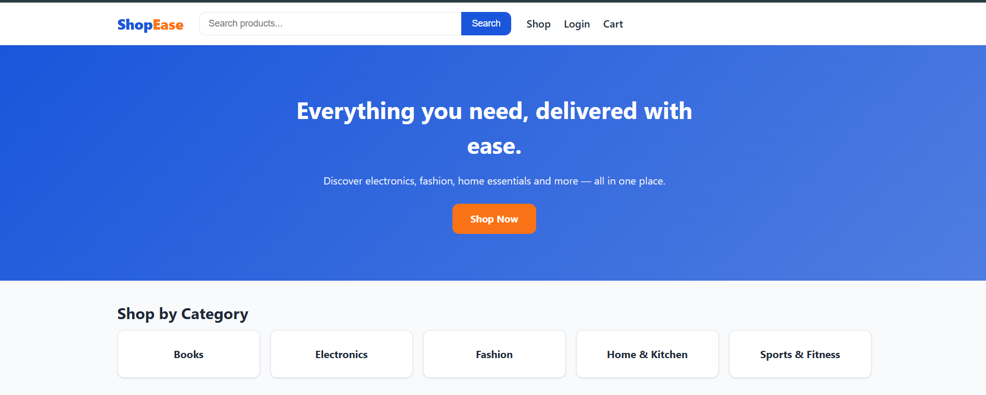
03 · PROJECT
Project Overview
Ledger
LEDGER DASHBOARD
Plans & subscriptions
Billing & invoices
Usage analytics
Admin controls
SaaS Subscription Management Platform with Stripe & Docker
A full-stack SaaS platform for plans, subscriptions, billing, invoices, usage analytics and role-based administration, backed by Stripe.
PRESENTATION LAYER
Next.js 14 + TypeScript
APPLICATION LAYER
Node.js + Express.js
DATA LAYER
PostgreSQL 16
Dockerized — Frontend, backend and database orchestrated with Docker Compose
Ledger — Live storefront homepage
LEDGER · CLOUD COMPUTING INTERNSHIP
04

Slide 5











04 · STACK
Technology Stack
FRONTEND
BACKEND
DATABASE
Next.js 14
TypeScript
Tailwind Recharts
Recharts
Node.js
Express.js
PostgreSQL 16
bcrypt
PAYMENTS & SECURITY
CONTAINERIZATION & TOOLS
Stripe
JWT
bcrypt
CORS
dotenv / dotenvHub
dotenv / Docker
Docker Compose
dotenv
LEDGER · CLOUD COMPUTING INTERNSHIP
05

Slide 6
05 · ARCHITECTURE
System Architecture
Customer
Browser client
Customer
Web browser
Stripe
Checkout • Billing Portal • Webhooks
Next.js Frontend
Dashboard • Plans • Billing • Admin
Next.js 14 Frontend
Docker Frontend
Presentation layer
Next.js on :3000
Express Backend
JWT • Roles • REST API
Docker Compose
Frontend + Backend + PostgreSQL
Node.js / Express API
Docker Backend
Application layer
Express API on :4000
PostgreSQL
Users • Plans • Subscriptions • Invoices • Usage
PostgreSQL Database
Docker PostgreSQL
Data layer
Persistent pgdata volume
Git / GitHub
Docker Compose
Stripe
Checkout • Billing Portal • Webhooks • Subscription Sync
LEDGER · CLOUD COMPUTING INTERNSHIP
06

Slide 7

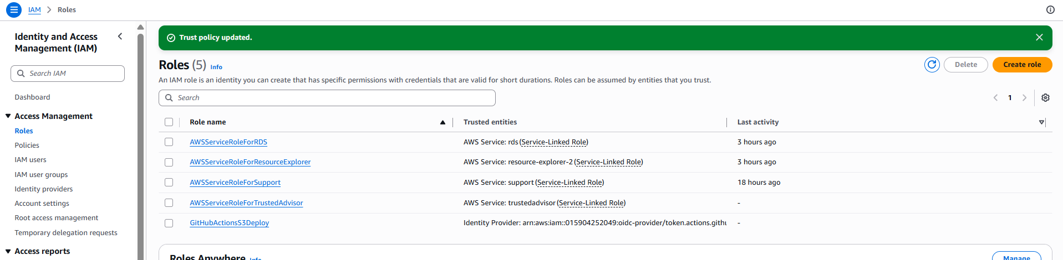
06 · INFRASTRUCTURE
Application Infrastructure
Docker
Next.js
RUNTIME SERVICES
frontend :3000
backend :4000
postgres :5432
persistent pgdata volume
Backend container
Frontend container
PostgreSQL
JWT + Roles
Persistent database
Application authorization
Development: Docker Compose • PostgreSQL 16 • Node.js • Next.js
External services: Stripe API + Stripe Webhooks
LEDGER · CLOUD COMPUTING INTERNSHIP
07

Slide 8
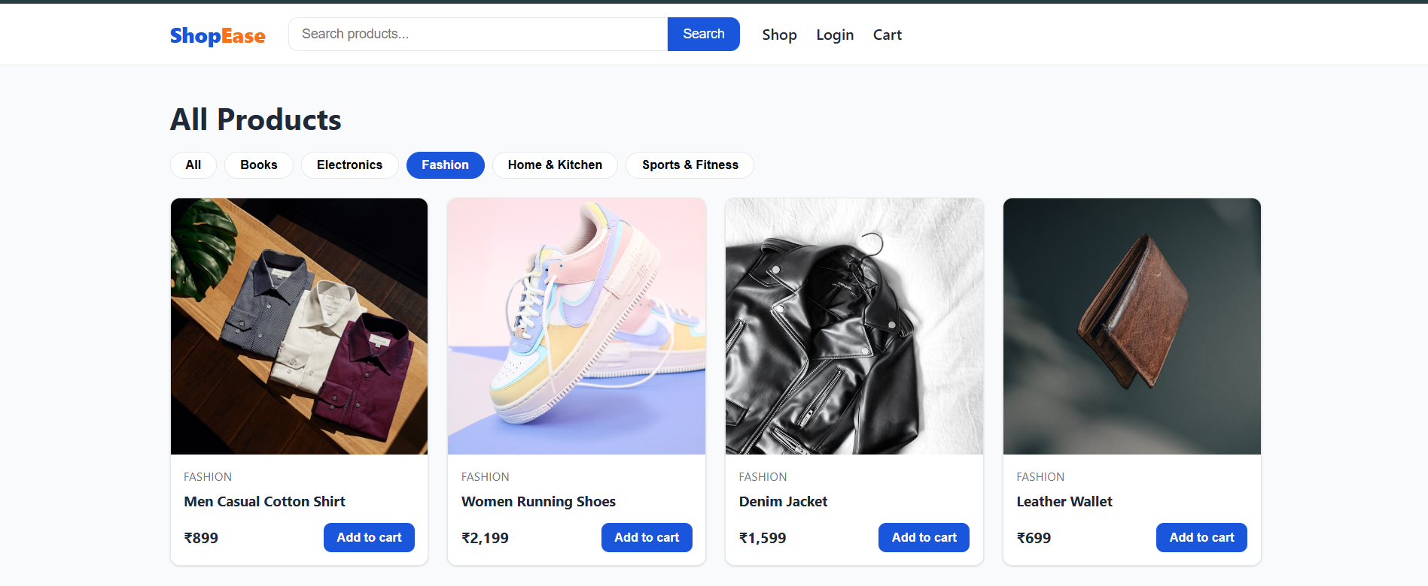
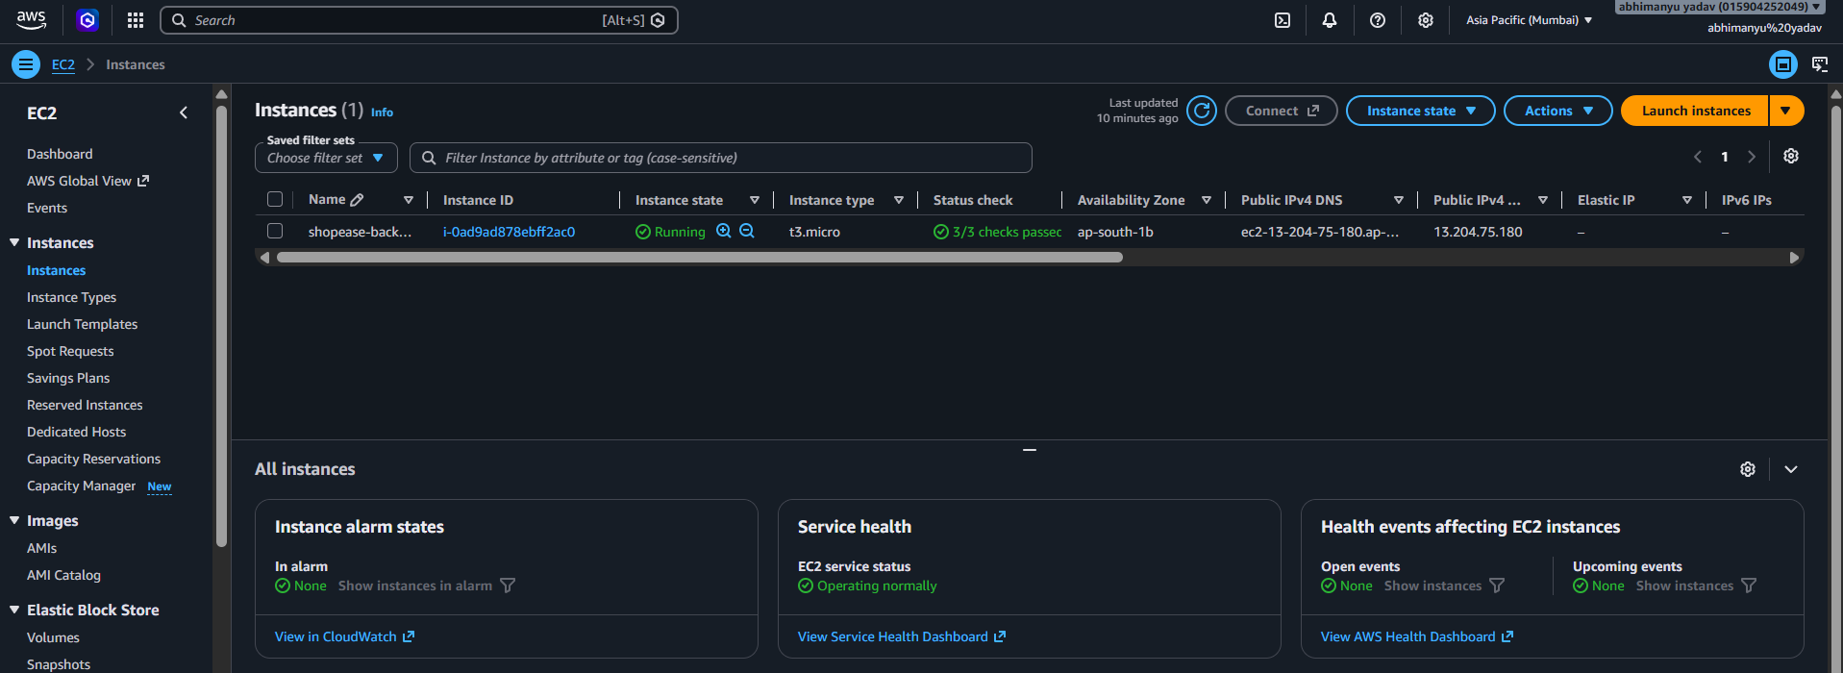
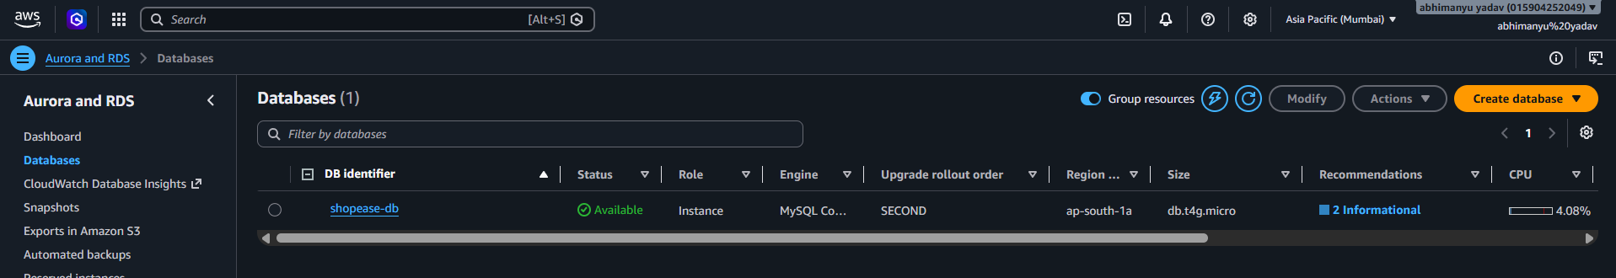
07 · IMPLEMENTATION
Application Implementation
FRONTEND
BACKEND
DATABASE
React + Vite
User interface
Production build
Hosted on S3
Node.js + Express
REST API communication
Hosted on EC2
Managed with PM2
MySQL
Hosted on Amazon RDS
Backend database connectivity
ap-south-1 region
FRONTEND
Dashboard • Plans • Billing • Admin
BACKEND
Auth • Subscription • Billing • Usage
DATABASE
PostgreSQL schema + persistent data
Ledger product catalog
Express API service — port 4000
PostgreSQL service — port 5432
LEDGER · CLOUD COMPUTING INTERNSHIP
08

Slide 9

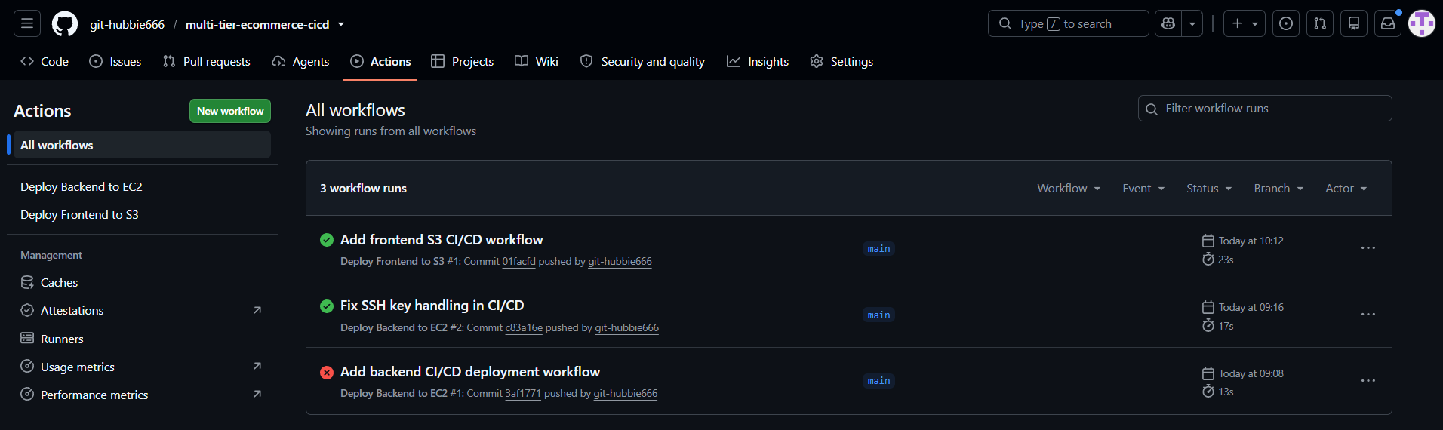
08 · BILLING
Subscription & Billing Flow
Customer
Select plan
Stripe Checkout
Payment
Stripe Webhook
Event delivery
PostgreSQL
Subscription + invoice
Customer
Ledger Frontend
Express API
BILLING CAPABILITIES
• Upgrade / downgrade with proration
• Cancel subscription
• Hosted Billing Portal
• Invoice synchronization
• Usage records and analytics
SUBSCRIPTION PATH
SYNC PATH
Select a plan
Stripe Webhook
Create Stripe Checkout
Update local DB
Complete payment
Stripe events keep subscriptions and invoices synchronized
LEDGER · CLOUD COMPUTING INTERNSHIP
09

Slide 10

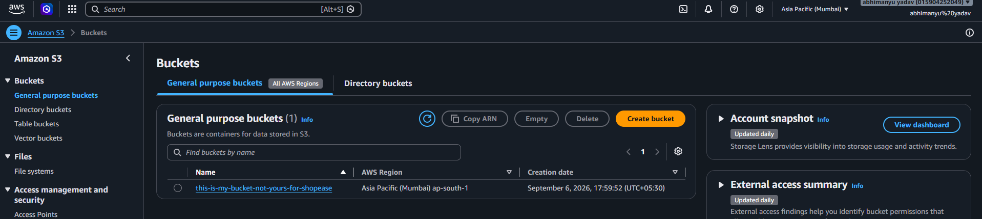
09 · CONFIGURATION
Application Configuration
ENVIRONMENT CONFIGURATION
DATABASE_URL
JWT_SECRET
STRIPE_SECRET_KEY
STRIPE_WEBHOOK_SECRET
CLIENT_URL
NEXT_PUBLIC_API_URL
FRONTEND
BACKEND
DATABASE
Next.js Docker service
Express Docker service
PostgreSQL 16 container
AUTHENTICATION
API COMMUNICATION
SOURCE CONTROL
JWT + bcrypt
CORS + typed API client
Git / GitHub
Docker Compose — frontend + backend + PostgreSQL
LEDGER · CLOUD COMPUTING INTERNSHIP
10

Slide 11

10 · PROBLEM SOLVING
Challenges & Solutions
CHALLENGE
SOLUTION
Frontend and backend are separate services
Configured CLIENT_URL and CORS
Protected API routes
Implemented JWT authentication and role guards
Stripe webhook verification
Used raw request body for Stripe signature verification
Billing synchronization
Webhook handlers update local subscription/invoice data
Reproducible local environment
Docker Compose defines all core services
LEDGER · CLOUD COMPUTING INTERNSHIP
11

Slide 12
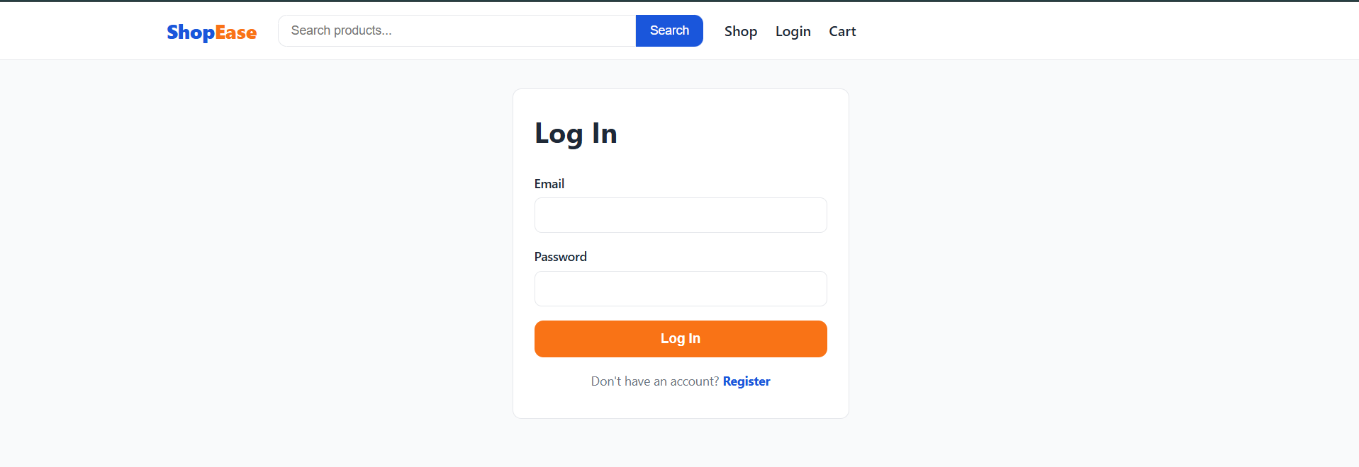
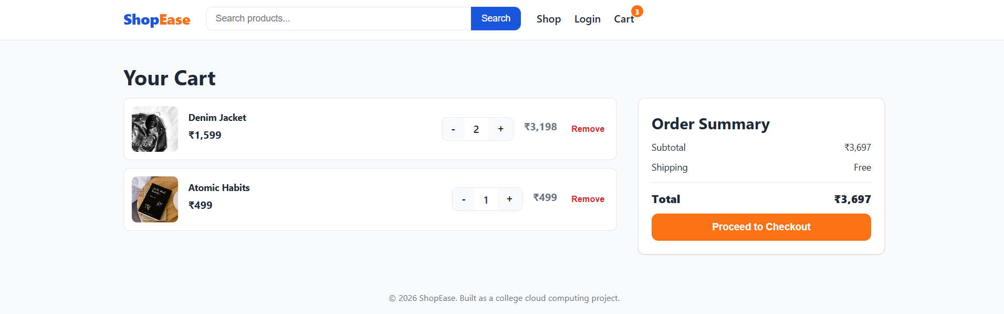
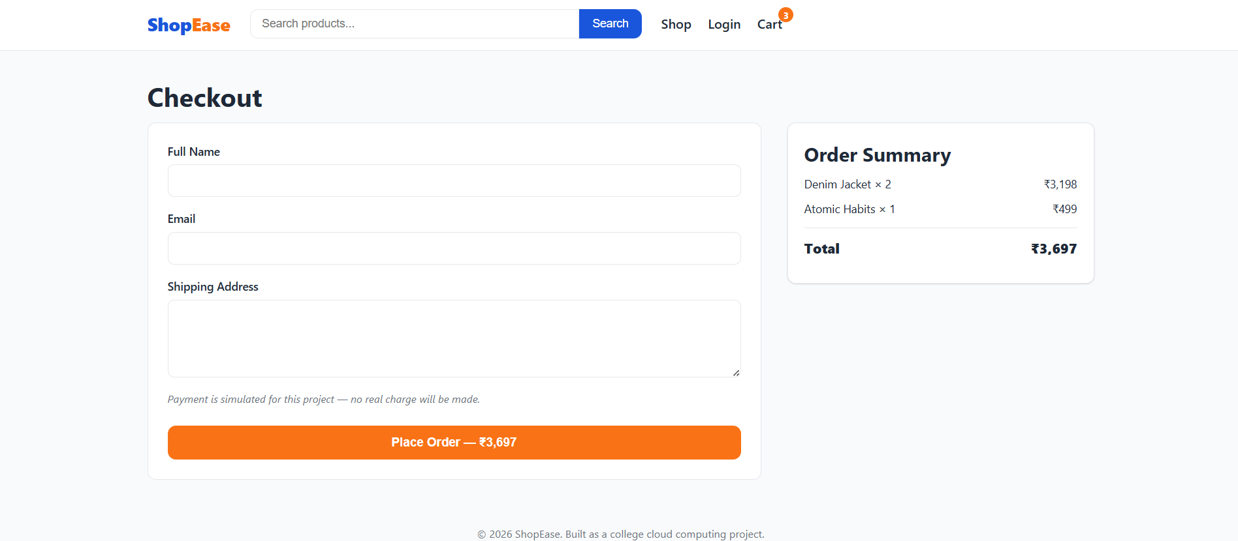
11 · QUALITY ASSURANCE
Testing & Validation
Registration and login flow verified
LOGIN
JWT authentication
PLANS
Subscription selection
JWT-protected API requests verified
Role-based admin routes verified
Evidence — Login / Register
Evidence — Plans
PostgreSQL connectivity and schema verified
BILLING
Invoices + portal
DASHBOARD
Usage analytics
Stripe checkout and billing flow verified
Webhook subscription/invoice synchronization verified
Evidence — Billing
Evidence — Dashboard
LEDGER · CLOUD COMPUTING INTERNSHIP
12

Slide 13



12 · GROWTH
Learning Outcomes
SaaS Architecture
Full-Stack Development
Containerization
Separated frontend, API, database and billing responsibilities
Next.js, Express.js, PostgreSQL and Stripe
Dockerfiles and Docker Compose service orchestration
Authentication & Roles
Billing & Webhooks
SaaS Readiness
JWT sessions, bcrypt and role-based authorization
Handled Stripe events and database synchronization
Security, configuration and deployment considerations
LEDGER · CLOUD COMPUTING INTERNSHIP
13

Slide 14


13 · CONCLUSION
Conclusion & Future Scope
Successfully developed Ledger, a SaaS subscription management platform combining Next.js, Express.js, PostgreSQL, Stripe, JWT authentication and Docker Compose.
FUTURE SCOPE
Email verification
Password reset
Rate limiting
Webhook queue
Managed production DB
Security hardening
Thank You
LEDGER · CLOUD COMPUTING INTERNSHIP
14

