Slide 1

PITAYAGRADE
Pre-Harvest Quality Grading and Disease Detection for Dragon Fruit
Capstone Defense Deck
Bachelor of Science in Information Technology
Academic Year 2025–2026
Current evidence status: quality models evaluated; physical-device/UAT evidence pending
Notes:
Open with the purpose of the system and the evidence boundary.
Source: PitayaGrade_Capstone_Paper.md and research/SCOPE_ALIGNMENT.md.

Slide 2
Problem and research boundary
02
Manual visual inspection varies with evaluator judgment, lighting and fatigue. PitayaGrade tests whether a local mobile workflow can support more consistent image-based assessment.
Evidence boundary
The current prototype demonstrates local ONNX execution and application workflows. It does not yet establish agricultural accuracy, field impact or superiority to manual grading.
Quality grades need consistent visual criteria and traceable records.
Visible disease cues require careful wording and expert confirmation.
Small farms benefit from offline capture, history and report export.
Accuracy and impact claims remain pending reviewed labels and formal testing.
PitayaGrade · BSIT Capstone · 2025–2026
Notes:
Keep the defense precise: distinguish implemented software from unverified research outcomes.
Source: manuscript Abstract and Chapter 5 evidence-status notes.

Slide 3
Objectives and intended users
03
General objective
Core users
Develop a mobile decision-support application for image-based dragon fruit grading, visible symptom estimation and local record keeping.
Farmer / User
Agricultural worker
Captures fruit, reviews the result and keeps scan records.
Supports interpretation, review and field follow-up.
Implemented objectives
Photo and live-camera capture
Selectable model interface
History, analytics and CSV reports
Local notifications and reviewer feedback
PitayaGrade · BSIT Capstone · 2025–2026
Notes:
Source: manuscript Sections 1.3 and 4.2.
Do not present the intended 90% target as a measured result.

Slide 4
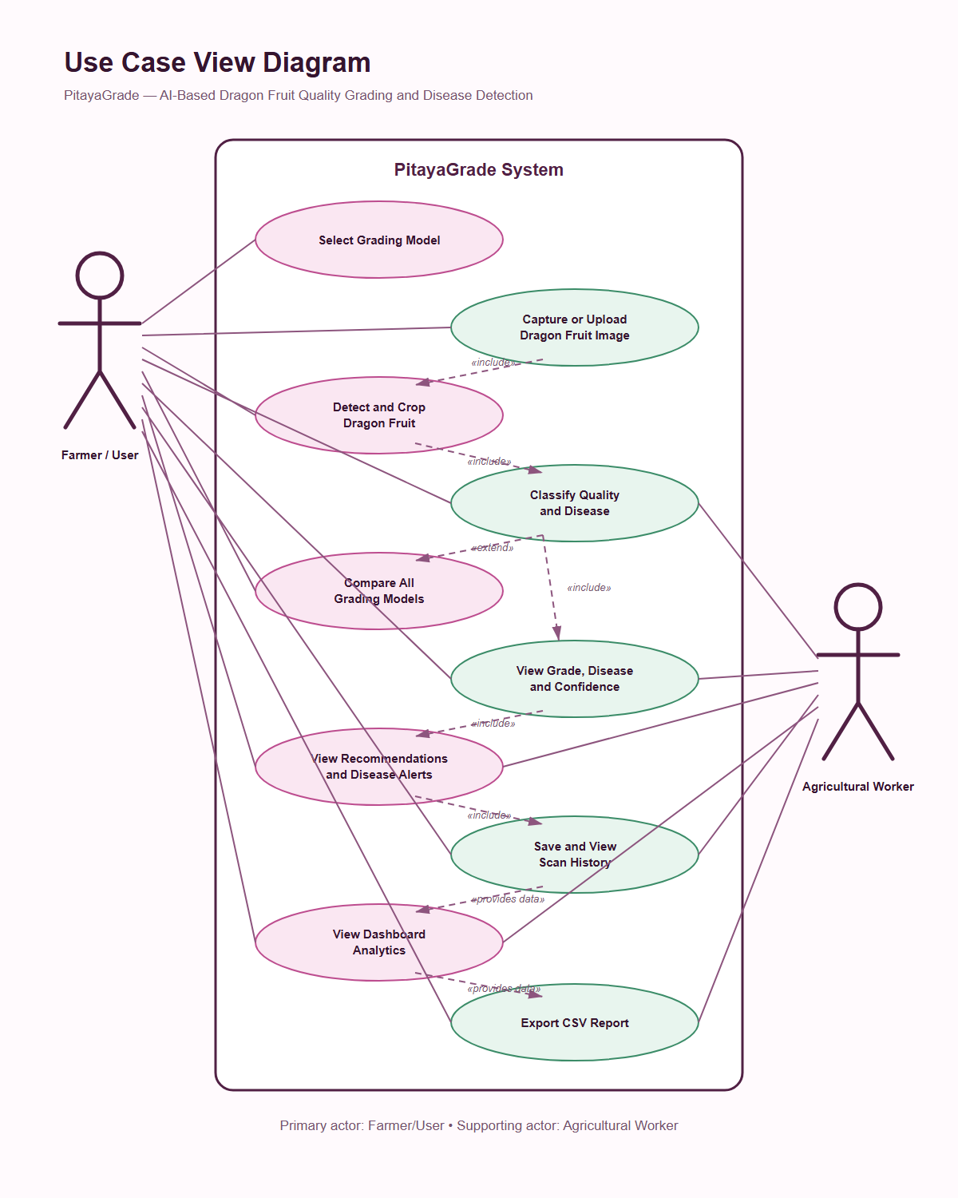
User interaction model
04
The mobile workflow keeps capture, results and records in one application.
Primary actor
Supporting actor
Farmer or user
Agricultural worker
PitayaGrade · BSIT Capstone · 2025–2026
Notes:
Source: assets/diagrams/pitayagrade-use-case-view.png.
Model comparison stays unavailable until comparable evaluated model files exist.

Slide 5
Implemented application architecture
05
All active scan processing remains on the device.
Capacitor application
Local inference
Local records
Input
›
HTML, CSS and JavaScript UI with shared photo/live scan logic
›
ONNX Runtime Web + WASM
Selectable ONNX quality models + dragon-fruit presence gate
›
Settings, scan history, review feedback and CSV reports
Camera frame or gallery image
Current disease output uses clearly labeled HSV image heuristics until an evaluated segmentation model is available.
No Firebase, cloud database or cloud AI service is required by the active application.
PitayaGrade · BSIT Capstone · 2025–2026
Notes:
Sources: README.md, js/model-inference.js, js/storage.js and research/SCOPE_ALIGNMENT.md.
This slide describes the active Capacitor application, not the earlier Flutter or Cordova prototypes.

Slide 6
Runtime scan sequence
06
1 Select
2 Capture
3 Infer
4 Validate
5 Save
Choose an available grade model
Take a photo, upload or use live view
Preprocess and run local ONNX
Apply confidence and fruit-signature checks
Show result and keep a local record
›
›
›
›
Photo and live-camera modes share the same model threshold and visual safety gate.
Rejected scans now show the object score versus the required threshold for troubleshooting.
PitayaGrade · BSIT Capstone · 2025–2026
Notes:
Sources: js/scanner.js, js/live-scanner.js and js/model-inference.js.
The active default object threshold is 50%.

Slide 7
Verified model catalog and selection status
07
Model | Role | App status | Evidence requirement
YOLOv8-Nano | Presence safety gate | Bundled | Checksum-verified ONNX gate
MobileNetV2 | Quality classifier | Selectable | 72.12% held-out accuracy
ResNet50 | Quality classifier | Selectable | 74.34% held-out accuracy
EfficientNet-B3 | Quality classifier | Selected | 74.78% accuracy · 58.51% macro F1
YOLOv8n-Seg | Disease segmentation | Pending | Reviewed masks + segmentation evaluation
Three checksum-verified quality classifiers are selectable. Disease segmentation remains unavailable pending reviewed masks and evaluation.
PitayaGrade · BSIT Capstone · 2025–2026
Notes:
Source: js/model-registry.js.
Do not describe the disabled entries as implemented models.

Slide 8
Implemented application capabilities
08
Scanning and interpretation
Records and delivery
Photo upload and camera capture
Local scan history and notes
Live camera HUD with model score
Human validation and rejection feedback
Model threshold and fruit-signature guard
Analytics and date-bounded reports
Quality grade plus image-based symptom estimate
CSV export, notifications and installable PWA
Android debug package available · offline runtime assets bundled · no server account required
PitayaGrade · BSIT Capstone · 2025–2026
Notes:
Sources: application modules in js/, README.md and research/SCOPE_ALIGNMENT.md.

Slide 9
Dataset preparation status
09
Human review and the frozen quality split are complete; disease-region masks remain pending.
Split | Grade A | Grade B | Grade C / Reject
Train | 168 | 221 | 130 / 577
Validation | 45 | 43 | 24 / 119
Test | 28 | 61 | 22 / 115
Unique hashes | 1,553 | Cross-split duplicates | 0
Review manifest | 1,553 images | Reviewed target labels | 1,553
What the audit proves
Every quality row has a human-reviewed target label
No byte-exact or source-group overlap across splits
The frozen manifest and checksums validate without error
It does not prove Philippine field representativeness, disease diagnosis or superiority to manual grading.
PitayaGrade · BSIT Capstone · 2025–2026
Notes:
Sources: research/dataset-audit.json and research/public-review-manifest.json.
Adjacent video frames can still cause leakage even when hashes differ.

Slide 10
Software verification evidence
10
Verification area | Current result | What it establishes
JavaScript regression suite | 112 checks passing | UI workflows, storage, reporting and runtime wiring
Python research tooling | 138 checks passing | Validation, preprocessing and evaluation safeguards
Bundled ONNX smoke test | Pass | Model executes through the shipped WASM backend
Android assembly and lint | Pass | Debug application builds without lint failure
GitHub verification | Pass | Repository checks repeat in automation
Held-out quality evaluation | 74.78% accuracy | EfficientNet-B3 on the frozen 226-image test split
Software checks establish compatibility. The held-out result is internal evidence and still requires field/UAT validation.
PitayaGrade · BSIT Capstone · 2025–2026
Notes:
Sources: latest local test runs, .github/workflows/verify.yml and research/SCOPE_ALIGNMENT.md.
Current debug APK SHA-256 begins 06a62fe9.

Slide 11
Held-out quality model comparison
11
Every candidate used the same frozen 226-image test split.
MobileNetV2
72.12% accuracy · 55.31% macro F1
ResNet50
74.34% accuracy · 54.83% macro F1
EfficientNet-B3 ranked first at 74.78% accuracy and 58.51% macro F1. Its accuracy lead over ResNet50 is only 0.44 percentage points.
Grade C is weakest (27.03% F1); retain human validation.
PitayaGrade · BSIT Capstone · 2025–2026
Notes:
Source: scripts/audit_runtime_gate.py and research/SCOPE_ALIGNMENT.md.
The 240 images are known-fruit development samples, so do not report 95% as accuracy.

Slide 12
Evaluation evidence and next validation
12
Freeze
Predict
Summarize
Test device
Run UAT
Complete · frozen reviewed manifest and model hashes
Complete · one prediction per held-out image
Complete · metrics, confusion matrices and errors retained
Pending · latency, offline use and failure cases on phones
Pending · approved tasks and anonymous participant IDs
›
›
›
›
Required retained files
predictions.csv · model-evaluation.csv retained · device-test.csv and uat.csv pending
The manuscript includes measured quality findings; final claims remain bounded until device testing, UAT and disease scope are resolved.
PitayaGrade · BSIT Capstone · 2025–2026
Notes:
Source: research/WEEK4_EVALUATION_PLAN.md and research/week4 templates.

Slide 13
Capstone completion scorecard
13
Weighted by deliverable readiness, with evidence work separated from software work.
Workstream | Weight | Earned | Basis
Scope and requirements | 10 | 10 | Scope frozen
Repository and repeatable builds | 10 | 10 | CI/build checks pass
Application functionality | 20 | 20 | Core workflow tested
Model infrastructure | 15 | 13 | Quality models ready; disease pending
Data governance and preparation | 15 | 15 | 3,050 reviewed
Formal evaluation and UAT | 10 | 5 | Quality tested; UAT pending
Manuscript and defense materials | 15 | 15 | Draft and deck ready
Release readiness | 5 | 0 | Unsigned; device test pending
88%
overall readiness
88 / 100
Readiness score, not model accuracy. Device/UAT evidence remains pending.
Notes:
Source: research/COMPLETION_SCORECARD.md.
This is a project-management estimate, not a model-performance metric.

Slide 14
The remaining 12%
14
Team or adviser input required
Then complete
Resolve disease segmentation: reviewed masks or adviser-approved scope waiver
Train/evaluate disease segmentation only if it remains in scope
Approve the retained quality results and final study protocol
Validate the APK across the physical-device matrix and approved UAT
Provide Android release signing key
Add approved device/UAT evidence and final figures to the manuscript
Run physical-device tests and approved UAT
Build the signed release and rehearse the defense
Critical path: disease scope › device testing › UAT › approved results › signed release › defense
PitayaGrade · BSIT Capstone · 2025–2026
Notes:
Sources: scripts/release-readiness.js and research/WEEK4_EVALUATION_PLAN.md.
Ask the panel to judge the prototype and protocol separately from the pending empirical findings.

Slide 15
Defense demonstration path
1
Choose
Select EfficientNet-B3 or compare the three verified quality models
2
Scan
Upload a clear dragon-fruit image
3
Interpret
Explain the grade, confidence, human-validation rule and limitations
4
Record
Open history, add review feedback and export CSV evidence
Questions
Public preview: irlcrshrgva-ui.github.io/PitayaGrade/
Notes:
Keep a local APK and screenshots available if network or camera access fails.
Close by restating the evidence boundary and the exact work needed for final completion.

