Slide 1
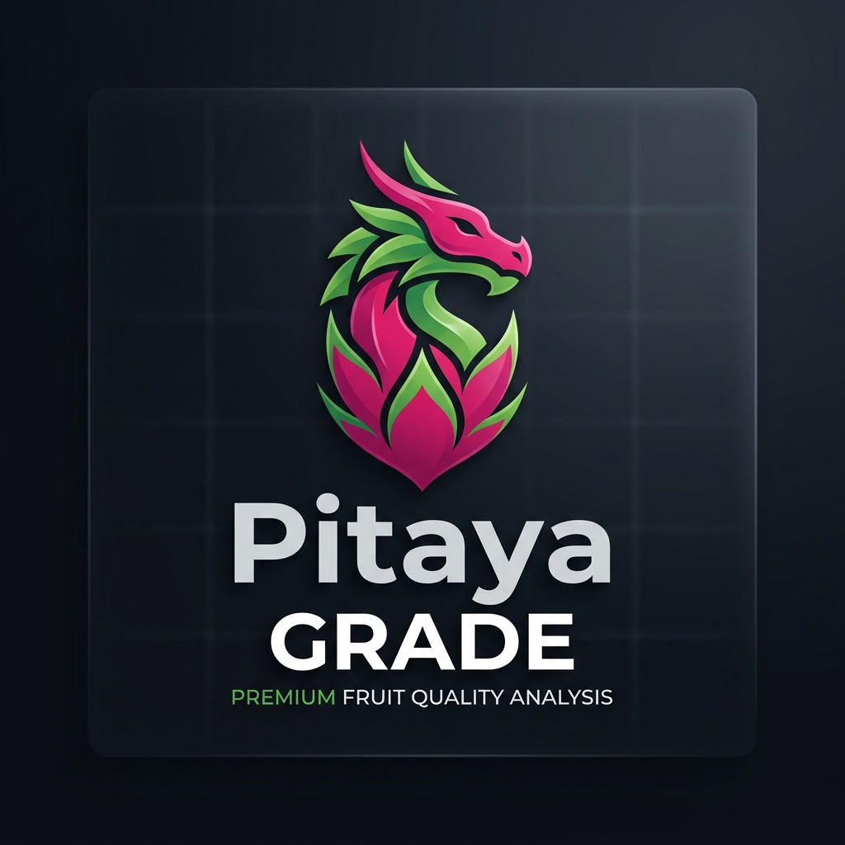
PITAYAGRADE
Pre-Harvest Quality Grading and Disease Detection for Dragon Fruit
Capstone Defense Deck
Bachelor of Science in Information Technology
Academic Year 2025–2026
Current evidence status: software prototype verified; formal model and user evidence pending
Notes:
Open with the purpose of the system and the evidence boundary.
Source: PitayaGrade_Capstone_Paper.md and research/SCOPE_ALIGNMENT.md.

Slide 2
Problem and research boundary
02
Manual visual inspection varies with evaluator judgment, lighting and fatigue. PitayaGrade tests whether a local mobile workflow can support more consistent image-based assessment.
Evidence boundary
The current prototype demonstrates local ONNX execution and application workflows. It does not yet establish agricultural accuracy, field impact or superiority to manual grading.
Quality grades need consistent visual criteria and traceable records.
Visible disease cues require careful wording and expert confirmation.
Small farms benefit from offline capture, history and report export.
Accuracy and impact claims remain pending reviewed labels and formal testing.
PitayaGrade · BSIT Capstone · 2025–2026
Notes:
Keep the defense precise: distinguish implemented software from unverified research outcomes.
Source: manuscript Abstract and Chapter 5 evidence-status notes.

Slide 3
Objectives and intended users
03
General objective
Core users
Develop a mobile decision-support application for image-based dragon fruit grading, visible symptom estimation and local record keeping.
Farmer / User
Agricultural worker
Captures fruit, reviews the result and keeps scan records.
Supports interpretation, review and field follow-up.
Implemented objectives
Photo and live-camera capture
Selectable model interface
History, analytics and CSV reports
Local notifications and reviewer feedback
PitayaGrade · BSIT Capstone · 2025–2026
Notes:
Source: manuscript Sections 1.3 and 4.2.
Do not present the intended 90% target as a measured result.

Slide 4
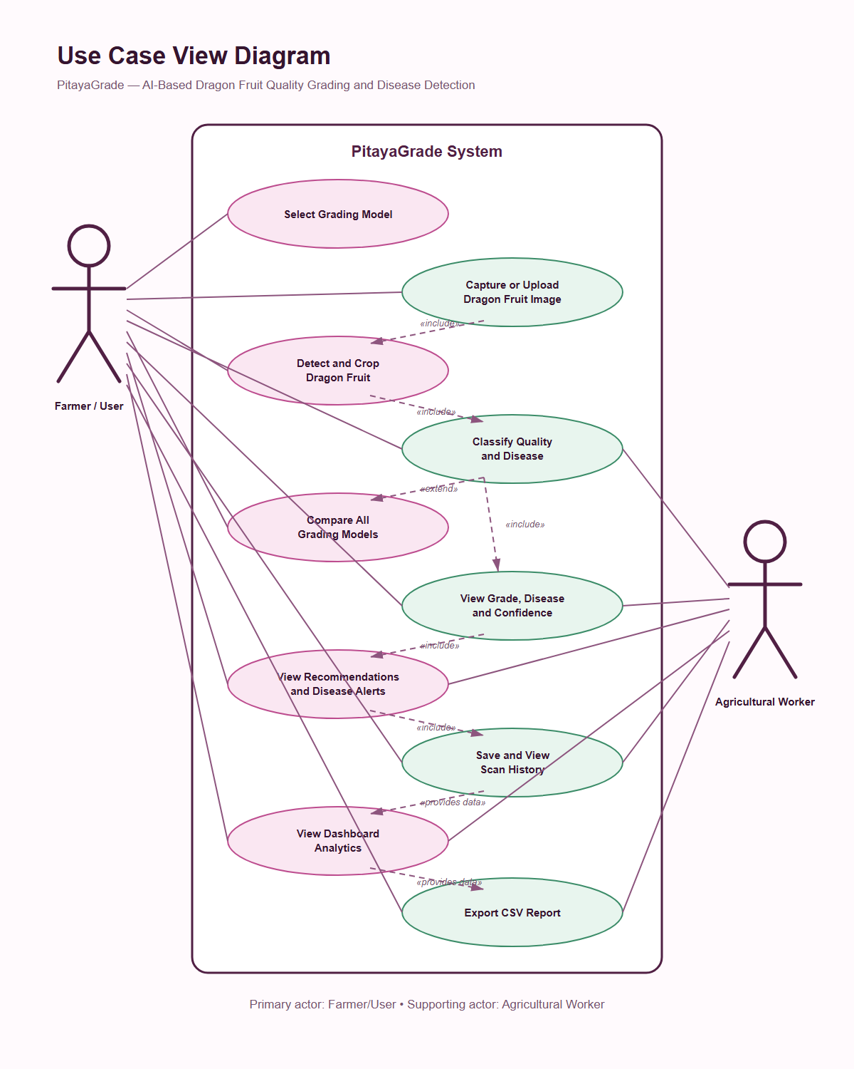
User interaction model
04
The mobile workflow keeps capture, results and records in one application.
Primary actor
Supporting actor
Farmer or user
Agricultural worker
PitayaGrade · BSIT Capstone · 2025–2026
Notes:
Source: assets/diagrams/pitayagrade-use-case-view.png.
Model comparison stays unavailable until comparable evaluated model files exist.

Slide 5
Implemented application architecture
05
All active scan processing remains on the device.
Capacitor application
Local inference
Local records
Input
›
HTML, CSS and JavaScript UI with shared photo/live scan logic
›
ONNX Runtime Web + WASM
YOLOv8-Nano grade detector
›
Settings, scan history, review feedback and CSV reports
Camera frame or gallery image
Current disease output uses clearly labeled HSV image heuristics until an evaluated segmentation model is available.
No Firebase, cloud database or cloud AI service is required by the active application.
PitayaGrade · BSIT Capstone · 2025–2026
Notes:
Sources: README.md, js/model-inference.js, js/storage.js and research/SCOPE_ALIGNMENT.md.
This slide describes the active Capacitor application, not the earlier Flutter or Cordova prototypes.

Slide 6
Runtime scan sequence
06
1 Select
2 Capture
3 Infer
4 Validate
5 Save
Choose an available grade model
Take a photo, upload or use live view
Preprocess and run local ONNX
Apply confidence and fruit-signature checks
Show result and keep a local record
›
›
›
›
Photo and live-camera modes share the same model threshold and visual safety gate.
Rejected scans now show the object score versus the required threshold for troubleshooting.
PitayaGrade · BSIT Capstone · 2025–2026
Notes:
Sources: js/scanner.js, js/live-scanner.js and js/model-inference.js.
The active default object threshold is 50%.

Slide 7
Model catalog and selection status
07
Model | Role | App status | Evidence requirement
YOLOv8-Nano | Integrated detection + grade | Selectable | Bundled ONNX and verified checksum
MobileNetV2 | Quality classifier | Disabled | Reviewed training + held-out evaluation
ResNet50 | Quality classifier | Disabled | Reviewed training + held-out evaluation
EfficientNet-B3 | Quality classifier | Disabled | Reviewed training + held-out evaluation
YOLOv8n-Seg | Disease segmentation | Disabled | Reviewed masks + segmentation evaluation
The interface exposes the planned catalog but enables only checksum-verified evaluated assets.
PitayaGrade · BSIT Capstone · 2025–2026
Notes:
Source: js/model-registry.js.
Do not describe the disabled entries as implemented models.

Slide 8
Implemented application capabilities
08
Scanning and interpretation
Records and delivery
Photo upload and camera capture
Local scan history and notes
Live camera HUD with model score
Human validation and rejection feedback
Model threshold and fruit-signature guard
Analytics and date-bounded reports
Quality grade plus image-based symptom estimate
CSV export, notifications and installable PWA
Android debug package available · offline runtime assets bundled · no server account required
PitayaGrade · BSIT Capstone · 2025–2026
Notes:
Sources: application modules in js/, README.md and research/SCOPE_ALIGNMENT.md.

Slide 9
Dataset preparation status
09
Structural checks are complete; research labels still need human review.
Split | Grade A | Grade B | Grade C / Reject
Train | 666 | 692 | 467 / 625
Validation | 142 | 148 | 101 / 134
Test | 143 | 149 | 100 / 134
Unique hashes | 3,501 | Cross-split duplicates | 0
Review manifest | 3,050 images | Reviewed target labels | 0
What the audit proves
File counts and labels parse
No byte-exact split duplicates
Annotation rows are structurally valid
It does not prove label correctness, source independence, consent or accuracy.
PitayaGrade · BSIT Capstone · 2025–2026
Notes:
Sources: research/dataset-audit.json and research/public-review-manifest.json.
Adjacent video frames can still cause leakage even when hashes differ.

Slide 10
Software verification evidence
10
Verification area | Current result | What it establishes
JavaScript regression suite | 72 checks passing | UI workflows, storage, reporting and runtime wiring
Python research tooling | 80 checks passing | Validation, preprocessing and evaluation safeguards
Bundled ONNX smoke test | Pass | Model executes through the shipped WASM backend
Android assembly and lint | Pass | Debug application builds without lint failure
GitHub verification | Pass | Repository checks repeat in automation
Agricultural accuracy | Pending | Requires reviewed held-out labels and predictions
Green software tests prove compatibility and behavior. They do not prove model accuracy.
PitayaGrade · BSIT Capstone · 2025–2026
Notes:
Sources: latest local test runs, .github/workflows/verify.yml and research/SCOPE_ALIGNMENT.md.
Current debug APK SHA-256 begins 06a62fe9.

Slide 11
Detector regression check
11
Known-fruit images used for development troubleshooting, not held-out accuracy.
Legacy gate
176 / 240 accepted
Corrected gate
228 / 240 accepted
The update lowered the default object threshold to 50% and allowed strong magenta/red skin when green tips are not visible. Face-like synthetic inputs remain rejected by regression tests.
This check supports debugging only. Formal recall and specificity remain unmeasured.
PitayaGrade · BSIT Capstone · 2025–2026
Notes:
Source: scripts/audit_runtime_gate.py and research/SCOPE_ALIGNMENT.md.
The 240 images are known-fruit development samples, so do not report 95% as accuracy.

Slide 12
Formal evaluation protocol
12
Freeze
Predict
Summarize
Test device
Run UAT
Hash reviewed manifests and model files
Export one prediction per held-out sample
Generate metrics, confusion matrices and errors
Record latency, offline use and failure cases
Use approved tasks and anonymous participant IDs
›
›
›
›
Required retained files
predictions.csv · model-evaluation.csv · device-test.csv · uat.csv
The manuscript changes only after these files contain approved, traceable results.
PitayaGrade · BSIT Capstone · 2025–2026
Notes:
Source: research/WEEK4_EVALUATION_PLAN.md and research/week4 templates.

Slide 13
Capstone completion scorecard
13
Weighted by deliverable readiness, with evidence work separated from software work.
Workstream | Weight | Earned | Basis
Scope and requirements | 10 | 10 | Scope frozen
Repository and repeatable builds | 10 | 10 | CI/build checks pass
Application functionality | 20 | 20 | Core workflow tested
Model infrastructure | 15 | 12 | Catalog ready; 1 asset
Data governance and preparation | 15 | 10 | Audited; labels pending
Formal evaluation and UAT | 10 | 3 | Protocol/templates ready
Manuscript and defense materials | 15 | 15 | Draft and deck ready
Release readiness | 5 | 0 | Unsigned; device test pending
80%
overall readiness
80 / 100
The remaining work carries the highest research risk.
Notes:
Source: research/COMPLETION_SCORECARD.md.
This is a project-management estimate, not a model-performance metric.

Slide 14
The remaining 20%
14
Team or adviser input required
Then complete
Review target-grade labels and source groups
Train and export the four pending models
Approve disease masks and study protocol
Evaluate all models on untouched held-out data
Provide Android release signing key
Replace manuscript placeholders with measured results
Run physical-device tests and approved UAT
Build the signed release and rehearse the defense
Critical path: reviewed data › trustworthy models › integration › device testing › real results › manuscript revision
PitayaGrade · BSIT Capstone · 2025–2026
Notes:
Sources: scripts/release-readiness.js and research/WEEK4_EVALUATION_PLAN.md.
Ask the panel to judge the prototype and protocol separately from the pending empirical findings.

Slide 15
Defense demonstration path
1
Choose
Select the available YOLOv8-Nano model
2
Scan
Upload a clear dragon-fruit image
3
Interpret
Explain grade, score, method and limitations
4
Record
Open history, add review evidence and export CSV
Questions
Public preview: irlcrshrgva-ui.github.io/PitayaGrade/
Notes:
Keep a local APK and screenshots available if network or camera access fails.
Close by restating the evidence boundary and the exact work needed for final completion.

