Slide 1
JECRC UNIVERSITY · TECH FEST 2026
Aegis*
Investigates suspicious links, messages, calls and apps, and shows the evidence behind every verdict.
Team Code Slayers aegis-security-bay.vercel.app
* No verdict without evidence.
Notes:
Aegis is our tech-fest project: an investigator for the four ways scams reach people in India: links, messages, calls and apps. The asterisk is the idea behind the product: Aegis never gives a verdict without showing the evidence behind it. The live site is aegis-security-bay.vercel.app.

Slide 2




Scams reach people through four doors
THE PROBLEM
₹22,845 cr
Links
Look-alike bank and KYC pages that steal logins and card details
lost by Indians to cyber fraud in 2024
Messages
SMS and WhatsApp texts pushing OTPs, UPI payments or KYC updates
22.68 lakh
Calls
Fake police, bank and courier callers, including “digital arrest”
cyber crime cases registered in 2024
Apps
Fake APKs that ask for SMS, accessibility and screen access
Source: Ministry of Home Affairs, reply in the Lok Sabha, July 2025
Most checkers give a verdict without showing why. Aegis shows the evidence.
Notes:
Government figures: ₹22,845 crore lost to cyber fraud in 2024 and 22.68 lakh cyber crime cases registered (Ministry of Home Affairs reply in the Lok Sabha, July 2025). These scams arrive through four doors: links, messages, calls and apps. A plain safe-or-unsafe verdict leaves people unable to check it, and gives police nothing to work with.

Slide 3



One place to investigate anything suspicious
WHAT AEGIS DOES
Link investigation
Message check
Call screening
Domain age, DNS, hosting, certificate and every redirect, checked on our server.
Finds OTP, KYC and payment pressure, and pulls out UPI IDs, numbers and links.
Flags bank, police and courier impersonation and quotes the exact words back.
App (APK) scan
Website code scan
Cases and reports
Reads permissions, signing certificate and network settings without installing.
Finds leaked secrets, missing security headers and vulnerable packages.
Every check becomes a case with evidence, ready for cybercrime.gov.in and 1930.
Notes:
Six tools in one product. Links are opened by our server, never on the user's phone, and private network addresses are blocked. Messages are read sentence by sentence for pressure tactics, and UPI IDs, phone numbers, links and amounts are pulled out. Calls are screened for impersonation, with the exact words quoted back. APKs are read without installing them. Website source code is scanned for secrets, headers and vulnerable packages. Everything ends up as a case with evidence and a report.

Slide 4
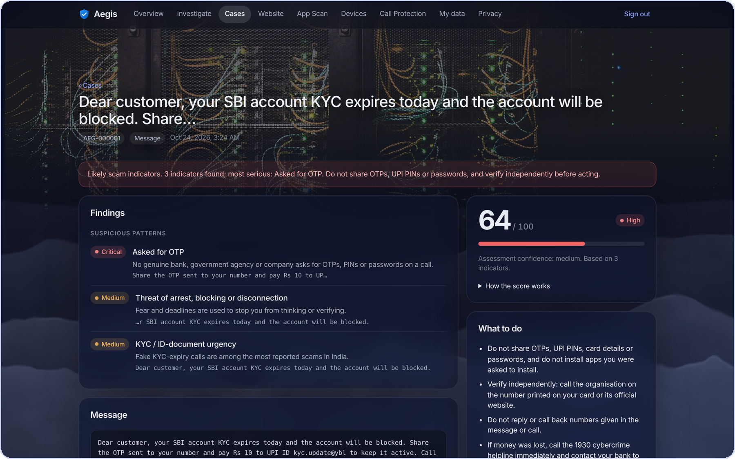
No verdict without evidence
HOW IT WORKS
1
Submit
A link, a message, a call recording or transcript, or an APK.
2
Check
Checks run on our server, never your device; private addresses are blocked.
3
Score
Each indicator adds points by severity; unverified hints add nothing.
4
Act
Clear next steps, a saved case and a report ready to file.
Low 0–19
Medium 20–44
High 45–69
Critical 70+
Real Aegis case: an SBI KYC scam SMS scores 64/100 (High), with every indicator quoted
Notes:
Every result follows the same four steps. Scoring is transparent: a critical indicator adds 40 points, high 25, medium 12, low 5, and a mitigating sign takes 10 away. Unverified hints add nothing. The total is capped between 0 and 100 and mapped to Low, Medium, High or Critical. The screenshot is a real case: a KYC-expiry SMS scored 64, High, because it asked for an OTP, threatened blocking and used KYC urgency, and each of those is quoted from the message.

Slide 5







Built to be trusted with your data
UNDER THE HOOD
Frontend
Backend
Privacy by design
Vanilla JS, strict CSP
FastAPI on Vercel
Call screening stores no audio; numbers are masked
Database
AI review
Uploaded APKs and source code are never kept
Supabase Postgres, Mumbai
Claude explains findings
Links are opened by our server, not your device
The My data page shows every record we hold
Android app
Tested
Export it all, or delete it from the Privacy page
Rates apps, screens calls
45 backend tests passing
Notes:
The stack is simple on purpose. The web app is plain JavaScript with a strict content security policy, so no third-party script can run. The API is FastAPI on Vercel, and data sits in Supabase Postgres in Mumbai, in its own schema. Claude is optional and only explains findings. The Android companion pairs with a code. 45 automated backend tests pass. Privacy: no call audio stored, uploads not kept, links opened server-side, and the new My data page shows users exactly what we hold, with export and delete.

Slide 6


Thank you, now see it live
LIVE DEMO
aegis-security-bay.vercel.app
DEMO PATH
1
Check a suspicious link
2
Paste a scam SMS
3
Open the case and prepare the report
4
See every record on My data
NEXT
Live call screening via a telephony provider
Threat-intel feeds for link checks
Speech-to-text for call recordings
Notes:
Demo path: check a suspicious link, paste a scam SMS, open the case and prepare the cybercrime report, then show the My data page. Next on the roadmap: live call screening through a real telephony provider (today it runs on a simulated adapter), threat-intelligence feeds for link checks, and speech-to-text for uploaded call recordings. Thank you. Questions?

