Slide 1

MAREL Home
International Research Laboratory
Members
Projects
Publications
News
Definir o design
Notes:
HOME

Slide 2
MAREL Home
International Research Laboratory
Members
Projects
Publications
News
FOTO #1
FOTO 2?
Definir o design
Notes:
HOME

Slide 3
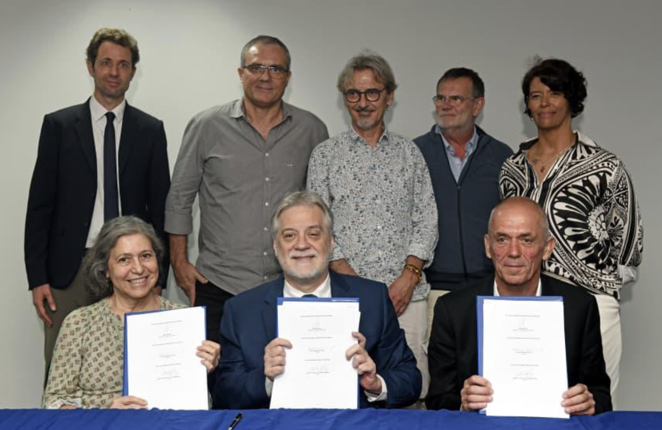
MAREL Home
International Research Laboratory
Members
Projects
Publications
News
In January 2026, the French Center for scientific Research (CNRS), the University of the State of Rio de Janeiro (UERJ), and the Federal Fluminense University, created a joint International Research Laboratory, the IRL MAREL (MARine Eutrophication Lab.) with one ambition: improve knowledge on all aspects of eutrophication processes in tropical coastal zones.
Eutrophication of coastal …..
Notes:
HOME

Slide 4
MAREL Home
International Research Laboratory
Members
Projects
Publications
News
Permanent members
Dr. Gwenaël Abril, PHOTO
CNRS, Director. Biogeochemical cycles; Ecosystem metabolism; Organic Matter; Functional ecology.
Courriel : gwenael.abrilATcnrs.fr
ORCID : https://orcid.org/0000-0002-4914-086X;
ResearchGate : https://www.researchgate.net/profile/Gwenael_Abril
Google Scholar https://scholar.google.com/citations?user=j2sRczYAAAAJ&hl=fr
Prof. Gleyci Moser, PHOTO
UERJ, Codirector
Keywords
ORCID : https://orcid.org/0000-0002-4914-086X;
ResearchGate : https://www.researchgate.net/profile/Gwenael_Abril
Google Scholar https://scholar.google.com/citations?user=j2sRczYAAAAJ&hl=fr
Prof. Alexandre Fernandes, PHOTO
UERJ.
Prof. Marcelo Bernardes, PHOTO
UFF, Codrirector
Prof. Wilson Machado, PHOTO UFF
Associate members
Prof. Silvia Nascimento UNIRIO
Dr Vincent Vantrepotte CNRS
Dr Pricilla Lange INPO
Prof Lino Sanders, UFRJ
Dr Laure Guillou CNRS
A. Prof. Aurelia Mouret Université d’Angers
Prof Edouard Metzger Université d’Angers
Prof. Lucas Duarte
Prof. Joao Felizardo UFF
Prof. Chris Monte UFF
Young scientists
Thais Erbas Post-doc UFF – UERJ
Elisa Passos Post-Doc UERJ
Domenica Lima Post-doc UERJ,
Fernanda Piedras Post-doc UERJ
Vinicius Estrelha PhD candidate UERJ
????
Notes:
HOME

Slide 5
MAREL Home
International Research Laboratory
Members
Projects
Publications
News
PROJECTS
TROPECOS Project (2023-2029). PEPR FairCarboN https://tropecos.fr
The TROPECOS project, funded by France2030, contributes to PEPR Research Program FairCarboN “Carbon dynamics in terrestrial ecosystems” https://www.pepr-faircarbon.fr/eng. TROPECOS involves a scientific community working on the coastal C cycle in three ultramarine territories (French Guiana, Guadeloupe, New Caledonia) and in two French international research structures with strong, long-standing partnerships in Vietnam (IRD international laboratory LECZ-CARE) and Brazil (CNRS international Research Laboratory MAREL). TROPECOS contributes to produce data and improve scientific knowledge on carbon fluxes in preserved and human-impacted tropical estuaries and mangroves, integrating adequately spatial and temporal variability of yet rapidly-transforming tropical coasts, in order to predict how their greenhouse gas footprint might change in the next decades.
EUTROBAYS Project (2023-2026). CAPES COFECUB
blablabla
Notes:
HOME

Slide 6
MAREL Home
International Research Laboratory
Members
Projects
Publications
News
Publications of the MAREL
Cotovicz L.C.Jr., Ribeiro R., Vidal L.O., Bernardes M., De Rezende C. E., Knoppers B. A. and Abril G. (2026). Methane and nitrous oxide reshape the air‐water greenhouse gas budget of a tropical estuarine delta. Journal of Geophysical Research: Biogeosciences 131. https://doi.org/10.1029/2026JG009956
Erbas T., Meziane T., Nepomuceno A., Pereira E., Duarte M., Brandini N., Cerda M., Le Moal P., Nascimento L.S., Abreu M., Machado W., Bernardes M., Moser G.A.O. and Abril G. (2026) Potential of the bivalve Perna perna as bioindicator of eutrophication in tropical coastal ecosystems: carbon and nitrogen stable isotopes, fatty acids and shell morphometry. Marine Environmental Research 218. https://doi.org/10.1016/j.marenvres.2026.108059.
Lauerwald R., Bastviken D., Battin T., Ciais P., Tian H., Allen G.H., Abril G., Catalán N., Deemer B.R., Marzadri A., Prairie Y., Tank S., Zhuang Q., Ran L., Canadell J., and Regnier P. (2026) Importance, drivers and trends of inland water greenhouse gas emissions Nature Reviews Earth & Environment. In press August 2026
Notes:
HOME

Slide 7
MAREL Home
International Research Laboratory
Members
Projects
Publications
News
PHOTO
Clic
23rd Nov. 2026
PhD Defense of Fulano at UERJ
NEWS
PHOTO
Clic
19th Nov. 2026
Field work in Guanabara Bay
PHOTO
Clic
1st Oct. 2026
NEW PAPER in Nature: Fulano et al
PHOTO
Clic
25th Sept. 2026
MAREL Internal Scientific Seminar
Notes:
HOME

Slide 8
MAREL Home
International Research Laboratory
Members
Projects
Publications
News
23rd Nov. 2026, PhD Defense of Fulano at UERJ
NEWS
Elenao Fulano presented his Phd defense at UERJ Entitled « Eu sei que ta assim porque comprovei que era»
Sumary : « isso ai, isso ai, isso ai, isso ai, isso ai, isso ai, isso ai, isso ai, isso ai, isso ai, isso ai, isso ai, isso ai, isso ai, isso ai, isso ai, isso ai, isso ai, isso ai, isso ai, isso ai, isso ai, isso ai, isso ai, isso ai, isso ai, isso ai, isso ai, mesmo isso ai, isso ai, isso ai, isso ai, isso ai, isso ai, isso ai, isso ai, isso ai, isso ai, isso ai, isso ai, isso ai, isso ai, isso ai, isso ai, isso ai, isso ai, isso ai, isso ai, isso ai, isso ai, isso ai, isso ai, isso ai, isso ai, isso ai, mesmo »
Jury composition:
UUUU, UFF
YYYY UERJ, co-adviser
ZZZZ UFPA adivser
YYYYYYY …
PHOTO
Notes:
HOME

Slide 9
MAREL Home
International Research Laboratory
Members
Projects
Publications
News
19th Nov. 2026 Field work in Guanabara Bay
NEWS
The second sampling work for the blahblahblah project occured in Guanabara Bay between 19/11/2026 and 21/11/2026
…. Objectives
… participants
PHOTO
Notes:
HOME

