Slide 1
CS97: Principles and Practices of Computing
Prof. Todd Millstein

Slide 2
What?
a new introductory course
for students with no prior programming experience
others should take CS31 this quarter
we will use the popular Python programming language as the vehicle to introduce programming and the broader field of computing

Slide 3
Why? [cs majors]
most computing majors who take CS31 have already taken a course in programming
anecdotally, this puts other students at a disadvantage and can cause them to lose interest in the field
CS97 provides the background needed to succeed in CS31 and beyond
CS97 is part of the department’s commitment to education innovation as an affiliate member of the BRAID initiative

Slide 4
Why? [non-majors]
computing affects all aspects of society
everyone can and should understand the key ideas of programming and computing
Python is a great language for introducing these ideas
a little computing power can go a long way

Slide 5
Why?
programming is super-fun
seriously, seriously fun
by the end of this week, you will be able to do creative things with computation that impress your friends

Slide 6
Who?
one instructor
Todd Millstein
two graduate teaching assistants (TAs)
Lun Liu
Lana Ramjit
four undergraduate learning assistants (LAs)
Daniel Guo
Dennis van Ee
Anirudh Veeraragavan
Matthew Wong

Slide 7
What is Computer Science?
the study of information:
how it can be represented (data)
how to transform it (algorithms)
how hard it is to transform it (complexity)
sort a list of 100 cities in alphabetical order
find an order to visit those cities that minimizes driving time

Slide 8
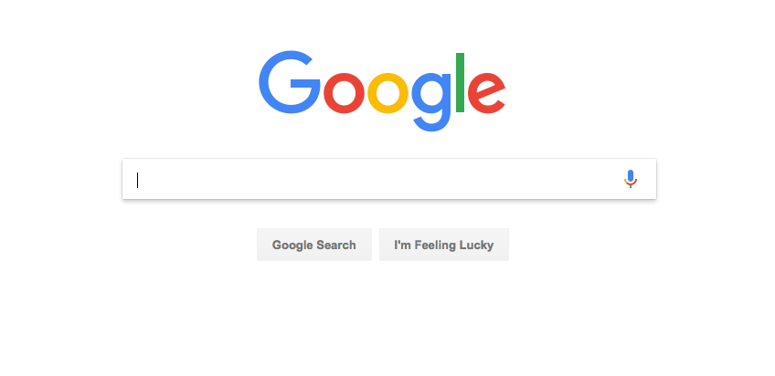
Example Algorithm: Google Search

Slide 9
Example Algorithm: Google Search
initial data?
search keywords, copies of a huge number of webpages
desired transformation?
produce the set of webpages that mention the keywords
ranked in order of likely usefulness
the data representation is critical for a fast algorithm
naive: an unordered sequence of webpages
better: an index mapping keywords to the pages that contain them

Slide 10
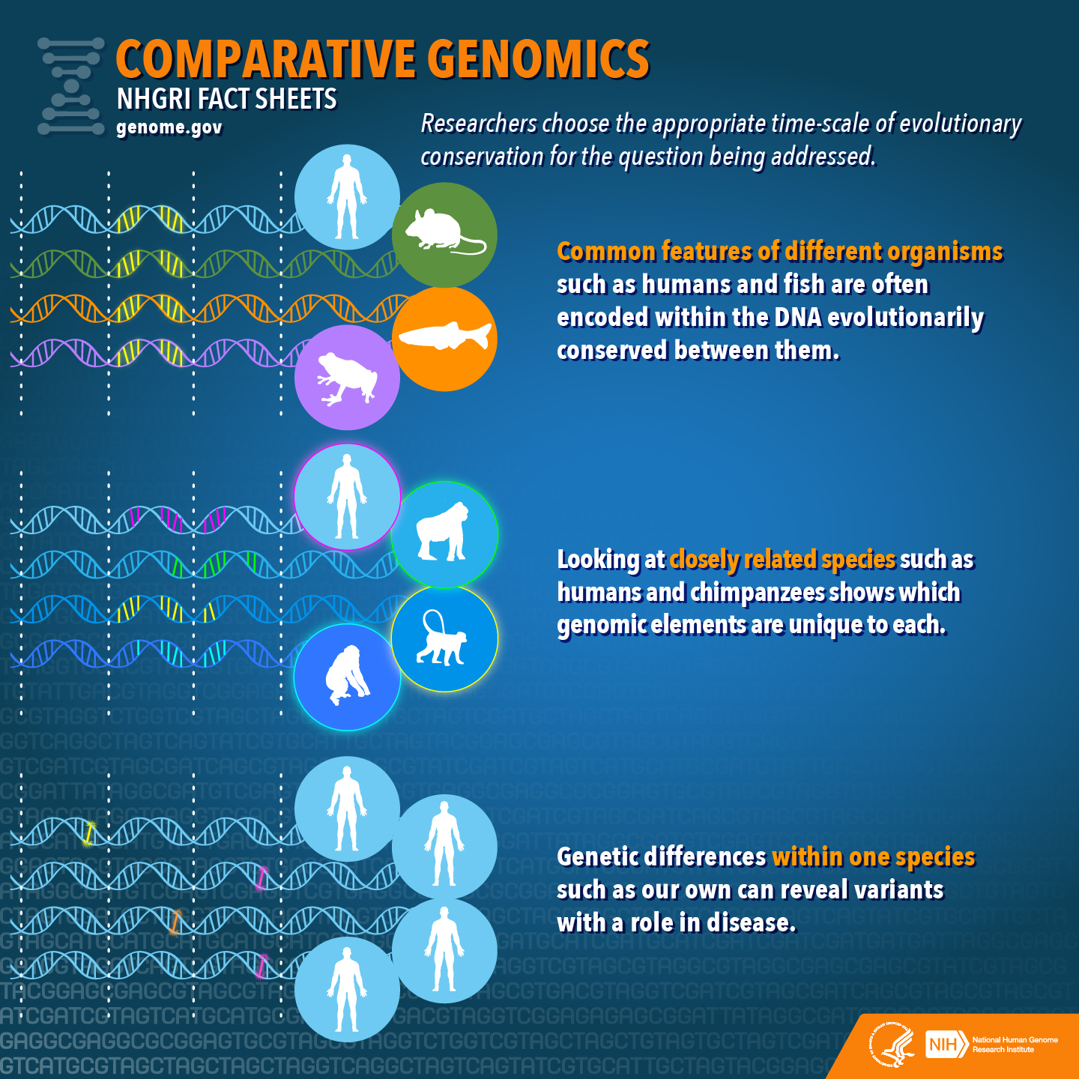
Example: Are Humans Closer to Chimps or Mice?

Slide 11
Example: Are Humans Closer to Chimps or Mice?
initial data?
DNA sequences of a human, chimp, and mouse
desired transformation?
depends on what we mean by “closer” !
longest common subsequence?
smallest “edit distance”?

Slide 12
Where Does Programming Fit In?
a programming language is the medium in which a computation is expressed
the same computation can be expressed in many different programming languages
each language has its own syntax and semantics
rules that determine which programs are valid
rules that determine the behavior of valid programs

Slide 13
Why Python?
lightweight syntax
naturally supports many different styles of programming
lots of “libraries” that make it easy to do many kinds of tasks with very little code
widely used by both professional and amateur programmers
it’s super-fun

Slide 14
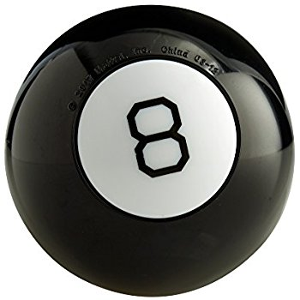
Enough Talking, Let’s Program…

